Slide 1

Are You Connected?

Slide 2
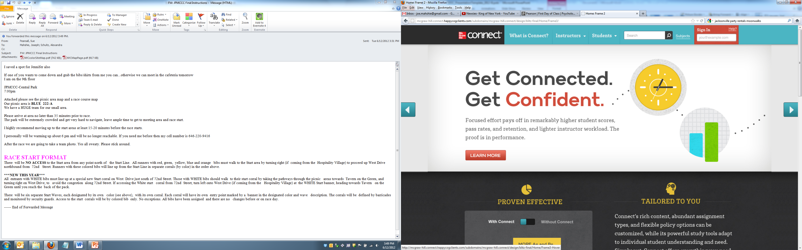
Your required materials…
Marketing by Kerin/Hartley/Rudelius, 11th edition, ©2013
Connect Product
Other Materials

Slide 3
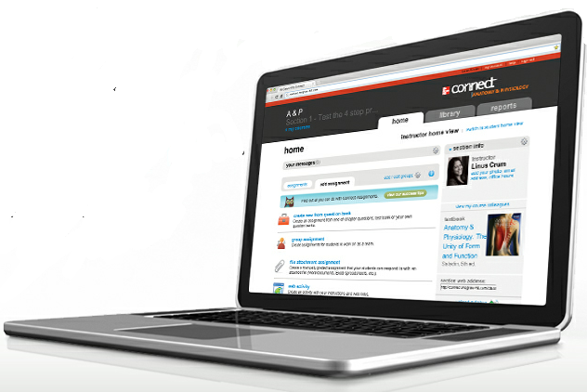
What is Connect?
With Connect, you can complete your coursework anytime and anywhere.
Connect gives you access to your assignments, eBook (within Connect Plus), videos, animations, LearnSmart and more…

Slide 4
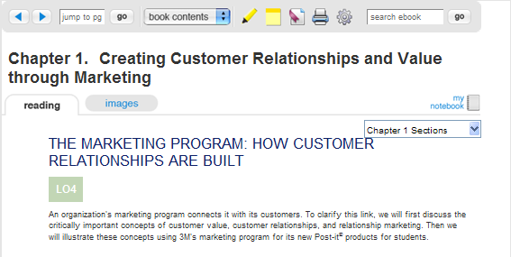
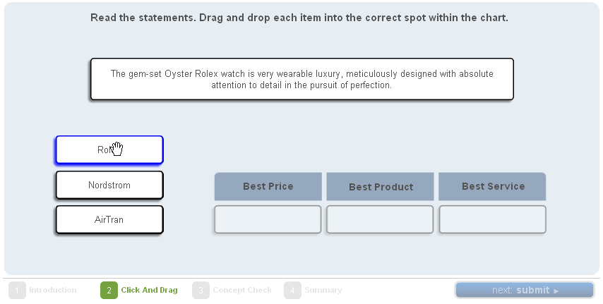
With ConnectPlus, you get…
Media-rich eBook
Textbook content delivered in
innovative ways
Instant feedback on assignments

Slide 5
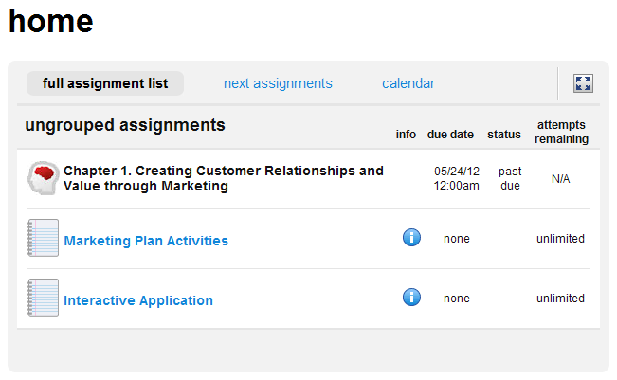

With ConnectPlus, you get…
Instructor-chosen, interactive homework assignments
Access to additional study resources, links to chapter videos and PPT presentations

Slide 6
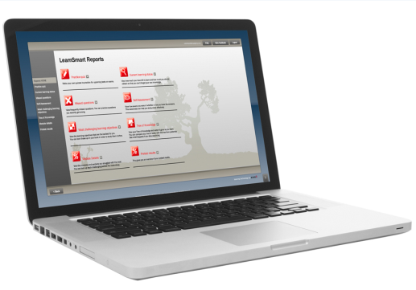
What is LearnSmart?
LearnSmart is an adaptive learning system designed to help students learn faster, study more efficiently, and retain more knowledge for greater success.

Slide 7
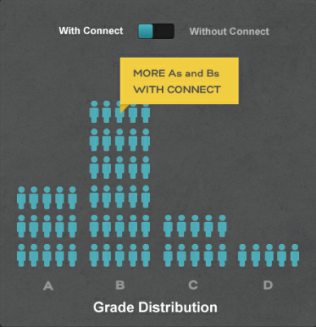
Why use Connect & LearnSmart?
Students who use Connect & LearnSmart are more successful in the course and receive higher grades than their peers not using Connect.

Slide 8
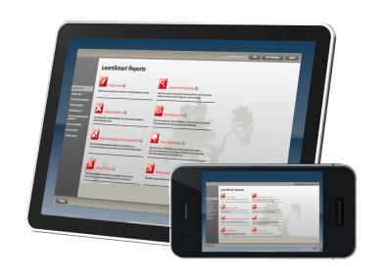

GREAT NEWS!
GET THE GRADE YOU ALWAYS WANTED
You can now purchase LearnSmart for some of your other courses. Most McGraw-Hill products have LearnSmart, so just visit the LearnSmart site to find out more.
www.mhlearnsmart.com

Slide 9
You have choices!
Connect Plus – BEST BET
  All digital, includes the Connect eBook and access to assignments
Print Text + Connect Plus
  Includes everything within Connect Plus and the printed textbook
Loose-leaf Text + Connect Plus
  Includes everything within Connect Plus and a three-hole punch version of the printed textbook

Slide 10
Get started in 5 easy steps.
Go the web address provided by your Instructor.
Click the “Register Now” Button.
Enter your email address.
Enter your access code, select “Buy Online”, or you can “Start Free Trial” if you don’t have an access code.
Complete the registration form, click “Submit”

Slide 11
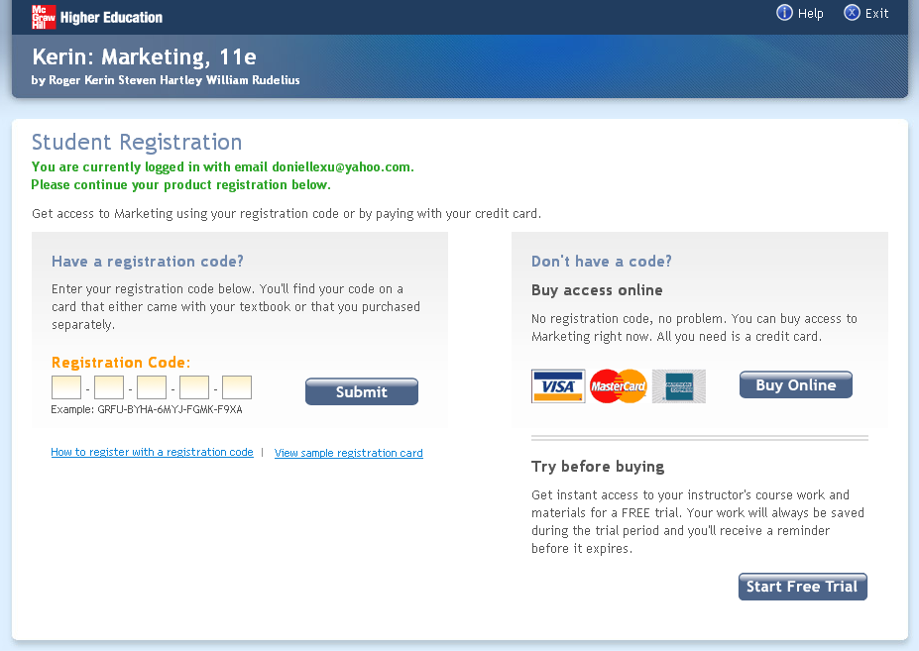

Slide 12
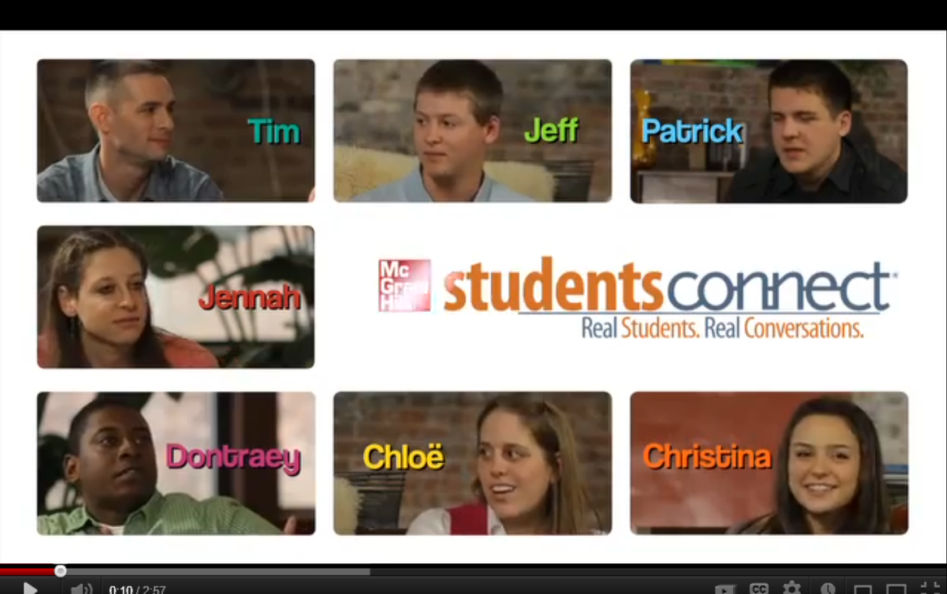
Real Students. Real Conversations.

Slide 13

Need Help?
Visit: www.mhhe.com/support
Call: (800) 331-5094
Monday – Thursday  8AM – 11PM
Friday  8AM – 6PM
Sunday  6PM – 11PM
(All times Central)
Visit Troubleshooting and Customer Service links on the bottom of every page in Connect for immediate help.
Stay Connected on Facebook! www.facebook.com/mcgrawhillconnect

Slide 14


ENTER TO WIN!
www.mhlearnsmart.com

