Slide 1
EVALUATING
A COMPANY’S EXTERNAL ENVIRONMENT
McGraw-Hill/Irwin
Copyright © 2013 by The McGraw-Hill Companies, Inc. All rights reserved.

Slide 2
LO1 Gain command of the basic concepts and analytical tools widely used to diagnose a company’s industry and competitive conditions.
LO2 Become adept at recognizing the factors that cause competition in an industry to be fierce, more or less normal, or relatively weak.
LO3 Learn how to determine whether an industry’s outlook presents a company with sufficiently attractive opportunities for growth and profitability.

Slide 3
Answering the Question,
“Where Are We Now?”
Two facets of the company’s situation
  The industry and competitive environments in which the company operates—its external environment
  The company’s resources and organizational capabilities—its internal environment
    Resource strengths and weaknesses
    Cost position
    Culture and the strength of its leadership

Slide 4

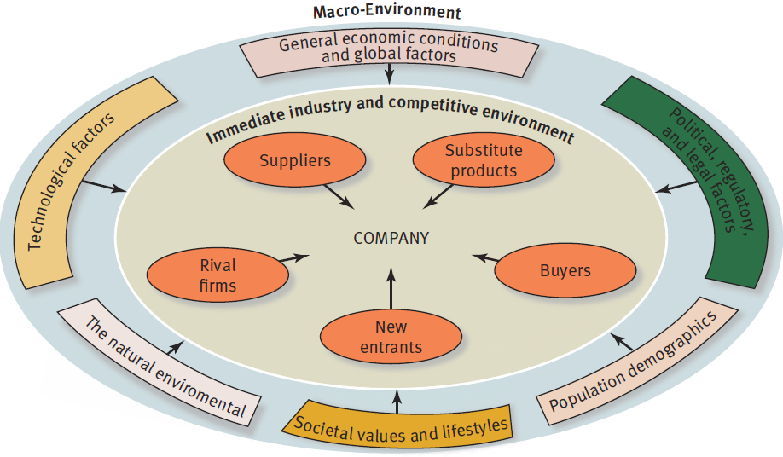
FIGURE 3.1
The Components of a Company’s Macro-Environment

Slide 5
Assessing the Company’s Industry and Competitive Environment
Do the dominant economic characteristics of the industry offer sellers’ opportunities for growth and attractive profits?
What kinds of competitive forces are industry members facing, and how strong is each force?
What forces are driving industry change, and what impact will these changes have on competitive intensity and industry profitability?

Slide 6
Assessing the Company’s Industry and Competitive Environment (cont’d)
What market positions do industry rivals occupy—who is strongly positioned and who is not?
What strategic moves are rivals likely to make next?
What are the key factors of competitive success?
Does the industry outlook offer good prospects for profitability?

Slide 7
Question 1: What Are the Industry’s Dominant Economic Characteristics?
Market size and growth rate
Number of rivals
Scope of competitive rivalry
Pace of technological change
Degree of vertical integration
Need for economies of scale
Learning and experience curve effects

Slide 8
What to Consider in Identifying an Industry’s Dominant Economic Features
TABLE 3.1
ECONOMIC CHARACTERISTIC | QUESTIONS TO ANSWER
Market size and growth rate | How big is the industry and how fast is it growing? What does the industry’s position in the life cycle (early development, rapid growth and takeoff, early maturity and slowing growth, saturation and stagnation, decline) reveal about the industry’s growth prospects?
Scope of competitive rivalry | Is the geographic area over which most companies compete local, regional, national, multinational, or global?
Demand-supply conditions | Is a surplus of capacity pushing prices and profit margins down? Is the industry overcrowded with too many competitors?
Market segmentation | Is the industry characterized by various product characteristics or customer wants, needs, or preferences that divide the market into distinct segments?
Pace of technological change | What role does advancing technology play in this industry? Do most industry members have or need strong technological capabilities? Why?

Slide 9
Question 2: How Strong Are the Industry’s Competitive Forces?
“ Where are we now? ”
The nature of the competitive forces differs across industries.
Competitive forces go beyond rivalry and include four coexisting forces.

Slide 10
The Five Competitive Forces
Affecting Industry Attractiveness
The competitive forces affecting industry attractiveness are:
  Buyer bargaining power
  Firms in other industries attempting to win buyers over to substitute products
  Supplier bargaining power
  The threat of new entrants into the market
  The strength of the rivalry to attract customers among competing sellers in an industry (usually the strongest of the competitive forces).

Slide 11
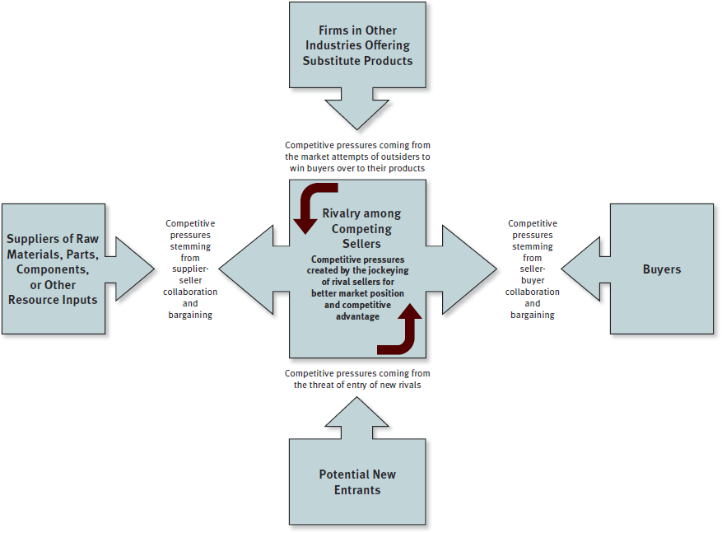
FIGURE 3.2
The Five-Forces
Model of Competition

Slide 12
The Competitive Force of
Buyer Bargaining Power
Whether seller-buyer relationships represent a minor or significant competitive force in limiting industry profitability depends on:
  Whether some or many buyers have sufficient bargaining leverage to obtain price concessions and other favorable terms.
  The extent to which buyers are price sensitive.

Slide 13
When Is the Bargaining
Power of Buyers Stronger?
Buyers gain bargaining leverage when:
  Their large size allows them to demand concessions.
  Their costs of switching to competing brands or substitutes are relatively low.
  They are few in number, control market access, or if
  a buyer-customer is particularly important to a seller.
  Weak buyer demand creates a “buyers’ market.”
  Buyers are well informed about sellers’ products, prices, and costs.
  Buyers pose a credible threat of integrating backward into the business of sellers.

Slide 14
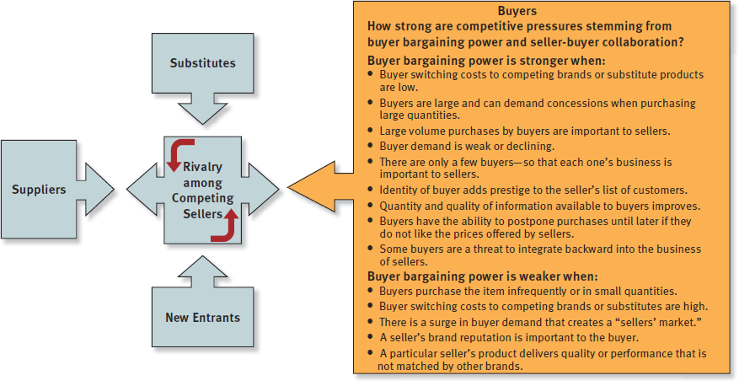
FIGURE 3.3
Factors Affecting the Strength of Buyer Bargaining Power

Slide 15
The Competitive Force of Substitute Products
The strength of competitive pressures from the sellers of substitute products depends on three factors:
  Whether substitutes are readily available and attractively priced.
  Whether buyers view the substitutes as comparable or better in terms of quality, performance, and other relevant attributes.
  Whether the costs that buyers incur in switching to the substitutes are high or low.

Slide 16
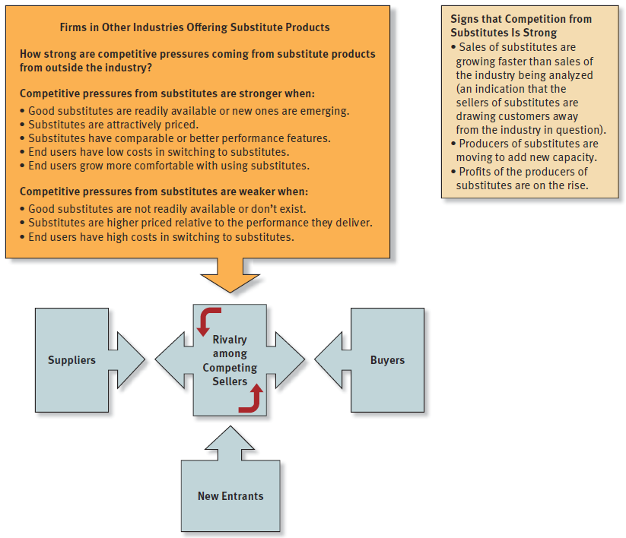

FIGURE 3.4
Factors Affecting Competition from Substitute Products

Slide 17
The Competitive Force of Supplier Bargaining Power
The bargaining power or leverage of industry suppliers is increased when:
  The item being supplied is not a commodity readily available from many suppliers.
  Industry members cannot readily switch their purchases from one supplier to another nor easily switch to attractive substitutes.
  Certain inputs are in short supply.
  Certain suppliers provide a differentiated input that enhances the performance, quality, or image of the industry’s product.

Slide 18
The Competitive Force of Supplier Bargaining Power (cont’d)
The bargaining power or leverage of industry suppliers is increased when:
  Suppliers provide specialized equipment or services that yield cost savings to industry members in conducting their operations.
  A large fraction of the costs of the buyer industry’s product is accounted for by the cost of a particular input.
  Industry members are not major or large customers of suppliers.
  Industry members cannot easily vertically integrate backward into the supplier’s industry.

Slide 19
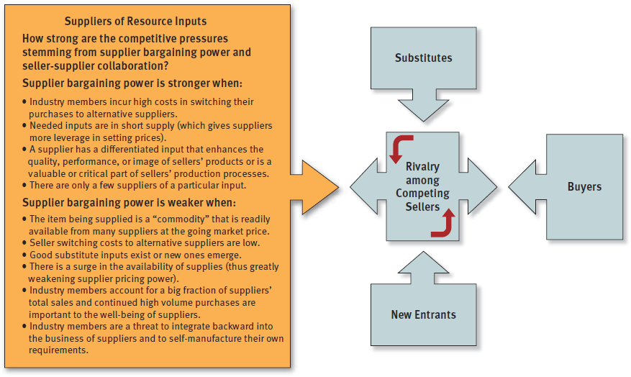
FIGURE 3.5
Factors Affecting the Strength of Supplier Bargaining Power

Slide 20
The Competitive Force of
Potential New Entrants
The threat of entrants into the marketplace presents significant competitive pressure when:
  There is a sizable pool of likely entry candidates.
  Potential entrants have ample entry resources at their command.
  Current industry participants are looking beyond their current markets for growth opportunities.
  The industry is growing, offers attractive profit opportunities, and its barriers to entry are low.

Slide 21
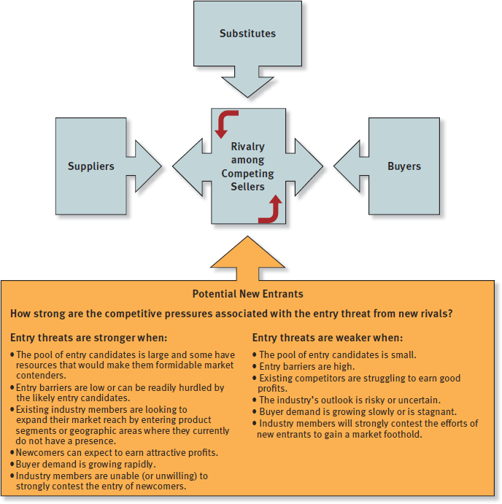
FIGURE 3.6
Factors Affecting
the Threat of Entry

Slide 22
What Are the Barriers to Entry?
The presence of sizable economies of scale in production or other areas of operation
Cost and resource disadvantages not related to scale of operation
Strong brand preferences and high degrees of customer loyalty
High capital requirements
Restrictive regulatory policies
The difficulties of building a network of distributors-retailers and securing adequate space on retailers’ shelves
Tariffs and international trade restrictions
The ability and willingness of industry incumbents to launch vigorous initiatives to block a newcomer’s successful entry

Slide 23
The Competitive Force of Rivalry among Competing Sellers
The rivalry among industry competitors strengthens and intensifies in markets where:
  Competing sellers regularly launch fresh actions to boost their market standing and business performance.
  Markets are slow-growing or are declining.
  Demand is off and there is excess capacity and/or inventory.
  It has become less costly for buyers to switch brands.
  The products of rival sellers have become more standardized.
  Industry conditions tempt competitors to use price cuts or other competitive weapons to boost unit volume.
  Competitors have become dissatisfied with their market position.
  Strong outside firms acquire weak firms in the industry and launch aggressive, well-funded moves to build market share.

Slide 24
The Competitive Force of Rivalry among Competing Sellers (cont’d)
The rivalry among industry competitors is usually weaker in industries where:
  The products of industry rivals become more differentiated.
  Markets or market segments are expanding and fast-growing.
  Markets are comprised of vast numbers of small rivals; likewise, it is often weak when there are fewer than five competitors.

Slide 25
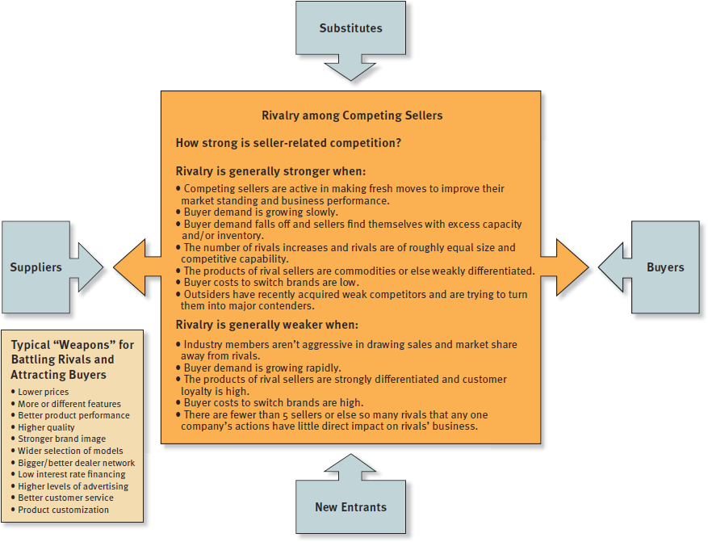
FIGURE 3.7
Factors Affecting the Strength of Competitive Rivalry

Slide 26
Industry Rivalry
Cutthroat
(Brutal)
Competitors engage in protracted price wars or habitually employ other aggressive tactics that are mutually destructive to profitability.
Fierce
(Strong)
The battle for market share is so vigorous that the profit margins of most industry members are squeezed to bare-bones levels.
Moderate
(Normal)
The maneuvering among industry members, while lively and healthy, still allows most industry members to earn acceptable profits.
Weak
Most industry members are satisfied with their sales growth and market share and rarely undertake offensives against their competitors.

Slide 27
The Collective Strengths of the Five Competitive Forces and Industry Profitability
As a rule, the stronger the collective impact
of the five competitive forces, the lower the combined profitability of industry participants.
The stronger the forces of competition, the much harder it becomes for industry members to earn attractive profits.

Slide 28
When the Five Competitive Forces Result in Attractive Market Conditions
An industry’s competitive environment tends to be attractive from a profit-making perspective when:
  Internal rivalry is moderate
  High entry barriers deter entry of new competitors
  Good substitutes do not exist
  Suppliers and customers are in weak bargaining positions
thereby producing competitive pressures that are very weak!

Slide 29
When the Five Competitive Forces Result in Unattractive Market Conditions
An industry’s competitive environment tends to be unattractive from a profit-making standpoint when:
  Internal rivalry among competitors is strong
  Low entry barriers make new competitor entry likely
  Good substitutes exist for industry products
  Suppliers and customers are in strong bargaining positions
thereby producing competitive pressures that are very intense or fierce!

Slide 30
Driving forces in the macro-environment are the major underlying causes of changes in industry and competitive conditions.

Slide 31
Question 3: What Are the Industry’s Driving Forces of Change and
What Impact Will They Have?
Driving forces analysis has three steps:
  Identifying what driving forces are present.
  Assessing whether the drivers of change are, individually or collectively, acting to make the industry more or less attractive.
  Determining what strategy changes are needed to prepare for the impact of the driving forces.

Slide 32
Question 3: What Are the Industry’s Driving Forces of Change and
What Impact Will They Have?
Identify the driving forces likely to reshape industry competitive conditions:
  Industry changes likely to take place within the next 1–3 years
  Usually only 3–4 factors qualify as real drivers of change
Assess the future impact of driving forces on industry attractiveness:
  Will they cause demand for product to increase or decrease?
  Will they act to make competition more or less intense?
  Will they lead to higher or lower industry profitability?
Determine what strategy changes are needed to prepare for impact of driving forces.

Slide 33
Identifying an Industry’s Driving Forces
Changes in an industry’s long-term growth rate
Increasing globalization of the industry
Emerging new Internet capabilities and applications
Changes in who buys the product and how they use it
Product innovation
Technological change and manufacturing process innovation
Marketing innovation
Entry or exit of major firms
Diffusion of technical know-how across more companies and more countries
Changes in cost and efficiency
Growing buyer preferences for differentiated products instead of a commodity product (or for a more standardized product instead of strongly differentiated products)
Regulatory influences and government policy changes
Changing societal concerns, attitudes, and lifestyles

Slide 34
TABLE 3.2
Common Driving Forces
Changes in the long-term industry growth rate. Increasing globalization. Emerging new Internet capabilities and applications. Changes in who buys the product and how they use it. Product innovation. Technological change and manufacturing process innovation. Marketing innovation. Entry or exit of major firms. Diffusion of technical know-how across more companies and more countries. Changes in cost and efficiency. Growing buyer preferences for differentiated products instead of a standardized commodity product (or for a more standardized product instead of strongly differentiated products). Regulatory influences and government policy changes. Changing societal concerns, attitudes, and lifestyles.

Slide 35
Question 4: How Are Industry Rivals Positioned?
Strategic group mapping
  Is a technique for displaying the different market or competitive positions that rival firms occupy in the industry.
A strategic group
  Is a cluster of industry rivals that have similar competitive approaches and market positions.

Slide 36
Strategic Group Mapping
Strategic group mapping is a technique for displaying the different market or competitive positions that rival firms occupy in the industry.
A strategic group is a cluster of industry rivals that have similar competitive approaches and market positions.

Slide 37
Constructing a Strategic Group Map
Identify the competitive characteristics that delineate strategic approaches used in the industry.
  Typical variables: the price/quality range (high, medium, low), geographic coverage (local, regional, national, global), degree of vertical integration (none, partial, full), product-line breadth (wide, narrow), choice of distribution channels (retail, wholesale, Internet, multiple channels), and degree of service offered (no-frills, limited, full).
Plot firms on a two-variable map based upon their strategic approaches.
Assign firms occupying the same map location to a common strategic group.
Draw circles around each strategic group, making the circles proportional to the size of the group’s share of total industry sales revenues.

Slide 38
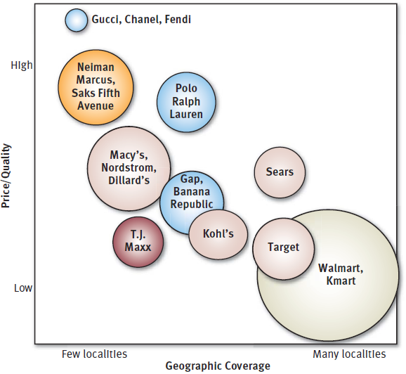
Concepts and Connections 3.1
Comparative Market Positions of Selected Retail Chains:
A Strategic Group Map Application

Slide 39
What Can Be Learned from
Strategic Group Maps?
Driving forces and competitive pressures often favor some strategic groups and hurt others.
Competitive pressures may cause the profit potential of different strategic groups to vary.

Slide 40
Question 5: What Strategic Moves
Are Rivals Likely to Make Next?
Considerations in trying to predict what strategic moves rivals are likely to make next include the following:
  What executives are saying about where the industry is headed, the firm’s situation, and their past actions and leadership styles.
  Identifying trends in the timing of product launches or new marketing promotions.
  Determining which rivals badly need to increase unit sales and market share.
  Considering which rivals have a strong incentive, along with the resources, to make major strategic changes.
  Knowing which rivals are likely to enter new geographic markets.
  Deciding which rivals are strong candidates to expand their product offerings and enter new product segments.

Slide 41
Predicting the Next Strategic Moves Rivals Are Likely to Make
Profiling key rivals involves gathering competitive intelligence about:
  Thinking and leadership styles of top executives
  Identifying trends in the timing of new-product launches and marketing promotions
  Considering which rivals have the motivation and capability to make major strategy changes

Slide 42
Concepts and Connections 3.2
Business Ethics And Competitive Intelligence
Those who gather competitive intelligence on rivals can sometimes cross the fine line between honest inquiry and unethical or even illegal behavior. For example, calling rivals to get information about prices, the dates of new-product introductions, or wage and salary levels is legal, but misrepresenting one’s company affiliation during such calls is unethical. Pumping rivals’ representatives at trade shows is ethical only if one wears a name tag with accurate company affiliation indicated.
Avon Products at one point secured information about its biggest rival, Mary Kay Cosmetics (MKC), by having its personnel search through the garbage bins outside MKC’s headquarters. When MKC officials learned of the action and sued, Avon claimed it did nothing illegal because a 1988 Supreme Court ruling declared that trash left on public property (in this case, a sidewalk) was anyone’s for the taking. Avon even produced a videotape of its removal of the trash at the MKC site. Avon won the lawsuit—but Avon’s action, while legal, scarcely qualifies as ethical.

Slide 43
Question 6: What Are the Industry
Key Success Factors?
Key success factors (or KSFs) are competitive factors most affecting every industry member’s ability to prosper.
KSFs include:
  Specific product attributes
  Necessary resources, competencies, and capabilities
  Specific intangible assets
  Competitive capabilities

Slide 44
Three Questions to Ask in Identifying Industry Key Success Factors
On what basis do buyers of the industry’s product choose between the competing brands of sellers? That is, what product attributes are crucial?
Given the nature of the competitive forces prevailing in the marketplace, what resources and competitive capabilities must a firm possess to be competitively successful?
What shortcomings are almost certain to put a firm at a significant competitive disadvantage?

Slide 45
TABLE 3.3
Common Types of Industry Key Success Factors
Technology-related KSFs | Expertise in a particular technology or in scientific research (important in pharmaceuticals, Internet applications, mobile communications, and most high-tech industries) Proven ability to improve production processes (important in industries where advancing technology opens the way for higher manufacturing efficiency and lower production costs)
Manufacturing-related KSFs | Ability to achieve scale economies and/or capture experience curve effects (important to achieving low production costs) Quality control know-how (important in industries where customers insist on product reliability) High utilization of fixed assets (important in capital-intensive/high fixed-cost industries) Access to attractive supplies of skilled labor High labor productivity (important for items with high labor content) Low-cost product design and engineering (reduces manufacturing costs) Ability to manufacture or assemble products that are customized to buyer specifications

Slide 46
TABLE 3.3
Common Types of Industry Key Success Factors (cont’d)
Distribution-related KSFs | A strong network of wholesale distributors/dealers Strong direct sales capabilities via the Internet and/or having company-owned retail outlets Ability to secure favorable display space on retailer shelves
Marketing-related KSFs | Breadth of product line and product selection A well-known and well-respected brand name Fast, accurate technical assistance Courteous, personalized customer service Accurate filling of buyer orders (few back orders or mistakes) Customer guarantees and warranties (important in mail-order and online retailing, big-ticket purchases, and new-product introductions) Clever advertising

Slide 47
TABLE 3.3
Common Types of Industry Key Success Factors (cont’d)
Skills- and capability-related KSFs | A talented workforce (superior talent is important in professional services such as accounting and investment banking) National or global distribution capabilities Product innovation capabilities (important where rivals are racing to be first to market with new product attributes or performance features) Design expertise (important in fashion and apparel industries) Short delivery time capability Supply chain management capabilities Strong e-commerce capabilities—a user-friendly website and/or skills in using Internet applications to streamline internal operations
Other types of KSFs | Overall low costs (not just in manufacturing) to be able to meet low-price expectations of customers Convenient locations (important in many retailing businesses) Ability to provide fast, convenient, after-the-sale repairs and service A strong balance sheet and access to financial capital (important in newly emerging industries with high degrees of business risk and in capital-intensive industries) Patent protection

Slide 48
Common Types of Industry
Key Success Factors
Expertise in a particular technology
Scale economies
Experience curve benefits
High capacity utilization
Strong network of wholesale distributors
Brand-building skills
Convenient retail locations

Slide 49
Question 7: Does the Industry Offer Good Prospects for Attractive Profits?
Involves assessing whether the industry and competitive environment is attractive or unattractive for earning good profits.
Draws upon all the previous analysis:
  The industry’s growth potential
  The effect of the intensity of competition on industry profitability
  Whether industry profitability will be favorably or unfavorably affected by the prevailing driving forces
  The firm’s competitive position in its industry relative to rivals
  How competently the firm performs industry’s key success factors

