Slide 1


Chapter 4
Vendors and Inventory

Slide 2
Chapter 4
The Vendors page is where the company keeps track of the suppliers you work with.
Vendors are people or companies that you pay money to, such as a store, utility, landlord, or subcontractors who work for you.
An inventory item is a product that is purchased from vendors for sales to customers.

Slide 3

QBO Tips
To make sure you are starting in the correct place in the data, display the Expense and Sales transactions, and the October 30, 20XX Trial Balance.
The Vendor Contact List includes vendors that are paid immediately with a check, or paid later for purchases on account.

Slide 4
Files Saved in Chapter 4
The chart shows the PDF and Excel files saved in Chapter 4. Files can be saved to a USB flash drive, hard-drive location, network, or external media. To identify your file, you could add your name at the end of the suggested file name.
PDF & Excel | Page
Chapter 4_October 31_Trial Balance | 148
Chapter 4_Vendor Contact List | 156
Chapter 4_Products and Services List | 166
Chapter 4_Journal | 171
Chapter 4_Transaction Detail by Account | 172
Chapter 4_Trial Balance | 173
Chapter 4_Inventory Valuation Summary | 174
Chapter 4_Vendor Balance Summary | 175
Chapter 4_AP Aging Summary | 176
Chapter 4_Profit and Loss | 179

Slide 5
Files Saved in Chapter 4 (concluded)
PDF & Excel | Page
Chapter 4_Balance Sheet | 181
Chapter 4_Statement of Cash Flows | 183
Exercise 4-2_Vendor Contact List | 192
Exercise 4-2_Product and Services List | 192
Exercise 4-2_Journal | 192
Exercise 4-2_Transaction Detail by Account | 192
Exercise 4-2_Trial Balance | 192
Exercise 4-2_Inventory Valuation Summary | 192
Exercise 4-2_Vendor Balance Summary | 192
Exercise 4-2_AP Aging Summary | 192
Exercise 4-2_Profit & Loss | 192
Exercise 4-2_Balance Sheet | 192
Exercise 4-2_Statement of Cash Flows | 192

Slide 6
Account Reconciliation
QB Cloud receives a bank statement every month for Account 101 Checking. The bank statement shows which checks, ATMs, and deposits cleared the bank.
Bank reconciliation is the process of bringing the balance of the bank statement and the balance of the checking account into agreement.

Slide 7
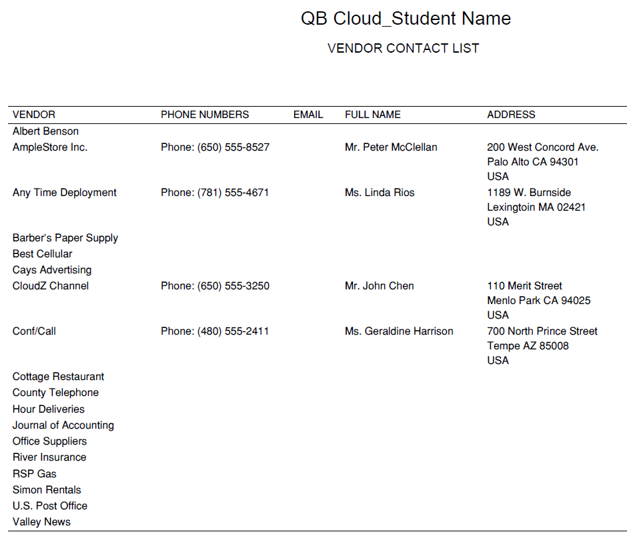
Vendor Contact List
The four vendors added in Chapter 4 show the vendor name, phone numbers, full name, and address. The other vendors were added in Chapter 3.

Slide 8


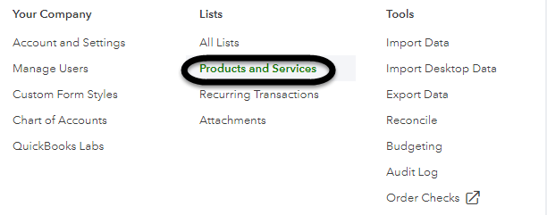
Inventory Products and Services
To add inventory, go to > . Or, Gear > Products and Services.

Slide 9
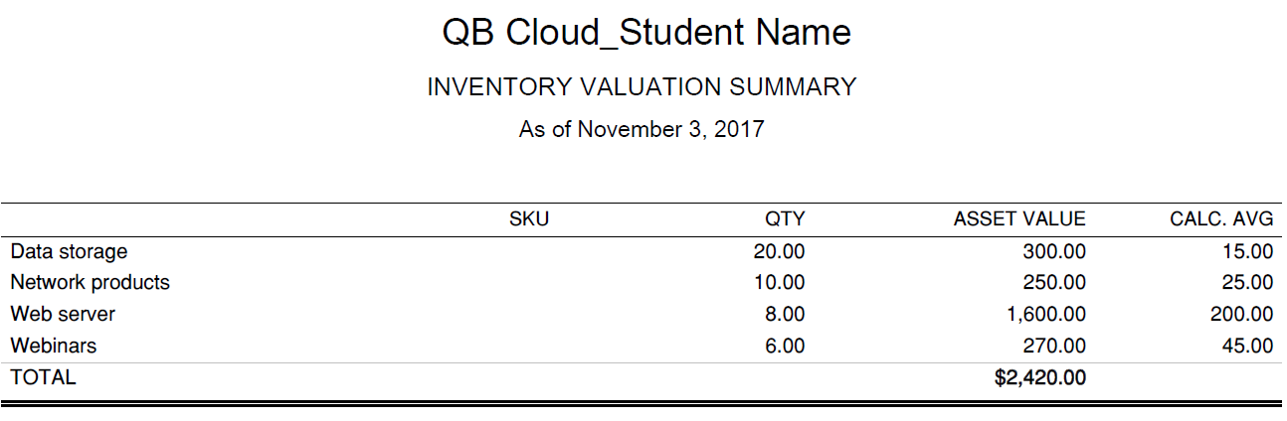
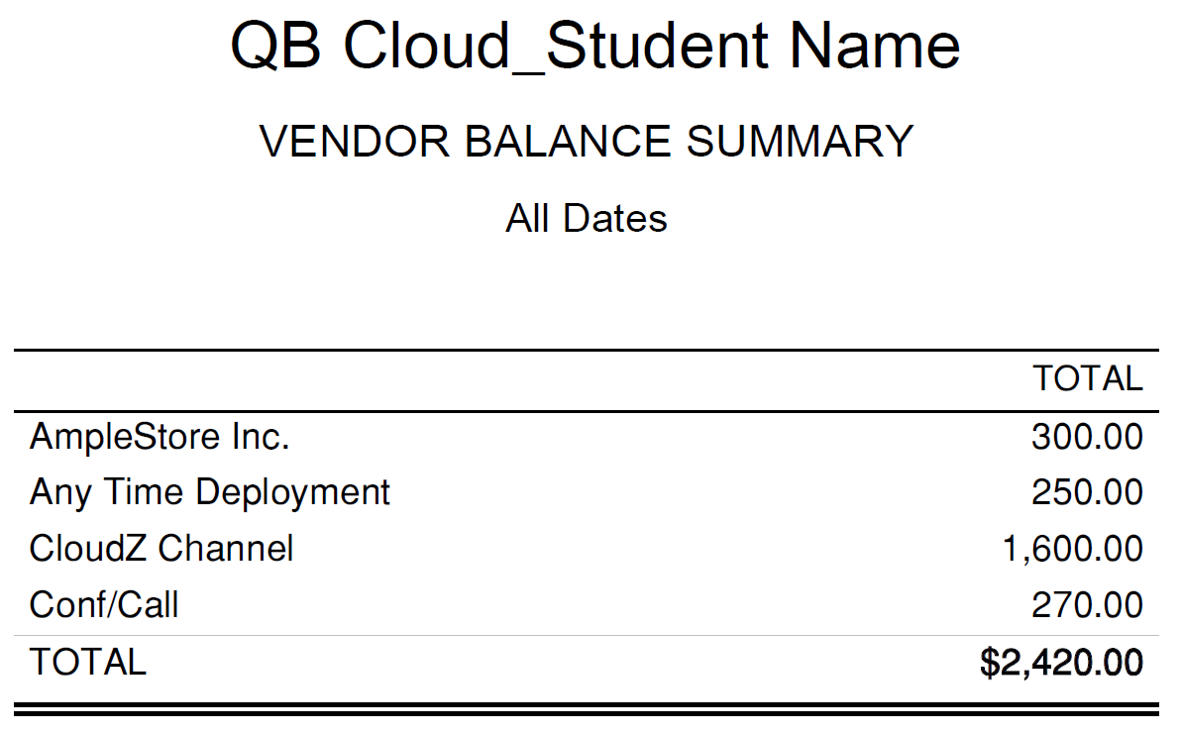
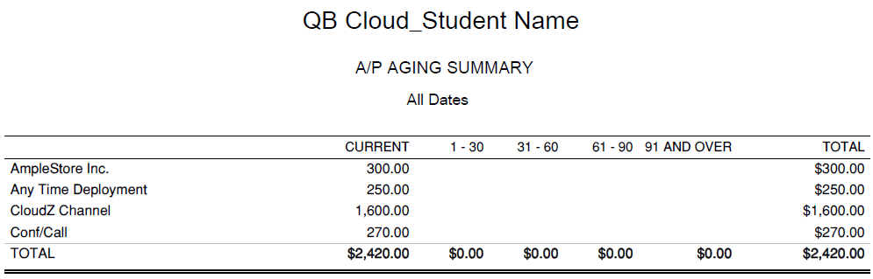
Inventory Valuation Summary, Vendor Balance Summary and A/P Aging Summary
The A/P Aging Summary total matches the balances of Account 115 Merchandise Inventory and Account 201 Accounts Payable.

Slide 10
Online Learning Center
For additional resources, to to www.mhhe.com/qbo2e > Student Edition > Chapter 4. The Online Learning Center includes:
Glossary
Multiple-Choice Questions
True or False Questions
Analysis Questions
Check Your Progress
Going to the Net
Narrated PowerPoints
Problem Solving
Videos

Slide 11
Videos
Watch an Inventory video.
Watch Create bills and expense reports in QuickBooks.

Slide 12
Going to the Net
Go to the QuickBooks Learn & Support website.
Type a Search word; for example Inventory.
Link to articles of interest to you.

Slide 13
Analysis Questions
What are vendors?
What is Accounts Payable and how do you verify its balance?
Why is the balance in Merchandise Inventory different than the balance in Accounts Payable? Include the account balances in your answer. Explain.

