Slide 1
PHOTO GALLERY
Study Guide in PowerPoint
to accompany
Thermodynamics: An Engineering Approach, 8th edition
by Yunus A. Çengel and Michael A. Boles

Slide 2
List Of Slides
3 Heat pump systems
4 Spark ignition internal combustion engine
5 Automobile heater core
6 Cut away of a hair drier
7 Throttle or expansion tube
8 Two-stage, intercooled refrigerant compressor
9 Shell and tube heat exchanger
10 Forced draft cooling tower
11 Honey comb like structure inside forced draft cooling tower
12 Components of a two-stage, air compressor with intercooling
13 Steam turbine blades
14 Compost pile

Slide 3
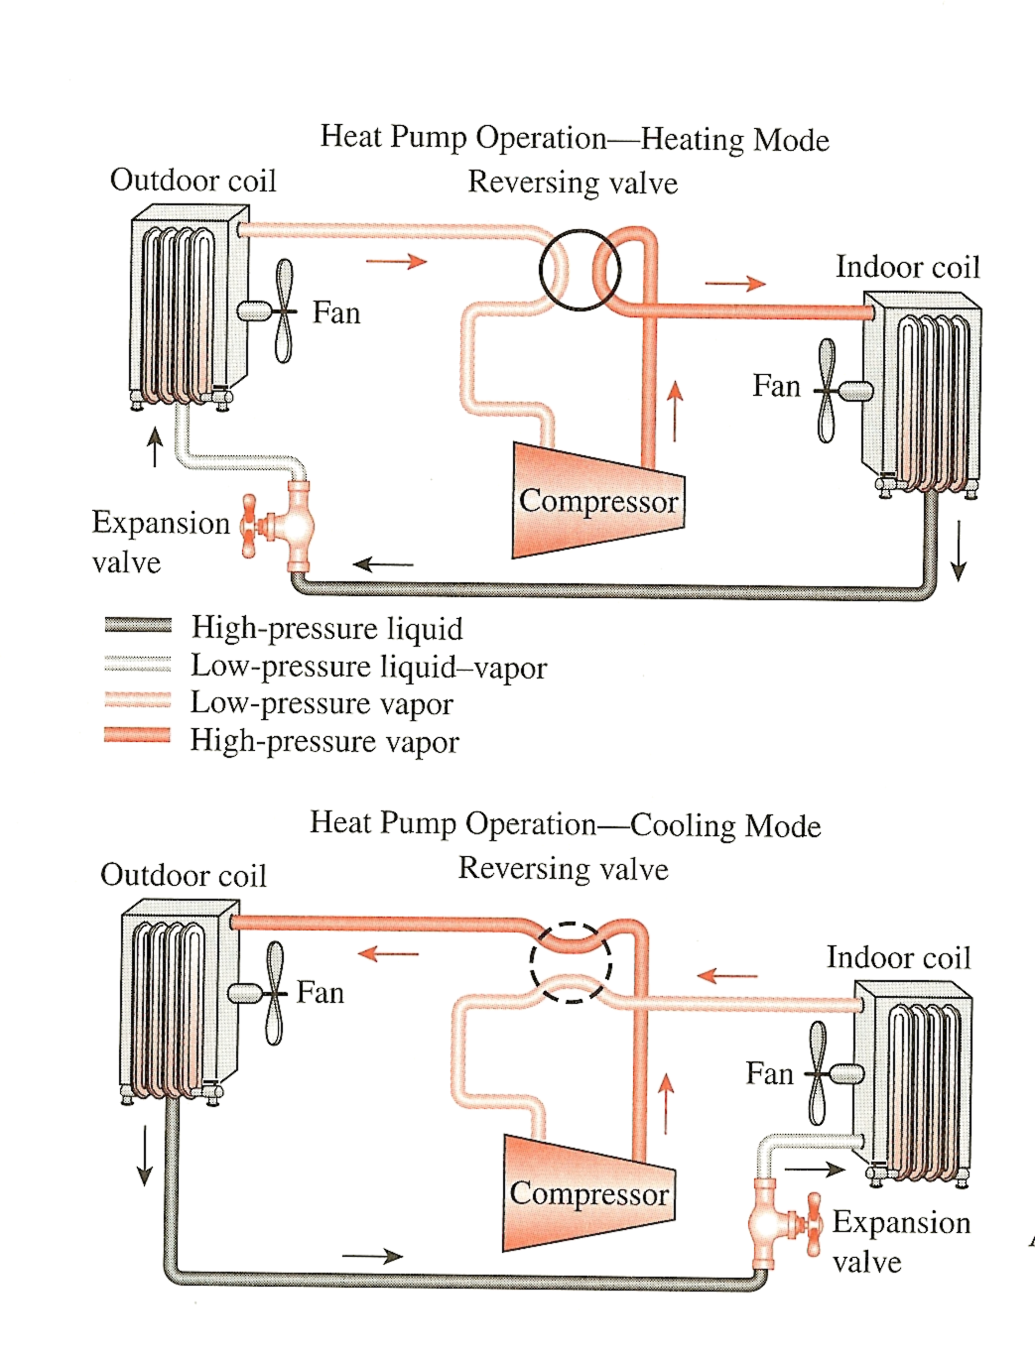
Heat Pump Systems
A typical heat pump system is shown here. In the heating mode high-pressure vapor refrigerant is sent to the indoor heat exchanger coil. The refrigerant gives up its energy to the inside air and condenses to a high-pressure liquid. The liquid is throttled to a low-pressure, low-temperature liquid-vapor in the outdoor coil and receives energy from the from the outside air. The refrigerant vaporizes, enters the compressor as a low-pressure vapor to be compressed to the high-pressure, and the cycle is completed.

Slide 4
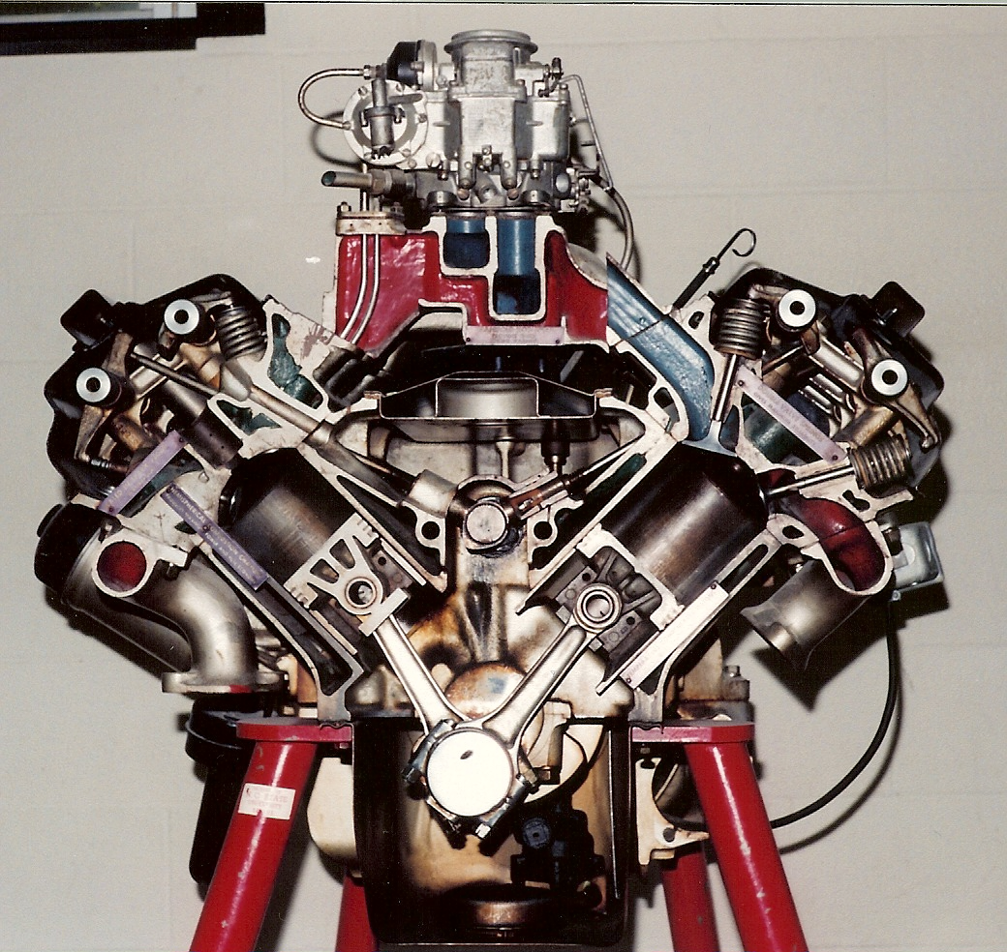
Spark ignition internal combustion engine
Photo by M. Boles

Slide 5
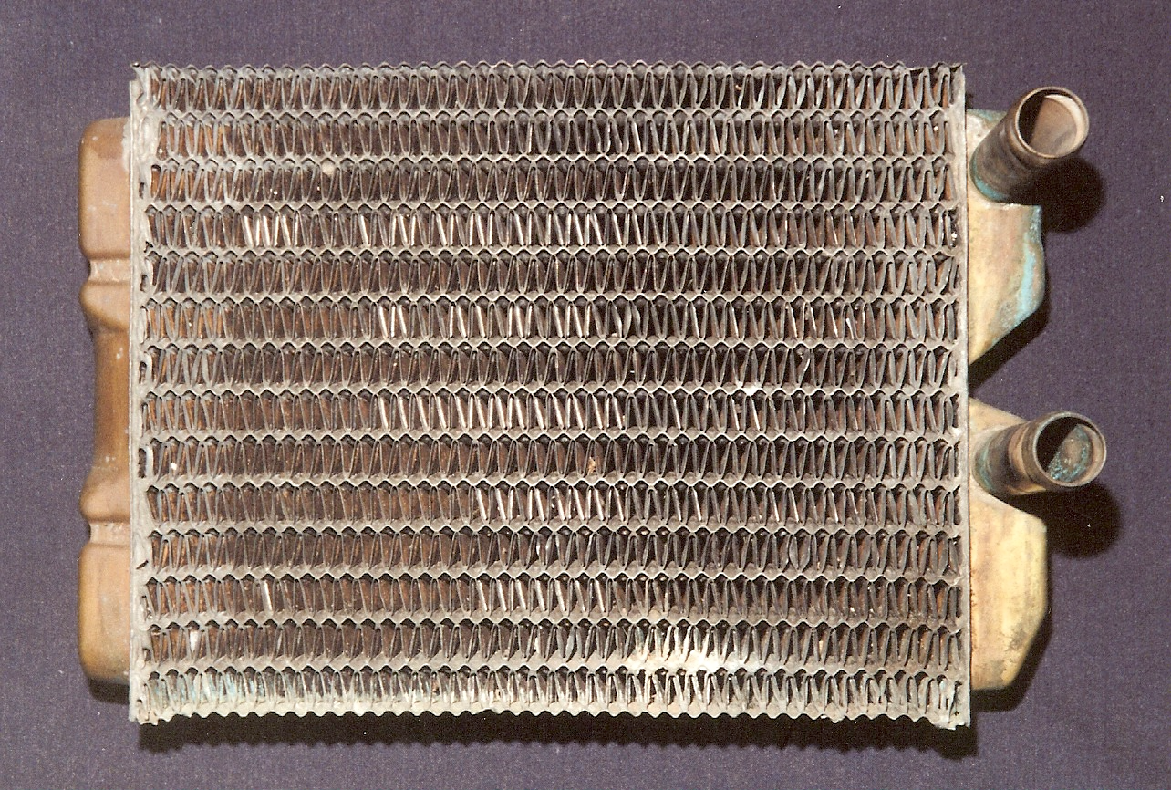
The heat exchanger shown here is typical of liquid-to-gas heat exchangers. In this case hot coolant from a 1966 Mustang engine flows into and out of the heat exchanger through the inlet and exit tubes. Air from the passenger compartment is heated as it flows through the fins.
Photo by M. Boles

Slide 6
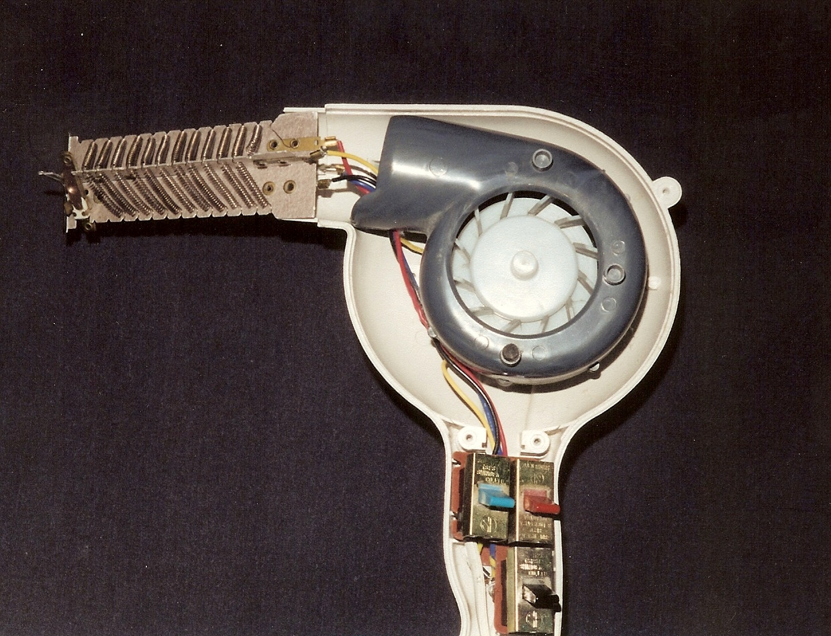
A hair drier is an example of a one entrance, one exit open system that receives electrical work input to drive the fan and power the resistance heater.
Photo by M. Boles

Slide 7
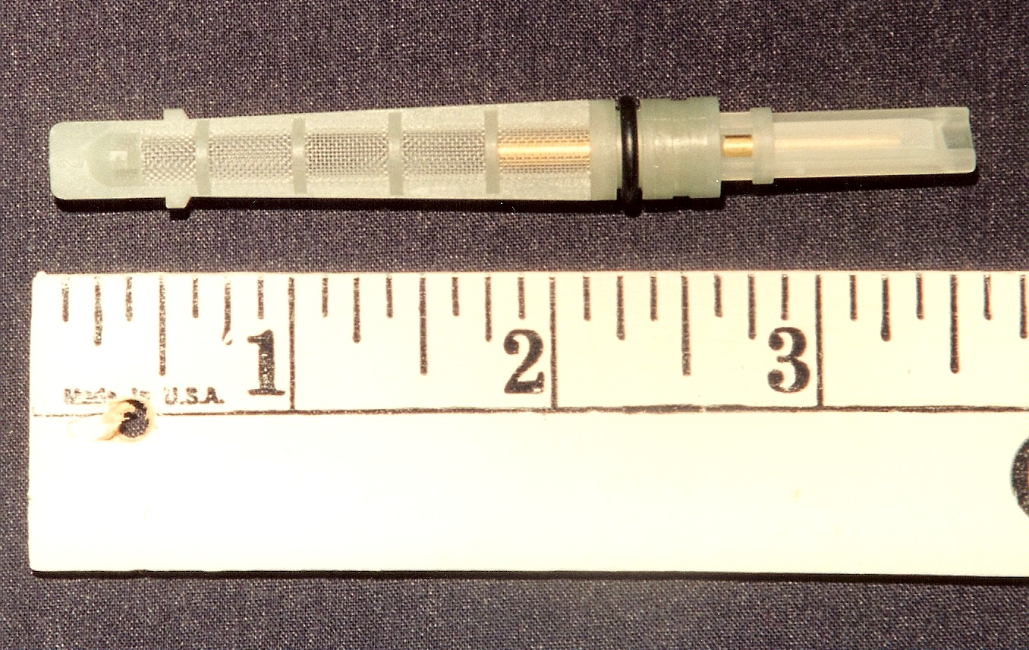
Throttle or expansion tube.
Throttle may be a simple as the expansion tube used in automobile air conditioning systems to cause the refrigerant pressure drop between the exit of the condenser and the inlet to the evaporator.
Photo by M. Boles

Slide 8
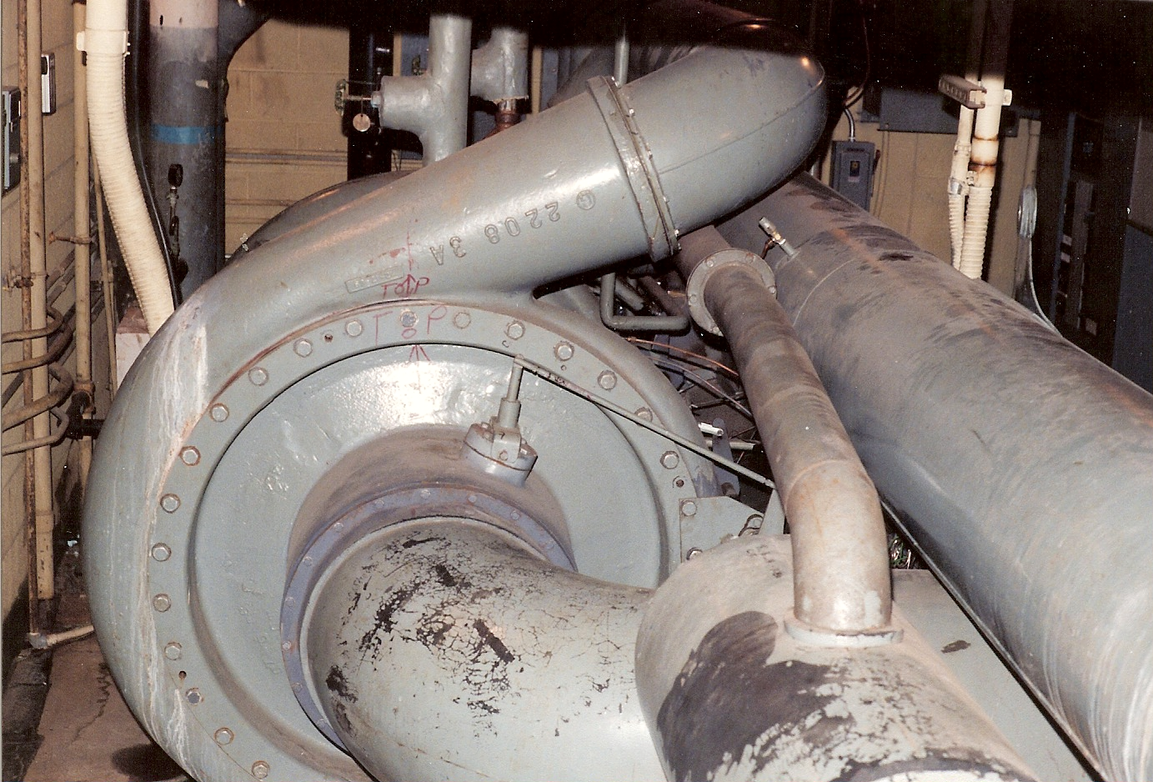
One stage of a two-stage, intercooled refrigerant compressor in a chilled water refrigeration system
Photo by M. Boles

Slide 9
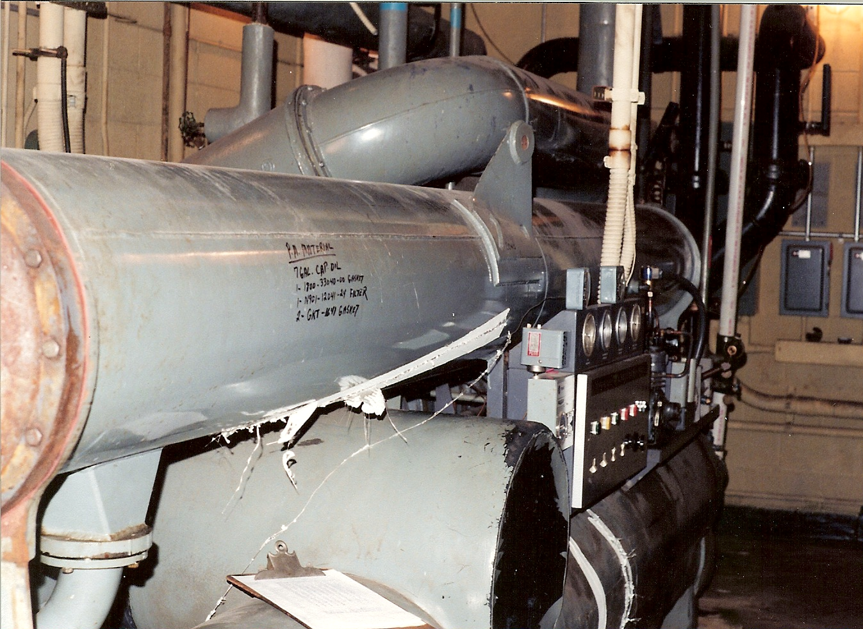
Typical shell and tube heat exchanger used for the intercooler, evaporator, and condenser for a chilled water refrigeration system.
Photo by M. Boles

Slide 10
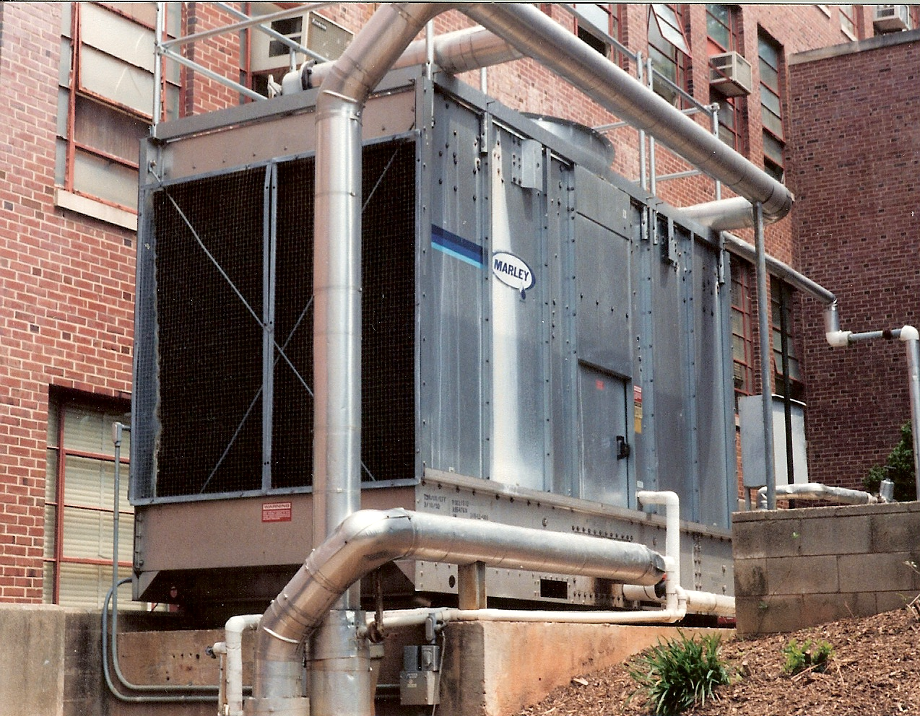
Forced draft cooling tower for cooling water used in the intercooler and condenser heat exchangers of the chilled water refrigeration system
Photo by M. Boles

Slide 11
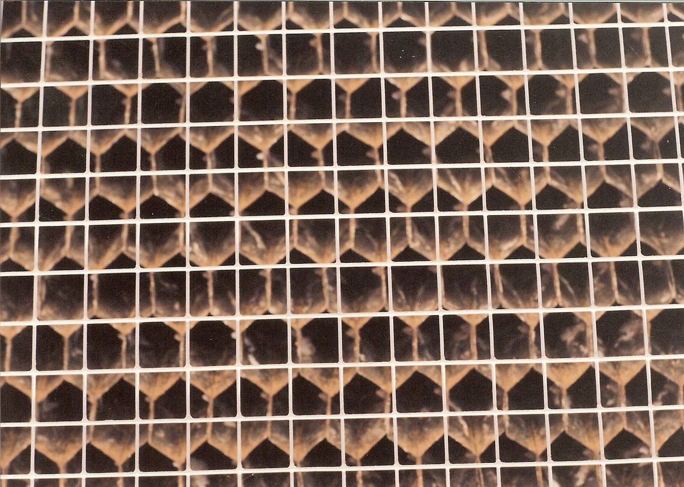
Honey comb like structure inside forced draft cooling tower to cause better mixing of the cooling water and air.
Photo by M. Boles

Slide 12
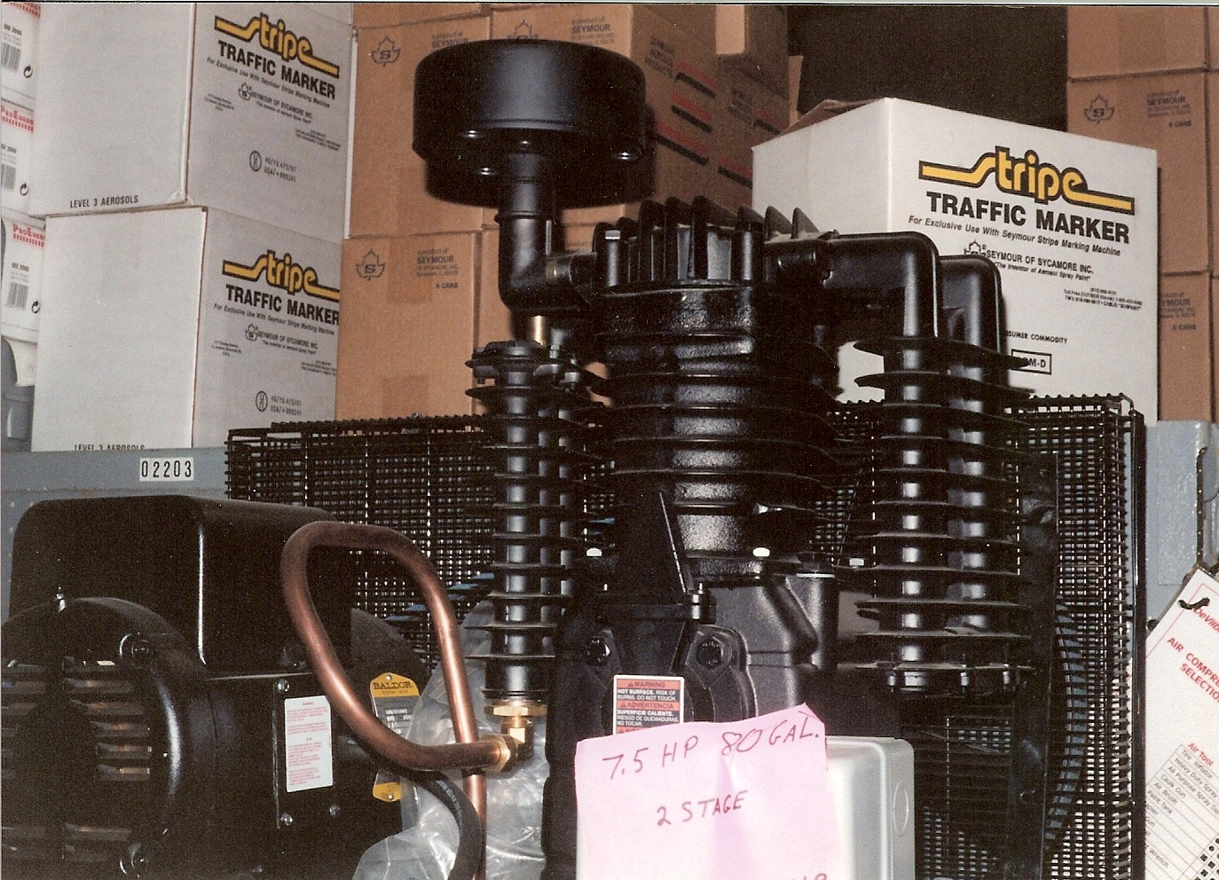
Another application of intercooling to reduce compressor work is shown here as a two-stage, 7.5 hp air compressor with intercooling attached to an eighty gallon tank.
First stage piston with second stage piston in back
Intercooling heat exchanger
Drive wheel spokes function as fan blades
Photo by M. Boles

Slide 13
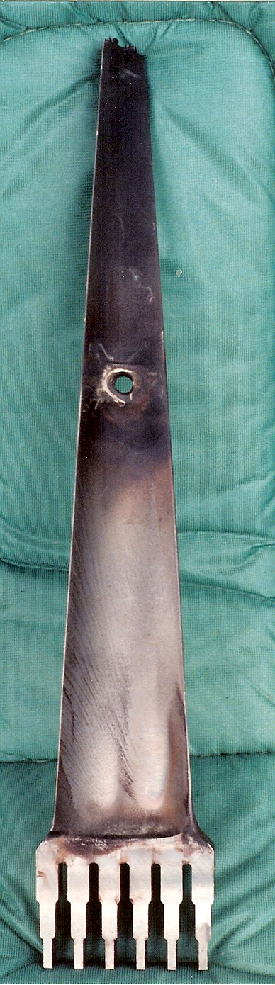
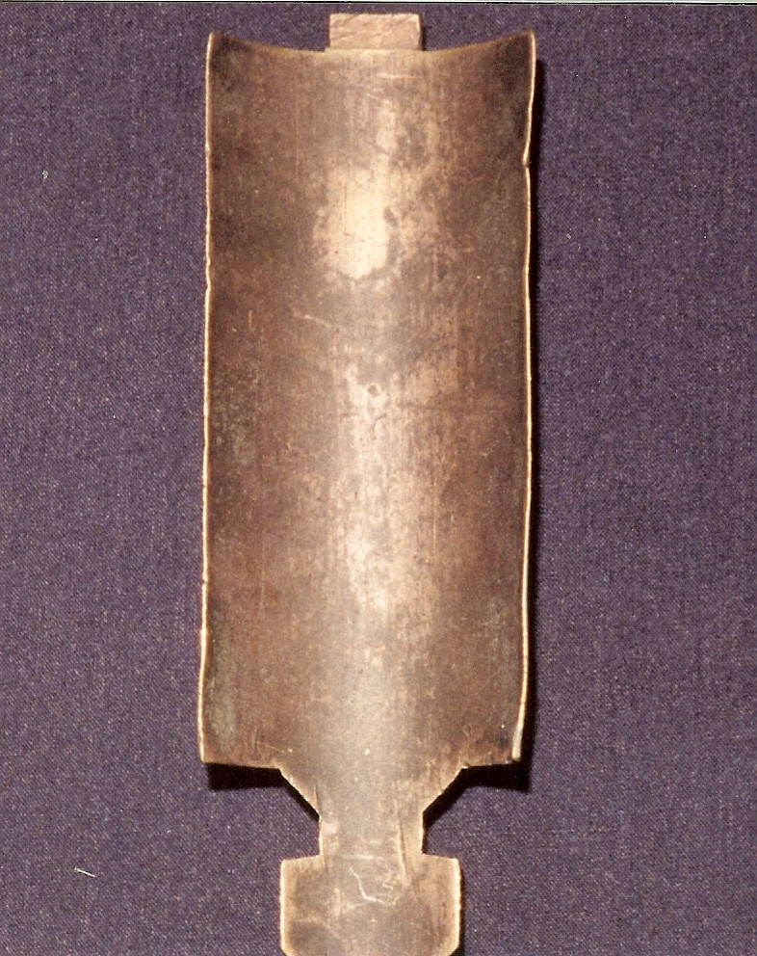
Steam turbine blades
Low pressure steam turbine blade.
Length is approximately 70 cm (30 in.).
High pressure steam turbine blade.
Length is approximately 20 cm (8 in.).
Photos by M. Boles

Slide 14
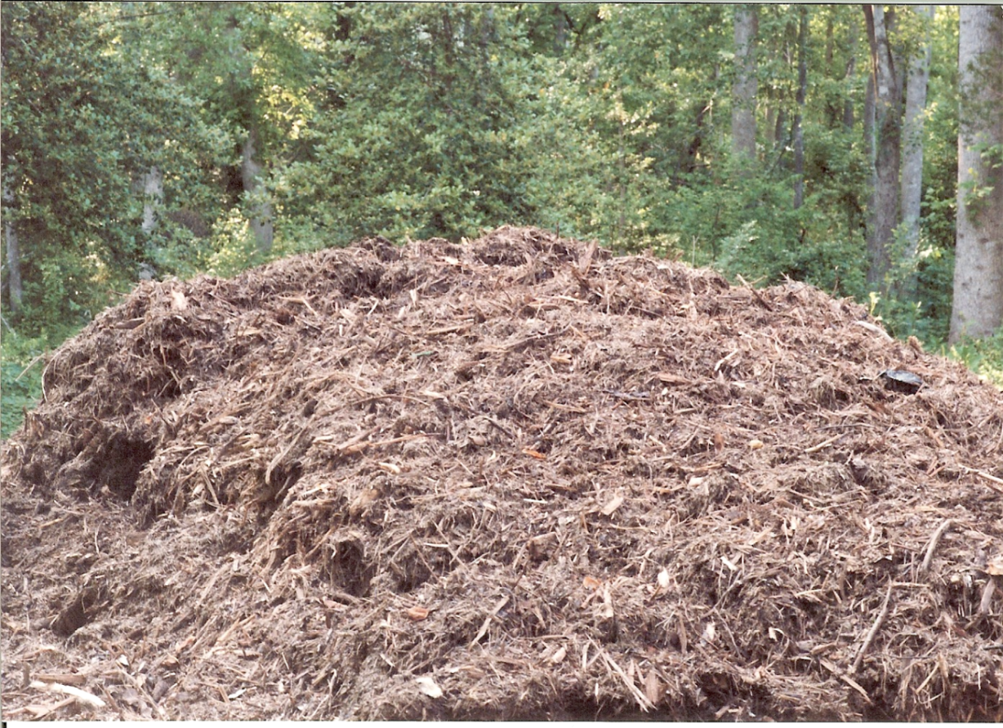
Compost pile
The chemical reaction in the compost pile shown below is an example of an exothermic reaction. On the day this photo was taken, the ambient temperature was 69°F. At two feet inside the pile, the temperature was 135°F.
Photo by M. Boles

