Slide 1

Part 1
Business in a Changing World
© 2015 McGraw-Hill Education.

Slide 2

CHAPTER 1 | The Dynamics of Business and Economics
CHAPTER 2 | Business Ethics and Social Responsibility
CHAPTER 2 APPENDIX | The Legal and Regulatory Environment
CHAPTER 3 | Business in a Borderless World

Slide 3
Learning Objectives
LO 2-1 Define business ethics and social responsibility and examine their importance.
LO 2-2 Detect some of the ethical issues that may arise in business.
LO 2-3 Specify how businesses can promote ethical behavior.
LO 2-4 Explain the four dimensions of social responsibility.
LO 2-5 Debate an organization’s social responsibilities to owners, employees, consumers, the environment and the community.

Slide 4
Business Ethics & Social Responsibility
Business Ethics
Principles and standards that determine acceptable conduct in business
Social Responsibility
A business’s obligation to maximize its positive impact and minimize its negative impact on society
Ethics refers to individual’s or work group’s decisions
Social responsibility is the impact of the entire organization’s activities on society
Social responsibility and ethics are not the same

Slide 5
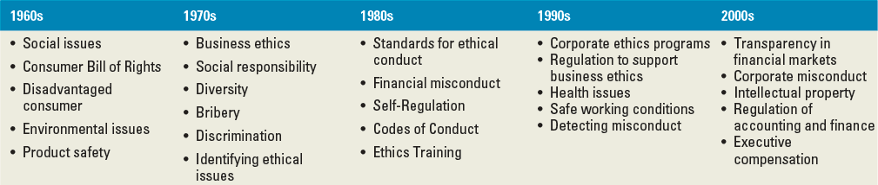
Laws and Regulations
Sarbanes-Oxley Act
Criminalized securities fraud and stiffened penalties for corporate fraud
Enacted after the accounting scandals in the early 2000’s
Dodd-Frank Act
Passed to reform the financial industry and offer consumers protection against complex and/or deceptive financial products
Enacted after the most recent recession

Slide 6
The Role of Ethics in Business
Growing concerns about legal and ethical issues in business strengthen the public’s perceptions that ethical standards and the level of trust in business need to be raised
Recent Legal and Ethical Issues
Subprime loans and foreclosures
Cybercrimes
Deceptive advertising
Unfair competitive practices
Accounting fraud
Learning to recognize and resolve ethical issues is a key step in evaluating ethical decisions

Slide 7

Recognizing Ethical Issues
Ethical Issue
An identifiable problem, situation, or opportunity that requires a person to choose from among several actions that may be evaluated as right or wrong, ethical or unethical
  Many issues seem straightforward but in reality are very complex
  One of the principal causes of unethical behavior is overly aggressive financial or business objectives

Slide 8
Recognizing Ethical Issues
Misuse of Company Time
Estimated to cost hundreds of billions a year in lost productivity
Misuse of Company Resources
Company policies help prevent company resource abuse
Conflict of Interest
Exists when a person must choose whether to advance their own interests or those of others
Bribery is a form of conflict of interest
Bribery
Payments, gifts or special favors intended to influence the outcome of a decision

Slide 9
Improving Ethical Behavior in Business
Employees must have established ethics policies if employees are to determine what conduct is acceptable
Code of Ethics
Formalized rules and standards that describe what a company expects of its employees
Whistleblowing
The act of an employee exposing an employer’s wrongdoing to outsiders, such as the media or government regulatory agencies

Slide 10
Social Responsibility Issues
Corporate Citizenship
The extent to which businesses meet the legal, ethical, economic, and voluntary responsibilities placed on them by their stakeholders
The company’s responsibilities to owners and stockholders
Maintaining proper accounting procedures
Providing investors with all relevant information
Protecting owner’s rights and investments

Slide 11
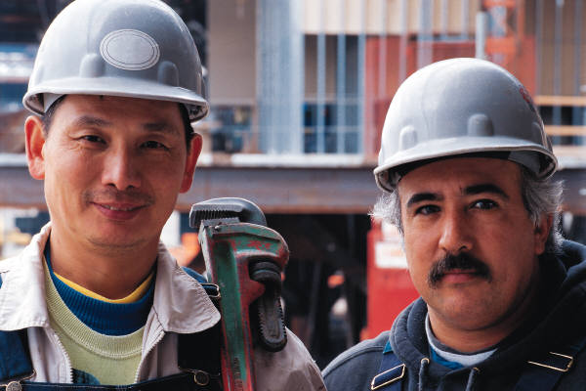
Social Responsibility Issues
Provide a safe workplace and pay them adequately
Company’s responsibilities to employees
Provide equal opportunities for all employees
Keep them informed of what is happening in the company
Listen to their grievances and treat them fairly

Slide 12

Social Responsibility Issues
Company’s responsibility to consumers
Provide them with satisfying, safe products
Respect their rights as consumers

Slide 13
Social Responsibility Issues
Consumerism
The activities individuals, groups and organizations undertake to protect their rights as consumer
Sustainability
Conducting activities in a way that allows for the long-term well-being of the natural environment, including all biological entities
Involves the assessment and improvement of business strategies, economic sectors, work practices, technologies and lifestyles so they maintain the health of the natural environment

Slide 14

Social Responsibility Issues
Sustainability issues
Pollution
Water – society is demanding clean water
Air – acid rain and global warming
Alternative energy
Reducing carbon emissions forces alternative energy sources
Land – garbage, strip mining and poor forest conservation

Slide 15
Social Responsibility Issues
Company’s Responses to Sustainability Issues
Making processes more eco-friendly is called “green” business
Recycling aluminum, paper and glass
Using green power sources when available
Larger companies may have a Vice President of Environmental Affairs
Greenwashing is creating a positive green association for non-green products

