Slide 1

Part 3
Managing for Quality and Competitiveness
© 2015 McGraw-Hill Education.

Slide 2

CHAPTER 6 | The Nature of Management
CHAPTER 7 | Organization, Teamwork, and Communication
CHAPTER 8 | Managing Service and Manufacturing Operations

Slide 3
Learning Objectives
LO 6-1 Define management and explain its role in the achievement of organizational objectives.
LO 6-2 Describe the major functions of management.
LO 6-3 Distinguish among three levels of management and the concerns of managers at each level.
LO 6-4 Specify the skills managers must have to be successful.
LO 6-5 Describe the different types of leaders and how leadership can be used to empower employees.
LO 6-6 Summarize the systematic approach to decision making used by many business managers.

Slide 4
The Importance of Management
Management
A process designed to achieve an organization’s objectives by using its resources effectively and efficiently in a changing environment
Managers
Those individuals in organizations who make decisions about the use of resources and who are concerned with planning, organizing, staffing, directing and controlling the organization’s activities to reach its objectives

Slide 5
Management Functions
Planning is the process of determining the organization’s objectives and deciding how to accomplish them; the first function of management
Planning
Mission is the statement of an organization’s fundamental purpose and basic philosophy
Goals are the results the company wants to achieve
Objectives are measurable statements on common issues such as profit, competitive advantage, efficiency and growth
Plans specify what should be done, by whom, where, when and how

Slide 6
Management Functions
Strategic Plans
Tactical Plans
Operational Plans
Crisis Management/Contingency Planning
Establish long-range objectives and overall strategy or course of action by which a firm fulfills its mission
Short-range plans designed to implement the activities and objectives specified in the strategic plan
Very short-term plans, specify actions individuals, work groups, or departments must accomplish to achieve the tactical plan and ultimately the strategic plan
An element in planning that deals with potential disasters

Slide 7
Management Functions
Organizing
The structuring of resources and activities to accomplish objectives in an efficient and effective manner
Staffing
Hiring of people to carry out the work of the organization
Downsizing
The elimination of a significant number of employees from an organization
Directing
Motivating and leading employees to achieve organizational objectives
Controlling
The process of evaluating and correcting activities to keep the organization on course

Slide 8
Levels of Management
Top Managers
The president and other top executives of a business, such as the chief executive officer (CEO), chief financial officer (CFO), and chief operations officer (COO), who have overall responsibility for the organization
Middle Managers
Those members of an organization responsible for the tactical planning that implements the general guidelines established by top management
First-Line Managers
Those who supervise both workers and the daily operations of an organization

Slide 9
Areas of Management
Financial Managers
Focus on obtaining needed funds for the successful operation of an organization and using those funds to further organizational goals
Productions and Operations Managers
Develop and administer the activities involved in transforming resources into goods, services and ideas ready for the marketplace

Slide 10
Areas of Management
Human Resources Managers
Handle the staffing function and deal with employees in a formalized manner
Marketing Managers
Responsible for planning, pricing, and promoting products and making them available to customers

Slide 11
Areas of Management
Information Technology (IT) Managers
Responsible for implementing, maintaining, and controlling technology applications in business, such as computer networks
Administrative Mangers
Manage an entire business or a major segment of a business; they are not specialists but coordinate the activities of specialized managers

Slide 12
Skills Needed by Managers
Leadership
The ability to influence employees to work toward organizational goals
Technical Expertise
The specialized knowledge and training needed to perform jobs that are related to particular areas of management
Needed most by first-line managers and least critical to top-level managers
Conceptual Skills
The ability to think in abstract terms and to see how parts fit together to form the whole
Needed most by top level managers

Slide 13
Skills Needed by Managers
Analytical Skills
The ability to identify relevant issues, recognize their importance, understand the relationships between them and perceive the underlying causes of a situation
Most important to the success of top level managers
Human Relation Skills
The ability to deal with people, both inside and outside the organization
Especially important in organizations that provide services, such as hospitals, airlines and banks

Slide 14
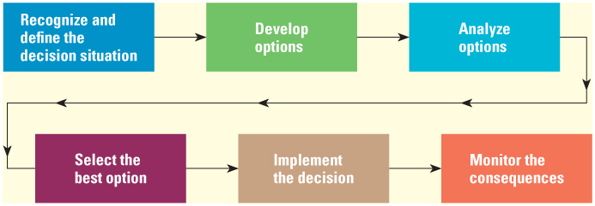
Decision Making
Steps in the Decision Making Process

Slide 15
The Reality of Management
Managers spend a lot of time establishing and updating an agenda of goals and plans for carrying out their responsibilities
Agenda
A calendar containing both specific and vague items, that covers short-term goals and long-term objectives
Networking
The building of relationships and sharing of information with colleagues who can help managers achieve the items on their agenda

