Slide 1

Part 4
Creating the Human Resource Advantage
© 2015 McGraw-Hill Education.

Slide 2

CHAPTER 9 | Motivating the Workforce
CHAPTER 10 | Managing Human Resources

Slide 3
Learning Objectives
LO 9-1 Define human relations and determine why its study is important.
LO 9-2 Summarize early studies that laid the groundwork for understanding employee motivation.
LO 9-3 Compare and contrast the human-relations theories of Abraham Maslow and Frederick Herzberg.
LO 9-4 Investigate various theories of motivation, including Theories X, Y, and Z; equity theory; and expectancy theory.
LO 9-5 Describe some of the strategies that managers use to motivate employees.

Slide 4
Nature of Human Relations
Human Relations
The study of the behavior of individuals and groups in organizational settings
Motivation
An inner drive that directs a person’s behavior toward goals
A goal is the satisfaction of some need, and a need is the difference between a desired state and an actual state

Slide 5
Morale
Morale
An employee’s attitude toward his or her job, employer, and colleagues
Low morale may cause:
High rates of absenteeism
High levels of productivity
High morale contributes to:
High returns to stakeholders
Employee loyalty
High rates of employee turnover
Absenteeism can cost a company as much as 36% of payroll

Slide 6
Rewards
Intrinsic Rewards
The personal satisfaction and enjoyment that you feel after attaining a goal
Extrinsic Rewards
Benefits and/or recognition received from someone else
In this class, you may feel personal enjoyment in learning how business works and aspire to have a career in business or to operate your own business one day
In this class, your grade is extrinsic recognition of your efforts and success in the class

Slide 7
Historical Perspectives on Employee Motivation
Classical Theory of Motivation
Theory suggesting that money is the sole motivator for workers
Early 20th century
Frederick W. Taylor and Frank & Lillian Gilbreth
Analyzed how workers perform specific work tasks in an effort to improve the employees’ productivity
Led to the application of scientific principles to management

Slide 8
Historical Perspectives on Employee Motivation
The Hawthorne Studies
1924-1932 at the Hawthorne Works Plant
Elton Mayo:
Postulated that physical conditions in workplace stimulate productivity
Productivity increased regardless of the physical conditions (the Hawthorne effect)
Findings show that social and psychological factors could significantly affect productivity and morale
Marks beginning of concern for human relations in the workplace

Slide 9
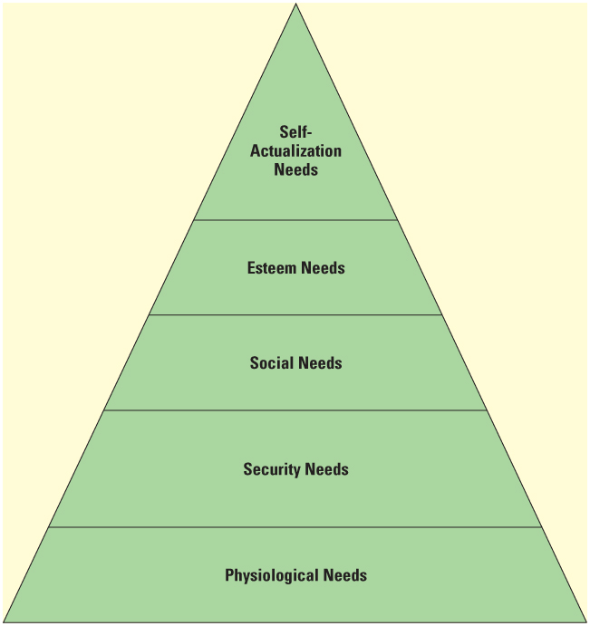
Maslow’s Hierarchy of Needs
Maslow’s Hierarchy
A theory that arranges the five basic needs of people—physiological, security, social, esteem, and self-actualization—into the order in which people strive to satisfy them

Slide 10
Maslow’s Hierarchy of Needs
Security Needs
Social Needs
The need for love, companionship, and friendship—the desire for acceptance by others
The need to protect oneself from physical and economic harm
Esteem Needs
The need for respect—both self-respect and respect from others
Self-Actualization Needs
The need to be the best one can be; at the top of Maslow’s hierarchy
Physiological Needs
The most basic human needs to be satisfied—water, food, shelter, and clothing

Slide 11
Herzberg’s Two-Factor Theory
Hygiene Factors
Aspects of Herzberg’s theory of motivation that focus on the work setting and not the content of the work; these aspects include adequate wages, comfortable and safe working conditions, fair company policies, and job security
Motivational Factors
Aspects of Herzberg’s theory of motivation that focus on the content of the work itself; these aspects include achievement, recognition, involvement, responsibility, and advancement

Slide 12
McGregor’s Theory X and Theory Y
Theory X
McGregor’s traditional view of management whereby it is assumed that workers generally dislike work and must be forced to do their jobs
Theory Y
McGregor’s humanistic view of management whereby it is assumed that workers like to work and that under proper conditions employees will seek out responsibility in an attempt to satisfy their social, esteem, and self-actualization needs

Slide 13
Theory Z, Equity Theory & Expectancy Theory
Theory Z
A management philosophy that stresses employee participation in all aspects of company decision making
Equity Theory
An assumption that how much people are willing to contribute to an organization depends on their assessment of the fairness, or equity, of the rewards they will receive in exchange
Expectancy Theory
The assumption that motivation depends not only on how much a person wants something but also on how likely he or she is to get it
Behavior Modification
Changing behavior and encouraging appropriate actions by relating the consequences of behavior to the behavior itself

Slide 14
Strategies for Motivating Employees
Job Rotation
Movement of employees from one job to another in an effort to relieve the boredom often associated with job specialization
Job Enlargement
The addition of more tasks to a job instead of treating each task as separate
Job Enrichment
The incorporation of motivational factors, such as opportunity for achievement, recognition, responsibility, and advancement, into a job

Slide 15
Strategies for Motivating Employees
Flextime
A program that allows employees to choose their starting and ending times, provided that they are at work during a specified core period
Compressed Workweek
A four-day (or shorter) period during which an employee works 40 hours
Job Sharing
Performance of one full-time job by two people on part-time hours

