Slide 1
The Management Process Today
Chapter One

Slide 2
Learning Objectives
LO1-1 Describe what management is, why management is important, what managers do, and how managers utilize organizational resources efficiently and effectively to achieve organizational goals
LO1-2 Distinguish among planning, organizing, leading, and controlling (the four principal managerial tasks), and explain how managers’ ability to handle each one can affect organizational performance
LO1-3 Differentiate among three levels of management, and understand the tasks and responsibilities of managers at different levels in the organizational hierarchy

Slide 3
Learning Objectives
LO1-4 Distinguish between three kinds of managerial skill, and explain why managers are divided into different departments
LO1-5 Discuss some major changes in management practices today that have occurred as a result of globalization and the use of advanced information technology (IT)
LO1-6 Discuss the principal challenges managers face in today’s increasingly competitive global environment

Slide 4
What is Management?
Management
  The planning, organizing, leading, and controlling of human and other resources to achieve organizational goals effectively and efficiently

Slide 5
Achieving High Performance
Organizational Performance
  A measure of how efficiently and effectively managers use organizational resources to satisfy customers and achieve organizational goals

Slide 6
Organizational Performance
Efficiency
  A measure of how well or productively resources are used to achieve a goal
Effectiveness
  A measure of the appropriateness of the goals an organization is pursuing and the degree to which the organization achieves those goals.

Slide 7
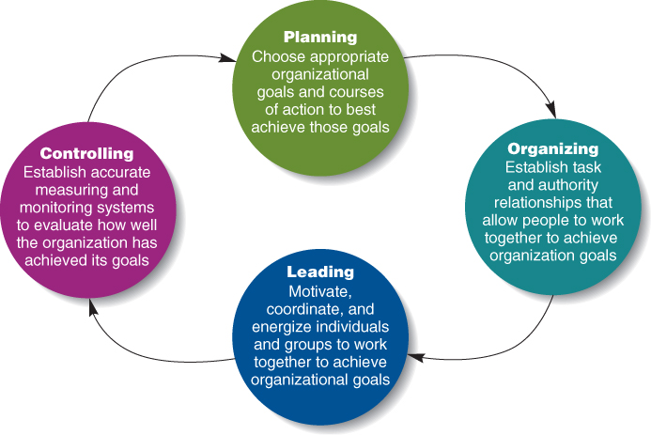
Four Tasks of Management
Figure 1.2

Slide 8
Controlling
Controlling
  Evaluating how well an organization is achieving its goals and taking action to maintain or improve performance
The outcome of the control process is the ability to measure performance accurately and regulate efficiency and effectiveness

Slide 9
Levels of Management
First line managers
  Responsible for the daily supervision of non-managerial employees
Middle managers
  Supervise first-line managers and are responsible for finding the best way to use resources to achieve organizational goals

Slide 10
Levels of Management
Top managers
  establish organizational goals, decide how departments should interact, and monitor the performance of middle managers

Slide 11

Levels of Managers
Top-management team
  A group composed of the CEO, the COO, and the vice presidents of the most important departments of a company.

Slide 12
Managerial Skills
Conceptual skills
  The ability to analyze and diagnose a situation and distinguish between cause and effect.
Human skills
  The ability to understand, alter, lead, and control the behavior of other individuals and groups.
Technical skills
  The job-specific knowledge and techniques required to perform an organizational role.

Slide 13
Technical Skills
Core competency
  Specific set of skills, abilities, and experiences that allows one organization to outperform its competitors

Slide 14

Empowerment and
Self-Managed Teams
Empowerment
  Expansion of employees’ knowledge, tasks, and decision-making responsibilities

Slide 15
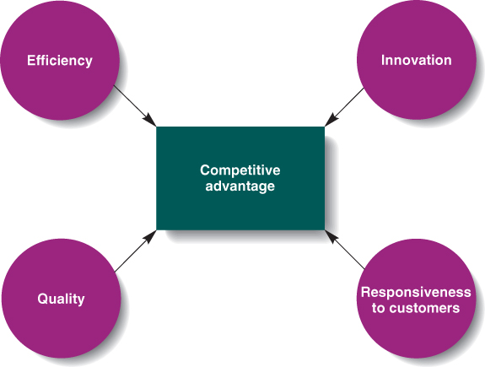
Building Blocks of Competitive Advantage
Figure 1.6

