Slide 1
Values, Attitudes, Emotions, and Culture:
The Manager as a Person
Chapter Two

Slide 2
Learning Objectives
LO2-1 Describe the various personality traits that affect how managers think, feel, and behave
LO2-2 Explain what values and attitudes are and describe their impact on managerial action
LO2-3 Appreciate how moods and emotions influence all members of an organization
LO2-4 Describe the nature of emotional intelligence and its role in management
LO2-5 Define organizational culture and explain how managers both create and are influenced by organizational culture

Slide 3
Personality Traits
Personality Traits
  Enduring tendencies to feel, think, and act in certain ways that can be used to describe the personality of every individual
Managers’ personalities influence their behavior and approach to managing people and resources

Slide 4
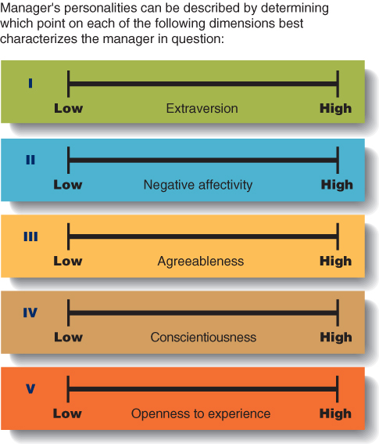
Big Five Personality Traits
Figure 2.1

Slide 5
Other Personality Traits
Internal locus of control
  Tendency to locate responsibility for one’s fate within oneself
Own actions and behaviors are major and decisive determinants of job outcomes

Slide 6
Other Personality Traits
External locus of control
  Tendency to locate responsibility for one’s own fate in outside forces and to believe that one’s own behavior has little impact on outcomes

Slide 7
Other Personality Traits
Self-Esteem
  The degree to which people feel good about themselves and their capabilities
High self-esteem causes a person to feel competent, and capable.
Persons with low self-esteem have poor opinions of themselves and their abilities.

Slide 8
Values, Attitudes, and
Moods and Emotions
Values
  Describe what managers try to achieve through work and how they think they should behave
Attitudes
  Capture managers’ thoughts and feelings about their specific jobs and organizations.
Moods and Emotions
  Encompass how managers actually feel when they are managing

Slide 9
Values
Terminal Values
  A lifelong goal or objective that an individual seeks to achieve
Instrumental Values
  A mode of conduct that an individual seeks to follow

Slide 10
Values
Norms
  Unwritten, informal codes of conduct that prescribe how people should act in particular situations and are considered important by most members of a group or organization.
Value System
  The terminal and instrumental values that are guiding principles in an individual’s life.

Slide 11

Attitudes
Organizational Commitment
  The collection of feelings and beliefs that managers have about their organization as a whole
Notes:
Committed managers are loyal to and are proud of their firms.
Commitment can lead to a strong organizational culture.
Commitment helps managers perform their figurehead and spokesperson roles.

Slide 12
Organizational Culture
Organizational Culture
  Shared set of beliefs, expectations, values, norms, and work routines that influence how members of an organization relate to one another and cooperate to achieve organizational goals

Slide 13
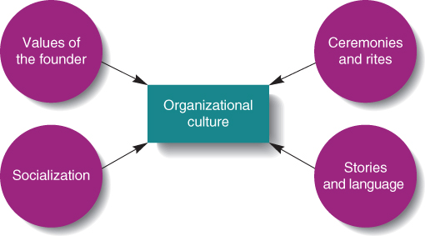
Factors that Maintain and Transmit
Organizational Culture
Figure 2.9

Slide 14

Role of Values and Norms
Ceremonies and Rites
  Formal events that recognize incidents of importance to the organization as a whole and to specific employees

Slide 15
Ceremonies and Rites
Rites of passage
  determine how individuals enter, advance within, or leave the organization
Rites of integration
  build and reinforce common bonds among organizational members

