Slide 1
Managing Ethics and Diversity
Chapter Three

Slide 2
Learning Objectives
LO3-1 Illustrate how ethics help managers determine the right way to behave when dealing with different stakeholder groups
LO3-2 Explain why managers should behave ethically and strive to create ethical organizational cultures
LO3-3 Appreciate the increasing diversity of the workforce and of the organizational environment

Slide 3
Learning Objectives (cont.)
LO3-4 Grasp the central role that managers play in the effective management of diversity
LO3-5 Understand why the effective management of diversity is both an ethical and a business imperative
LO3-6 Understand the two major forms of sexual harassment and how they can be eliminated

Slide 4

The Nature of Ethics
Ethics
  The inner-guiding moral principles, values, and beliefs that people use to analyze or interpret a situation and then decide what is the “right” or appropriate way to behave

Slide 5
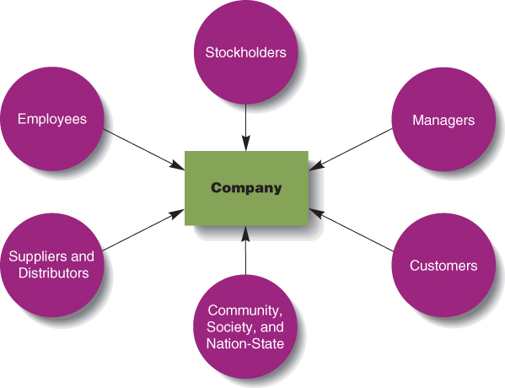
Types of Company Stakeholders
Figure 3.1

Slide 6
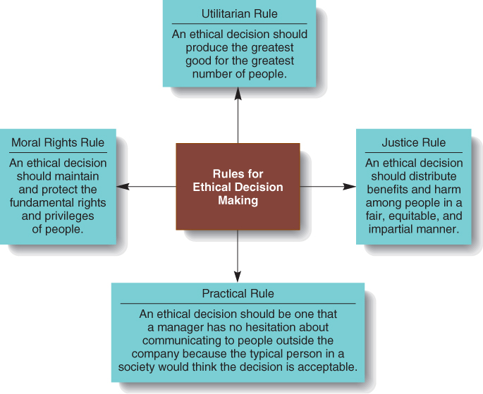
Four Ethical Rules
Figure 3.2
Notes:
Utilitarian Rule
Decision that produces the greatest good for the greatest number of people
How do you measure the benefits and harms that will be done to each stakeholder group?
How do you evaluate the rights and importance of each group?
Moral Rights rule
Decision that best maintains and protects the fundamental or inalienable rights and privileges of the people affected by it
Justice rule
Decision that distributes benefits and harms among people and groups in a fair, equitable, or impartial way
Practical rule
Decision that a manager has no hesitation about communicating to people outside the company because the typical person would think it is acceptable

Slide 7
Practical Decision Model
Does my decision fall within the acceptable standards that apply in business today?
Am I willing to see the decision communicated to all people and groups affected by it?
Would the people with whom I have a significant personal relationship approve of the decision?

Slide 8
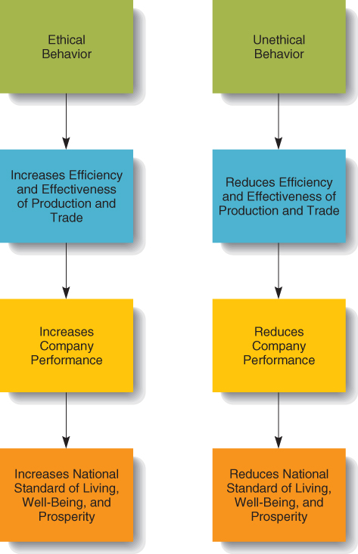
Some Effects of Ethical/Unethical Behavior
Figure 3.3

Slide 9
Why should managers behave ethically?
Trust
  Willingness of one person or group to have faith or confidence in another person’s goodwill, even though this puts them at risk
Reputation
  Esteem or high repute that individuals or organizations gain when they behave ethically

Slide 10
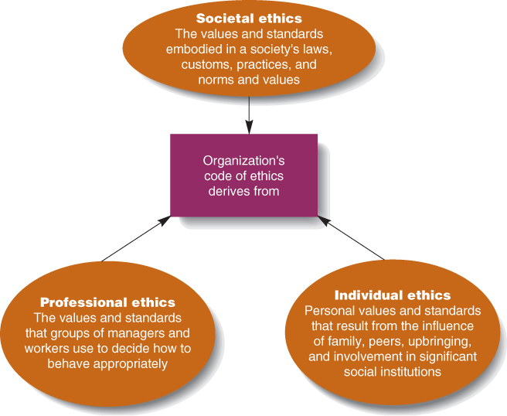
Determinants of Ethics
Figure 3.4
Notes:
Societal Ethics
Standards that govern how members of a society should deal with each other on issues such as fairness, justice, poverty, and the rights of the individual
People behave ethically because they have internalized certain values, beliefs, and norms
Professional Ethics
Standards that govern how members of a profession are to make decisions when the way they should behave is not clear-cut
Medical & legal ethics
Individual Ethics
Personal values and attitudes that govern how individuals interact with other people

Slide 11
The Increasing Diversity of the Workforce and the Environment
Diversity
  Differences among people due to age, gender, race, ethnicity, religion, sexual orientation, socioeconomic background, education, physical appearance, capabilities, disabilities, and any other characteristic used to distinguish people.

Slide 12
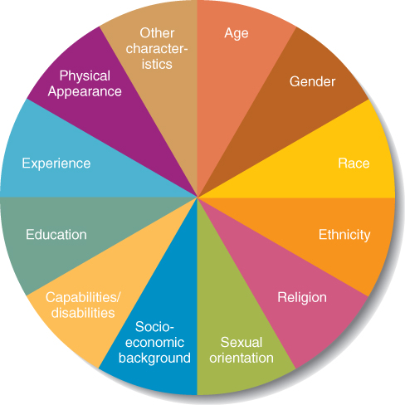
Sources of Diversity in the Workplace
Figure 3.5

Slide 13
Workforce Diversity:
Capabilities and Disabilities
Disability Issues
  Providing reasonable accommodations for individuals with disabilities
  Promoting a nondiscriminatory workplace environment
  Educating the organization about disabilities

Slide 14

Forms of Sexual Harassment
Quid pro quo
  Asking for or forcing an employee to perform sexual favors in exchange for receiving some reward or avoiding negative consequences.

Slide 15
Forms of Sexual Harassment
Hostile work environment
  Telling lewd jokes, displaying pornography, making sexually oriented remarks about someone’s personal appearance, and other sex-related actions that make the work environment unpleasant.

