Slide 1
Managing in the
Global Environment
Chapter Four

Slide 2
Learning Objectives
LO4-1 Explain why the ability to perceive, interpret, and respond appropriately to the organizational environment is crucial for managerial success
LO4-2 Differentiate between the global task and global general environments
LO4-3 Identify the main forces in both the global task and general environments, and describe the challenges that each force presents to managers

Slide 3
Learning Objectives
LO4-4 Explain why the global environment is becoming more open and competitive and identify the forces behind the process of globalization that increase the opportunities, complexities, challenges, and threats that managers face
LO4-5 Discuss why national cultures differ and why it is important that managers be sensitive to the effects of falling trade barriers and regional trade associations on the political and social systems of nations around the world

Slide 4
What is the Global Environment?
Global Organizations
  Organizations that operate and compete in more than one country
  Uncertain and unpredictable
Global Environment
  Set of global forces and conditions that operate beyond an organization’s boundaries but affect a manager’s ability to acquire and utilize resources

Slide 5
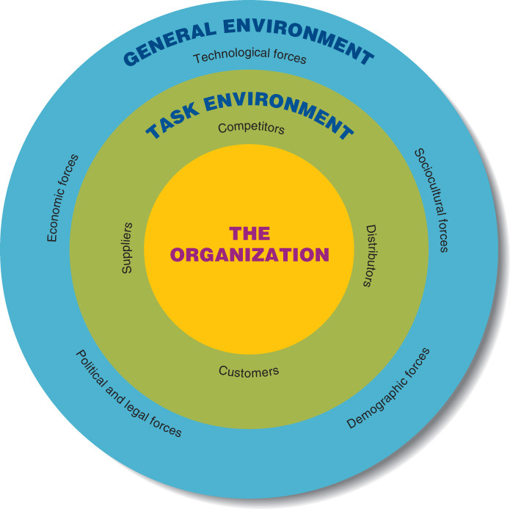
Forces in the Global Environment
Figure 4.1

Slide 6
What is the Global Environment?
Task Environment
  Set of forces and conditions that originate with suppliers, distributors, customers, and competitors and affect an organization’s ability to obtain inputs and dispose of its outputs because they influence managers daily

Slide 7

What is the Global Environment?
General environment
  the wide-ranging global, economic, technological, socio-cultural, demographic, political, and legal forces that affect an organization and its task environment

Slide 8
The Task Environment
Suppliers
  Individuals and organizations that provide an organization with the input resources that it needs to produce goods and services
    Raw materials, component parts, labor (employees)

Slide 9

Global Outsourcing
Global Outsourcing
  The purchase or production of inputs or final products from overseas suppliers to lower costs and improve product quality or design.

Slide 10

The Task Environment
Barriers to Entry
  Factors that make it difficult and costly for the organization to enter a particular task environment or industry

Slide 11
Barriers to Entry
Economies of scale
  Cost advantages associated with large operations
Brand loyalty
  Customers’ preference for the products of organizations currently existing in the task environment
Government regulations

Slide 12
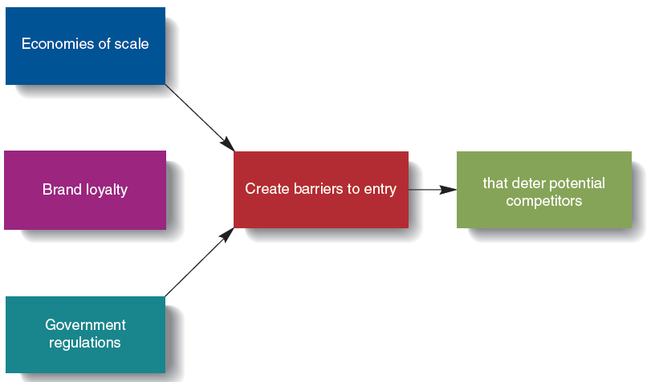
Barriers to Entry and Competition
Figure 4.2

Slide 13
The General Environment
Technological Forces
  Outcomes of changes in the technology that managers use to design, produce, or distribute goods and services
Sociocultural Forces
  Pressures emanating from the social structure of a country or society or from the national culture
Notes:
Technology – the combination of skills and equipment that managers use in the design, production, and distribution of goods and services

Slide 14
The Process of Globalization
Globalization
  the set of specific and general forces that work together to integrate and connect economic, political, and social systems across countries, cultures, or geographical regions so that nations become increasingly interdependent and similar

Slide 15
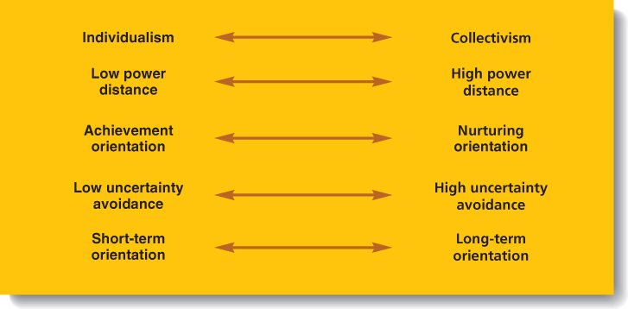
Hofstede’s Model of
National Culture
Figure 4.4

