Slide 1
Decision Making, Learning, Creativity, and Entrepreneurship
Chapter Five

Slide 2
Learning Objectives
LO5-1 Understand the nature of managerial decision making, differentiate between programmed and nonprogrammed decisions, and explain why nonprogrammed decision making is a complex, uncertain process.
LO5-2 Describe the six steps that managers should take to make the best decisions, and explain how cognitive biases can lead managers to make poor decisions.
LO5-3 Identify the advantages and disadvantages of group decision making, and describe techniques that can improve it

Slide 3
Learning Objectives
LO5-4 Explain the role that organizational learning and creativity play in helping managers to improve their decisions.
LO5-5 Describe how managers can encourage and promote entrepreneurship to create a learning organization, and differentiate between entrepreneurs and intrapreneurs

Slide 4

The Nature of Managerial Decision Making
Decision Making
  The process by which managers respond to opportunities and threats by analyzing options, and making determinations about specific organizational goals and courses of action
Notes:
Decisions in response to opportunities—occurs when managers respond to ways to improve organizational performance.
Decisions in response to threats—occurs when managers are impacted by adverse events to the organization.

Slide 5
Decision Making
Intuition
  feelings, beliefs, and hunches that come readily to mind, require little effort and information gathering and result in on-the-spot decisions
Reasoned judgment
  decisions that take time and effort to make and result from careful information gathering, generation of alternatives, and evaluation of alternatives

Slide 6
The Classical Model
Classical Model of Decision Making
  A prescriptive model of decision making that assumes the decision maker can identify and evaluate all possible alternatives and their consequences and rationally choose the most appropriate course of action
Notes:
Optimum decision
The most appropriate decision in light of what managers believe to be the most desirable future consequences for their organization

Slide 7
The Administrative Model
Administrative Model of Decision Making
  An approach to decision making that explains why decision making is inherently uncertain and risky and why managers usually make satisfactory rather than optimum decisions
  Bounded rationality, incomplete information
Notes:
Bounded rationality
Cognitive limitations that constrain one’s ability to interpret, process, and act on information

Slide 8
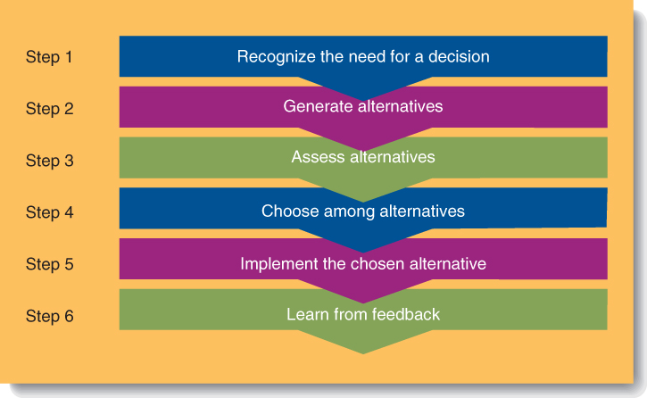
Six Steps in Decision Making
Figure 5.4

Slide 9
Group Decision Making
Groupthink
  A pattern of faulty and biased decision making that occurs in groups whose members strive for agreement among themselves at the expense of accurately assessing information relevant to a decision

Slide 10

Group Decision Making
Devil’s Advocacy
  Critical analysis of a preferred alternative, made in response to challenges raised by a group member who, playing the role of devil’s advocate, defends unpopular or opposing alternatives for the sake of argument.

Slide 11
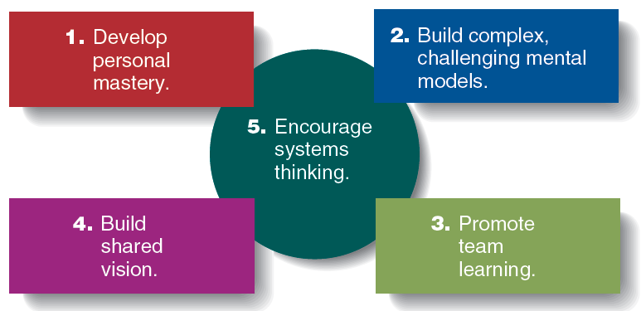
Senge’s Principles for Creating a Learning Organization
Figure 5.6
Notes:
Personal Mastery
Managers empower employees and allow them to create and explore.
Mental Models
Challenge employees to find new, better methods to perform a task.
Team Learning
Is more important than individual learning since most decisions are made in groups.
Build a Shared Vision
People share a common mental model of the firm to evaluate opportunities.
Systems Thinking
Knowing and understanding how actions in one area of the firm will impact other areas of the firm.

Slide 12

Organizational Learning and Creativity
Creativity
  A decision maker’s ability to discover original and novel ideas that lead to feasible alternative courses of action

Slide 13
Promoting Group Creativity
Brainstorming
  Managers meet face-to-face to generate and debate many alternatives.
  Group members are not allowed to evaluate alternatives until all alternatives are listed.
  When all are listed, then the pros and cons of each are discussed and a short list created.

Slide 14
Entrepreneurship and Creativity
Entrepreneurs
  an individual who notices opportunities and decides how to mobilize the resources necessary to produce new and improved goods and services
Social entrepreneurs
  An individual who pursues initiatives and opportunities and mobilizes resources to address social problems and needs in order to improve society and wellbeing through creative solutions.

Slide 15

Entrepreneurship and Creativity
Entrepreneurship
  Mobilization of resources to take advantage of an opportunity to provide customers with new and improved goods and services

