Slide 1
Planning, Strategy, and Competitive Advantage
Chapter Six

Slide 2
Learning Objectives
LO6-1 Identify the three main steps of the planning process and explain the relationship between planning and strategy
LO6-2 Differentiate between the main types of business-level strategies and explain how they give an organization a competitive advantage that may lead to superior performance
LO6-3 Differentiate between the main types of corporate-level strategies and explain how they are used to strengthen a company’s business-level strategy and competitive advantage
LO6-4 Describe the vital role managers play in implementing strategies to achieve an organization’s mission and goals.

Slide 3
Planning and Strategy
Planning
  Identifying and selecting appropriate goals and courses of action for an organization
Strategy
  A cluster of decisions about what goals to pursue, what actions to take, and how to use resources to achieve goals

Slide 4
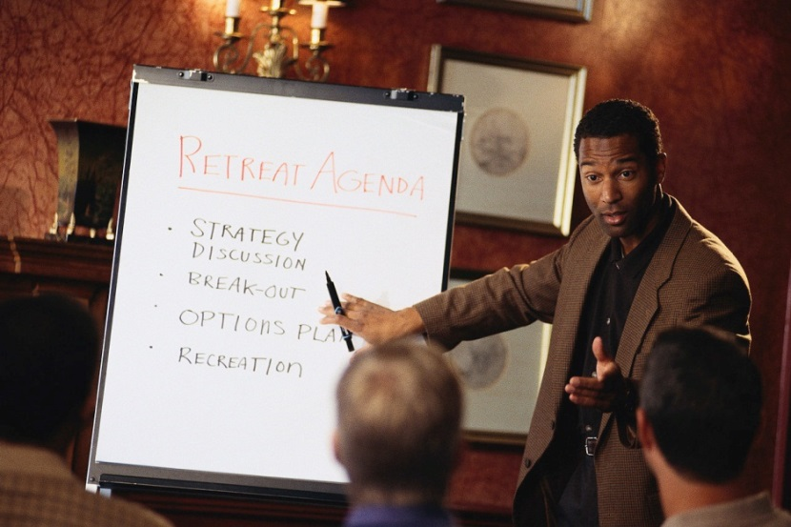
Planning and Strategy
Mission Statement
  A broad declaration of an organization’s purpose that identifies the organization’s products and customers and distinguishes the organization from its competitors

Slide 5
Levels and Types of Planning
Business-Level Plan
  Divisional managers’ decisions pertaining to divisions long-term goals overall strategy, and structure
Business-Level Strategy
  outlines the specific methods a division, business unit, or organization will use to compete effectively against its rivals in an industry

Slide 6
Levels and Types of Planning
Functional-Level Plan
  Functional managers’ decisions pertaining to the goals that they propose to pursue to help the division attain its business-level goals
Functional-level strategy
  A plan of action to improve the ability of each of an organization’s functions to perform its task-specific activities in ways that add value to an organization’s goods and services.

Slide 7
Standing Plans
Policies
  general guides to action.
Rules
  formal written specific guides to action.
Standard operating procedures (SOP)
  specify an exact series of actions to follow

Slide 8
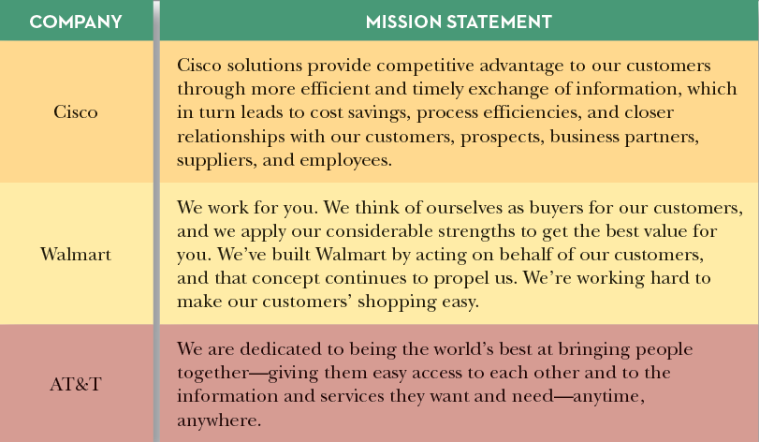
Three Mission Statements
Figure 6.4

Slide 9

Determining the Organization’s
Mission and Goals
Strategic leadership
  the ability of the CEO and top managers to convey a compelling vision of what they want the organization to achieve to their subordinates

Slide 10
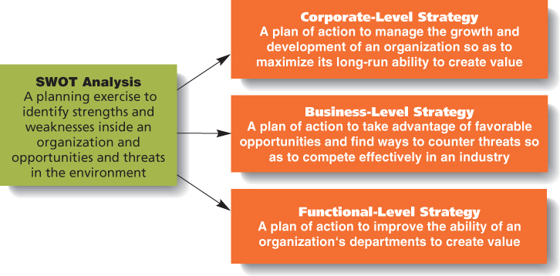
Planning and Strategy Formulation
Figure 6.5

Slide 11

Formulating Corporate-Level Strategies
Concentration on a Single Industry
  reinvesting a company’s profits to strengthen its competitive position in its current industry

Slide 12
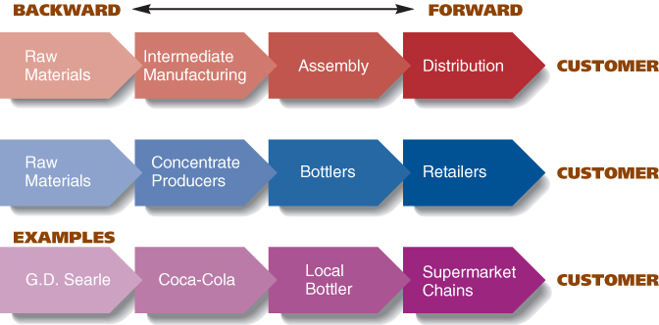
Stages in a Vertical Value Chain
Figure 6.6

Slide 13
Diversification
Diversification
  expanding a company’s business operations into a new industry in order to produce new kinds of valuable goods or services

Slide 14
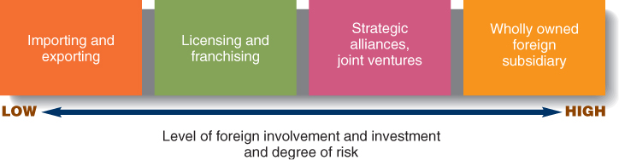
Four Ways of Expanding Internationally
Figure 6.7

Slide 15
International Expansion
Exporting
  making products at home and selling them abroad
Importing
  selling at home products that are made abroad

