Slide 1
Designing Organizational Structure
Chapter Seven

Slide 2
Learning Objectives
LO7-1 Identify the factors that influence managers’ choice of an organizational structure
LO7-2 Explain how managers group tasks into jobs that are motivating and satisfying for employees
LO7-3 Describe the types of organizational structures managers can design, and explain why they choose one structure over another
LO7-4 Explain why managers must coordinate jobs, functions, and divisions using the hierarchy of authority and integrating mechanisms.

Slide 3

Designing Organizational Structure
Organizing
  The process by which managers establish the structure of working relationships among employees to achieve goals

Slide 4
Designing Organizational Structure
Organizational Structure
  Formal system of task and reporting relationships that coordinates and motivates organizational members so that they work together to achieve organizational goals

Slide 5
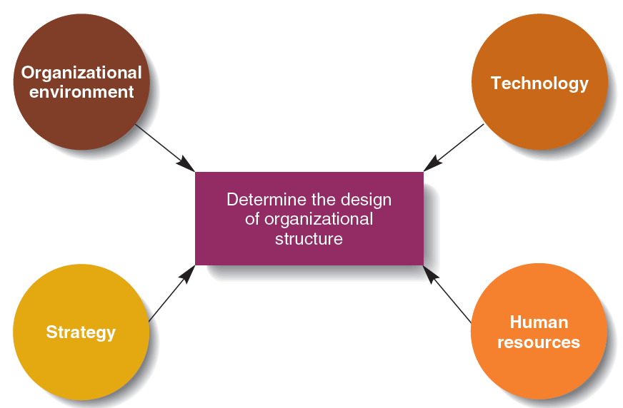
Factors Affecting
Organizational Structure
Figure 7.1
Notes:
The Organizational Environment
The quicker the environment changes, the more problems face managers.
Structure must be more flexible (i.e., decentralized authority) when environmental change is rapid.
Strategy
Different strategies require the use of different structures
A differentiation strategy needs a flexible structure, low cost may need a more formal structure
Increased vertical integration or diversification also requires a more flexible structure
Technology
The combination of skills, knowledge, tools, equipment, computers and machines used in the organization
More complex technology makes it harder for managers to regulate the organization
Managers must take into account all four factors (environment, strategy, technology
and human resources) when designing the structure of the organization

Slide 6
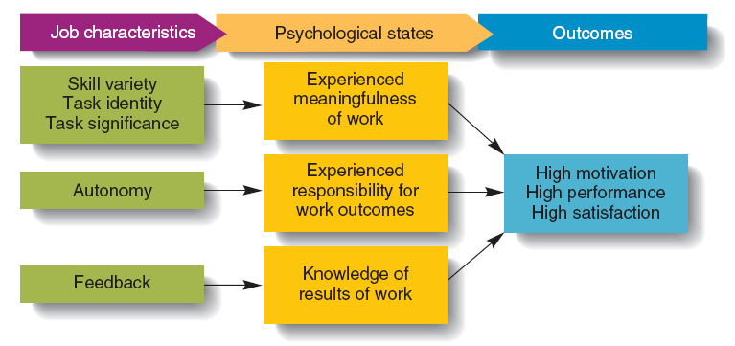
The Job Characteristics Model
Figure 7.2

Slide 7

Grouping Jobs into Functions
Functional Structure
  An organizational structure composed of all the departments that an organization requires to produce its goods or services

Slide 8
Divisional Structures
Divisional Structure
  An organizational structure composed of separate business units within which are the functions that work together to produce a specific product for a specific customer
Notes:
Divisions create smaller, manageable parts of a firm
Divisions develop a business-level strategy to compete
Divisions have marketing, finance, and other functions
Functional managers report to divisional managers who then report to corporate management

Slide 9
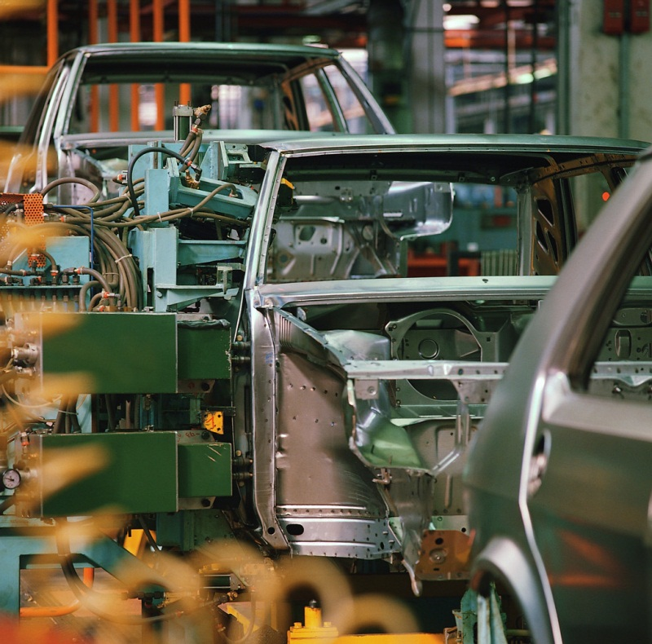
Types of Divisional Structures
Product Structure
  Each product line or business is handled by a self-contained division

Slide 10
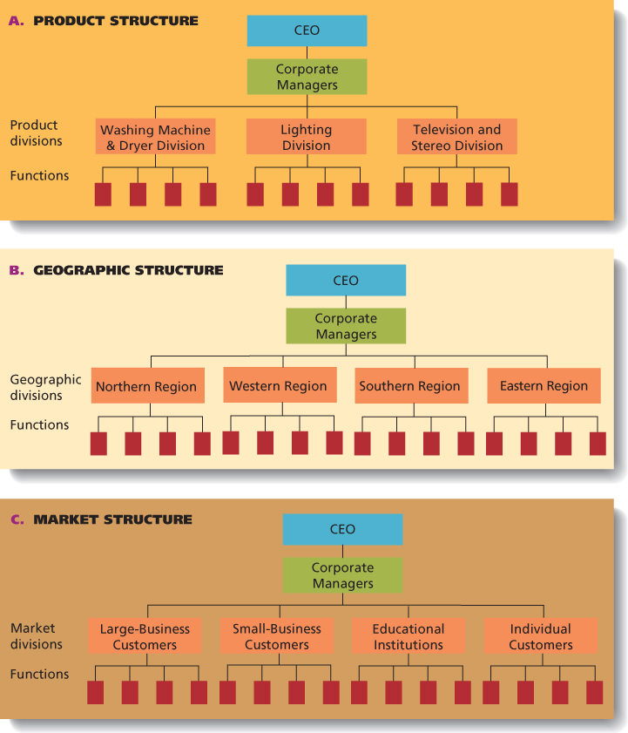
Figure 7.4
Product, Market, and Geographic Structures

Slide 11
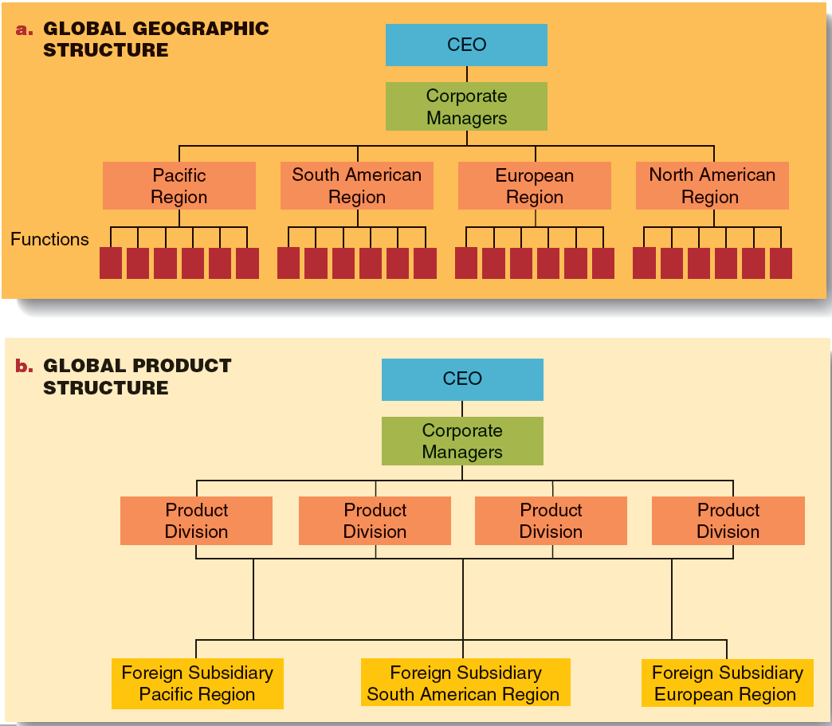
Global Geographic and
Global Product Structures
Figure 7.5

Slide 12
Matrix Design Structure
Matrix Structure
  An organizational structure that simultaneously groups people and resources by function and product

Slide 13
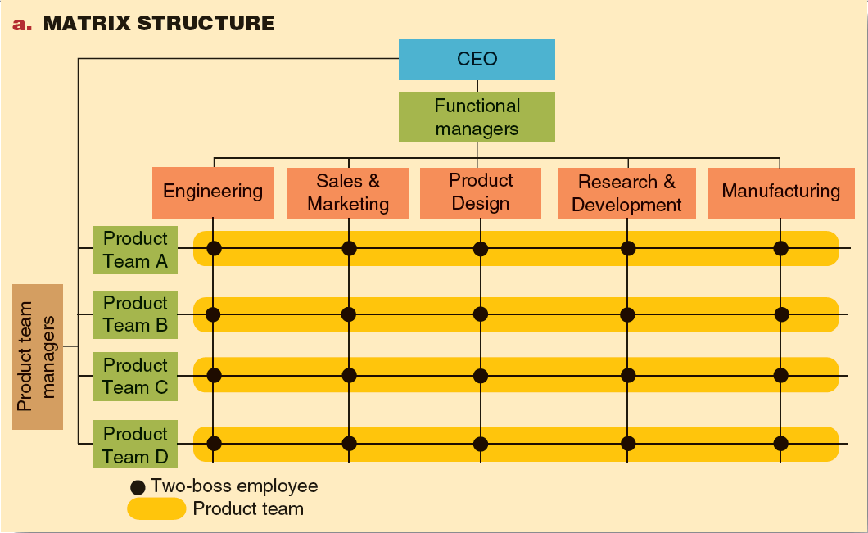
Matrix Structure
Figure 7.6
Notes:
The matrix structure is very flexible and can respond rapidly to the need for change
Each employee has two bosses (functional manager and product manager) and possibly cannot satisfy both

Slide 14
Allocating Authority
Line Manager
  someone in the direct line or chain of command who has formal authority over people and resources
Staff Manager
  Someone responsible for managing a specialist function, such as finance or marketing.

Slide 15

Strategic Alliances
Knowledge Management System
  A company-specific virtual information system that allows workers to share their knowledge and expertise and find others to help solve problems.

