Slide 1
Control, Change, and
Entrepreneurship
Chapter Eight

Slide 2
Learning Objectives
LO8-1 Define organizational control, and identify the main output and behavior controls managers use to coordinate and motivate employees
LO8-2 Describe the four steps in the control process and the way it operates over time.
LO8-3 Identify the main output controls, and discuss their advantages and disadvantages as means of coordinating and motivating employees.

Slide 3
Learning Objectives
LO8-4 Explain how clan control or organizational culture creates an effective organizational architecture
LO8-5 Discuss the relationship between organizational control and change, and explain why managing change is a vital management task
LO8-6 Understand the role of entrepreneurship in the control and change process

Slide 4

What is Organizational Control?
Controlling
  Process where managers monitor and regulate how efficiently and effectively an organization and its members are performing the activities necessary to
  achieve organizational
  goals

Slide 5
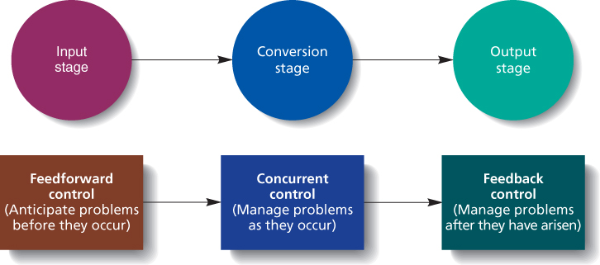
Three Types of Control
Figure 8.1

Slide 6
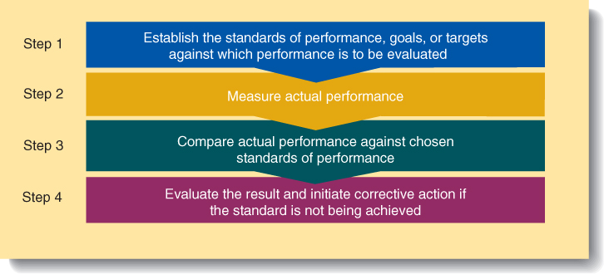
Four Steps in Organizational Control
Figure 8.2
Notes:
Establish standards, goals, or targets against which performance is to be evaluated
Standards must be consistent with the organization’s strategy
Measure actual performance
Managers can measure outputs resulting from worker behavior or they can measure the behavior themselves.
Compare actual performance against chosen standards
Managers must decide if performance actually deviates, often, several problems combine creating low performance
Evaluate the result and initiate corrective action if the situation is not being achieved
Standards have been set too high or too low.
Workers may need additional training or equipment.
This step is often hard since the environment is constantly changing.

Slide 7
Operating Budgets
Operating Budget
  A blueprint that states how managers
  intend to allocate and use the
  resources they control to attain organizational goals effectively and efficiently
Lower-level managers are evaluated for their ability to stay within the budget and to make the best use of available resources
Notes:
Managers are evaluated by how well they meet goals for controlling costs, generating revenues, or maximizing profits while staying within their budgets.

Slide 8
Management by Objectives
Management by Objectives (MBO)
  A goal-setting process in which managers and subordinates negotiate specific goals and objectives for the subordinate to achieve and then periodically evaluate their attainment of those goals
Notes:
Specific goals are set at each level of the firm.
Goal setting is participatory with manager and worker
Periodic reviews of subordinates’ progress toward goals are held (pay raises and promotions are tied to goal attainment).
Teams are also measured in this way with goals and performance measured for the team.

Slide 9

Bureaucratic Control
Bureaucratic Control
  Control of behavior by means of a comprehensive system of rules and standard operating procedures.
Notes:
Rules and SOPs tell the worker what to do (standardized actions) so outcomes are predictable.
There is still a need for output control to correct mistakes.
Bureaucratic control is best used for routine problems in stable environments.

Slide 10
Adaptive vs. Inert Culture
Adaptive Culture
  Culture whose values and norms help an organization to build momentum and to grow and change as needed to achieve its goals and be effective
Inert Culture
  Culture that leads to values and norms that fail to motivate or inspire employees
  Leads to stagnation and often failure over time

Slide 11
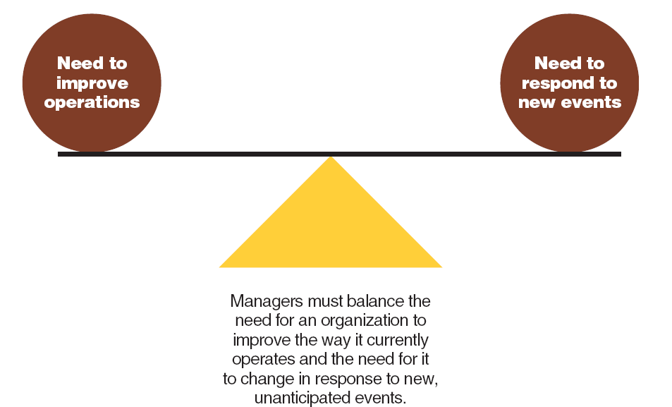
Organizational Control and Change
Figure 8.5

Slide 12
Organization Change
Organization Change
  Movement of an organization away from its present state and toward some desired future state to increase its efficiency and effectiveness

Slide 13
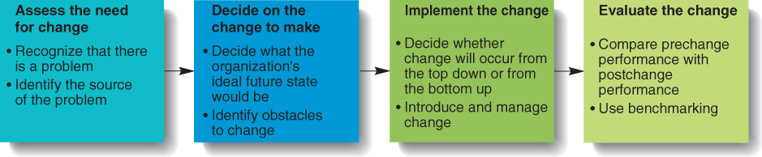
Four Steps in the
Organizational Change Process
Figure 8.6

Slide 14

Organization Change
Benchmarking
  Process of comparing one company’s performance on specific dimensions with the performance of other high performance organizations

Slide 15
Entrepreneurship, Control, and Change
Entrepreneurs
  People who notice opportunities and take responsibility for mobilizing the resources necessary to produce new and improved goods and services
Notes:
Entrepreneur Success
An entrepreneur must hire managers who can create an operating and control system that will let a new venture survive and prosper

