Slide 1
Motivation
Chapter Nine

Slide 2
Learning Objectives
LO9-1 Explain what motivation is and why managers need to be concerned about it
LO9-2 Describe from the perspectives of expectancy theory and equity theory what managers should do to have a highly motivated workforce
LO9-3 Explain how goals and needs motivate people and what kinds of goals are especially likely to result in high performance
LO9-4 Identify the motivation lessons that managers can learn from operant conditioning theory and social learning theory
LO9-5 Explain why and how managers can use pay as a major motivation tool

Slide 3

The Nature of Motivation
Motivation
  The psychological forces that determine the direction of a person’s behavior in an organization, a person’s level of effort, and a person’s level of
  persistence

Slide 4
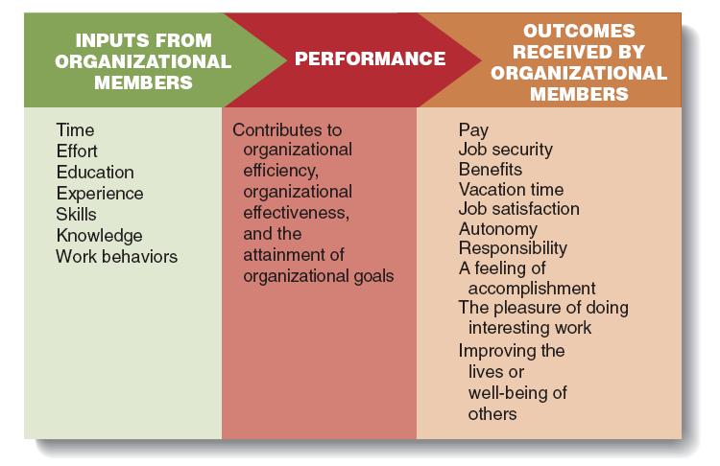
The Motivation Equation
Figure 9.1

Slide 5
Expectancy Theory
Expectancy theory
  The theory that motivation will be high when workers believe that high levels of effort lead to high performance and high performance leads to the attainment of desired outcomes.

Slide 6
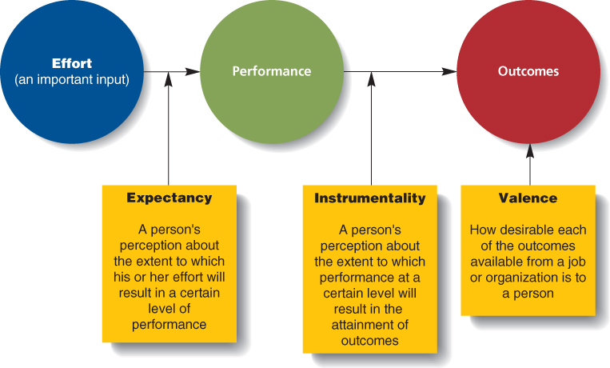
Expectancy, Instrumentality, and Valence
Figure 9.2

Slide 7
Need Theories
Need Theories
  Theories of motivation that focus on what needs people are trying to satisfy at work and what outcomes will satisfy those needs
  Basis premise is that people are motivated to obtain outcomes at work to satisfy their needs

Slide 8

McClelland’s Needs for Achievement, Affiliation, and Power
Need for Achievement
  A strong desire to perform challenging tasks well and meet personal standards for excellence

Slide 9
Equity Theory
Equity Theory
  A theory of motivation that focuses on people’s perceptions of the fairness of their work outcomes relative to their work inputs.
Notes:
A relative outcome to input ratio comparison to oneself or to another person (referent) perceived as similar to oneself.
Equity exists when a person perceives that their outcome/input ratio to be equal to the referent’s ratio.
If the referent receives more outcomes, they should also give more inputs to achieve equity.

Slide 10

Goal Setting Theory
Goal Setting Theory
  Focuses on identifying the types of goals that are effective in producing high levels of motivation and performance and explaining why goals have these effects
Notes:
Considers how managers can ensure that workers focus their inputs in the direction of high performance and the achievement of organizational goals.

Slide 11
Learning Theories
Learning Theories
  Theories that focus on increasing employee motivation and performance by linking the outcomes that employees receive to the performance of desired behaviors and the attainment of goals

Slide 12
Operant Conditioning Theory
Operant Conditioning
  People learn to perform behaviors that lead to desired consequences and learn not to perform behaviors that lead to undesired consequences.
Notes:
Linking specific behaviors to the attainment of specific outcomes can motivate high performance and prevent behaviors that detract from organizational effectiveness.

Slide 13

Social Learning Theory
Vicarious Learning
  Learning that occurs when a learner is motivated to perform a behavior by watching another person perform and be reinforced for doing so
  Also called Observational Learning
Notes:
People are motivated to imitate models who are highly competent, expert, receive attractive reinforcers, and are friendly or approachable.

Slide 14

Merit Pay and Performance
Merit Pay Plan
  A compensation plan that bases pay on performance

Slide 15
Salary Increase or Bonus?
Employee Stock Option
  A financial instrument that entitles the bearer to buy shares of an organization’s stock at a certain price during a certain period of time or under certain conditions.

