Slide 1
Leaders and
Leadership
Chapter Ten

Slide 2
Learning Objectives
LO10-1 Explain what leadership is, when leaders are effective and ineffective, and the sources of power that enable managers to be effective leaders.
LO10-2 Identify the traits that show the strongest relationship to leadership, the behaviors leaders engage in, and the limitations of the trait and behavioral models of leadership

Slide 3
Learning Objectives (cont.)
LO10-3 Explain how contingency models of leadership enhance our understanding of effective leadership and management in organizations
LO10-4 Describe what transformational leadership is, and explain how managers can engage in it
LO10-5 Characterize the relationship between gender and leadership and explain how emotional intelligence may contribute to leadership effectiveness.

Slide 4
The Nature of Leadership
Leadership
  The process by which a person exerts influence over other people and inspires, motivates and directs their activities to help achieve group or organizational goals
Notes:
Effective leadership increases the firm’s ability to meet new challenges.

Slide 5

The Nature of Leadership
Leader
  An individual who is able to exert influence over other people to help achieve group or organizational goals

Slide 6
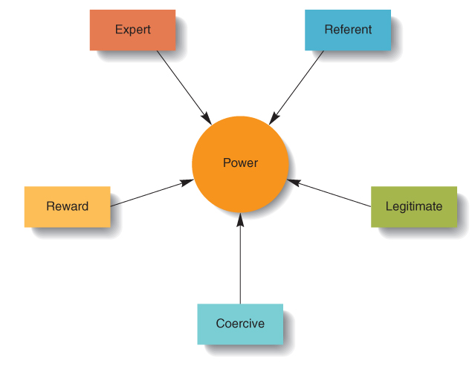
Sources of Managerial Power
Figure 10.1

Slide 7

Power: The Key to Leadership
Legitimate Power
  The authority that a manager has by virtue of his or her position in an organizational hierarchy
Reward Power
  The ability of a manager to give or withhold tangible and intangible
  rewards
Notes:
Legitimate Power
The authority that a manager has by virtue of his or her position in the firm.
Example: the power to hire or fire employees.
Reward Power
The ability of a manager to give or withhold tangible and intangible rewards.
Example: awarding pay raises or providing verbal praise for good performance.
Effective managers use reward power to signal to employees that they are doing a good job.

Slide 8
Power: The Key to Leadership
Coercive Power
  The ability of a manager to punish others
Expert Power
  Power that is based on special knowledge, skills, and expertise that a leader possesses
Notes:
Coercive Power
The ability of a manager to punish others.
Examples: verbal reprimand, pay cuts, and dismissal
Limited in effectiveness and application; can have serious negative side effects.
Expert Power
Power that is based on special knowledge, skills, and expertise that the leader possesses.
First-line and middle managers have the most expert power; most often consists of technical ability.

Slide 9
Empowerment: An Ingredient in Modern Management
Empowerment
  the process of giving employees at all levels the authority to make decisions, be responsible for their outcomes, improve quality, and cut costs

Slide 10
Leadership Models
Trait Model
  Focused on identifying personal characteristics that cause effective leadership.
  Many “traits” are the result of skills and knowledge and effective leaders do not necessarily possess all of these traits.
Notes:
Research shows that certain personal characteristics do appear to be connected to effective leadership.

Slide 11
The Behavior Model
Consideration
  behavior indicating that a manager trusts, respects, and cares about subordinates
Initiating structure
  behavior that managers engage in to ensure that work gets done, subordinates perform their jobs acceptably, and the organization is efficient and effective
Notes:
Behavioral Model
Consideration: employee-centered leadership behavior indicating that a manager trusts, respects, and cares about subordinates
Initiating structure: job-oriented leadership behavior that managers engage in to ensure that work gets done, subordinates perform their jobs acceptably, and the organization is efficient and effective.
Both behaviors are independent; managers can be high or low on both behaviors.

Slide 12
Contingency Models of Leadership
Fiedler’s Model
  Personal characteristics can influence leader effectiveness
  Leader style is the manager’s characteristic approach to leadership

Slide 13
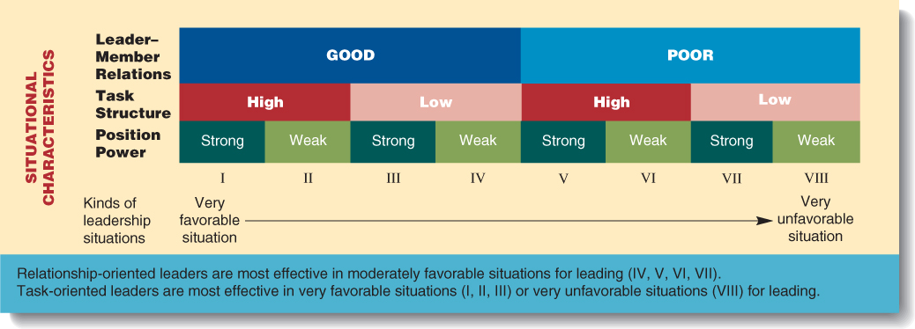
Fiedler’s Contingency Theory of Leadership
Figure 10.2

Slide 14

The Leader Substitutes Model
Leadership Substitute
  A characteristic of a subordinate or characteristic of a situation or context that acts in place of the influence of a leader and makes leadership unnecessary

Slide 15
Transformational Leadership
Transformational leadership
  Makes subordinates aware of the importance of their jobs and performance to the organization by providing feedback to the worker
  Makes subordinates aware of their own needs for personal growth and development
  Motivates workers to work for the good of the organization, not just themselves

