Slide 1
Effective Team Management
Chapter Eleven

Slide 2
Learning Objectives
LO11-1 Explain why groups and teams are key contributors to organizational effectiveness.
LO11-2 Identify the different types of groups and teams that help managers and organizations achieve their goals.
LO11-3 Explain how different elements of group dynamics influence the functioning and effectiveness of groups and teams.

Slide 3
Learning Objectives
LO11-4 Explain why it is important for groups and teams to have a balance of conformity and deviance and a moderate level of cohesiveness.
LO11-5 Describe how managers can motivate group members to achieve organizational goals and reduce social loafing in groups and teams.

Slide 4
Groups, Teams and
Organizational Effectiveness
Group
  Two or more people who interact with each other to accomplish certain goals or meet certain needs
Team
  A group whose members work intensely with each other to achieve a specific, common goal or objective
Notes:
Two characteristics that distinguish teams from groups are the intensity with which team members work together and the presence of a specific overriding team goal or objective

Slide 5
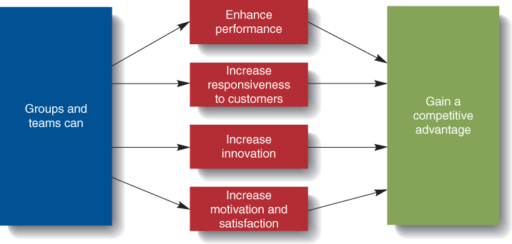
Groups’ and Teams’ Contributions to Organizational Effectiveness
Figure 11.1

Slide 6
Teams and Innovation
Innovation
  the creative development of new products, new technologies, new services, or even new organizational structures
To speed innovation, managers need to form teams in which each member brings some unique resource to the team
Notes:
Managers should empower the team and make it accountable for the innovation process.
Individuals rarely possess the wide variety of skills needed for successful innovation.
Team members can uncover each other’s flaws and balance each other’s strengths and weaknesses

Slide 7
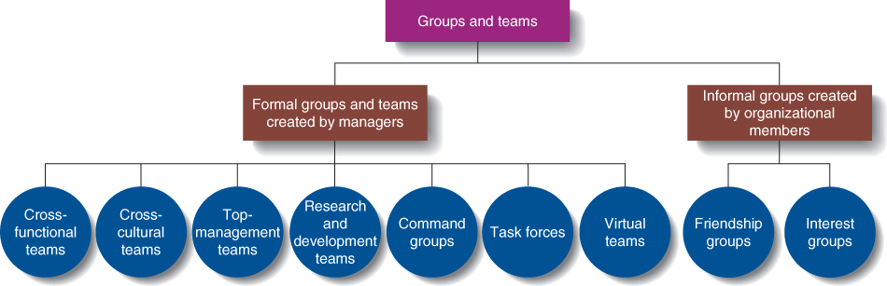
Types of Groups and Teams
Figure 11.2

Slide 8
Types of Groups and Teams
Self-Managed Work Team
  A group of employees who supervise their own activities and monitor the quality of the goods and services they provide
Notes:
Keys to effective self managed teams:
Give the team enough responsibility and autonomy to be self-managing.
The team’s task should be complex enough to include many different steps.
Select members carefully for their diversity, skills, and enthusiasm.
Keys to effective self managed teams:
Managers should guide and coach, not supervise.
Determine training needs and be sure it is provided.

Slide 9

Types of Groups and Teams
Friendship Groups
  An informal group composed of employees who enjoy one another’s company and socialize with one another

Slide 10
Group Roles
Group Role
  A set of behaviors and tasks that a group member is expected to perform because of his position in the group
Role making
  taking the initiative to modify an assigned role by assuming additional responsibilities
Notes:
In cross-functional teams, members are expected to perform roles in their specialty.
Managers should clearly describe expected roles to group members when they are assigned to the group.
Role-making occurs as workers take on more responsibility in their roles as group members.
Self-managed teams may assign the roles to members themselves.

Slide 11
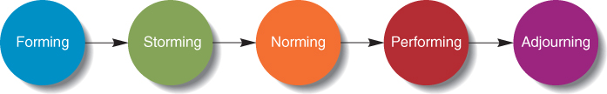
The Stages of Group Development
Figure 11.3

Slide 12

Group Norms
Group Norms
  Shared guidelines or rules for behavior that most group members follow

Slide 13
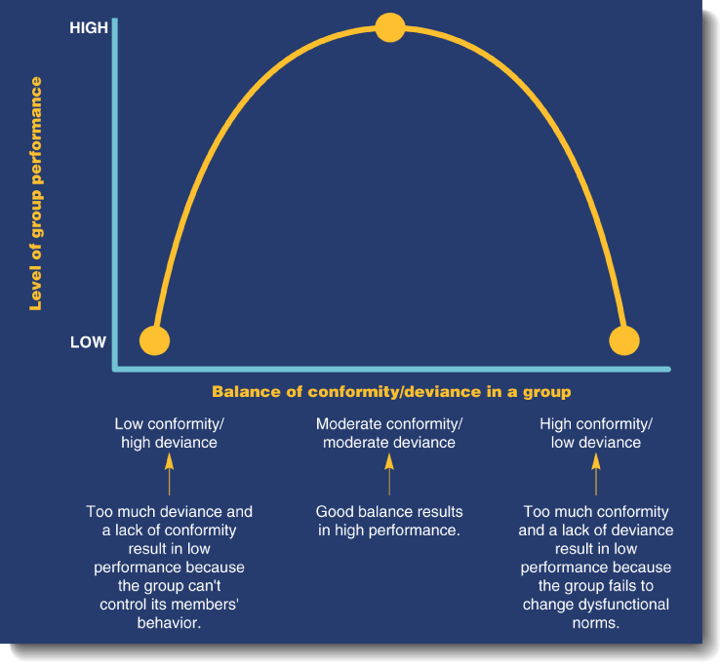
Balancing Conformity and
Deviance in Groups
Figure 11.4
Notes:
Conformity and Deviance
Members conform to norms to obtain rewards, imitate respected members, and because they feel the behavior is right.
Conformity and deviance must be balanced for high performance from the group.
Deviance allows for new ideas in the group.

Slide 14
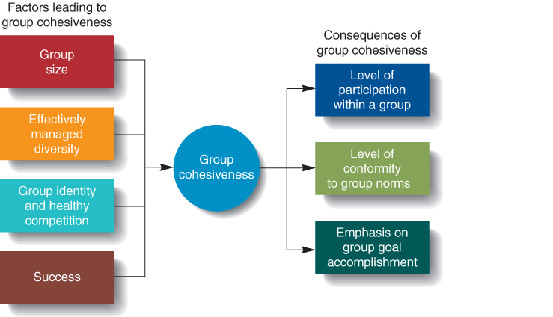
Sources and Consequences of
Group Cohesiveness
Figure 11.5

Slide 15

Managing Groups and Teams for High Performance
Social loafing
  The tendency of individuals to put forth less effort when they work in groups than when they work alone

