Slide 1
Building and Managing Human Resources
Chapter Twelve

Slide 2
Learning Objectives
LO12-1 Explain why strategic human resource management can help an organization gain a competitive advantage.
LO12-2 Describe the steps managers take to recruit and select organizational members.
LO12-3 Discuss the training and development options that ensure organization members can effectively perform their jobs.

Slide 3
Learning Objectives (cont.)
LO12-4 Explain why performance appraisal and feedback is such a crucial activity, and list the choices managers must make in designing effective performance appraisal and feedback procedures.
LO12-5 Explain the issues managers face in determining in determining levels of pay and benefits
LO12-6 Understand the role that labor relations play in the effective management of human resources

Slide 4

Strategic Human Resource Management
Human Resource Management (HRM)
  Activities that managers engage in to attract and retain employees and to ensure that they perform at a high
  level and contribute
  to the accomplishment
  of organizational goals.
Notes:
HRM activities
Recruitment and selection
Training and development
Performance appraisal and feedback
Pay and benefits
Labor relations

Slide 5
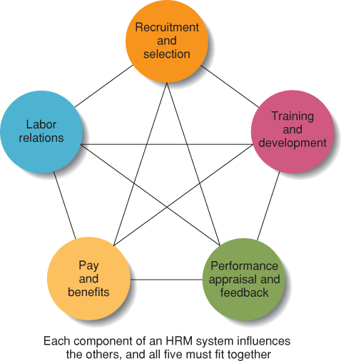
Components of a Human Resource Management System
Figure 12.1
Notes:
Recruitment and Selection
Used to attract and hire new employees who have the abilities, skills, and experiences that will help an organization achieve its goals.
Training and Development
Ensures that organizational members develop the skills and abilities that will enable them to perform their jobs effectively in the present and the future
Changes in technology and the environment require that organizational members learn new techniques and ways of working
Performance Appraisal and Feedback
Provides managers with the information they need to make good human resources decisions about how to train, motivate, and reward organizational members
Feedback from performance appraisal serves a developmental purpose for members of an organization
Pay and Benefits
Rewarding high performing organizational members with raises, bonuses and recognition.
Increased pay provides additional incentive.
Benefits, such as health insurance, reward membership in firm.
Labor relations
Steps that managers take to develop and maintain good working relationships with the labor unions that may represent their employees’ interests

Slide 6
Recruitment and Selection
Recruitment
  Activities that managers engage in to develop a pool of candidates for open positions.
Selection
  The process that managers use to determine the relative qualifications of job applicants and their potential for performing well in a particular job.

Slide 7

Human Resource Planning
Human Resource Planning (HRP)
  Activities that managers engage in to forecast their current and future needs for human resources.
  Demand, supply
  forecast
Notes:
Demand forecasts
Estimates the qualifications and numbers of employees the firm will need given its goals strategies.
Supply forecasts
Estimates the availability and qualifications of current employees now and in the future, as well as the supply of qualified workers in the external labor market.

Slide 8
Job Analysis
Job Analysis
  Identifying the tasks, duties and responsibilities that make up a job and the knowledge, skills, and abilities needed to perform the job.
  Should be done for each job in the organization.

Slide 9
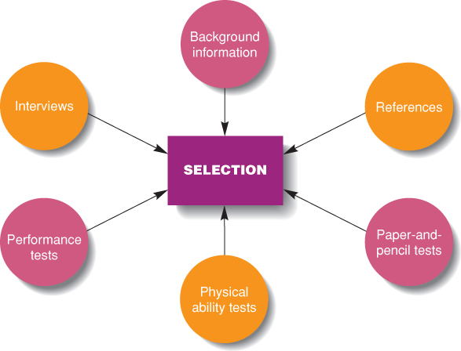
Selection Tools
Figure 12.3
Notes:
Background Information
Helpful to screen out applicants who are lacking key qualifications
Determine which qualified applicants are more promising than others
Interviews
Structured interviews where managers ask each applicant the same job-related questions.
Unstructured interviews that resemble normal conversations.
Usually structured interviews preferred; bias is possible in unstructured interviews.
Paper-and-Pencil Tests
Ability tests assess the extent to which applicants possess the skills necessary job performance
Managers must have sound evidence that the tests are good predictors of performance
Physical ability tests
Measures of dexterity, strength, and stamina for physically demanding jobs
Measures must be job related to avoid discrimination.
Performance tests
Tests that measure an applicant’s current ability to perform the job or part of the job such as requiring an applicant to take typing speed test.
Assessment centers are facilities where managerial candidates are assessed on job-related activities over a period of a few days.
References
Knowledgeable sources who know the applicants’ skills, abilities, and other personal characteristics
Many former employers are reluctant to provide negative information

Slide 10
Training and Development
Training
  Teaching organizational members how to perform current jobs and helping them to acquire the knowledge and skills they need to be effective performers.
Development
  Building the knowledge and skills of organizational members to enable them to take on new responsibilities and challenges.

Slide 11

Training and Development
Needs Assessment
  An assessment of which employees need training or development and what
  type of skills or knowledge
  they need to acquire.

Slide 12
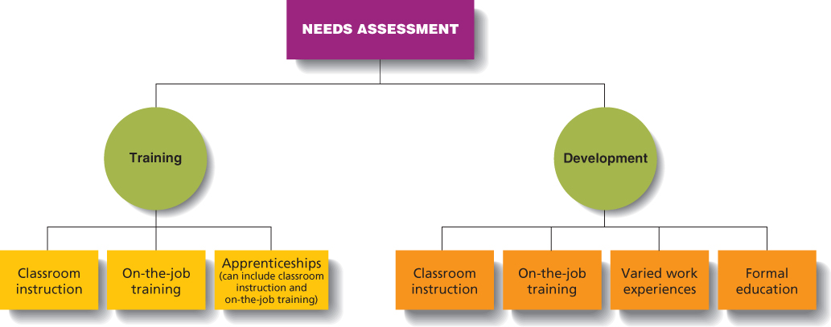
Training and Development
Figure 12.4
Notes:
Classroom Instruction
Employees acquire skills in a classroom setting.
Includes use of videos, role-playing, and simulations.
On-the-Job Training
Employee learning occurs in the work setting as new worker does the job.
Training is given by co-workers and can be done continuously to update the skills of current employees.
Varied Work Experiences
Top managers have need to and must build expertise in many areas.
Employees identified as possible top managers are assigned different tasks and a variety of positions in an organization.
Formal Education
Tuition reimbursement is common for managers taking classes for MBA or job-related degrees.
Long-distance learning can also be used to reduce travel and other expenses for managerial training.

Slide 13

Performance Appraisal and Feedback
Performance Appraisal
  The evaluation of employees’ job performance and contributions to their organization.
  Traits, behaviors, results
Notes:
Performance Feedback
The process through which managers share performance appraisal information, give subordinates an opportunity to reflect on their own performance, and develop with subordinates, plans for the future.
Trait Appraisals
Assessing subordinates on personal characteristics that are relevant to job performance.
Disadvantages of trait appraisals
Employees with a particular trait may choose not to use that particular trait on the job.
Traits and performance are not always obviously linked
It is difficult to give feedback on traits.
Behavior Appraisals
Assesses how workers perform their jobs—the actual actions and behaviors that exhibit on the job.
Focuses on what a worker does right and wrong and provides good feedback for employees to change their behaviors.
Results appraisals
Managers appraise performance by the results or the actual outcomes of work behaviors
Objective appraisals
Assesses performance based on facts (e.g., sales figures).
Subjective appraisals
Assessments based on a manager’s perceptions of traits, behavior, or results.
Graphic rating scales
Behaviorally anchored rating scales (BARS)
Behavior observation scales (BOS)
Forced ranking systems

Slide 14
Labor Relations
Labor Relations
  The activities managers engage in to ensure they have effective working relationships with the labor unions that represent their employees interests.
Notes:
Laws regulating areas of employment.
Fair Labor Standards Act (1938) prohibits child labor, sets a minimum wage and maximum working hours.
Equal Pay Act (1963) men and women doing equal work will get equal pay.
Work Place Safety (1970) OSHA mandates procedures for safe working conditions.

Slide 15

Unions
Collective bargaining
  Negotiation between labor and management to resolve conflicts and disputes about issues such as working hours, wages, benefits, working conditions, and
  job security.

