Slide 1
Communication and Information Technology Management
Chapter Thirteen

Slide 2
Learning Objectives
LO13-1 Differentiate between data and information, list the attributes of useful information, and describe three reasons why managers must have access to information to perform their tasks and roles effectively
LO13-2 Explain why effective communication-the sharing of information-helps an organization gain a competitive advantage and describe the communication process

Slide 3
Learning Objectives
LO13-3 Define information richness, and describe the information richness of communication media available to managers
LO13-4 Differentiate among four kinds of management information systems

Slide 4
Information and the Manager’s Job
Data
  Raw, unsummarized, and unanalyzed facts.
Information
  Data that is organized in a meaningful fashion
Notes:
2

Slide 5
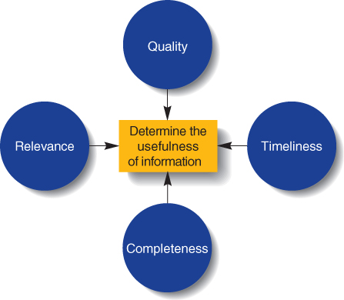
Factors Affecting the Usefulness of Information
Figure 13.1

Slide 6
Information Systems and Technology
Information Technology
  The set of methods or techniques for acquiring, organizing, storing, manipulating, and transmitting information
Management Information System
  A specific form of IT that managers utilize to generate the specific, detailed information they need to perform their roles effectively.

Slide 7

Communication, Information and Management
Communication
  The sharing of information between two or more individuals or groups to reach a common understanding.

Slide 8
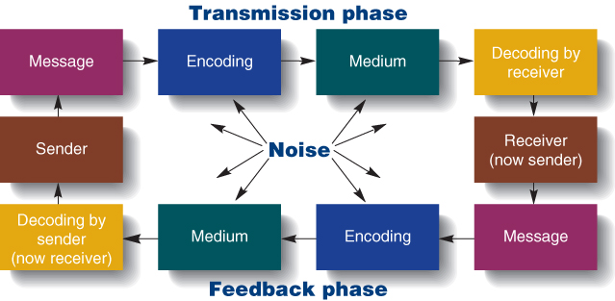
The Communication Process
Figure 13.2

Slide 9
Verbal & Nonverbal Communication
Verbal Communication
  The encoding of messages into words, either written or spoken
Nonverbal Communication
  The encoding of messages by means of facial expressions, body language, and styles of dress.

Slide 10
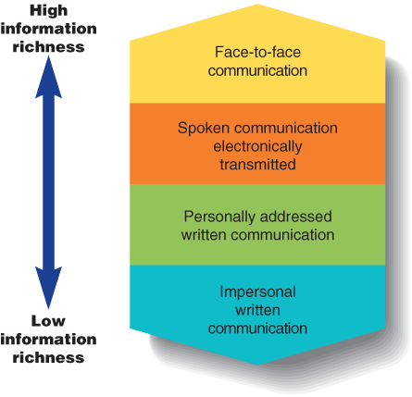
The Information Richness of Communication Media
Figure 13.3

Slide 11

Face-to-Face Communication
Management by Wandering Around
  Face-to-face communication technique in which a manager walks around a work area and talks informally with employees about issues and concerns

Slide 12
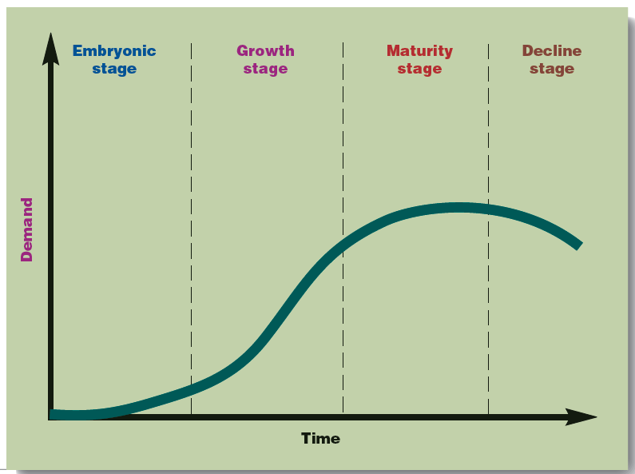
IT and the Product Life Cycle
Product life cycle
  The way demand for a product changes in a predictable pattern over time.
Figure 13.4
Notes:
6

Slide 13
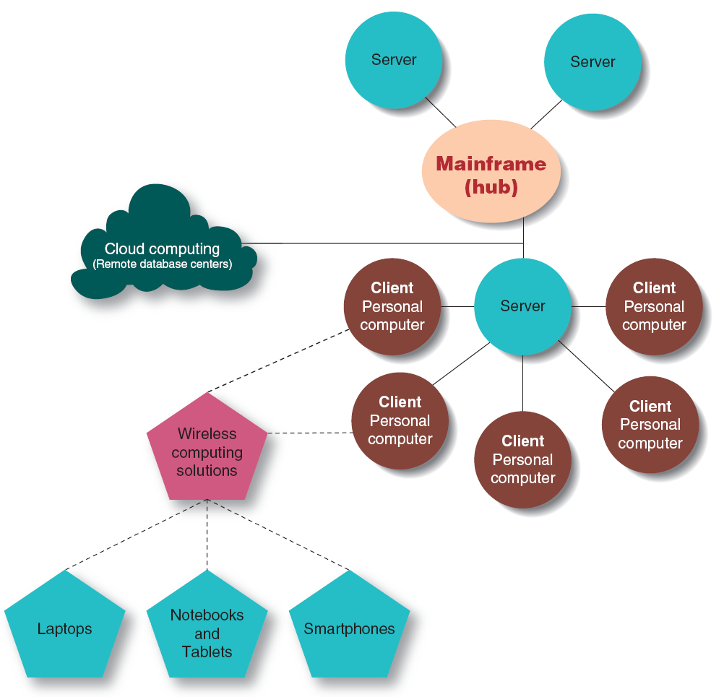
A Four-Tier Information System with Cloud Computing
Figure 13.5

Slide 14
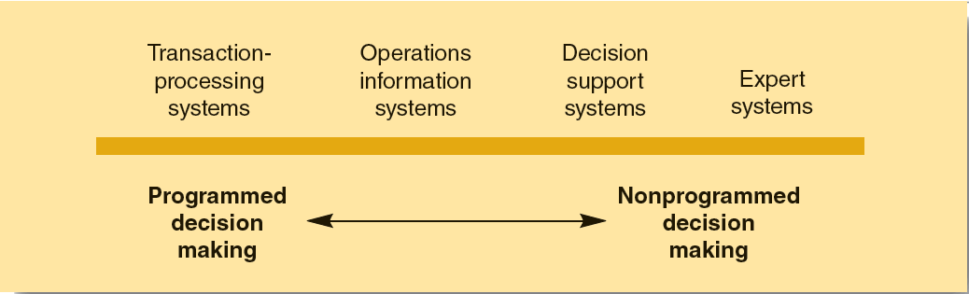
Four Computer-Based Management Information Systems
Figure 13.6

Slide 15

The Organizational Hierarchy
Information distortion
  changes in meaning that occur as information passes through a series of senders and receivers

