Slide 1
Operations Management:
Managing Vital Operations and Processes
Chapter Fourteen

Slide 2
Learning Objectives
LO14-1 Explain the role of operations management in achieving superior quality, efficiency, and responsiveness to customers.
LO14-2 Describe what customers want, and explain why it is so important for managers to be responsive to their needs.

Slide 3
Learning Objectives (cont.)
LO14-3 Explain why achieving superior quality in an organization’s operations and processes is so important.
LO14-4 Explain why achieving superior efficiency is so important.

Slide 4

Operations Management
Operations Management
  The management of any aspect of the production system that transforms inputs into finished goods and services

Slide 5
Operations Management
Production System
  The system that an organization uses to acquire inputs, convert inputs into outputs, and dispose of the outputs

Slide 6
Operations Management
Operations Manager
  Manager who is responsible for managing an organization’s production system and for determining where operating improvements might be made

Slide 7
Operations Management
Quality
  goods and services that are reliable, dependable, or psychologically satisfying
Efficiency
  amount of inputs required to produce a given output
Responsiveness to customers
  action taken to meet the demands and needs of customers

Slide 8
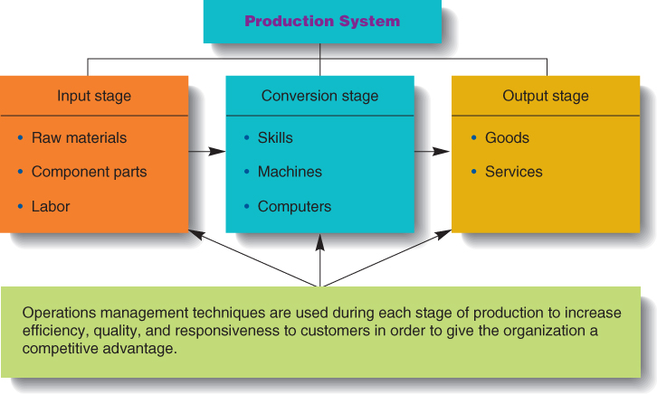
The Purpose of
Operations Management
Figure 14.1

Slide 9
Customer Relationship Management
Customer relationship management (CRM)
  technique that uses IT to develop an ongoing relationship with customers to maximize the value an organization can deliver to them over time

Slide 10
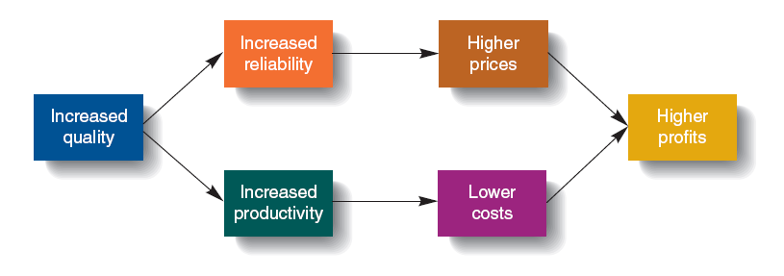
Impact of Increased Quality on
Organizational Performance
Figure 14.2

Slide 11
Facilities Layout, Flexible Manufacturing, and Efficiency
Flexible Manufacturing
  Operations management techniques that attempt to reduce the setup costs associated with a production system.
Notes:
16

Slide 12
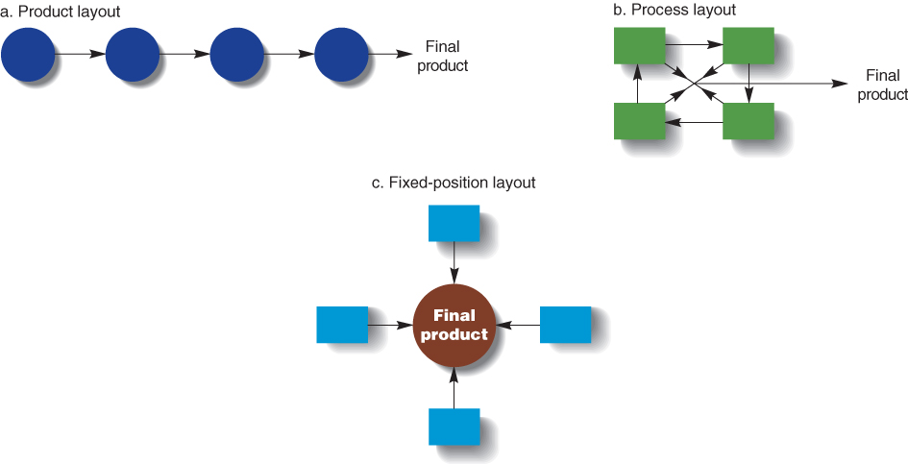
Three Facilities Layouts
Figure 14.3

Slide 13
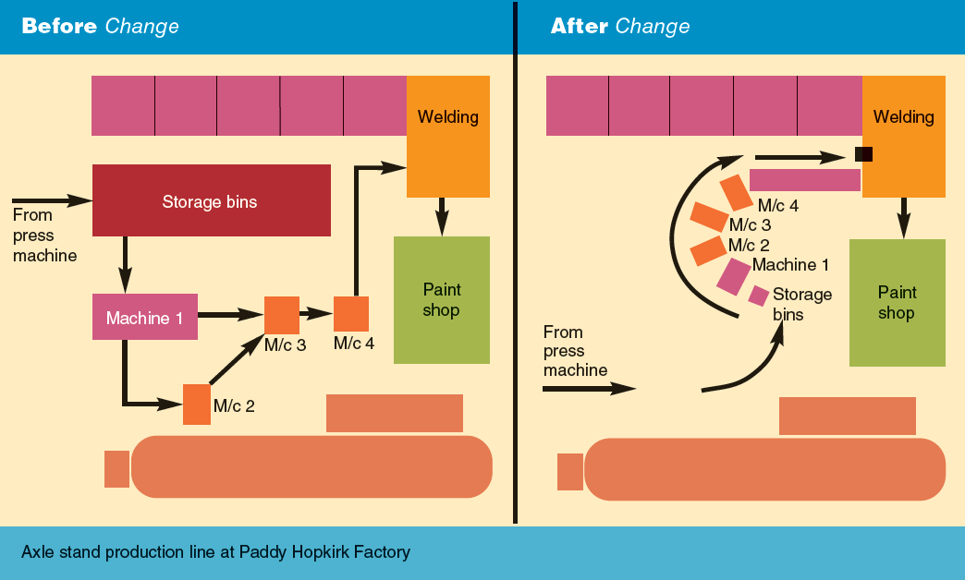
Changing a Facilities Layout
Figure 14.4

Slide 14

Just-in-Time Inventory and Efficiency
Inventory
  the stock of raw materials, inputs, and component parts that an organization has on hand at a particular time

Slide 15
Process Reengineering and Efficiency
Process Reengineering
  The fundamental rethinking and radical redesign of the business process to achieve dramatic improvement in critical measures of performance such as cost, quality, service, and speed

