Slide 1
Chapter 16
Scheduling
Copyright © 2015 McGraw-Hill Education. All rights reserved. No reproduction or distribution without the prior written consent of McGraw-Hill Education.

Slide 2
Chapter 16: Learning Objectives
You should be able to:
  LO 16.1 Explain what scheduling involves and the importance of good scheduling
  LO 16.2 Compare product and service scheduling hierarchies
  LO 16.3 Describe scheduling needs in high-volume systems
  LO 16.4 Describe scheduling needs in intermediate-volume systems
  LO 16.5 Describe scheduling needs in job shops
  LO 16.6 Use and interpret Gantt charts
  LO 16.7 Use the assignment method for loading
  LO 16.8 Give examples of commonly used priority rules
  LO 16.9 Discuss the Theory of Constraints and that approach to scheduling
  LO 16.10 Summarize some of the unique problems encountered in service systems, and describe some of the approaches used for scheduling service systems

Slide 3
Scheduling
Scheduling:
  Establishing the timing of the use of equipment, facilities and human activities in an organization
Effective scheduling can yield
    Cost savings
    Increases in productivity
    Other benefits
LO 16.1

Slide 4
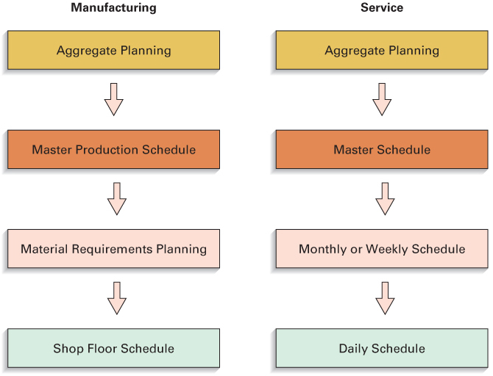
Scheduling Hierarchies
LO 16.2

Slide 5
High Volume Systems
Flow System
  High-volume system in which all jobs follow the same sequence
  Flow system scheduling
    Scheduling for flow systems
    The goal is to achieve a smooth rate of flow of goods or customers through the system in order to get high utilization of labor and equipment
Workstation 1
Workstation 2
Output
LO 16.3

Slide 6
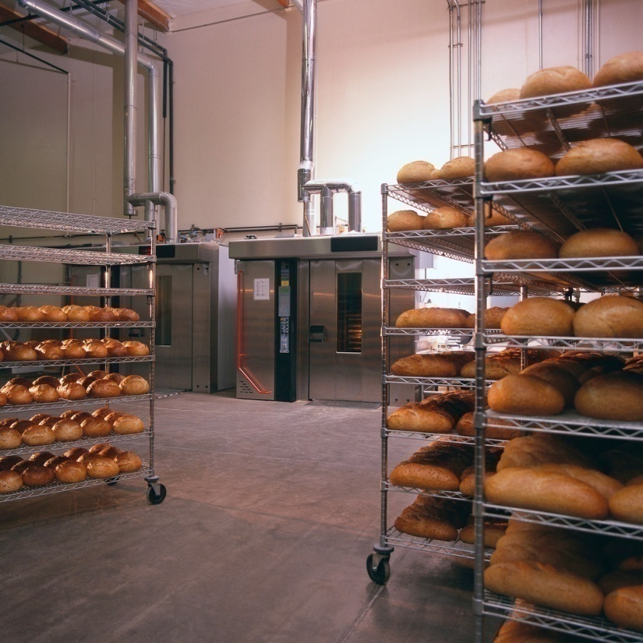
Intermediate-Volume Systems
Outputs fall between the standardized type of output of high-volume systems and the make-to-order output of job shops
Output rates are insufficient to warrant continuous production
  Rather, it is more economical
  to produce intermittently
    Work centers periodically
    shift from one product to
    another
LO 16.4

Slide 7

Low-Volume Systems
Job shop scheduling
  Scheduling for low-volume systems with many variations in requirements
    Make-to-order products
    Processing requirements
    Material requirements
    Processing time
    Processing sequence and setups
  A complex scheduling environment
    It is impossible to establish firm schedules until actual job orders are received
LO 16.5

Slide 8
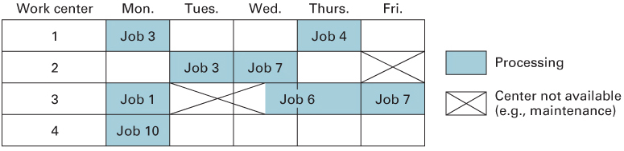
Gantt Charts
Load chart
  A Gantt chart that shows the loading and idle times for a group of machines or list of departments
LO 16.6

Slide 9
Hungarian Method
Row reduction: subtract the smallest number in each row from every number in the row
  Enter the result in a new table
Column reduction: subtract the smallest number in each column from every number in the column
  Enter the result in a new table
Test whether an optimum assignment can be made
  Determine the minimum number of lines needed to cross out all zeros
  If the number of lines equals the number of rows, an optimum assignment is possible. Go to step 6
  Else, go to step 4
LO 16.7

Slide 10
Hungarian Method (contd.)
If the number of lines is less than the number of rows, modify the table:
  Subtract the smallest number from every uncovered number in the table
  Add the smallest uncovered number to the numbers at intersections of cross-out lines
  Numbers crossed out but not at intersections of cross-out lines carry over unchanged to the next table
Repeat steps 3 and 4 until an optimal table is obtained
Make the assignments
  Begin with rows or columns with only one zero
  Match items that have zeros, using only one match for each row and each column
  Eliminate both the row and the column after the match
LO 16.7

Slide 11
Priority Rules
FCFS - first come, first served
SPT - shortest processing time
EDD - earliest due date
CR - critical ratio
S/O - slack per operation
Rush - emergency
LO 16.8

Slide 12

Theory of Constraints
Theory of constraints
  Production planning approach that emphasizes balancing flow throughout a system, and pursues a perpetual five-step improvement process centered around the system’s currently most restrictive constraint.
    Bottleneck operations limit system output
      Therefore, schedule bottleneck operations in a way that minimizes their idle times
    Drum-buffer-rope
      Drum = the schedule
      Buffer = potentially constraining resources outside of the bottleneck
      Rope = represents synchronizing the sequence of operations to ensure effective use of the bottleneck operations
LO 16.9

Slide 13
Theory of Constraints: Metrics
Three important theory of constraints metrics:
  Throughput
    The rate at which the system generates money through sales
  Inventory
    Inventory represents money tied up in goods and materials used in a process
  Operating expense
    All the money the system spends to convert inventory into throughput: this includes utilities, scrap, depreciation, and so on
LO 16.9

Slide 14

Service Operation Problems
Service scheduling often presents challenges not found in manufacturing
  These are primarily related to:
    The inability to store or inventory services
    The random nature of service requests
Service scheduling may involve scheduling:
  Customers
  Workforce
  Equipment
LO 16.10

Slide 15

Scheduling Service Operations
Scheduling customers: Demand Management
  Appointment systems
    Controls customer arrivals for service
  Reservation systems
    Enable service systems to formulate a fairly accurate estimate demand on the system for a given time period
Scheduling the workforce: Capacity Management
  Cyclical Scheduling
    Employees are assigned to work shifts or time slots, and have days off, on a repeating basis
LO 16.10

