Slide 1

Chapter Five
Program Design

Slide 2
Objectives (1)
Be able to choose and prepare a training site based on how trainees will be involved and interact with the content and each other in the course
Prepare for instruction using a curriculum road map, lesson plan, design document, and concept map
Explain how trainees’ age, generational differences, and personality might influence how programs are designed

Slide 3
Objectives (2)
Prepare a request for proposal (RFP) and a list of questions to evaluate training consultants and suppliers
Explain the program design elements that should be included to ensure near and far transfer of training
Develop a self-management module for a training program

Slide 4
Objectives (3)
Design application assignments and action plans to enhance learning and transfer of training
Make recommendations about what managers can do before, during, and after training to facilitate learning and transfer
Identify different ways to manage knowledge and the conditions necessary for employees to share knowledge

Slide 5
Importance of Program Design
Program design refers to the organization and coordination of training
Program design is the heart of effective training because it directly influences knowledge and skill acquisition
Programs must be carefully designed to ensure maximum learning

Slide 6
Three Phases of Design
Phase 1: Pre-Training
  Involves preparing and motivating trainees to attend training
Phase 2: The Learning Event
  Involves preparing instruction and the physical environment
Phase 3: Post-Training
  Designing strategies to facilitate transfer

Slide 7
The Training Site
Comfortable and accessible
Quiet, private, and free from interruptions
Sufficient space for trainees to move around easily, offers enough room for trainees to have adequate work space, and has good visibility

Slide 8
The Training Room
Create an environment conducive to learning—there are a number of details to consider
glare
ceiling
electrical outlets
acoustics
colors
room structure
lighting
wall & floor covering
chairs
noise
technology

Slide 9
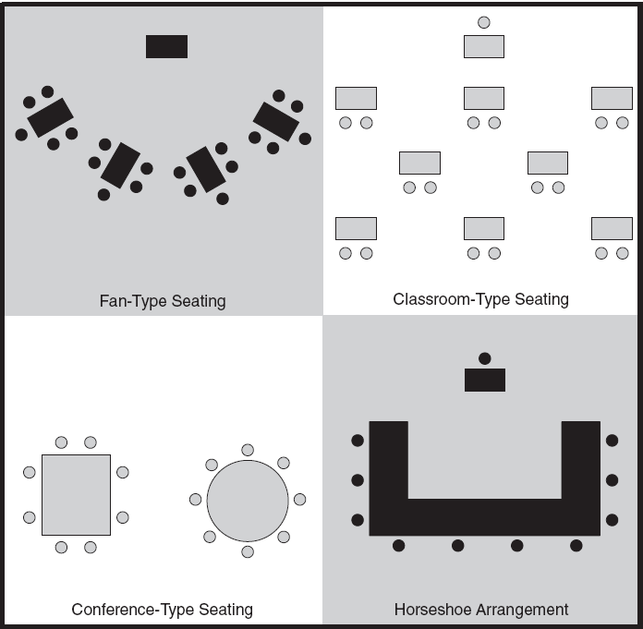
Seating Arrangements

Slide 10
When does each work? (1)
Fan-type seating
  trainees can easily switch from listening to practicing in groups
Classroom-type seating
  appropriate when lecture and audiovisual presentations are the primary methods

Slide 11
When does each work? (2)
Conference-type seating
  appropriate for total groups discussions (with no small group interaction)
Horseshoe type-seating
  appropriate for both presentation and total group instruction

Slide 12
Choosing Trainers
Trainers need to be both skilled in the subject matter at hand and in program facilitation
Given that trainers are central to learning experience, great care should be taken when selecting outside vendors

Slide 13
Create a Learning Setting
When choosing a training room, determine the extent to which trainees decide when, where, and how they will learn, and whether learning will occur by interaction with others

Slide 14
Preparation of Materials
Know content very well
Use mental and physical rehearsal to build your confidence and assess your strengths and areas for improvement
Observe master trainers to get new ideas
Design the training from the audience’s perspective—ask “So what?”

Slide 15
Adapt to Generational Differences (1)
Traditionalists prefer a standard training room, an orderly environment, and do not like being put on the spot
Baby Boomers prefer classroom learning, interactive activities, and materials that provide an overview and means to access more detailed information

Slide 16
Adapt to Generational Differences (2)
Generation Xers prefer a self-directed learning environment that includes technology-delivered methods
Millennials like to learn by working alone and helping others to learn; they prefer blended learning

Slide 17
Adapt to Generational Differences (3)
Nexters prefer entertaining training activities; they respond well to training that is interactive and creative
Because most groups include a mix of generations, provide a learning environment that can benefit all learners

Slide 18
Pre-Training Motivation
Communicate to trainees the purpose of the course, objectives, prerequisites, and who else will be attending
Assign pre-work to ensure trainees come to the program with a sense of focus and a basic understand of training content
Managers should encourage attendance and set expectations for learning

Slide 19
Provide an Overview
Give the big picture, including objectives, timeline, and activities, and assignments
A concept map can be used for organizing and presenting knowledge
  Includes concepts shown in boxes, with relationships between concepts indicated by connecting lines

Slide 20
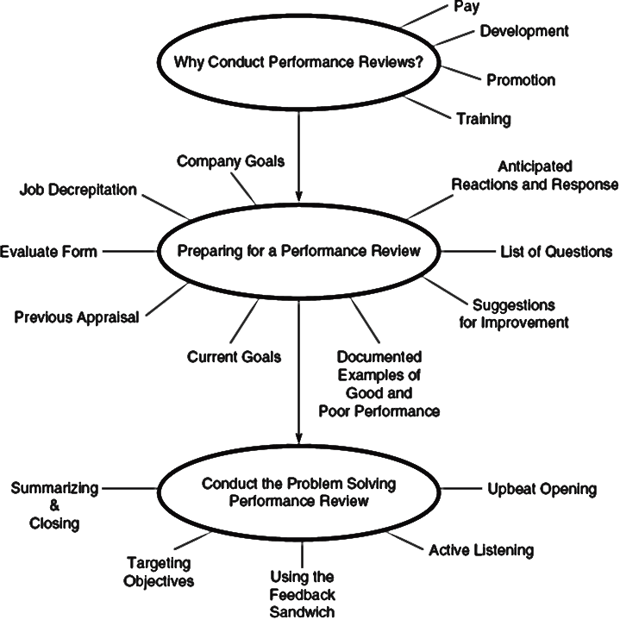
Example Concept Map
Notes:
This concept map is for a course on conducting effective performance reviews.

Slide 21
Help Trainees Retain & Recall Content
Chunk learning topics into short sessions of no longer than 20 minutes
Incorporate mnemonics and metaphors
Have trainees consider how they can use what they are learning
Incorporate application assignments

Slide 22
Classroom Management
Monitor the room for extra chairs, overflowing trash cans, and materials left from previous sessions
Why is doing this important? Why might trainers fail to do this?

Slide 23
Interacting with Trainees
Communicate topics to be covered, the learning approach, and expectations
Be cognizant of the self-fulling prophecy
Be dramatic to emphasize key points
To create intimacy in large rooms, move toward trainees
Facilitate discussions from different parts of the room

Slide 24
Getting Trainees Involved
Involvement is key to engaging trainees and facilitating learning
  Prepare questions to be discussed in breakout groups
  Use creative activities and games
  Use assessments for trainees to learn about themselves and others
  Incorporate roleplaying

Slide 25
Discussions
Discussions can be an effective means to engage trainees, but need to be planned
Discussions can be used to brainstorm ideas and solutions, debrief activities, apply knowledge, and evaluate experiences
Use open-ended questions, different opening questions, follow-up questions, and discussion prompts

Slide 26
Disruptive Trainees
Disruptions should be managed, not ignored
Address disruptions tactfully
For trainees who disrupt, sleep, or interrupt, consider using activities to engage them
Ask disruptive trainees to leave as a last resort

Slide 27
Managing Group Dynamics
To ensure an even distribution of expertise, ask trainees to indicate whether they consider themselves novice, experienced, or expert
Arrange groups with individuals of different expertise
Group dynamics can be altered by changing learners’ positions in the room

Slide 28
Curriculum, Course, & Lesson Design
A curriculum refers to an organized program of study designed to meet a complex learning objective
A course or program covers more specific learning objectives and addresses a more limited number of competencies

Slide 29
Curriculum Road Map (1)
A curriculum road map refers to a figure that shows:
  all of the courses in a curriculum
  paths that learners can take through it
  sequences in which courses have to be completed

Slide 30
Curriculum Road Map (2)
Design document
  outlines scope of project, delivery methods, and objectives
  used to guide development and explain training to relevant stakeholders
Lesson plan
  translates content and activities into a guide to help deliver training
  includes the sequence of activities that will be conducted

Slide 31
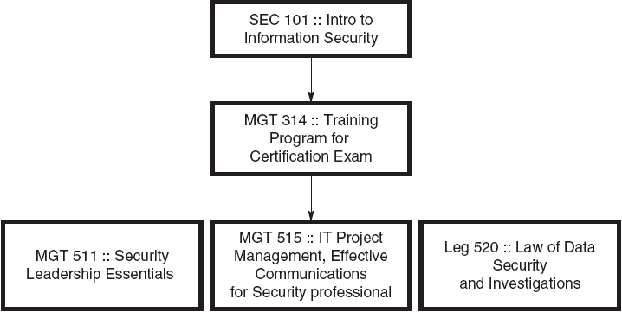
Example Curriculum Road Map
Notes:
An example of a curriculum road map for a security management training curriculum.

Slide 32
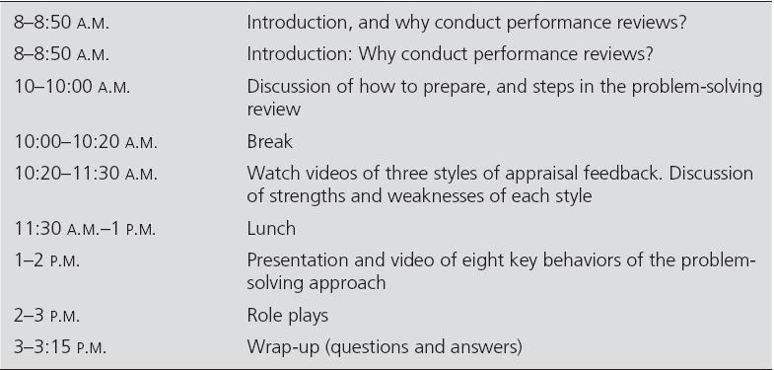
Example Lesson Plan

Slide 33
Request for Proposal
A request for proposal (RFP) is a document that outlines for potential vendors:
  type of service the company is seeking
  type of references needed
  number of employees to be trained
  funding for the project
  follow-up process to determine level of satisfaction and service
  expected date of project completion

Slide 34
Near or Far Transfer?
One key consideration is whether the focus of training is on near or far transfer
Near transfer refers to applying learned capabilities exactly as taught in training
Far transfer refers to applying learned capabilities to a work environment that is not identical to training

Slide 35
Promoting Near Transfer
Use standardized procedures, processes, and checklists
Provide explanations for any differences between training and work tasks
Encourage trainees to focus only on important differences between training tasks and work tasks
Explain why the procedure should be performed exactly

Slide 36
Promoting Far Transfer
Teach general concepts, broad principles, and key behaviors
Focus on general principles that apply to a number of situations
Provide a list of prompts and questions to help trigger self-reflection and questions

Slide 37
Self-Management Training
To prepare trainees for obstacles on the job, provide instruction in self-management
  Discuss relapses
  Set transfer and performance goals
  Identify obstacles
  Generate strategies to overcome obstacles
  Self administer rewards for successful transfer

Slide 38
Manager Support
Increasing levels of manager support, from low to high, include:
  acceptance of training
  encouragement of training
  participating in training
  reinforcement
  allowing trainees to practice
  teaching—serving as a trainer

Slide 39
Peer Support
Transfer can be enhanced by a support network among trainees
Peers can share successful experiences, discuss how they coped with challenges, and provide encouragement and feedback

Slide 40
Opportunities to Use
Opportunity to use learned capabilities is central to successful transfer
Opportunity is influenced by the work environment and trainee motivation
Opportunity can be measured by asking former trainees:
  whether they perform a task
  how many times they perform the task
  the extent to which they perform difficult and challenging tasks

Slide 41
Technological Support
An electronic performance support system (EPSS) is a ccomputer application that provides skills training, information access, and expert advice
An EPSS can enhance transfer by acting as an as-needed reference resource
An EPSS can help measure and evaluate transfer

Slide 42
Knowledge Management
The process of enhancing company performance by designing and implementing tools, processes, systems, structures, and cultures to improve the creation, sharing, and use of knowledge

Slide 43
Knowledge Management Strategies (1)
Use technology, e-mail, and social networking sites to allow people to store and share
Publish directories of expertise
Develop informational maps that identify where specific knowledge is stored in the company
Create top management knowledge management positions

Slide 44
Knowledge Management Strategies (2)
Require employees to give presentations
Allow employees to take time off to acquire new knowledge
Create an online library of learning resources
Design office space to facilitate interaction
Create communities of practice

Slide 45
Keys to Knowledge Management Success
The training and IT departments must collaborate
Technology must be easy to use and not cumbersome
There must be employee trust and a willingness to share

