Slide 1

Chapter Two
Strategic Training

Slide 2
Objectives
Discuss how business strategy influences the type and amount of training in a company
Describe the strategic training and development process
Discuss how a company’s staffing and human resource planning strategies influence training

Slide 3
Objectives
Explain the training needs created by concentration, internal growth, external growth, and disinvestment business strategies
Discuss the advantages and disadvantages of centralizing the training function
Explain a corporate university and its benefits

Slide 4
Objectives
Discuss the strengths of a business-embedded learning function
Discuss how to create a learning or training brand and why it is important
Develop a marketing campaign for a training course or program

Slide 5
Training is Strategic
Training can have both a direct an indirect impact on organizational success
Business strategy will shape the training function
  Strategic impacts what gets trained, who gets training, and how much training is valued
The role of training is evolving

Slide 6
The Learning Organization
A company that has:
  an enhanced capacity to learn, adapt, and change
  carefully scrutinized and aligned training processes with company goals
  training as a part of a system designed to create human capital

Slide 7
4 Steps of Strategic Training
Identify the organization’s business strategy
Determine strategic training initiatives
Translate initiatives into concrete learning activities
Identify metrics and evaluate

Slide 8
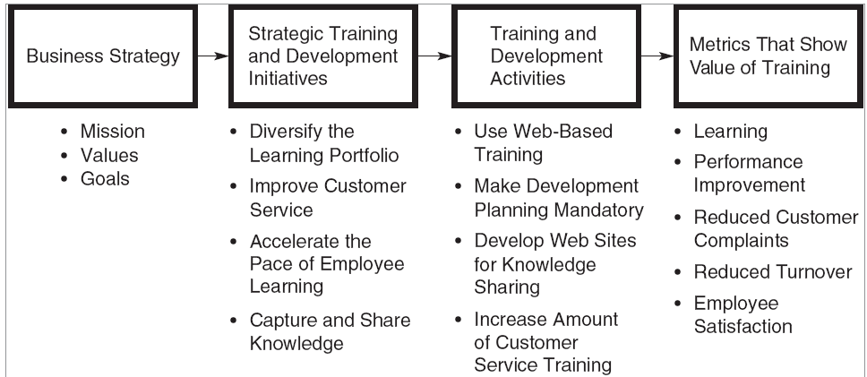
The Strategic Process

Slide 9
1. Identify Business Strategy
Determine the company’s mission
Establish goals
Perform a SWOT—strengths, opportunities, weakness, and threats
Determine strategic choice

Slide 10
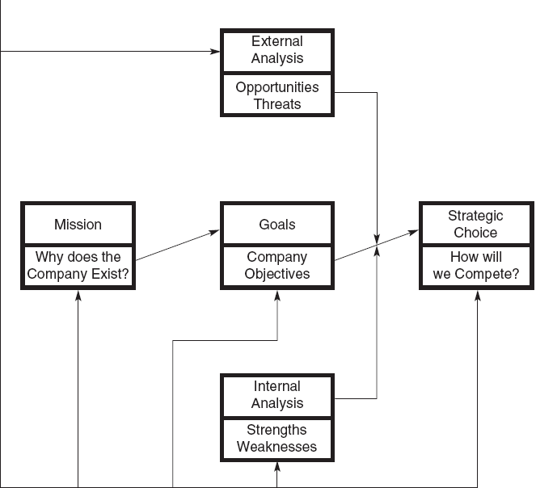
Formulating Business Strategy

Slide 11
2. Determine Strategic Initiatives
Learning-related actions that a company should take to achieve its business strategy
A road map to guide specific training activities
Avoid the disconnect between strategy and execution

Slide 12
Common Strategic Initiatives
Diversify the learning portfolio
Expand who is trained
Accelerate the pace of learning
Improve customer service
Capture and share knowledge
Ensure the work environment supports learning and transfer of training
Notes:
Note: Not all of the initiatives in the text are on the slide.

Slide 13
Questions to Ask
What is the vision and mission?
What capabilities are critical for success?
What types of training will best attract, develop, and retain employees?
Is there a plan to communicate the link between training and strategy?
Does senior management support training?
Notes:
Note: Not all of the questions in the text are on the slide.

Slide 14
3. Translate Initiatives to Activities
The next step is to determine specific, concrete activities that align with strategic initiatives
Such activities will vary based on the initiatives that were developed

Slide 15
4. Identify Metrics & Evaluate
The final step is to determine if training investments were successful
Strategic training evaluation is not intended to evaluate the effectiveness of an isolated program, but a set of training activities
The business-related outcomes examined should be directly linked to strategy and goals

Slide 16
Balanced Scorecard
Customer (time, quality, performance, service, cost)
Internal business processes (processes that influence customer satisfaction)
Innovation and learning (operating efficiency, employee satisfaction, continuous improvement)
Financial (profitability, growth, shareholder value)

Slide 17
Organizational Characteristics
Roles of employees and managers
Top management support
Integration of business units
Global presence
Business conditions
Other HRM practices
Strategic value of jobs and employee uniqueness
Unionization
Staff involvement

Slide 18
Roles of Employees & Managers
Employees now performing roles once reserved for management
Given the prevalence of teams, employees require more cross-training and interpersonal skills training
Managers’ jobs are highly complex, requiring greater skill and training

Slide 19
Top Management Support
Set a clear direction for learning
Provide encouragement and resources
Take an active role in governing learning
Develop and teach new programs
Serve as a role model
Promote learning through different channels

Slide 20
Integration of Business Units
Integration of business units affects the approach to training
In a highly integrated business, employees need to understand all parts of the company, and training must address those needs

Slide 21
Global Presence
For companies with global operations, training is needed to prepare employees for overseas assignments
Companies must decide if training will be coordinated through a central U.S. facility or through satellite locations

Slide 22
Business Conditions
With low unemployment, it’s difficult to find top talent
In unstable environments, training may become short-term
When there is growth, training will be in high demand

Slide 23
Business Conditions
When trying to revitalize and redirect, there are fewer incentives for training
When downsizing, training may focus on continued employability

Slide 24
Staffing Strategy & Training
Fortress—limited resources for training; recruit from the outside
Baseball team—creativity needed; recruit from other companies or new graduates
Club—highly regulated industries; develop own talent
Academy—specialized skills; heavy focus on developing employees

Slide 25
Strategic Value & Uniqueness
Knowledge-based workers—heavy training
Job-based employees—less training than knowledge workers
Contract employees—limited training
Alliance/partnerships—sharing expertise and team training

Slide 26
Extent of Unionization
Presence of a union leads to joint union-management programs for preparing employees for jobs
Given that unions have a significant impact on HRM practices, they must be involved in determining strategic training priorities
Collaboration is key

Slide 27
Staff Involvement
Managers need to be involved so training links to business needs and transfer can be supported
Managers will be more involved if they are rewarded for doing so
+
Employees now assume greater responsibility for planning their own development

Slide 28
Training in Different Strategies
Concentration Strategy
  Skill currency and the development of the existing workforce
Internal Growth Strategy
  Creation of new jobs and tasks, innovation, and talent management

Slide 29
Training in Different Strategies
External Growth Strategy
  Integration, redundancy, and restructuring
Disinvestment Strategy
  Efficiency

Slide 30
Centralized Training
There are several advantages:
  Stronger alignment with strategy
  Common set of metrics or scorecards to evaluate training
  Streamlined processes
  Better integration of programs to develop leaders
  Easier to manage talent during times of change

Slide 31
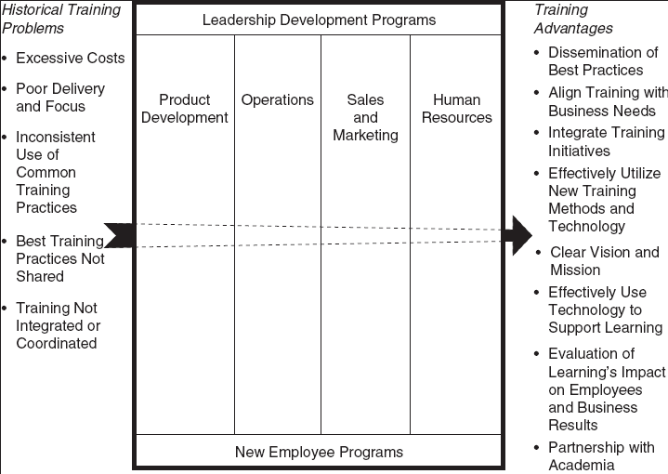
Corporate University Model

Slide 32
Corporate University Model
There are several advantages :
  Dissemination of best practices
  Alignment of training with business needs
  Integration of training initiatives
  Effective use of new technology and methods
  Clear vision and mission
  Evaluation of learning focused on employee and business results
  Partnership with academia

Slide 33
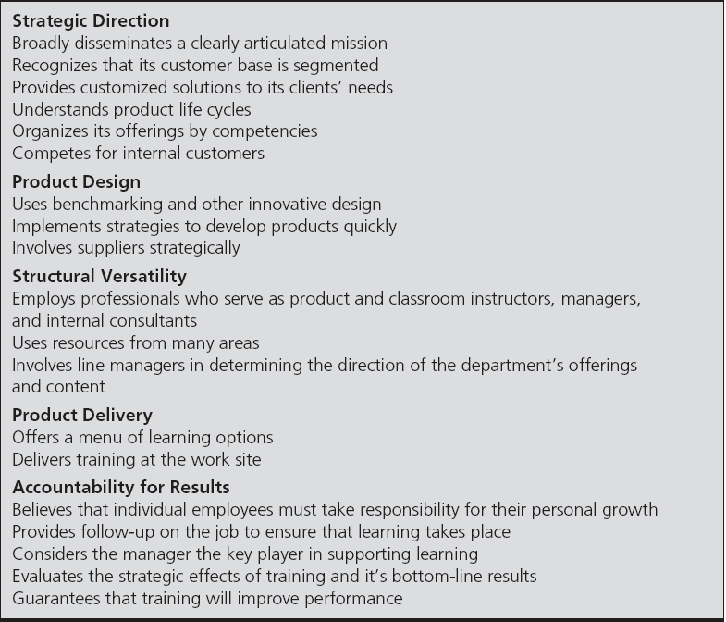
Business-Embedded Function

Slide 34
Change Model Perspective
Four change-related problems need to be addressed before the implementation of any new training practice.
  Resistance to change
  Loss of control
  Power imbalance
  Task redefinition challenges

Slide 35
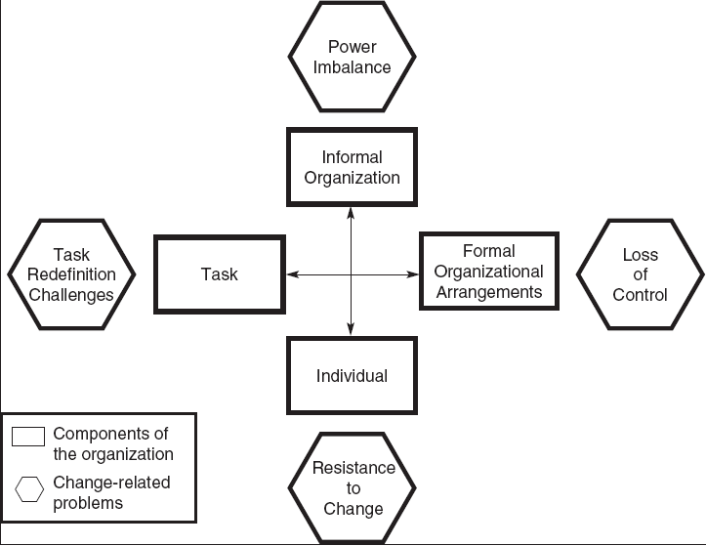
A Change Model

Slide 36
Marketing Training
Despite its value, some individuals may not necessarily value training
Training often needs to be marketed so key constituents value learning
Internal marketing involves making employees and managers excited about training and learning

Slide 37
Internal Marketing Tactics
Involve the target audience
Demonstrate how training can solve business problems
Show examples of previous successes
Identify a “champion” who supports training
Advertise through multiple channels
Speak in terms employees understand
Notes:
Note: Not all of the tactics from the text are presented on the slide.

Slide 38
Outsourcing Training
Reasons for outsourcing:
  Cost savings
  Time savings that allow a company to focus on business strategy
  Improvements in compliance with regulatory training
  Lack of internal capability to meet learning demands
  Desire to access best training practices

Slide 39
Be Strategic
Outsourcing may not necessarily be the solution
Be sure to consider:
  the skill set in question
  resources and expertise
  desire for control
  the quality of the potential vendor
  the importance of training in the organization

