Slide 1

Chapter Six
Training Evaluation

Slide 2
Objectives
Explain why evaluation is important
Identify and choose outcomes to evaluate a training program
Discuss the process used to plan and implement a good training evaluation
Discuss the strengths and weaknesses of different evaluation designs

Slide 3
Objectives
Choose the appropriate evaluation design based on the characteristics of the company and the importance and purpose of the training
Conduct a cost-benefit analysis for a training program
Explain the role of workforce analytics and dashboards in determining the value of training practices

Slide 4
Key Terms
Training effectiveness: benefits derived training
Training evaluation: process of determining training effectiveness
Training outcomes: measures to evaluate training effectiveness
Evaluation design: data will be collected and which data will be collected for training evaluation

Slide 5
Formative Evaluation
Refers to evaluation of training that takes place during program design
Helps to ensure training is well organized, runs smoothly, and that trainees learn and are satisfied
Provides information on how to make a program better

Slide 6
Summative Evaluation
Refers to evaluation conducted to determine if training has lead to desirable outcomes
Examines whether trainees have improved or acquired knowledge, skills, attitudes, behaviors, or other outcomes
Includes examining the business impact of training

Slide 7
Importance of Evaluation
There are multiple reasons to evaluate:
  identify a program’s strengths and weaknesses
  assess what features of training content and context matter
  identify which trainees benefited
  gather information for marketing training
  determine financial benefits and costs

Slide 8
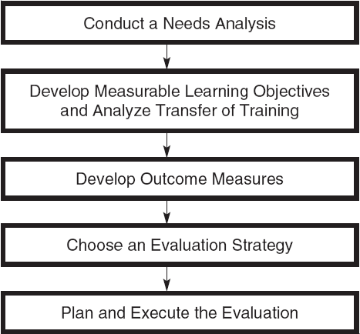
The Evaluation Process

Slide 9
Training Outcomes
Results
Learning & Cognitive Outcomes
Behavior & Skill-Based Outcomes
Affective Outcomes
Reactions
Return on Investment

Slide 10
Reactions
Trainees’ perceptions of the training experience relating to the content, facilities, trainer, and methods
Key questions to consider include:
  Did the trainees like the program?
  Did the environment help learning?
  Was the material meaningful?
Typically measured at the end of training

Slide 11
Learning & Cognitive Outcomes
Relate to familiarity with information, including principles, facts, techniques, procedures, and processes
Typically measured via paper-and-pencil tests and self-assessments
Tests often preferred over self-assessments

Slide 12
Behavior & Skill-Based Outcomes
Relate to proficiency with technical skills, motor skills, and behavior
Include learning and transfer
Learning often assessed via work samples
Transfer often assessed via observation or managerial/peer ratings

Slide 13
Affective Outcomes
Include attitudes and motivation
  e.g., self-efficacy, employee engagement, motivation to learn, tolerance for diversity, attitudes toward safety
The attitude of interest depends on the training objectives
Affective outcomes often measured via surveys

Slide 14
Results
Did training have an impact on meaningful business outcomes?
Outcomes used to determine the benefits of training to the company
  e.g., reduced costs, increased employee retention, increased sales, improved quality or customer service

Slide 15
Return on Investment
Involves comparing the training program's benefits to its costs in monetary terms
  Benefits: value the company gains
  Direct costs: salaries for employees involved in training, program materials, facilities, and travel
  Indirect costs: costs not related directly to design and delivery

Slide 16
Which Outcomes?
Relevance
Reliability
Discrimination
Practicality

Slide 17
Relevance
The extent to which training outcomes are related to the learned capabilities emphasized in the program
Contamination refers to the inclusion of inappropriate or irrelevant outcomes
Deficiency refers to the omission of important information

Slide 18
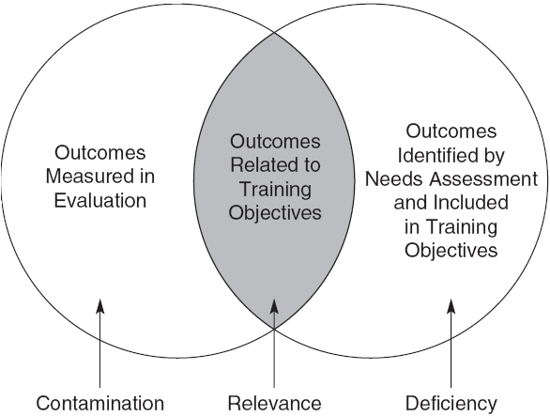
Deficiency, Relevance, & Contamination

Slide 19
Reliability
The extent to which outcomes can be measured consistently over time
Evaluators are concerned with consistency over time, such that items do not change in meaning or interpretation over time

Slide 20
Discrimination
The extent to which measured performance reflects a true difference
We want tests that discriminate between high and low performance
  A test that is too easy may not discriminate
  In this instance, both high and low performers would do well and appear “good” even though they are not

Slide 21
Practicality
The extent to which outcomes can be easily measured and collected
Companies often claim that measurement is too burdensome

Slide 22
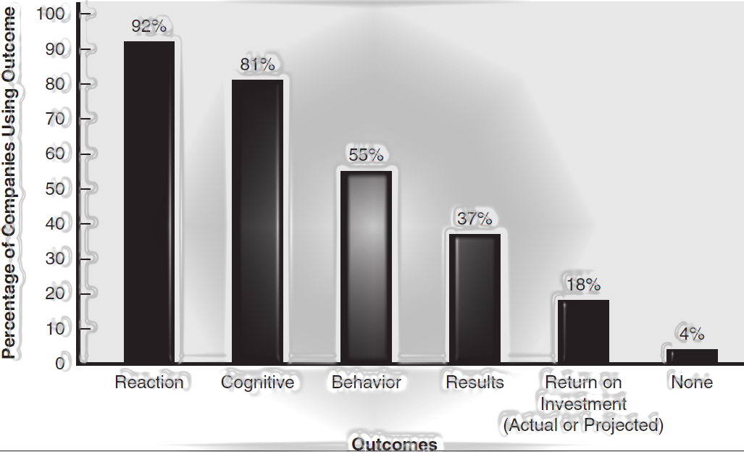
Training Evaluation Practices

Slide 23
Which Outcomes?
While collecting data on all outcomes is ideal, it may not always be necessary
Consider the scope of the training and practical considerations
Do not assume that positive reactions lead to transfer

Slide 24
Threats to Validity
Threats to validity refer to factors that will lead an evaluator to question the results
Internal validity is the believability of the study
External validity is the generalizability of the evaluation results to other groups and situations

Slide 25
Controlling for Threats
There are three ways to control for threats:
  Use pre-tests and post-tests
  Use a control group
  Random assignment of employees to control and training groups

Slide 26
Post-test Only
Involves collecting only post-training outcomes
Appropriate when trainees can be expected to have similar levels of proficiency prior to training
Strengthened with a control group

Slide 27
Pre-test / Post-test
Involves collecting both pre-training and post-training outcomes to determine if a change has occurred
Is there a difference in outcomes before and after training?

Slide 28
Pre-test / Post-test with Comparison Group
Includes pre-training and post-training outcomes and use of a control group
If the post-training improvement is greater for the training group, there is evidence that training was responsible

Slide 29
Time Series
Involves collecting measures at periodic intervals pre- and post-training
A comparison group may be used
The strength of this design can be improved by using reversal, which refers to a time period when participants no longer receive training

Slide 30
Solomon Four-Group
Combines the pre-test/post-test comparison group design and the posttest-only control group design
  Pre-test, treatment, post-test
  Pre-test, no treatment, post-test
  No pre-test, treatment, post-test
  No pre-test, no treatment, post-test

Slide 31
When Evaluation May Not Be Necessary
Time constraints
Managers and trainees may lack expertise
The company may view training as an investment from which it expects little or no return

Slide 32
When Evaluation is a Must
The training is ongoing and has the potential to affect many employees
The training program involves multiple classes and a large number of trainees
The expertise exists to evaluate
The cost of training is significant
There is sufficient time and interest
Notes:
Note: Not all reasons from the text are listed.

Slide 33
Cost-Benefit Analysis
Companies may desire to quantify whether the benefits of training outweigh the costs
Cost-benefit analysis
  Process of determining the economic impact of training using accounting methods that look at training costs and benefits

Slide 34
Cost Categories
program development or purchase
instructional materials
equipment and hardware
facilities
travel and lodging
salary of the trainer and support staff
cost of lost productivity or replacement workers while trainees are away

Slide 35
Determining Benefits
A number of methods can be used to identify benefits
  literature that summarizes benefits
  pilot training programs
  observing successful job performers asking trainees and managers for estimates

Slide 36
Calculating Return on Investment (ROI)
Identify annual change in outcomes
Place a monetary value on the outcomes
Determine the annual change in value
Determine training costs
Calculate net benefit
Divide net benefits by costs

Slide 37
Utility Analysis
Assessing the dollar value of training based on:
  estimates of the difference in performance between trained and untrained employees
  number of individuals trained
  length of time training is expected to influence performance
  variability in performance in the untrained group of employees

Slide 38
Success Cases & Return on Expectations
Success cases refer to concrete examples showing how learning has led to results the company finds worthwhile and credible
Return on expectations (ROE) demonstrates to key stakeholders that their expectations about training have been satisfied

Slide 39
Big Data
Big data refer to complex datasets compiled across different systems, including marketing, sales, HR, finance, accounting, customer service, and operations
Three dimensions characterize big data
  volume
  variety
  velocity

Slide 40
Big Data & Training
Big data help make decisions about human capital based on data, rather than intuition and conventional wisdom
Big data can be used to:
  evaluate the effectiveness of programs
  determine their impact on business results
  develop predictive models for forecasting training needs, course enrollments, and outcomes

