Slide 1

Chapter Seven
Traditional Training Methods

Slide 2
Objectives
Discuss the strengths and weaknesses of presentational, hands-on, and group building training methods
Provide recommendations for effective on-the-job training (OJT)
Develop a case study
Develop a self-directed learning module

Slide 3
Objectives
Discuss the key components of behavior modeling training
Explain the conditions necessary for adventure learning to be effective
Discuss what team training should focus on to improve team performance

Slide 4
70-20-10 Model
70 percent of learning derives from job-related experiences
20 percent of learning derives from interactions with others
10 percent of learning derives from formal educational events

Slide 5
A Learning System
Insert Figure 7.1

Slide 6
A Learning System
Guided Competency Learning
  well defined competencies trained via lecture and online methods
Social Competency Learning
  well defined competencies learned via mentoring, job experiences, and coaching

Slide 7
A Learning System
Guided Contextual Learning
  context dependent competencies trained via simulation, on-the-job training, behavior modeling, and experiential learning
Social Contextual Learning
  context dependent competencies learned via social media and informal interactions through others

Slide 8
Traditional Training Methods
Apprenticeship
Audiovisual
On-the-job Training
Self-Directed Learning
Lecture
Simulations
Case Studies
Business Games
Role Plays
Behavior Modeling
Adventure Learning
Team Training
Action Learning

Slide 9
Lecture
Standard lecture: trainer speaks and trainees listen
Team teaching: two or more trainers present
Guest speakers: speakers visit
Panel: multiple speakers present and ask questions
Student presentations: groups of trainees present

Slide 10
Lecture
Advantages
  relatively inexpensive and efficient for large groups
  useful when the instructor is the main knowledge holder
Disadvantages
  passive
  potentially weak connection to the work environment

Slide 11
Audiovisual
Includes overheads, slides, and video
Video is highly popular, but rarely used alone
Video can be effective for illustrating communication skills, interviewing skills, customer-service skills, and step-by-step procedures

Slide 12
Video
Advantages
  can demonstrate content that cannot be easily demonstrated live
  provides consistency
  useful complement to other methods
Disadvantages
  creative approach may be weak
  may become obsolete
  passive

Slide 13
On-the-Job Training (OJT)
Involves learning by observing others and emulating their behavior
Considered informal because it does not occur in a classroom and because managers or coworkers are trainers
Useful for training new employees, upgrading experienced employees’ skills, and cross-training

Slide 14
On-the-Job Training (OJT)
Advantages
  requires less time and cost than formal training
  customized and offered at any time
  focuses on actual job content
Disadvantages
  may be inconsistent
  bad habits may be passed on

Slide 15
Enhancing OJT
Break tasks down into important steps
Prepare resources and support
Show trainees how to perform the task and explain key points
Have the trainee practice small parts and then entire tasks
Provide feedback
Have the trainee practice until accurate reproduction is achieved
Notes:
Note: Not all strategies are listed.

Slide 16
Self-Directed Learning
Places complete responsibility for learning on the learner, including when learning will take place and with whom
Content is pre-determined, but trainees can learn the content at their own pace and in their own way
Trainers should be available to answer questions and facilitate learning
Notes:
Note: Not all strategies are listed.

Slide 17
Self-Directed Learning
Advantages
  flexibility for trainees
  fewer trainers, facilities, and resources required
  consistent training content
Disadvantages
  may place too much responsibility on learners
  may be costly

Slide 18
Developing Self-Directed Learning
Conduct a job analysis to identify the tasks
Write trainee-centered learning objectives
Develop the content for a learning packet
Break content into small chunks
Develop an evaluation package

Slide 19
Apprenticeships
Work-study type training involving on-the-job and classroom training
Typically sponsored by a company or trade union
Common in skilled trades, such as for an electrician, carpenter, and plumber

Slide 20
Apprenticeships
Trainee advantages
  earn pay while they learn
  wages increase as skills improve
  competitive job offers
Trainee disadvantages
  historically restricted access to women and minorities

Slide 21
Apprenticeships
Employer advantages
  meet specific business needs
  attract talented employees
  trainees are skilled and motivated
Employer disadvantages
  costly
  potentially narrow skill set

Slide 22
Simulations
Training method that represents a real-life situation where trainees’ decisions result in outcomes that mirror what would happen on the job
The best simulations have a high degree of identical elements

Slide 23
Simulations
Advantages
  highly realistic hands-on practice
  allow trainees to make mistakes
Disadvantages
  potentially expensive to develop
  may be difficult to incorporate identical elements

Slide 24
Case Study
In-depth scenario how employees or an organization dealt with a difficult situation
Trainees are required to analyze and critique the actions taken, indicate appropriate actions, and suggest what should have been done differently
Individuals learn through a process of discovery

Slide 25
Case Study
Advantages
  useful for developing intellectual skills
  engage learners
Disadvantages
  trainees must be highly motivated and have a degree of expertise
  recommendations are merely hypothetical

Slide 26
Business Games
Primarily used for management skill development
Require trainees to actively gather information, analyze, and make decisions
Stimulate learning because participants are actively involved and because games mimic the competitive nature of business

Slide 27
Business Games
Common characteristics of games:
  involve a contest or competition
  designed to demonstrate an application of a knowledge or skill
  alternative courses of action are available
  trainees do not know for certain the consequences of their actions
  rules limit participant behavior

Slide 28
Business Games
Advantages
  can be used for training that would otherwise involve risk of accident or high cost
  active involvement
Disadvantages
  difficult to develop
  not always realistic
  trainees must be motivated

Slide 29
Role Plays
Require trainees take on a role, such as a manager or disgruntled employee, and explore what is involved in the role
Often included in programs focused on the development of interpersonal skills

Slide 30
Role Plays
Advantages
  allow trainees to practice skills
  trainees are engaged
Disadvantages
  trainees may not always take role playing seriously
  scenarios may not be realistic

Slide 31
Enhancing Role Plays
Explain the background and context
Provide a script with sufficient detail
Arrange the room so other trainees can see
Provide observation sheets and checklists that highlight key issues
Provide sufficient time to debrief and provide feedback

Slide 32
Behavior Modeling
Hands-on method that involves presenting to trainees a model, highlighting the key aspects of the model, practice, and feedback
Based on social learning theory
Highly effective for interpersonal skills

Slide 33
Effective Modeling Displays
Clear presentation of the key behaviors
A model that is credible to trainees
An overview of the behaviors
Repetition of each behavior
A review of the behaviors
Models using the behaviors correctly and incorrectly

Slide 34
Behavior Modeling
Advantages
  hands-on practice
  highly effective in promoting transfer
Disadvantages
  potentially time-consuming to implement

Slide 35
Adventure Learning
Method aimed at developing teamwork, leadership skills, and self-awareness
Activities range from highly strenuous and challenging ones, such as mountain climbing, to less challenging ones, such as rope courses
Exercises must be related to a specific learning objective

Slide 36
Adventure Learning
Advantages
  trainees interact and build relationships
  can be self-enlightening and invigorating
Disadvantages
  potential physical harm
  costly
  not all trainees may be motivated

Slide 37
Team Training
Three key aspects of team performance
  Behavior—teams must communicate, coordinate, adapt, and complete complex tasks
  Knowledge—teams must have “mental models” that allow them to function effectively
  Attitudes—members must have favorable attitudes toward each other

Slide 38
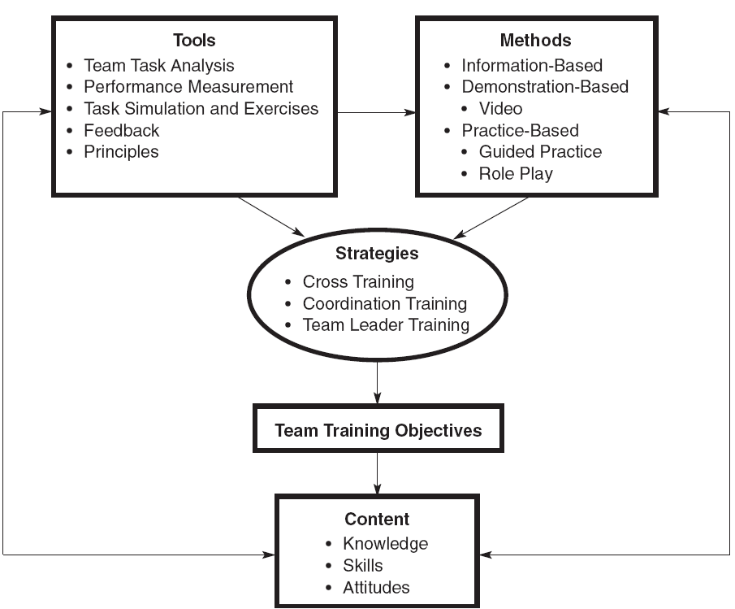
Elements of Team Training

Slide 39
Team Training
Advantages
  when properly designed, team training generally results in more effective teams
Disadvantages
  potentially costly
  time consuming

Slide 40
Action Learning
Involves assigning teams an actual problem, committing to an action plan, and holding them accountable
Used to solve important problems, develop leaders, build teams, and transform organizational cultures
Typically involves teams of 6 to 30

Slide 41
Action Learning
Advantages
  highly interactive and engaging
  highly effective in developing the target skills and promoting transfer
Disadvantages
  requires trainees with a high level of ability

Slide 42
Choosing a Method
A variety of considerations should be taken into account
  The learning outcome, which the most important
  The learning environment
  Transfer of training considerations
  Cost
  Overall effectiveness

Slide 43
General Trends
There is considerable overlap in learning outcomes across methods
Hands-on methods are more effective than presentation methods
Presentation methods are less expensive
Where possible, use multiple methods to capitalize on the strengths of each

