Slide 1
Chapter 6
Bond Markets

Slide 2
Bond Markets
Capital markets are markets for equity and debt instruments with original issue maturities of more than one year
Bonds are long-term debt obligations issued by corporations and government units
Bond markets are markets in which bonds are issued and traded
  Treasury notes (T-notes) and bonds (T-bonds)
  Municipal bonds
  Corporate bonds

Slide 3
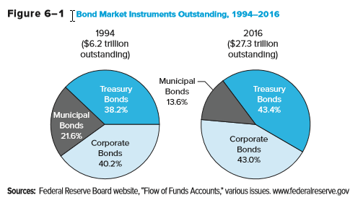
Bond Market Instruments Outstanding, 1994 - 2016

Slide 4
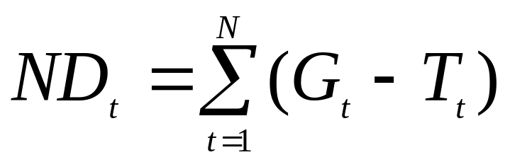
Treasury Notes and Bonds
Treasury notes and bonds (T-notes and T-bonds) are issued by the U.S. Treasury to finance the national debt and other government expenditures
The annual federal deficit is equal to annual expenditures (G) less taxes (T) received
The national debt (ND) is the sum of historical annual federal deficits:

Slide 5
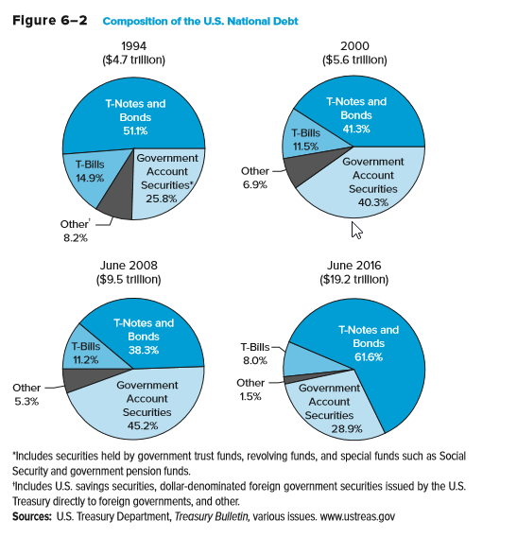
Composition of the U.S. National Debt

Slide 6
Treasury Notes and Bonds Continued
Default risk free: backed by the full faith and credit of the U.S. government
Low returns: low interest rates (yields to maturity) reflect low default risk
Interest rate risk: because of their long maturity, T-notes and T-bonds experience wider price fluctuations than money market securities when interest rates change
Liquidity risk: older issued T-bonds and T-notes trade less frequently than newly issued T-bonds and T-notes
Notes:
Newly issued Treasuries are called ‘on the run’ and older Treasuries are called ‘off the run.’

Slide 7
Treasury Notes and Bonds Concluded
T-notes have original maturities from over 1 to 10 years
T-bonds have original maturities from over 10 years
Issued in minimum denominations (multiples) of $100
May be either fixed principal or inflation-indexed
  Principal value used to determine the coupon on inflation-indexed bonds is adjusted to reflect inflation (measured by the CPI)
    In other words, the semiannual coupon payments and the final principal payment of inflation-indexed bonds are based on the inflation-adjusted principal value of the security
Trade in very active secondary markets
Prices are quoted as percentages of face value, while coupon rates are set at intervals of 0.125 (or 1/8 of 1) percent

Slide 8
Sample Treasury Bond Quote
Maturity mo/yr: Month and year, the bond matures November 15, 2045, but it may be callable before that time.
Coupon: Coupon rate of 3% or $30.00 per year but paid semiannually ($1,000 face).
Bid: The closing price per $100 of par the dealer will pay to buy the bond; the seller would receive this price from selling to the dealer. In this case, 107.6563% of $1,000 or $1,076.56.
$1,000 par Treasury Bond
Maturity | Coupon | Bid | Asked | Chg | Asked Yld
11/15/2045 | 3.000 | 107.6563 | 107.6865 | 0.0938 | 2.624

Slide 9
Sample Treasury Bond Quote Continued
Asked: The closing price per $100 of par the dealer requires to sell the bond; the buyer would pay this price to the dealer. In this case, 107.6865% of $1,000 or $1,076.87.
Chg: The change from the prior closing ASKED price. In this case, the ASKED price increased 0.0938 from the prior quoted closing ask price
Asked Yld = Promised compound yield rate if purchased at the Asked price. In this case, the yield is 2.624%
Maturity | Coupon | Bid | Asked | Chg | Asked Yld
11/15/2045 | 3.000 | 107.6563 | 107.6865 | 0.0938 | 2.624
Notes:
Note that the yield is the yield to call if the price is above par and the yield to maturity if below par. The yield calculation uses semiannual compounding.

Slide 10
Treasury STRIPS
Separate Trading of Registered Interest and Principal Securities (STRIPS), a.k.a. “Treasury zero bonds” or “Treasury zero-coupon bonds”
  Treasury security in which the periodic interest payment is separated from the final principal payment, effectively creating two sets of securities – one set for each semiannual interest payment and one for the final principal payment
Created by the U.S. Treasury in response to the separate trading of Treasury security principal and interest that had been developed by securities firms
STRIPS may be used to immunize against interest rate risk

Slide 11
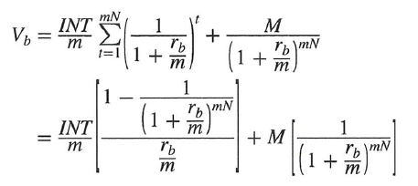
Treasury Note and Bond Yields
Prices quoted in the financial press (i.e., “clean prices”) are calculated as:
    V_{b} = the present value of the bond
    M = the par (i.e., face) value of the bond
    INT = annual interest payment = par value * coupon rate
    N = the number of years until the bond matures
    m = the number of times per year interest is paid
    r_{b} = interest rate used to discount cash flows on the bond

Slide 12
Accrued Interest
Accrued interest must be paid by the buyer of a bond to the seller of a bond if the bond is purchased between interest payment dates.
  It is the portion of the coupon payment accrued between the last coupon payment and the settlement day
The price of the T-bond or T-note with accrued interest is called the full price or the dirty price, while the price without accounting for accrued interest is the clean price.

Slide 13
Accrued Interest Continued
Accrued interest on T-notes and T-bonds is calculated as:
The full (or dirty) price of a T-note or T-bond is the sum of the clean price (V_{b}) and the accrued interest

Slide 14
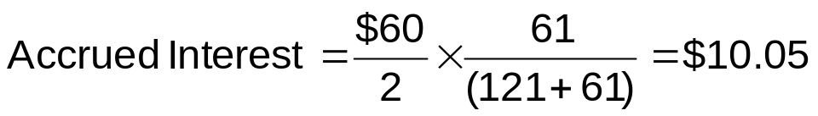
Accrued Interest Example
You buy a 6% coupon $1,000 par T-bond 59 days after the last coupon payment. Settlement occurs in two days. You become the owner 61 days after the last coupon payment (59+2), and there are 121 days remaining until the next coupon payment. The bond’s clean price quote is 120.59375. What is the full or dirty price (sometimes called the invoice price)?
The clean price is 120.59375% of $1,000 or $1,205.9375.
Thus, the dirty price is $1,205.9375 + $10.05 = $1,215.9875.
Notes:
Note: Treasuries use actual days, but munis and corporates use 30 day months and a 360 day year.

Slide 15
T-Note and Bond Markets
The primary market of T-notes and T-bonds is similar to that of T-bills; the U.S. Treasury sells T-notes and T-bonds through competitive and noncompetitive Treasury auctions
  2-, 3-, 5-, and 7-year notes are auctioned monthly
  10-year notes and 30-year bonds are auctioned quarterly (Feb, May, Aug, and Nov)
Most secondary trading occurs directly through brokers and dealers

Slide 16
T-Note and Bond Markets Continued
Competitive and non-competitive bidders
Competitive bidders submit bid yields, highest bid accepted is call the ‘stop out yield’
  All noncompetitive bidders and competitive bidders who bid less than the stop out receive their full allotment. Bidders at the stop out yield may receive a prorata share of their allotment.
  T-Note or Bond coupon rate is rounded down from stop yield to the nearest 1/8th if needed.

Slide 17
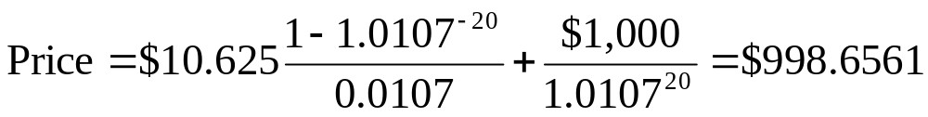
T-Note and Bond Markets Concluded
The stop out yield on a 10 year Treasury is 2.14%. What price would every successful bidder pay for a $1,000 par bond?
  The annual coupon will be rounded down to the nearest 1/8th or to 2 1/8th or 2.125%. The semiannual coupon is (2.125%/2)*$1,000 = $10.625. Thus:
All investors would pay a quoted price of 99.86561 per $100 of par

Slide 18
Municipal Bonds
Municipal bonds are securities issued by state and local governments and are repaid using tax receipts or revenues generated from a project
  to fund imbalances between expenditures and receipts
  to finance long-term capital outlays
Attractive to household investors because interest is exempt from federal and most local income taxes
General obligation (GO) bonds are backed by the full faith and credit of the issuer
Revenue bonds are sold to finance specific revenue-generating projects and are backed by the cash flows from that project
Notes:
The majority of munis are Revenue Bonds.

Slide 19
Municipal Bonds Continued
Compare municipal bond returns with fully taxable corporate bonds by finding the after tax return for corporate bonds:
i_{a} = i_{b}(1 – t)
  i_{a} = after-tax rate of return on a taxable corporate bond
  i_{b} = before-tax rate of return on a taxable bond
  t = marginal total income tax rate of the bond holder
Alternately, convert municipal interest rates to tax equivalent rates of return: i_{b} = i_{a}/(1 – t)

Slide 20
Municipal Bond Rates & Taxes
For a 28% tax bracket, what is the equivalent after tax rate of a 6% corporate yield?
  i_{a} = 6%(1- 0.28) = 4.32%
For a 28% tax bracket, what corporate taxable yield is equivalent to a 4.5% municipal bond rate?
  i_{b} = 4.5% / (1-0.28) = 6.25%

Slide 21
Municipal Bonds Concluded
Primary markets
  Firm commitment underwriting: a public offering of municipals made through an investment bank, where the investment bank guarantees a price for the newly issued bonds by buying the entire issue and then reselling it to the public
  Best efforts offering: a public offering in which the investment bank does not guarantee a firm price and acts more as a placing or distribution agent (for a fee)
  Private placement: bonds are sold on a semi-private basis to qualified investors (generally FIs)
Secondary markets: Municipals trade infrequently due mainly to a lack of information on bond issuers

Slide 22
Corporate Bond Characteristics
Corporate bonds are long-term obligations issued by corporations
  Minimum denomination on publicly traded corporate bonds is $1,000
A bond indenture is the legal contract that specifies the rights and obligations of the bond issuer and the bond holders
Bearer versus registered bonds
Term versus serial bonds
Mortgage bonds are secured debt issues

Slide 23

Corporate Bonds Characteristics Continued
Debentures and subordinated debentures
Convertible bonds versus nonconvertible bonds
    r_{cvb} = yield on a convertible bond
    r_{ncvb} = yield on a nonconvertible bond
    op_{cvb} = value of the conversion option to the bond holder
Stock warrants give bond holders the opportunity to purchase common stock at a prespecified price

Slide 24

Corporate Bond Characteristics Concluded
Callable bonds versus noncallable bonds
  r_{ncb} = yield on a noncallable bond
  r_{cb} = yield on a callable bond
  op_{cb} = value of the issuer’s option to call the debt early
A sinking fund provision is a requirement that the issuer retire a certain amount of the bond issue early over a number of years, especially as the bond approaches maturity
Notes:
A call provision is an unattractive feature to bond holders, since the bond holder may be forced to return the bond to the issuer before he/she is ready to end the investment (and the investor can only reinvest the funds at a lower interest rate). For that reason, callable bonds have higher yields than comparable noncallable bonds.

Slide 25
The Trading Process for Corporate Bonds
Primary sales are identical to that of municipals (i.e., either occur through a public sale or a private placement)
Secondary markets
  The exchange market (e.g., NYSE Bonds)
  The over-the-counter (OTC) market
Bond ratings
  The three major bond rating agencies are Moody’s, Standard & Poor’s (S&P), and Fitch Ratings
  Bonds are rated by perceived default risk
  Bonds may be either investment or speculative (i.e., junk) grade
Notes:
The instructor may wish to mention that one of the unintended consequences of the so called Volcker Rule in the Dodd-Frank bill has been to make it more expensive for banks to hold bond inventories. As a result they have reduced their market making activity and reduced liquidity in the bond markets.

Slide 26
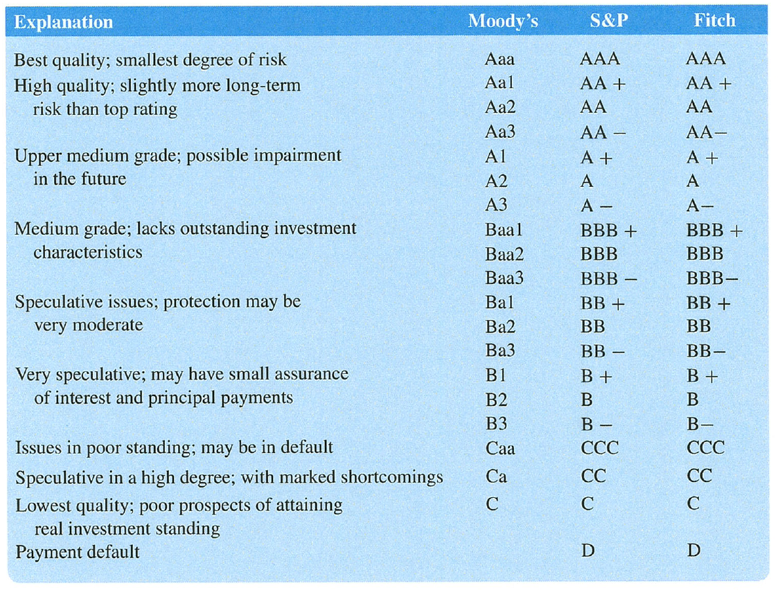
Bond Credit Ratings

Slide 27
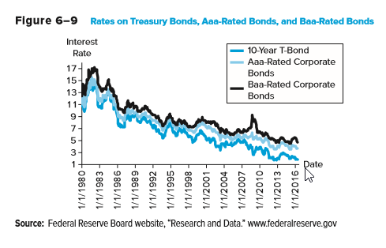
Rates on Treasury Bonds

Slide 28
Corporate Bond Quote Example
Issuer name, ticker symbol and coupon
Maturity month and year
Bond rating by the three major ratings agencies
High, Low, and Last prices in decimal form as a percent of par
  Daily high price was $953.35
Change is the change from the prior day’s last price
Yield % is the promised yield to maturity using the last price
Issuer Name | Symbol | Coupon | Maturity | Moody’s/S&P/ Fitch | High | Low | Last | Change | Yield %
Philip Morris Intl | PM3975964 | 2.625 % | 03/06/2023 | A2/A/A | 95.335 | 93.521 | 93.772 | 0.858 | 3.388

Slide 29
Bond Market Indexes
Managed by major investment banks
  E.g., Barclays, Merrill Lynch
Reflect both the monthly capital gain and loss on bonds plus any interest (coupon) income earned
Changes in values of bond indexes can be used by bond traders to evaluate changes in the investment attractiveness of bonds of different types and maturities

Slide 30
Bond Market Participants
The major issuers of debt market securities are federal, state and local governments, as well as corporations
The major purchasers of capital market securities are households, businesses, government units, and foreign investors
  Financial firms (e.g., banks, insurance companies, and mutual funds) are the major suppliers of funds for municipal and corporate bonds
  Foreign investors and financial firms are the major suppliers of funds for Treasury securities (including T-bills, T-notes, and T-bonds)

Slide 31
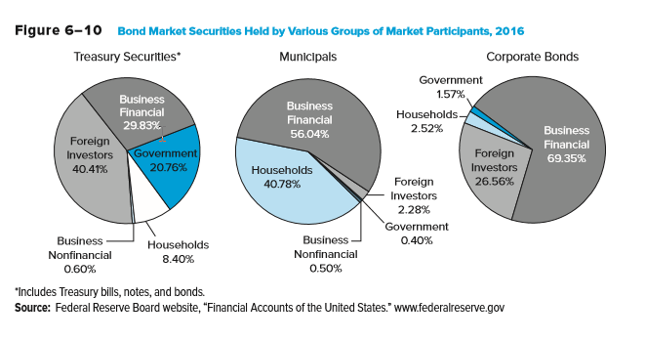
Bond Market Securities Held by Various Groups of Market Participants

Slide 32
International Aspects of Bond Markets
Motivations for international bond investing
  Potentially higher returns
  Better diversification
Additional complexities in international bond investing
  Higher risk; political risks higher and potential for capital flight in lesser developed markets
    Greek crisis in Europe is an example
  Lower recourse in the event of non-repayment
  Foreign exchange rate movements can significantly impact returns
Notes:
A lender to a sovereign nation has very little recourse in the event of non-repayment except the threat of reputational loss and reduced access to future capital.

Slide 33
International Aspects of Bond Markets Continued
International bond markets involve unregistered bonds that are internationally syndicated, offered simultaneously to investors in several countries, and issued outside of the jurisdiction of any single country
Eurobonds are long-term bonds issued outside the country of the currency in which they are denominated
  E.g., dollar-denominated bonds issued in Europe or Asia
Foreign bonds are long-term bonds issued outside of the issuer’s home country and usually denominated in the currency of the country in which they are issued
  E.g., Japanese company issues a dollar-denominated public bond rather than a yen-denominated bond in the U.S.
Sovereign bonds are government-issued debt

Slide 34
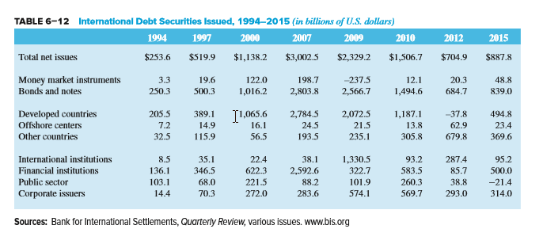
International Debt Securities Issued, 1994 - 2015

Slide 35
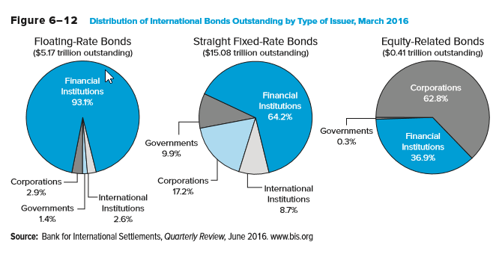
Distributions of International Bonds Outstanding by Type of Issuer, March 2016

