Slide 1
Chapter Seven
Mortgage Markets

Slide 2
Mortgages and Mortgage-Backed Securities
Mortgages are loans to individuals or businesses to purchase homes, land, or other real property
Many mortgages are securitized
  Securitization occurs when securities are packaged and sold as assets backing a publicly traded or privately held debt instrument
Mortgages differ from bonds and stocks
  Mortgages are backed by a specific piece of real property
  Primary mortgages have no set size or denomination
  Primary mortgages generally involve a single investor
  Comparatively little information exists on mortgage borrowers

Slide 3
Primary Mortgage Market
Four basic types of mortgages are issued by financial institutions
  Home mortgages are used to purchase one- to four-family dwellings (called “single-family mortgages”)
  Multifamily dwelling mortgages are used to purchase apartment complexes, townhouses, and condominiums
  Commercial mortgages are used to finance the purchase of real estate for business purposes
  Farm mortgages are used to finance the purchase of farms

Slide 4
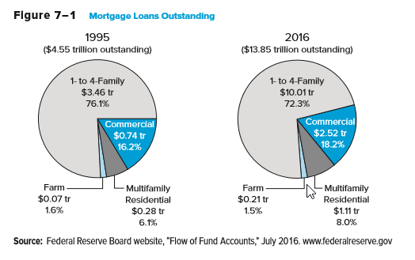
Mortgage Loans Outstanding

Slide 5
Mortgage Characteristics
Collateral: lenders place liens against properties that remain in place until the loan is fully paid off
A down payment is a portion of the purchase price of the property a financial institution requires the mortgage borrower to pay up front
  Private mortgage insurance (PMI) is generally required when the loan-to-value ratio is more than 80% (i.e., the borrower makes a down payment of less than 20%)
Federally insured mortgages
  Repayment is guaranteed by either the Federal Housing Administration (FHA) or the Veterans Administration (VA)

Slide 6
Mortgage Characteristics Continued
Conventional mortgages are mortgages that are not federally insured
Amortized mortgages have fixed principal and interest payments that fully pay off the mortgage by its maturity date
  Fully amortized mortgage maturities are usually either 15 or 30 years
Balloon payment mortgages require fixed monthly interest payments for 3 to 5 years, at which point full payment of the mortgage principal is due
Fixed-rate mortgages lock in the borrower’s interest rate
  Therefore, required monthly payments are fixed over the life of the mortgage and lenders assume interest rate risk

Slide 7
Mortgage Characteristics Concluded
Adjustable-rate mortgages (ARMs) tie the borrower’s interest rate to some market interest rate or interest rate index
  Required monthly payments can change over the life of the mortgage, although they may initially be fixed for a set time period.
    For example, 5/1 ARMs and 3/1 ARMs are popular
  Rates or payment changes are usually ‘capped’
    For example, the cap on a 5/1 ARM may be stated as ‘5/2/5’
  Borrowers assume interest rate risk with an ARM
  ARMs can increase default risk
Notes:
In a 5/1 ARM the payment is fixed for the first 5 years, and then adjusts annually. A 3/1 is fixed for the first three years. Alternatively some ARMs begin adjusting immediately.
The 5/2/5 cap means the first rate adjustment can be no more than 5%, after that the maximum annual change is 2% , and the maximum interest rate increase over the life of the mortgage is 5%.
ARMs are riskier for homebuyers. They may make sense if the buyer believes they will not stay in the home for more than 3 to 5 years, and believe they will be able to sell or refinance at reasonable rates in the future.

Slide 8
Discount Points and Other Fees
Discount points are fees or payments made when a mortgage loan is issued (at closing)
  Each point costs the borrower 1 percent of the principal value
  The lender reduces the interest rate used to determine the payments on the mortgage in exchange for points paid
Other fees
  Application fee
  Title search
  Title insurance
  Appraisal fee
  Loan origination fee
  Closing agent and review fees
  Other fees (e.g., VA or FHA loan guarantees and PMI)

Slide 9
Mortgage Refinancing
Mortgage refinancing
  When a borrower takes out a new mortgage and uses the proceeds to pay off an existing mortgage
  Mortgages are most often refinanced when an existing mortgage has a higher interest rate than current rates
  Borrowers must balance the savings of a lower monthly payment with the costs (fees) of refinancing
  An often-cited rule of thumb is that the new interest rate should be 2 percentage points less than the refinanced mortgage rate

Slide 10
Mortgage Amortization
Each fixed monthly payment consists partly of repayment of the principal and partly of the interest on the outstanding mortgage balance
An amortization schedule shows how the fixed monthly payments are split between principal and interest

Slide 11
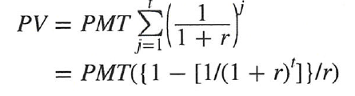
Mortgage Payments
The present value of a mortgage can be written as:
    PV = principal amount borrowed
    PMT = monthly mortgage payment
    r = monthly interest rate on the mortgage
    t = number of months over the life of the mortgage

Slide 12
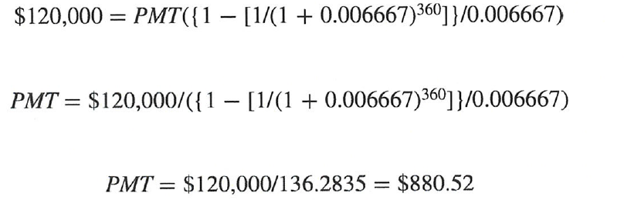
Mortgage Payments Continued
A borrower agrees to a $150,000, 30-year fixed-rate mortgage with a 8% quoted interest rate. What is the payment amount and how much of each payment goes to principle and interest?

Slide 13
Other Types of Mortgages
Jumbo mortgages
  Jumbo mortgages are mortgages for loan amounts that exceed the maximum ‘conforming’ limits allowed by the mortgage agencies Fannie Mae and Freddie Mac ($417,000 in 2016, with some exceptions)
Subprime mortgages
  Subprime mortgages are mortgages where the borrowers do not qualify for a ‘prime’ credit rating because of a low credit score arising from prior credit problems such as delinquencies and defaults. Or, they may simply lack sufficient credit history or have insufficient income.

Slide 14
Other Types of Mortgages Continued
Alt-A mortgages
  “Alternative A-papers” are mortgages that are riskier than prime, but not as risky as subprime
  Interest rates on Alt-A loans are usually between prime and subprime rates
Option ARMs (“Pick-a-Payment”)
  Give homebuyers an initial choice of payment options
  Minimum payment: 1% interest rate for 12 months, then variable rate, capitalization of unpaid interest, growing loan balance
  Interest Only payment: pay interest only at an adjustable rate for first 5 to 10 years of loan, payments will increase substantially when IO term expires.
  15-year or 30-year fully amortizing payment
Notes:
Alt-A: They may represent borrowers who have incomplete documentation, poorer credit scores, higher loan to value ratios, etc. than prime mortgages.
Minimum payment: When loan balance reaches 110% to 115% of the original balance, the borrower loses this option and must choose one of the others.
Before the crisis, these options were sold to naïve borrowers, but they are obviously very risky. The borrowers were apparently told they were not risky, or the risk was downplayed because the homebuyers were told they could refinance when the payments increased. The financial crisis eliminated this ability however.

Slide 15
Other Types of Mortgages Concluded
Second mortgages and home equity loans
  Second mortgages are secured by a piece of real estate already used to secure a first mortgage
  Home equity loans let customers borrow on a line of credit secured with a second mortgage on their homes
Reverse-annuity mortgages (RAMs)
  Retirees or homeowners with a substantial amount of equity in their home can sell the equity back to a bank over time
  Various payment options are available
  Costs and servicing fees are high

Slide 16
Secondary Mortgage Markets
FIs remove mortgages from their balance sheets through one of two mechanisms
  By pooling recently originated mortgages together and selling them in the secondary market
  By securitizing mortgages (i.e., by issuing securities backed by newly originated mortgages)
Advantages of securitization
  FIs can reduce the liquidity risk, interest rate risk, and credit risk of their loan portfolios
  FIs generate income from origination and service fees

Slide 17
Mortgage Sales
FIs have sold mortgages and commercial real estate among themselves for over 100 years
A large part of correspondent banking involves small banks making loans that are too big for them to hold on their balance sheets and selling parts of these loans to large banks with whom they have had a long-term deposit and lending correspondent relationship
Large banks often sell parts of their loans (i.e., participations) to smaller banks
Mortgage sales occur when an FI originates a mortgage and sells it to an outside buyer
  A loan sale is made with recourse if the loan buyer can sell the loan back to the originator, should it go bad

Slide 18
Mortgage Sales Continued
Mortgage sellers
  Money center banks, smaller banks, foreign banks, investment banks, hedge funds, and the U.S. government
Mortgage sales allow FIs to manage credit risk, achieve better asset diversification, and improve their liquidity and interest rate risk positions
FIs are encouraged to sell loans for economic and regulatory reasons
  Sold mortgages can still generate fee income for the bank
  Sold mortgages reduce the cost of reserve and capital requirements
Mortgage buyers
  Investment banks, vulture funds, domestic and foreign banks, insurance companies and pension funds, closed-end bank loan mutual funds, and nonfinancial corporations

Slide 19
Secondary Mortgage Markets
Government-sponsored enterprises (GSEs)
The U.S. government established the Federal National Mortgage Association (FNMA, or Fannie Mae) in 1938 to buy mortgages from depository institutions so they could lend to other mortgage borrowers
  Mandate was to act as a secondary mortgage market facility that could purchase, hold, and sell mortgage loans
The Federal Home Loan Mortgage Corporation (FHLMC, or Freddie Mac) was formed in the 1960s to facilitate financing of conventional mortgages

Slide 20
Secondary Mortgage Markets Continued
Government National Mortgage Association (GNMA, or “Ginnie Mae”) began operations in 1968 when it split off from Fannie Mae, and has two major functions
  Sponsoring mortgage-backed securities programs of financial institutions such as banks, thrifts, and mortgage bankers
  Acting as a guarantor to investors in mortgage-backed securities regarding the timely pass-through of principal and interest payments from the FI or mortgage servicer to the bond holder
Only supports those pools of mortgage loans whose default or credit risk is insured by one of four government agencies, all of which target groups that might otherwise be disadvantaged in the housing market
  E.g., Low-income families, young families, and veterans
  Maximum mortgage under the GNMA securitization program had a cap of $417,000 for a single-family home in 2016 (with exceptions)
Notes:
The four government agencies with mortgage pools supported by GNMA are the Federal Housing Administration (FHA), the Veterans Administration (VA), the Department of Housing and Urban Development’s Office of Indian and Public Housing, and the USDA Rural Development.

Slide 21
Secondary Mortgage Markets Concluded
Between 2005 and 2007, subprime mortgage default rates increased from 5.37% to 10.09%
Subprime mortgage holders 60 days or more behind in their payments hit 17.1% in June 2007 and was over 20% in August of the same year
Problems in the subprime market spilled over to the broader mortgage markets and helped fuel nationwide declines in home prices, which put many homeowners underwater and led to the bankruptcies of many major financial institutions
On September 7, 2008, the Federal Housing Finance Agency (FHFA) placed both Fannie Mae and Freddie Mac in government conservatorship
Notes:
The term underwater means the homeowners owe more on their mortgage than their house is worth. This provides an incentive for homeowners to default on their mortgages.
As of April 2011, the taxpayers were out about $132 billion on the two mortgage agencies with more losses expected.

Slide 22
Mortgage-Backed Securities
Mortgage-backed securities allow mortgage issuers to separate the credit risk exposure from the lending process
Pass-through securities “pass through” promised principal and interest payments to investors
Three agencies are directly involved in the creation of mortgage-backed pass-through securities
  Ginnie Mae, Fannie Mae, and Freddie Mac
Private mortgage pass-through issuers create pass-throughs from nonconforming mortgages
  E.g., commercial banks, thrifts, and private conduits

Slide 23
Mortgage-Backed Securities Continued
Collateralized mortgage obligations (CMOs) are mortgage-backed bonds with multiple bond holder classes or tranches
  Each bond holder class has a different guaranteed coupon
  Mortgage prepayments retire only one tranche at a time, so all other trances are sequentially prepayment protected
Mortgage-backed bonds (MBBs)
  MBBs allow FIs to raise long-term low-cost funds without removing mortgages from their balance sheets
  A group of mortgage assets is pledged as collateral against a MBB issue, but there is no direct link between the cash flows of the mortgages and the cash flows on the MBB

Slide 24
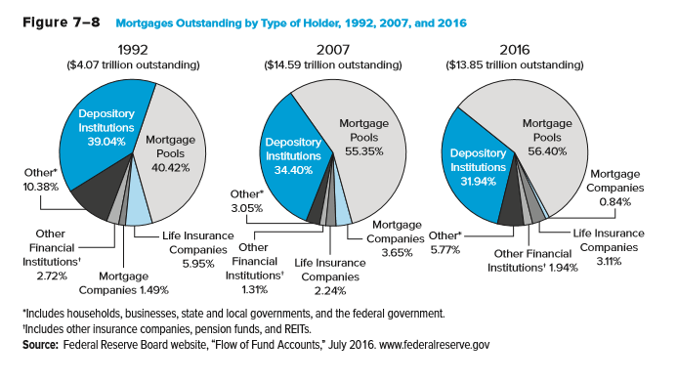
Mortgages Outstanding by
Type of Holder
Notes:
2010 data

Slide 25
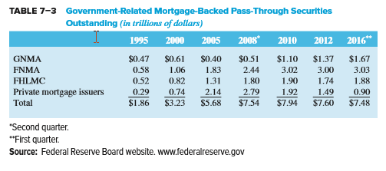
Mortgage-Backed Pass-Through Securities Outstanding

Slide 26
International Trends in Securitization
Europe is the world’s second-largest and most developed securitization market
  The European mortgage securitization peaked in 2008 before falling dramatically in 2009 as a result of the financial crisis
  The role of London banks in the mortgage-backed securitization market is now in question after the U.K.‘s 2016 referendum (aka “Brexit)
Parts of Europe and Asian real estate markets were not as affected by the mortgage crisis because they lacked substantial subprime lending

Slide 27
International Trends in Securitization Continued
The largest banks in the Netherlands, Switzerland, and the United Kingdom had net losses in 2008
  Banks in Ireland, Spain, and the United Kingdom were especially hard hit as they had large investments in toxic mortgages and mortgaged-backed securities, both U.S. and domestic
Securitization overseas is often structured differently, with originators retaining title to the mortgages even after securitization
Securitization has declined due to the crisis, but will continue in the future

Slide 28
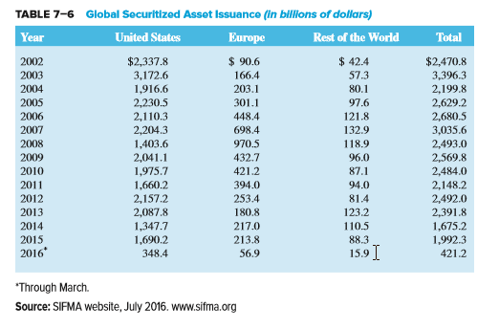
Global Securitized Asset Issuance

