Slide 1
Chapter Eight
Stock Markets

Slide 2
Overview of Stock Markets
Primary stock markets allow suppliers of funds to raise equity capital
Secondary stock markets are the most closely watched and reported of all financial markets
Stockholders are the legal owners of a corporation
  Have a right to share in the firm’s profits (e.g., through dividends)
  Are residual claimants
  Have limited liability
  Have voting rights (e.g., to elect board of directors)

Slide 3
Common Stock
Common stock is the fundamental ownership claim in a public or private corporation
Dividends are discretionary, and are thus not guaranteed
Common stockholders have the lowest priority claim in the event of bankruptcy (i.e., a residual claim)
Limited liability implies that common stockholders can lose no more than their original investment
Common stockholders control the firm’s activities indirectly by exercising their voting rights in the election of the board of directors

Slide 4
Common Stock Voting Rights
Dual-class firms have two classes of common shares outstanding, with different voting rights assigned to each class
With cumulative voting, the number of votes assigned to each stockholder equals the number of shares held multiplied by the number of directors to be elected
  The number of shares needed to elect p directors, N_{p}, is:
N_{p} = [(p x # of votes available) / (# of directors to be elected + 1)] +1
A proxy vote allows stockholders to vote by absentee ballot (e.g., by internet or by mail)

Slide 5
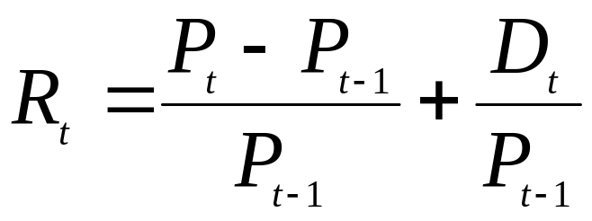
Stock Returns
The return on a stock over one period (R_{t}) can be divided into capital gains and dividend returns:
    P_{t} = stock price at time t
    D_{t} = dividends paid over time t – 1 to t
    (P_{t} – P_{t – 1}) / P_{t – 1} = capital gain over time t – 1 to t
    D_{t} / P_{t – 1} = return from dividends over time t – 1 to t

Slide 6
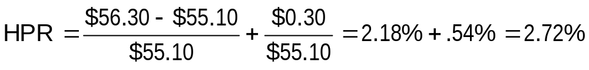
Stock Returns Example
Suppose an investor buys 10 shares of stock priced at $55.10 and sells the stock one year later for $56.30 after collecting a $0.30 dividend per share. What was the investor’s pre-tax holding period return?
If dividend income is taxed at a 28% rate and capital gains are taxed at 20%, what was the investor’s after-tax holding period return?

Slide 7
Preferred Stock
Preferred stock is a hybrid security that has characteristics of both bonds and common stock
  Similar to common stock in that it represents an ownership interest in the issuing firm, but like a bond it pays a fixed periodic (dividend) payment
Generally has fixed dividends that are paid quarterly
Generally does not have voting rights unless dividend payments are missed
Nonparticipating versus participating
Cumulative versus noncumulative
Notes:
Under the government’s Capital Purchase Program (a part of TARP), the government injected capital into firms and received cumulative preferred stock in return paying a 5% cumulative dividend for five years then a 9% dividend afterwards.

Slide 8
Primary Stock Markets
Primary markets are markets in which corporations raise funds through new issues of securities, most of the time through investment banks
  E.g., Morgan Stanley or Bank of America Merrill Lynch
Investment banks act as distribution agents in best efforts underwriting
Investment banks act as principals in firm commitment underwriting
  gross proceeds – net proceeds = underwriter’s spread
A syndicate is a group of investment banks working in concert to issue stock; the lead underwriter is the originating house

Slide 9
Primary Stock Markets Continued
An initial public offering (IPO) is the first public issue of financial instruments by a firm
A seasoned offering is the sale of additional securities by a firm whose securities are already publicly traded
  Preemptive rights give existing stockholders the ability to maintain their proportional ownership
A red herring prospectus is a preliminary version of the prospectus that describes a new security issue
Shelf registration allows firms to offer multiple issues of stock over a two-year period with only one registration statement

Slide 10
Secondary Stock Markets
Secondary stock markets are the markets in which stocks, once issued, are traded among investors
The U.S. has several major stock markets
  New York Stock Exchange Euronext (NYSE/Euronext)
    The NYSE/Euronext Exchange was purchased by ICE in 2013.
  National Association of Securities Dealers Automated Quotation (NASDAQ)
  Bats/Direct Edge (former ECNs)

Slide 11
NYSE Euronext
Trading occurs at a specific place on the floor of the exchange called a trading post
Each stock has a special market maker called a specialist or Designated Market Maker (DMM) that maintains liquidity for the stock at all times

Slide 12
NYSE Euronext Continued
Three types of transactions occur at trading posts
  A market order is an order to transact at the best price available when the order reaches the trading post
  A limit order is an order to transact at a specified price
  Specialists transact for their own account
Program trading is the simultaneous buying and selling of a portfolio of at least 15 different stocks valued at more than $1 million using computer programs to initiate the trades
Circuit breakers give investors time to make informed choices during periods of high market volatility

Slide 13
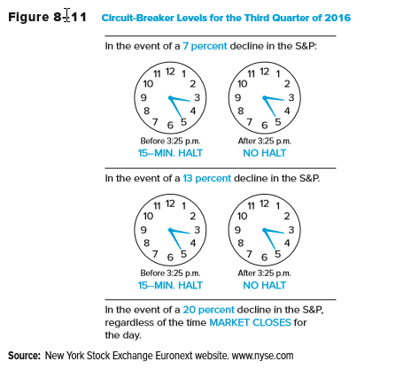
Circuit-Breaker Levels

Slide 14
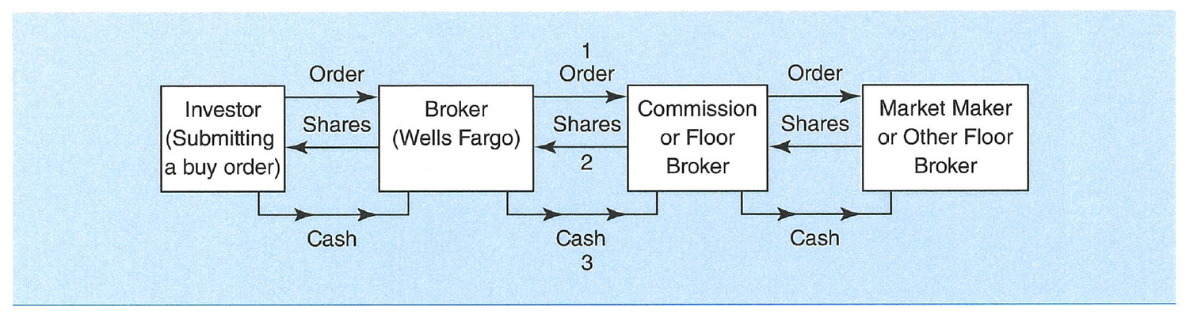
Purchase of a Stock on the NYSE

Slide 15
Stock Market Quote
Name
Symbol
Open
High
Low
Close
Net Chg
% Chg
Volume
52 Wk High
52 Wk Low
Div
Yield
P/E
YTD % Chg

Slide 16
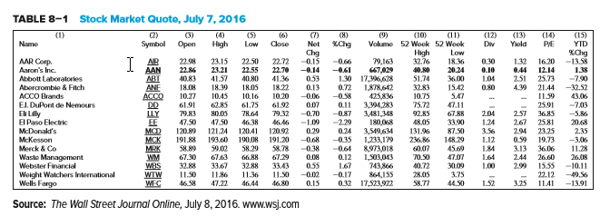
Stock Market Quote Example

Slide 17
Exchange Traded Funds (ETFs)
Pioneered by the former AMEX (now NYSE/AMEX)
  ETFs are index funds that are listed on an exchange and can be traded intraday and shorted
  Prices may not exactly match an index

Slide 18
NASDAQ and OTC Markets
NASDAQ was the world’s first electronic market and has no physical trading floor
Provides continuous trading for the most active stocks traded over-the-counter (OTC)
Primarily a dealer market where many, often more than 20, dealers act as market makers
A small order execution system (SOES) provides automatic order execution for orders of less than or equal to 1,000 shares
The NASD maintains an electronic “OTC bulletin board” and “pink sheets” for small firms that are not part of the NASDAQ

Slide 19
Secondary Stock Markets
Choice of market listings
  NYSE has extensive listing requirements (e.g., firm market value and trading volume)
  NASDAQ requirements are cheaper and can be met by smaller firms with less active trading
Electronic communication networks (ECNs)
  Normal trading occurs between 9:30 a.m. and 4:00 p.m. eastern standard time
  Extended-hours trading occurs through computerized alternative trading systems (ATSs) a.k.a. ECNs
  BATS (Better Alternative Trading System) has now become an exchange
Online trading via the internet is becoming increasingly popular with both individual and professional investors

Slide 20
Flash Trading
Flash trading
  For a fee, traders are allowed to see incoming buy or sell orders milliseconds earlier than general market traders
Exchanges claim that the flash trading benefits all traders by creating more market liquidity and the opportunity for price improvement
Critics contend that flash trading creates a market in which certain traders can unfairly exploit others
Wash trades
  The illegal act of acting as both buyer and seller in the same transaction

Slide 21
Flash Trading Continued
In flash trading, traders are allowed to see incoming buy or sell orders milliseconds earlier than general market traders
Flash traders then use computerized statistical analysis to generate high frequency trading strategies that are executed by computer as well
  Pro
    Flash trading creates more liquidity and the possibility of price improvement
  Cons
    Creates a disadvantage for regular traders and investors who are not allowed to view incoming orders
    High volume of trading generated by multiple computers can lead to events like the so called “flash crash”

Slide 22
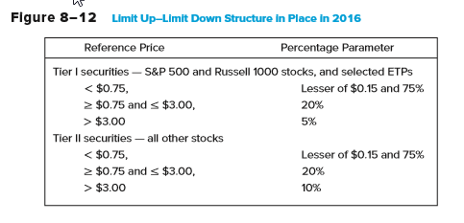
Flash Trading Concluded
As a result of the flash crash, the SEC imposed circuit breaker rules for individual stocks
Trading is halted if the price breaks the price band
  Price band = (Reference Price) ± [(Reference price) × (Percentage parameter)]

Slide 23
Naked Access and Dark Pools
Naked access occurs when brokers and exchanges allow some traders to engage in high frequency trades anonymously using the broker’s access code
Dark pools of liquidity are trading networks that provide liquidity but that do not display trades on order books
  In 2008, 3% of daily stock trading was processed through dark pool trading. In 2016, this number climbed to 42%.
In 2013, the SEC approved a plan for new rules requiring dark pools to disclose and detail trading activity on their platforms
  New rules require such systems to file detailed information about their operations, including trading by broker dealer operators on the ATS, which could pose conflicts of interest

Slide 24
Stock Market Indexes
A stock market index is the composite value of a group of secondary market-traded stocks
Price-weighted index
  The Dow Jones Industrial Average (DJIA), composed of 30 large companies, is the most widely reported stock market index
Value-weighted indexes
  NYSE Composite
  Standard & Poor’s 500
  NASDAQ Composite
  Wilshire 5000

Slide 25
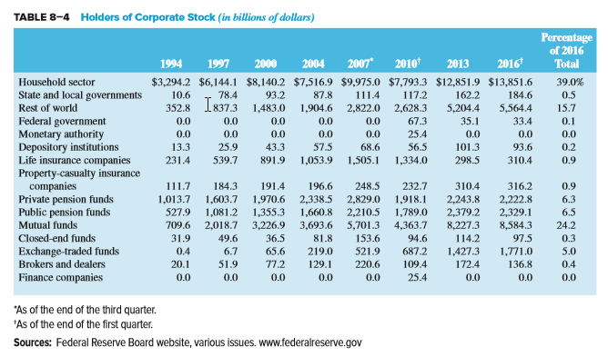
Holders of Corporate Stock

Slide 26
Other Stock Market Issues
Economic indicators
  Stock market indexes might be used to forecast future economic activity
    An increase (decrease) in stock market indexes today potentially signals the market’s expectation of higher (lower) corporate dividends and profits and, in turn, higher (lower) economic growth
  Stock prices are one of the 10 variables included in the index of leading economic indicators used by the Federal Reserve as it formulates economic policy

Slide 27
Other Stock Market Issues Continued
Market efficiency refers to the speed with which financial security prices reflect unexpected news events
  Weak form market efficiency
    Concludes that investors cannot make more than the fair (required) return using information based on historical price movements
      Empirical research suggests that markets are weak form efficient
  Semistrong form market efficiency
    According to semistrong form market efficiency, investors cannot make more than the fair (required) return by trading on public news releases
      Note that if semistrong form market efficiency holds, weak form market efficiency must hold as well

Slide 28
Other Stock Market Issues Concluded
Market efficiency refers to the speed with which financial security prices reflect unexpected news events
  Strong form market efficiency
    States that stock prices fully reflect all information about the firm, both public and private
    According to strong form efficiency, even learning private information about the firm is of not help in earning more than the required rate of return
      Limited empirical testing, but studies do suggest that corporate insiders earn abnormal returns from trading and the more informed the insider, the more often abnormal returns are earned
      For this reason, laws prohibit investors from trading on the basis of private information

Slide 29
Stock Market Regulations
The Securities and Exchange Commission (SEC) is the primary regulator of stock markets
  Promote full and fair disclosure of information on securities and ensure fair treatment of investors
  Enforce Securities Act of 1933/Securities Exchange Act of 1934
  Prosecute inside trading
    Galleon Fund, Raj Rajaranam
    SAC Capital Advisors LP
  SEC failed to uncover Madoff fraud
    Significant turnover of personnel since

Slide 30
Stock Market Regulations Continued
The Financial Industry Regulatory Authority (FINRA) is the regulator for all U.S. securities firms
FINRA oversees registering and educating brokers and dealers, examining securities firms, promulgating rules, enforcing federal securities laws, and conducting dispute arbitration
Notes:
FINRA was created by the 2007 merger of the NASD and the regulatory arm of the NYSE.

Slide 31
International Aspects of Stock Markets
U.S. stock markets are the world’s largest
European markets have increased their share of the global market with the advent of a common currency, the Euro, but hurt by the Euro area crisis
Growth has strengthened China and Pacific Basin countries
International stock markets allow investors to diversify by holding stocks issued by corporations in foreign countries
International diversification can increase risk due to incomplete information about foreign stocks as well as foreign exchange and political risk

Slide 32
American Depository Receipts (ADRs)
An ADR is a certificate that represents ownership of a foreign stock
  Created by a U.S. bank, after acquiring stock in foreign corporations in their domestic currencies
  The bank then issues dollar ADRs backed by the shares of the foreign stock, investors earn returns in U.S. dollars
There are currently over 3,600 ADRs of foreign corporations available to U.S. investors representing asset values of over $3.1 trillion in 2015

Slide 33
American Depository Receipts (ADRs) Continued
There are 3 types of ADRs:
Level 1 ADRs trade OTC and are not required to meet U.S. GAAP nor issue annual reports
Level 2 ADRs trade on the exchanges and must meet exchange requirements and adhere to U.S. reporting standards
Level 3 ADRs meet the same reporting standards as Level 2 and must register with the SEC and file the equivalent of 10K forms. These firms are allowed to raise public capital in the U.S.
Notes:
Level 2 ADRs are much more liquid than Level 1 offerings.
ADRs provide low cost diversification, but may more directly expose investors to currency and sovereign risk.

Slide 34
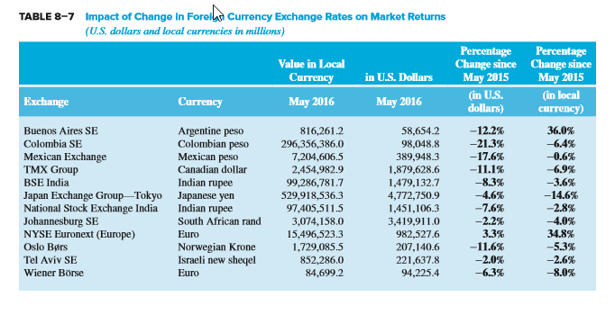
Impact of Change in Foreign Currency Exchange Rates on Market Returns

Slide 35
Capital Asset Pricing Model
CAPM
  A model that predicts the relationship between the risk and equilibrium required returns on risky assets
  Built on the theory that the appropriate risk premium on an asset will be determined by its contribution to the risk of an investor’s overall portfolio

Slide 36
Event Study Tests
Marked model
  Used by event studies to identify the normal relationship between a stock’s return and the market’s return using a period of time prior to a news release (e.g., the year prior)
  Represented as an ordinary least squares regression equation

