Slide 1
Chapter Nine
Foreign Exchange Markets

Slide 2
Overview of Foreign Exchange Markets
Today’s U.S.-based companies compete and operate globally
Events and movements in foreign financial markets can affect the profitability and performance of U.S. firms
  Firms with only U.S. operations still face foreign competition
    For example, a U.S. resort competes with European resorts even though the U.S. firm has no foreign operations
    If the dollar strengthens against the euro, the cost to come to the U.S. resort increases for Europeans and can reduce the number of foreign visitors at the U.S. resort

Slide 3
Overview of Foreign Exchange Markets Continued
Foreign trade is possible because of the ease with which foreign currencies can be exchanged
  U.S. imported $3.7 trillion worth of goods in 2015
  U.S. exported $3.3 trillion worth of goods in 2015
If a country imports more than they export, the supply of that country’s currency in the foreign exchange markets will exceed demand for the country’s currency and the value of the currency will tend to fall, all else equal.

Slide 4
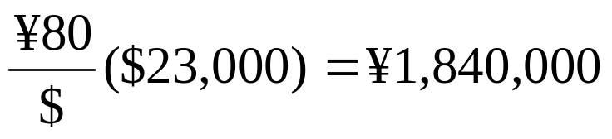
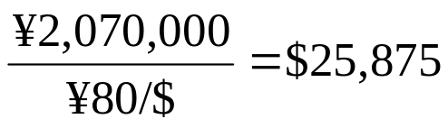
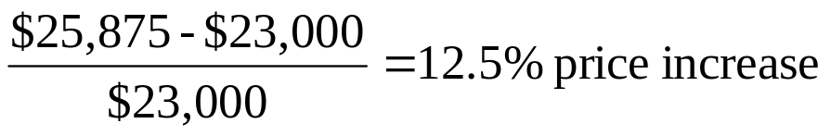
Foreign Exchange Markets Example
A weakening dollar can generate inflation in the U.S.
  Toyota sells Camrys in the U.S. for $23,000 when the exchange rate is 90¥ per dollar. Toyota receives ¥2,070,000 in revenue per car sold.
  If the dollar weakens and is worth only 80¥ per dollar, how many yen will Toyota receive per car sold?
  What price would Toyota have to charge to receive the same amount of yen as before?

Slide 5
Overview of Foreign Exchange Markets Concluded
Internationally active firms often seek to hedge their foreign currency exposure
  By using derivatives such as swaps and futures
  By borrowing money in the same currency in which they are earning revenues
  By locating production facilities (and incurring local currency costs) where they are earning revenues

Slide 6
Foreign Exchange
Foreign exchange markets are markets in which one currency is exchanged for another, either today (in the spot market) or at a set time in the future (in the forward market)
Foreign exchange markets facilitate:
  Foreign trade
  Raising capital in foreign markets
  The transfer of risk between market participants
  Speculation in currency values
A foreign exchange rate is the price at which one currency can be exchanged for another currency

Slide 7
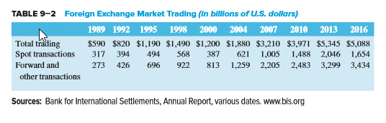
Foreign Exchange Market Trading

Slide 8
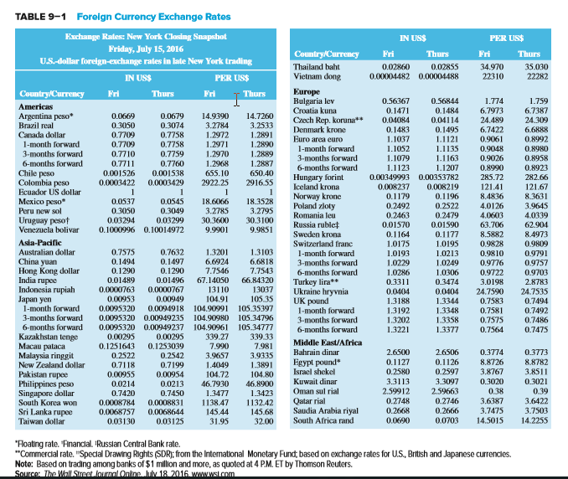
Foreign Currency Exchange Rates

Slide 9
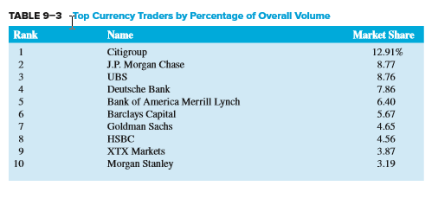
Top Currency Traders

Slide 10
Foreign Exchange Continued
Foreign exchange risk is the risk that cash flows will vary as the actual amount of U.S. dollars received on a foreign investment changes due to a change in foreign exchange rates
Currency depreciation occurs when a country’s currency falls in value relative to other currencies
  Domestic goods become cheaper for foreign buyers
  Foreign goods become more expensive for foreign sellers
Currency appreciation occurs when a country’s currency rises in value relative to other currencies

Slide 11
Foreign Exchange Concluded
Foreign exchange markets operated under the gold standard through most of the 1800s
  U.K. was the dominant international trading country until WWII forced it to deplete its gold reserves to purchase arms and munitions from the U.S.
1944: Bretton Woods Agreement fixed exchange rates within 1% bands
1971: Smithsonian Agreement increased bands to 2 ¼%
1973: Smithsonian Agreement II introduced “managed” free float

Slide 12
FX Market
Foreign exchange markets are the largest of all financial markets with turnover exceeding $4.8 trillion per day in 2015
London continues to be the largest center for trading in foreign exchange
  Over 37% of worldwide trading
New York is the second-largest market
  Over 19% of all trading
Singapore is the third-largest
  Handles about 1/7th the volume of London

Slide 13
FX Rates
Foreign exchange rates may be listed two ways
  U.S. dollars received per unit of foreign currency (in US$)
  Foreign currency received for each U.S. dollar (per US$)
Foreign exchange can involve both spot and forward transactions
  Spot foreign exchange transactions involve the immediate exchange of currencies at current exchange rates
  Forward foreign exchange transactions involve the exchange of currencies at a specified exchange rate at a specific date in the future

Slide 14
Exchanges
Organized derivatives markets have existed since 1972
  International Money Market (IMM) (a subsidiary of the Chicago Mercantile Exchange Group (CMEG)) is based in Chicago
  Derivative trading in foreign currency futures and options
In 1982, the Philadelphia Stock Exchange (PHLX) became the first exchange to offer around-the-clock trading of currency options

Slide 15
The European Currency (€)
The European Community (EC) was formed in 1967 by consolidating three smaller communities
  European Coal and Steel Community
  European Economic Market
  European Atomic Energy Community
The Maastricht Treaty of 1993 set the stage for the eventual creation of the Euro
The Euro (€), the currency of the European Union (EU), began trading on January 1, 1999 when twelve European countries fixed their currencies’ exchange ratios
Euro notes and coins began circulating on January 1, 2002

Slide 16
The Euro (€)
The U.S. dollar depreciated against the euro in the mid-2000s, but generally strengthened during the European sovereign debt crisis
  Interest rate differentials play a large role in euro/$ exchange rate movements, except during European sovereign debt crisis
The Central Bank of Russia has replaced some of its U.S. dollar reserves with euros, as has the Chinese Central Bank
In 2016, 43.8% of foreign exchange transactions were denominated in dollars, compared to 15.6% denominated in euros

Slide 17
The Yuan
In the early 2000s, the international community pressured China to allow its currency (the yuan) to float freely instead of pegging it to the U.S. dollar
  Chinese exports were relatively cheap, which hurt domestic manufacturing in other countries, especially the U.S.
    The yuan was mostly pegged to either the euro or the dollar from 2001-2005, and during the crisis from 2008-2010
    2009 – Hong Kong was allowed to begin trading the yuan offshore
    January 2011 – Chinese based companies were allowed to use the yuan off the mainland and America was allowed to begin yuan trading
    October 2011 – foreign companies can settle direct investment accounts on the mainland in yuan
    February 2013 - the CME Group initiated trading in yuan (or renminbi) futures
    November 2015 – the IMF designated the Chinese yuan an IMF-accepted reserve currency, along with the US dollar, Japanese Yen, British Pound Sterling, and euro in the Special Drawing Right (SDR) basket

Slide 18
The Dollar during the Financial Crisis
From September 2008 to March 2009, the dollar increased in value against the major currencies as investors sought out safety in U.S. Treasury investments
From March 2009 to November 2009, the dollar began to fall as investors again sought out higher yields as fears of economic collapse subsided
Varied since (based on the amount of fears of investors), but generally trending upward with continuing problems in Europe, even with U.S. credit rating downgrade

Slide 19
Foreign Exchange Risk
The risk involved with a spot foreign exchange transaction is that the value of the foreign currency may change relative to the U.S. dollar
Foreign exchange risk can come from holding foreign assets and/or liabilities
Suppose a firm makes an investment in a foreign country:
  Convert domestic currency to foreign currency at spot rates
  Invest in foreign country security
  Repatriate foreign investment and investment earnings at prevailing spot rates in the future

Slide 20
Foreign Exchange Risk Continued
Firms can hedge their foreign exchange exposure either on or off the balance sheet
On-balance-sheet hedging involves matching foreign assets and liabilities
  As foreign exchange rates move, any decreases in foreign asset values are offset by decreases in foreign liability values (and vice versa)
Off-balance-sheet hedging involves the use of forward contracts or other derivative securities
  Forward contracts are entered into (at t = 0) that specify exchange rates to be used in the future (i.e., no matter what the prevailing spot exchange rates are at t = 1)

Slide 21
Foreign Exchange Exposure
A financial institution’s overall net foreign exchange exposure in any given currency is measured as
Net exposure_{i} = (FX assets_{i} – FX liabilities_{i}) + (FX bought_{i} – FX sold_{i})
= Net foreign assets_{i} + Net FX bought_{i}
= Net position_{i}
  where
  i = ith country’s currency
A net long (short) position is a position of holding more (fewer) assets than liabilities in a given currency

Slide 22
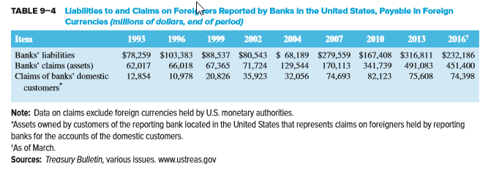
Foreign Exchange Exposure Continued

Slide 23
Trading Activities
A financial institution’s position in foreign exchange markets generally reflects four trading activities:
  Purchase and sale of foreign currencies for customers’ international trade transactions
  Purchase and sale of foreign currencies for customers’ investments
  Purchase and sale of foreign currencies for hedging purposes
  Purchase and sale of foreign currencies for speculation (i.e., profiting through forecasting foreign exchange rates)

Slide 24


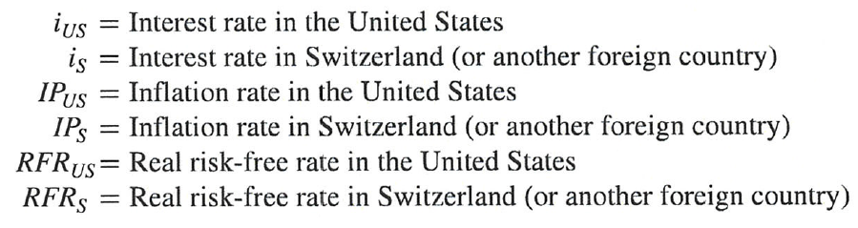
Purchasing Power Parity (PPP)
Purchasing power parity (PPP) is the theory explaining the change in foreign currency exchange rates as inflation rates in the countries change

Slide 25



Purchasing Power Parity (PPP) Continued
Assuming real rates of interest (or rates of time preference) are equal across countries:
Then, the following is true:
The PPP theorem says the change in the exchange rate between two countries'’ currencies is proportional to the difference in the inflation rates in the two countries:

Slide 26
International Fisher Effect (IFE)
The IFE states that the expected spot rate is the current spot rate multiplied by the ratio of the foreign nominal interest rate to the domestic nominal interest rate
Implication
  The country with the higher (lower) nominal interest rate will tend to see its currency depreciate (appreciate)
Notes:
This is simply the uncovered version of the interest rate parity theorem. To exploit deviations from this equation is a risky arbitrage so it may not hold as well as the standard interest rate parity which uses the forward rate.

Slide 27
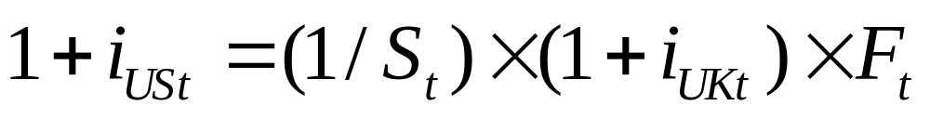
Interest Rate Parity
The interest rate parity theorem (IRPT) is the theory that the domestic interest rate should be equal to the foreign interest rate minus the expected appreciation of the domestic currency
For example, using the British pound and the dollar:
  i_{USt} = the interest rate on a U.S. investment maturing at time t
  i_{UKt} = the interest rate on a U.K. investment maturing at time t
  S_{t} = $/£ spot exchange rate at time t
  F_{t} = $/£ forward exchange rate at time t

Slide 28
Interest Rate Parity Example
Suppose U.S. interest rates are 9%, British interest rates are 11%, and the current spot rate is £1 = $1.60. According to interest rate parity, what is the equilibrium forward rate?
  i_{USt} = the interest rate on a U.S. investment maturing at time t
  i_{UKt} = the interest rate on a U.K. investment maturing at time t
  S_{t} = $/£ spot exchange rate at time t
  F_{t} = $/£ forward exchange rate at time t

Slide 29
Interest Rate Parity Example Continued
Suppose U.S. interest rates are 9%, British interest rates are 11%, and the current spot rate is £1 = $1.60. How could one take advantage of this if the forward rate is actually $1.55?
Investors would borrow pounds at 11% in the U.K., owing £1.11 pounds at year-end per pound borrowed
Sell the pounds spot for $1.60/£ and invest in the U.S. giving $1.60 × 1.09 = $1.744
Buy the £1.11 pounds owed at the forward rate of $1.55 a pound for a dollar cost of £1.11 ($1.55/£) = $1.7205
The net gain is $1.744 - $1.7205 = $0.0235 per pound borrowed
Notes:
This works because the difference in interest rates is 2% and the percent change in the currency value is a 3.125% drop in value of the pound. So we borrow at the higher rate and invest in the lower, losing 2% but we more than make it up by borrowing in a currency that is weakening by 3.125%.
Stress that this is riskless arbitrage that does not involve your own money so it is a money machine. Note we have ignored risk and tax differences in the investments and transaction costs.
Banks set the forward rates based on interest rate differentials.

Slide 30
Balance of Payments Accounts
Balance of payments accounts summarize all transactions between citizens of two countries
  Current accounts summarize foreign trade in goods and services, net investment income, and gifts, grants, or aid given to other countries
  Capital accounts summarize capital flows into and out of a country
  Financial accounts record transfers of financial capital and nonfinancial capital
    Accounts are further divided into sub-accounts: U.S.-owned assets abroad are divided into official reserve assets, government assets, and private assets

