Slide 1
Chapter Ten
Derivative Securities Markets

Slide 2
Derivatives
A derivative is a financial security whose payoff is linked to another, previously issued security
  Derivatives involve the buying and selling, or transference, of risk
In many derivatives, two parties agree to exchange a standard quantity of an asset at a predetermined price at a specific date in the future
In theory, derivative trading should not adversely affect the economic system because it allows individuals who want to bear risk to take more risk, while allowing individuals who want to avoid risk to transfer that risk elsewhere
Notes:
In 2003, Alan Greenspan (former Fed Reserve Board Chairman) credited the derivative securities markets with helping the banking system maintain its strength through the economic recession in the early 2000s.

Slide 3
Derivatives’ Uses
Derivatives are leveraged instruments where participants put up a small amount of money and obtain the gain or loss on a much larger position
Derivatives are used for speculation and for hedging
  Speculation
    Buying or selling a derivative contract in order to earn a leveraged rate of return
  Hedging
    Entering into a derivatives contract to reduce the risk associated with positions or commitments in their line of business

Slide 4
Derivatives Markets
The first wave of modern derivatives were foreign currency futures
  In response to the introduction of floating exchange rates between currencies of different countries (result of the Smithsonian Agreements of 1971 and 1973)
The second wave of modern derivatives were interest rate derivative securities
  In response to increases in the volatility of interest rates in the late 1970s and after, as the Federal Reserve started to target nonborrowed reserves rather than interest rates
The third wave of modern derivatives occurred in the 1990s and 2000s with credit derivatives
  E.g., credit forwards, credit risk options, and credit swaps

Slide 5
Forwards and Futures
A spot contract is an agreement to transact involving the immediate exchange of assets and funds
A forward contract is an agreement to transact involving the future exchange of a set amount of assets at a set price
Forward contracts:
  Can be based on a specified interest rate (e.g., LIBOR) rather than a specified asset
  Involve underlying assets that are nonstandardized, because the terms to each contract are negotiated individually between the buyer and seller

Slide 6
Forwards and Futures Continued
A futures contract is an agreement to transact involving the future exchange of a set amount of assets for a price that is settled daily
Futures contracts differ from forwards in that futures:
  are characterized by significantly less default risk
  employ margin requirements and daily marking to market
    margin requirement is a performance bond posted by a buyer and a seller of a futures contract

Slide 7
Futures Markets
Futures contract trading occurs in trading “pits” using an open-outcry auction among exchange members
  Floor brokers place trades for the public
  Professional traders trade for their own accounts
  Position traders take a position in the futures market based on their expectations about the future direction of the prices of the underlying assets, and trade for their own account
  Day traders take a position within a day and liquidate it before day’s end
  Scalpers take positions for very short periods of time, sometimes only minutes, in an attempt to profit from active trading

Slide 8
Futures Markets Continued
Price volatility and trading interest determines which contracts are offered
Profit pressures for derivatives exchanges to merge
  CME Group contains CME Globex, CBOT, NYMEX, and COMEX
Electronic trading is becoming more popular for derivative trading
  E.g., Eurex, the world’s largest derivatives exchange, launched a fully electronic exchange in the U.S. in 2004

Slide 9
Futures Contract Terms
Underlying unit
Deliverable grades
Tick size
Price quote
Contract months
Last trading day
Last delivery day
Delivery method
Settlement
Position limits
Trading hours
Ticker symbol
Exchange rule

Slide 10
Futures Contracts
A long position is the purchase of a futures contract
A short position is the sale of a futures contract
A clearinghouse is the unit that oversees trading on the exchange and guarantees all trades made by the exchange traders
Open interest is the total number of the futures or option contracts outstanding at the beginning of the day

Slide 11
Futures Contracts Continued
An initial margin is a deposit required on futures trades to ensure that the terms of the contracts will be met
  Amount of the margin varies according to the type of contract traded and the quantity of futures contracts traded
  Minimum margin levels are set by each exchange
The maintenance margin is the margin a futures trader must maintain once a futures position is taken
  If losses occur such that margin account funds fall below the maintenance margin, the customer is required to deposit additional funds in the margin account to keep the position open

Slide 12
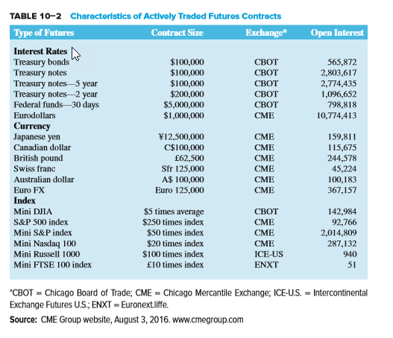
Characteristics of Actively Traded Futures Contracts

Slide 13
Marking to Market and Margin Requirements Example
An investor has a $1 million long position in T-bond futures. The investor’s broker requires a maintenance margin of 4%, or $40,000 ($1m * 0.04), which is the amount currently in the investor’s account.
Suppose the value of the futures contracts drops by $50,000 to $950,000. The investor will now be required to hold $38,000 ($950,000 * 0.04) in his account (or, he has a $2,000 surplus).
Further, because futures contracts are marked to market, the investor’s broker will make a margin call to the investor requiring him to immediately send a check for $50,000 - $2,000, or $48,000, leaving him with an account balance of $38,000 at his broker for the $950,000 T-bond futures position.

Slide 14
Options
An option is a contract that gives the holder the right, but not the obligation, to buy or sell an underlying asset at a prespecified price for a specified time period
A call option is an option that gives the purchaser the right, but not the obligation, to buy the underlying security from the writer of the option at a prespecified price on or before a prespecified date
A put option is an option that gives the purchaser the right, but not the obligation, to sell the underlying security to the writer of the option at a prespecified price on or before a prespecified date

Slide 15
Profit Diagrams for Call Options
Payoff Payoff for
profit call buyer
C
0 Stock price
X at expiration
-C
Payoff
loss
Payoff for call writer

Slide 16
Profit Diagrams for Put Options
Payoff
profit
P
0 Stock price
X at expiration
-P
Payoff
loss
Payoff for put writer
Payoff for put buyer

Slide 17
Options Continued
The Black-Scholes option pricing model (the model most commonly used to price and value options) is a function of:
  the spot price of the underlying asset
  the exercise price on the option
  the option’s exercise date
  the price volatility of the underlying asset
  the risk-free rate of interest
The intrinsic value of an option is the difference between an option’s exercise price and the underlying asset price
  the intrinsic value of a call option = max{S – X, 0}
  the intrinsic value of a put option = max{X – S, 0}

Slide 18
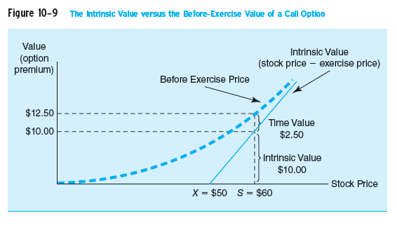
Option Intrinsic Value and Time Value

Slide 19
Option Price Quote Example
The May call is in the money (positive intrinsic value) and the call premium is $3.30 * 100 = $330 (contracts are for 100 shares)
The intrinsic value of the call (S-X) is ($8.79 - $6.00) * 100 = $279
The time value of the call is $330 - $279 = $51
The May put is out of the money and the put’s intrinsic value (X-S) is 0
The put still has time value, however, equal to $0.45 * 100 = $45
AMR |  |  |  | Underlying stock price $8.79
Expiration |  | Call |  |  | Put
 | STRIKE | LAST | VOLUME | OPEN INTEREST | LAST | VOLUME | OPEN INTEREST
May | 6.00 | 3.30 | 12 | 578 | 0.45 | 20 | 4175
Jan | 7.50 | 1.30 | 60 | 17062 | 0.15 | 138 | 58909
Notes:
An investor would not exercise the May call because that would be throwing away the $51 time value.
Notice that the closer to the money option has much higher open interest.

Slide 20
Option Markets
The Chicago Board of Options Exchange (CBOE) opened in 1973 as the first exchange devoted solely to the trading of stock options
Options on futures contracts began trading in 1982
An American option can be exercised at any time before (and on) the expiration date
A European option can be exercised only on the expiration date
The trading process for options is similar to that for futures contracts

Slide 21
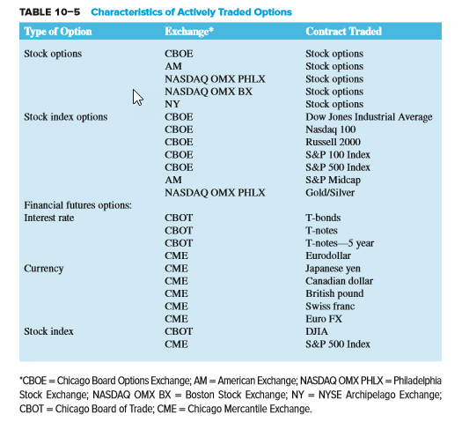
Characteristics of Actively Traded Options

Slide 22
Options Concluded
The underlying asset on a stock option is the stock of a publicly traded company
The underlying asset on a stock index option is the value of a major stock market index (e.g., DJIA or S&P 500)
The underlying asset on a futures option is a futures contract
Credit spread call options
  The value of a credit spread call option increases as the default (risk) premium or yield spread on a specified benchmark bond of the borrower increases above some exercise spread
  A digital default option pays a stated amount in the event of a loan default

Slide 23
Swaps
A swap is an agreement between two parties to exchange a series of cash flows for a specific period of time at a specified interval
A plain vanilla interest rate swap is an exchange of fixed-interest payments for floating-interest payments by two counterparties
  The swap buyer makes the fixed-rate payments in an interest rate swap transaction
  The swap seller makes the floating-rate payments in an interest rate swap transaction
  No principal is exchanged

Slide 24
Swaps Continued
A currency swap is a swap used to hedge against exchange rate risk from mismatched currencies on assets and liabilities
  Usually associated with borrowing money
  The exchanges can be at a fixed or a variable rate of interest as negotiated in the contract, but the exchanges occur at a known currency exchange rate
  Used to hedge exchange rate risk from mismatched currencies of assets and liabilities

Slide 25
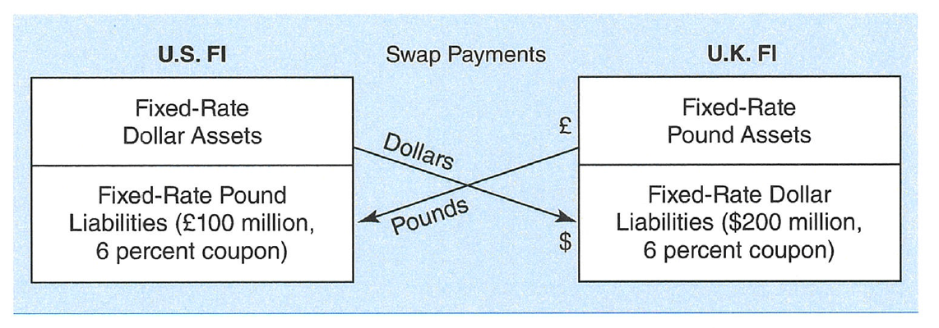
Fixed-Fixed Pound/Dollar Currency Swap

Slide 26
Swaps Concluded
Credit default swaps (CDS) allow financial institutions to hedge credit risk
  Total return swaps involve swapping an obligation to pay interest at a specified fixed or floating rate for payments representing the total return on a loan (interest and principal value changes) of a specified amount
    Can be used to hedge credit exposure, but contain an element of interest rate risk as well as credit risk
  In a pure credit swap, the financial institution lender will send (each swap period) a fixed fee or payment (like an insurance premium) to the counterparty, but if the FI lender’s loan or loans do not default, it receives nothing back from the counterparty
    A pure credit swap is similar to buying credit insurance and/or a multiperiod credit option

Slide 27
Swap Markets
Swaps are not standardized contracts
Swap dealers (usually financial institutions) keep markets liquid by matching counterparties or by taking positions themselves
Unlike futures and options markets, swap markets were historically governed by very little regulation
The International Swaps and Derivatives Association (ISDA) is an association among 56 countries that sets codes of standards for swap documentation

Slide 28
Caps, Floors, and Collars
Financial institutions use options on interest rates to hedge interest rate risk
  A cap is a call option on interest rates, often with multiple exercise dates
  A floor is a put option on interest rates, often with multiple exercise dates
  A collar is a position taken simultaneously in a cap and a floor (usually buying a cap and selling a floor)

Slide 29
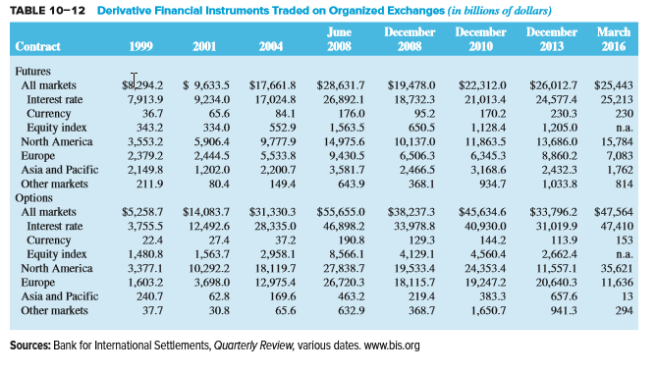
International Aspects of Derivative Securities Markets

Slide 30
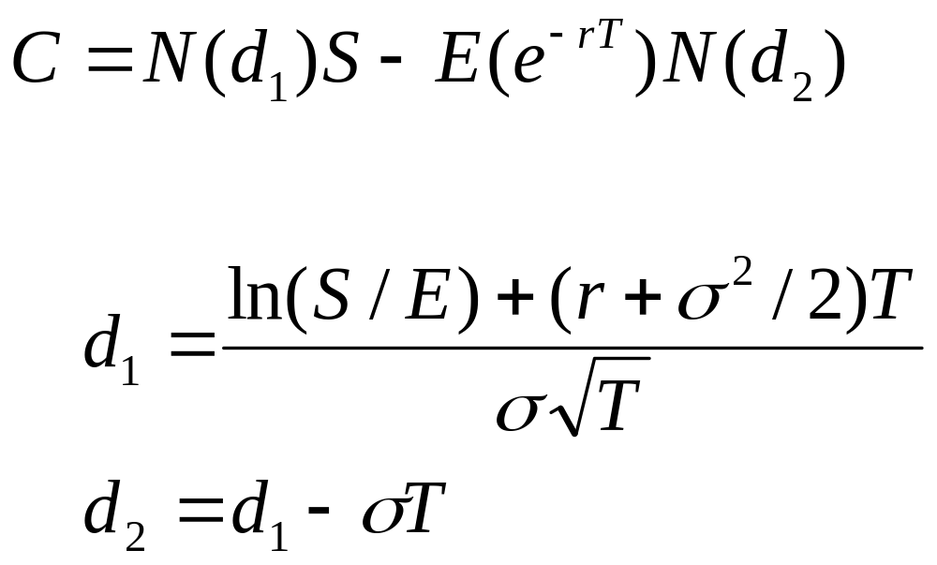
Black-Scholes Option Pricing Model

