Slide 1
Chapter Eleven
Commercial Banks: Industry Overview

Slide 2
Commercial Banks
Commercial banks are the largest group of financial institutions in terms of total assets
Major assets are loans
Major liabilities are federally insured deposits—thus, they are considered depository institutions
Perform services essential to U.S. financial markets
  Play a key role in the transmission of monetary policy
  Provide payment services
  Provide maturity intermediation services
Banks are regulated to protect against disruptions to the services they perform and to protect government insured deposits

Slide 3
Commercial Bank Assets
Loans generate the most revenue for banks
  Loans and investment securities continue to be the primary assets of the banking industry
  Though business loans were the major asset on bank balance sheets between 1965 and 1987, they have dropped in importance since 1987
Investment securities generate revenue and provide banks with liquidity
Cash assets are held to meet reserve requirements and to provide liquidity
Other assets include premises and equipment, other real estate owned, etc.

Slide 4
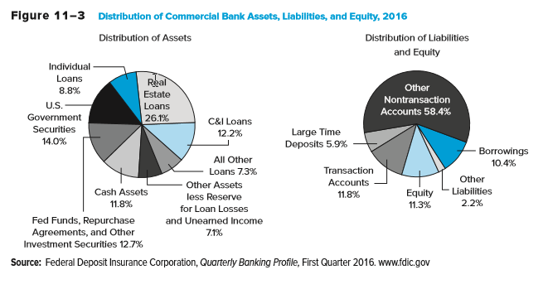
Commercial Bank Assets, Liabilities, and Equity, 2016

Slide 5
Commercial Bank Assets Continued
Commercial banks face unique risks because of their asset structure
  Credit (default) risk is the risk that loans are not repaid
  Liquidity risk is the risk that depositors will demand more cash than banks can immediately provide
  Interest rate risk is the risk that interest rate changes erode profitability or net worth
  Credit, liquidity, and interest rate risk all contribute to a commercial bank’s level of insolvency risk

Slide 6
Commercial Bank Liabilities
Transaction accounts are the sum of noninterest-bearing demand deposits and interest-bearing checking accounts
  Transaction accounts are about 15.5% of total deposits
  Interest-bearing checking accounts are called negotiable order of withdrawal (NOW) accounts
Household (retail) savings and time deposits have been declining in recent years because of competition from money market mutual funds (MMMFs)
  Passbook savings accounts
  Retail time deposits
Large time deposits
  Negotiable CDs are fixed-maturity interest-bearing deposits with face values of $100,000 or more that can be resold in the secondary market

Slide 7
Commercial Bank Liabilities and Equity
Nondeposit liabilities
  Fed funds purchased
  Repurchase agreements
  Notes and bonds
Minimum levels of equity capital are required by regulators to act as a buffer against losses
  Common and preferred stock
  Surplus or additional paid-in capital
  Retained earnings

Slide 8
Off-Balance-Sheet Activities
Commercial banks engage in many fee-related activities that are conducted off the balance sheet
  Guarantees such as letters of credit
    Future commitments to lend
  Derivative transactions
    E.g., futures, forwards, options, and swaps
Off-balance-sheet (OBS) assets
  When an event occurs, this item moves onto the asset side of the balance sheet or income is realized on the income statement
Off-balance-sheet (OBS) liabilities
  When an event occurs, this item moves onto the liability side of the balance sheet or an expense is realized on the income statement

Slide 9
Commercial Banks Continued
Number of banks have been decreasing over time
  U.S. had 14,483 banks in 1984
  U.S. had 5,289 banks in 2016
The Reigle-Neal Act of 1994
  Made it easier for banks to open branches across state lines
Financial Services Modernization Act of 1999
  Gave commercial banks the full authority to enter the investment banking (and insurance) business
Industrial loan corporations (ILCs) are considered “non-bank” banks
  E.g., Walmart and Target both attempted to utilize ILCs, and Target’s application was approved

Slide 10
Shadow Banking
Shadow banking
  Activities of nonfinancial service firms that perform banking services
How does it work?
  Savers place their funds with MMMFs and similar funds, which invest those funds in the liabilities of shadow banks. Borrowers get loans and leases from shadow banks rather than from traditional banks.
Shadow banks face significantly less regulation than traditional banks

Slide 11
Commercial Banks Concluded
Retail banking is consumer-oriented
  Residential and consumer loans are funded by accepting small deposits
  Community banks specialize in retail banking
Wholesale banking is commercial-oriented
  Commercial and industrial loans are often funded with purchased funds
  Regional or superregional banks engage in a complete array of wholesale banking activities
  Money center banks rely heavily on nondeposit or borrowed sources of funds, often borrowed in the federal funds market

Slide 12
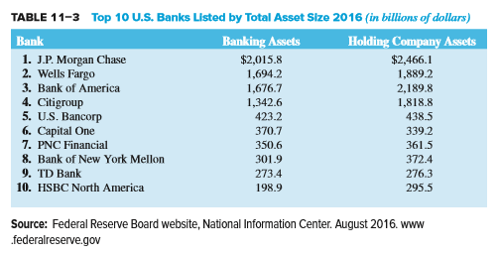
Top Ten U.S. Banks by Asset Size, 2016

Slide 13
Bank Size and Activities
Size has traditionally affected the types of activities and financial performance of commercial banks
  Small banks typically focus on the retail side
  Large banks usually engage in both retail and wholesale banking, often focusing on the wholesale side of the business
Interest rate spread is the difference between lending and deposit rates
Net interest margin is interest income minus interest expense divided by earning assets
Return on assets is net income divided by assets
Return on equity is net income divided equity

Slide 14
Bank Size and Activities Continued
Common differences between large and small banks
  Larger banks generally lend to larger corporations, meaning their interest rate spreads and net interest margins have usually been narrower than those of smaller regional banks
  Large banks tend to pay higher salaries and invest more in buildings and premises than small banks
  Small banks usually hold fewer OBS assets and liabilities
  Large banks tend to diversify their operations more and generate more noninterest income than small banks
  Large banks tend to use more purchased funds and have fewer core deposits
  Large banks tend to hold less equity than do small banks

Slide 15
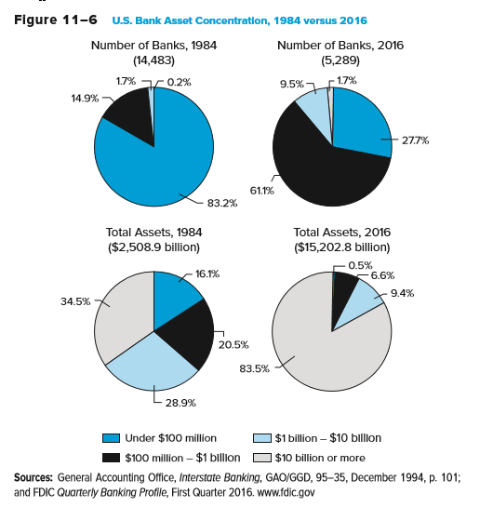
U.S. Bank Asset Concentration, 1984 versus 2016

Slide 16
Industry Performance
U.S. commercial banks flourished during the economic expansion (and falling interest rates) of the 1990s
  Commercial bank earnings were a record $71.6 billion in 1999
The economic downturn of the early 2000s caused performance to deteriorate only slightly
  Average ROA was 1.19% in 2000, down from 1.31% in 1999
By 2003, ROA and ROE had reached all-time highs
In the fourth quarter of 2006, mortgage delinquencies (particularly subprime mortgages) surged
Losses from falling values of subprime mortgages caused fourth quarter 2007 net income to hit a 16-year low

Slide 17
Industry Performance Continued
Performance deteriorated in the late 2000s during the strongest recession in the U.S. since the Great Depression
  Less than half of all institutions reported increased earnings in 2007, the first time in 23 years that a majority of institutions had not posted full-year earnings increases
ROA and ROE over time
  In 2008, annual ROA was a poor 0.13%, and it fell again in 2009 to 0.09% before rising to 0.65% in 2010
  Similarly, ROE was 1.33% in 2008, 0.85% in 2009, and 9.26% in 2015

Slide 18
Industry Performance Concluded
Number of insured institutions on the FDIC’s “Problem List” declined from 203 to 183 during 2015, and there were only 8 bank failures
Performance has deteriorated slightly in 2016 as ROA and ROE fell to 0.95% and 8.43%, respectively
  Higher expenses for loan losses and lower noninterest income from trading and asset servicing

Slide 19
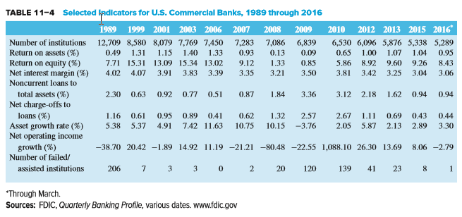
Selected Indicators for U.S. Commercial Banks, 1989 through 2016

Slide 20
Regulators
The Federal Deposit Insurance Corporation (FDIC) insures the deposits of commercial banks
The U.S. has a dual banking system—banks can be either nationally or state-chartered
  The Office of the Comptroller of the Currency (OCC) charters, closes, and examines national banks
  State authorities charter and regulate state-chartered banks
The Federal Reserve System (FRS) serves as the central bank of the U.S. and has regulatory power over nationally chartered banks, their holding companies and state banks that opt into the Federal Reserve System
  A holding company is a parent company that owns a controlling interest in a subsidiary bank or other FI

Slide 21
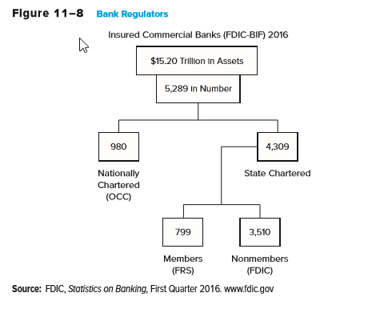
Bank Regulators

Slide 22
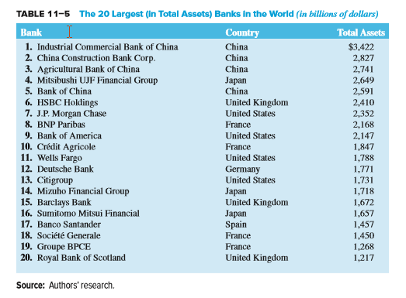
20 Largest Banks in the World by Total Assets

Slide 23
Global Issues
Advantages of international expansion
  Risk diversification
  Economies of scale
  Innovations
  Funds source
  Customer relationships
  Regulatory avoidance
Disadvantages of international expansion
  Information/monitoring costs
  Nationalization/expropriation
  Fixed costs

Slide 24
Global Banking Performance
The financial crisis of 2008-2009 spread worldwide and banks saw losses that were magnified by illiquid markets
  The largest banks in the Netherlands, Switzerland, and the U.K. had net losses in 2008
  Banks in Ireland, Spain, and the U.S. were especially hard hit because they had large investments in mortgages and mortgage-backed securities
Many European banks averted outright bankruptcy thanks to direct support from their central banks and national governments

Slide 25
Global Banking Performance Continued
Greece suffered a severe debt crisis in the spring of 2010
  Problems from the Greek banking system then spread to other European nations, such as Portugal, Spain and Italy
  The situation stabilized after 2012, but a major debt payment was due from Greece to creditors on June 30, 2015
    Deal was reached that required Greece to surrender to all of its creditors’ demands: tax increases, pension reform, and the creation of a fund (under European supervision) with state-owned assets earmarked to be privatized or liquidated
European banking system was rocked again in June 2016 with “Brexit”

