Slide 1
Chapter Twelve
Commercial Banks’ Financial Statements and Analysis

Slide 2
CAMELS Ratings
Regulators use CAMELS ratings to evaluate the safety and soundness of banks
CAMELS ratings rely heavily on financial statement data
Components
  Capital adequacy
  Asset quality
  Management quality
  Earnings quality
  Liquidity
  Sensitivity to market risk

Slide 3
CAMELS Ratings Components
Capital adequacy
  Evaluated in relation to the volume of risk assets; the volume of marginal and inferior quality assets; the bank’s growth experience, plan, and prospects; and the strength of management
Asset quality
  Evaluated by the level, distribution, and severity of adversely classified assets; the level and distribution of nonaccrual and reduced-rate assets; the adequacy of the allowance for loan losses; and management’s demonstrated ability to administer and collect problem credits
Management quality
  Evaluated against virtually all factors necessary to operate the bank within accepted banking practices and in a safe/sound manner

Slide 4
CAMELS Ratings Components Continued
Earnings
  Evaluated with respect to their ability to cover losses and provide adequate capital protection; trends; peer group comparisons; the quality and composition of net income; and the degree of reliance on interest-sensitive funds
Liquidity
  Evaluated in relation to the volatility of deposits; the frequency and level of borrowings; the use of brokered deposits; technical competence; availability of assets readily convertible into cash; and access to money markets or other sources of funds
Sensitivity to market risk
  Reflects the degree to which changes in interest rates, foreign exchange rates, commodity prices, or equity prices can adversely affect an FI’s earnings or economic capital

Slide 5
CAMELS Ratings Continued
CAMELS ratings range from 1 to 5
  Composite “1”—banks are basically sound in every respect
  Composite “2”—banks are fundamentally sound, but may have modest weaknesses correctable in the normal course of business
  Composite “3”—banks exhibit financial, operational, or compliance weaknesses ranging from moderately severe to unsatisfactory
  Composite “4”—banks have an immoderate volume of serious financial weaknesses or a combination of other conditions that are unsatisfactory
  Composite “5”—banks have an extremely high immediate or near-term probability of failure

Slide 6
Financial Statements
The Federal Financial Institutions Examination Council (FFIEC) prescribes uniform principles, standards, and report forms for depository institutions
  Balance sheets are reported on report of condition forms
  Income statements are reported on report of income forms
  Commercial banks report contingent assets and liabilities on off-balance-sheet reports
Retail banks focus business activities on consumer banking relationships
Wholesale banks focus business activities on commercial banking relationships
  Most wholesale banks also engage in retail banking

Slide 7
Commercial Bank Assets
#1 - Cash and due from depository institutions
  Consists of vault cash, deposits at the Federal Reserve, deposits at other financial institutions, and cash items in the process of collection
  None of these generates much income for the bank
#2 - Investment securities
  Consists of federal funds sold, repurchase agreements (RPs or repos), U.S. Treasury and agency securities, securities issued by states and political subdivisions (municipals), mortgage-backed securities, and other debt and equity securities
  Highly liquid, low default risk, and can usually be traded in secondary markets

Slide 8
Commercial Bank Assets Continued
#3 - Loans and leases
  Categorized as commercial and industrial (C&I) loans, loans secured by real estate, individual or consumer loans, and other loans
  Major asset items on the bank’s balance sheet and generate the largest flow of revenue income
  Least liquid asset items and a major source of credit and liquidity risk for most banks
#4 - Other assets
  Consists of items such as trading assets, premises and fixed assets, other real estate owned, intangible assets, and other
  Generally a small part of the bank’s overall assets

Slide 9
Commercial Bank Liabilities
#1 - Deposits
  Demand deposits
  Negotiable order of withdrawal (NOW) accounts
  Money market deposit accounts (MMDAs)
  Other savings deposits
  Retail certificates of deposits (CDs)
  Wholesale certificates of deposits (CDs)
    Negotiable instruments traded in secondary markets
    Brokered deposits

Slide 10
Commercial Bank Liabilities and Equity
#2 - Borrowed funds
  Federal funds
  Repurchase agreements (RPs or repos)
  Other borrowing
    Banker’s acceptances (BAs), commercial paper, medium-term notes, and discount window loans
#3 - Other liabilities
  Do not require interest to be paid
    Accrued interest, deferred taxes, dividends payable, minority interests in consolidates subsidies, and other miscellaneous claims
Equity
  Preferred and common stock
  Surplus and additional paid-in capital
  Retained earnings

Slide 11
Off-Balance-Sheet Items
Off-balance-sheet items are contingent assets and liabilities that may affect a commercial bank’s balance sheet and/or income statement
Loan commitments
  Contractual commitment by a bank or another FI (e.g., insurance company) to loan to a customer a certain maximum amount at given interest rate terms
Letters of credit
  Commercial letters of credit
  Standby letters of credit
Loans sold
  Loans originated by the bank and then sold to other investors that can be returned to the originating institution
Derivative securities
  Futures, forward, swap, and option positions taken by the FI for hedging or other purposes

Slide 12
Other Fee-Generating Activities
Trust services
  Trust departments of commercial banks hold and manage assets for individuals or corporations
Processing services
  Commercial banks have traditionally provided financial data processing services for their business customers, including managing a customer’s accounts receivable and accounts payable
  Cash management services include the provision of lockbox services
Correspondent banking
  Provision of banking services to other banks that do not have the staff resources to perform the service themselves

Slide 13
Income Statement
Income statement
  Identifies the interest income and expenses, net interest income, provision for loan losses, noninterest income and expenses, income before taxes and extraordinary items, and net income from on- and off-balance sheet activities
  Net interest income = Interest income – interest expense
  Net noninterest income = Noninterest income – noninterest expense
  Income before taxes and extraordinary items (EBTEI) = Net interest income – provision for loan losses + noninterest income – noninterest expense
  Net income = EBTEI – income taxes +/- extraordinary items

Slide 14
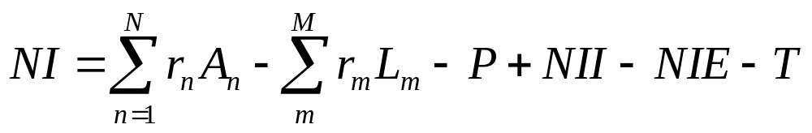
Relationship between Income Statement and Balance Sheet
There is a direct relationship between the income statement and the balance sheet of commercial banks
  NI = net income
  A_{n} = dollar value of the bank’s nth asset
  L_{m} = dollar value of the bank’s mth liability
  r_{n} = rate earned on the bank’s nth asset
  r_{m} = rate paid on the bank’s mth liability
  P = provision for loan losses
  NII = noninterest income earned, including income from OBS activities
  NIE = noninterest expenses
  T = taxes and extraordinary items
  N = number of assets the bank holds
  M = number of liabilities the bank holds

Slide 15
Income Statement Example
Suppose that a bank has equity of $200, interest expense of $90, provision for loan loss (P) = $20, net noninterest income of -$15, and a tax rate of 34%. What is the minimum total interest revenue required to give a ROE of 15%? ($ in millions)
Required NI = NI/$200 = 0.15 or NI = $30
NI = [Interest revenue – Interest expense – P + (NII – NIE)] × (1 – Tax rate)
  $30 = [Interest revenue – $90 – $20 + –$15] × (1 – 0.34)
  Required interest revenue = $170.45

Slide 16
Financial Statement Analysis
Financial statement analysis is based on accounting ratios
Time series analysis is the analysis of financial statements over a period of time
Cross-sectional analysis is the analysis of financial statements comparing one firm with others
  the Uniform Bank Performance Report (UBPR) maintained by the FFIEC allows banks to observe competitor financial statements
Most financial statement analyses is a combination of time series analysis and cross-sectional analysis

Slide 17
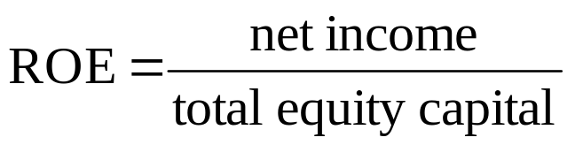
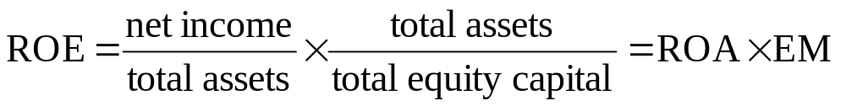
Return on Equity (ROE) Framework
Return on Equity (ROE) analysis begins with ROE and then breaks it down into its components
ROE measures the amount of income after taxes earned for each dollar of equity capital contributed by the bank’s stockholders
ROE can be broken down into two component parts:

Slide 18
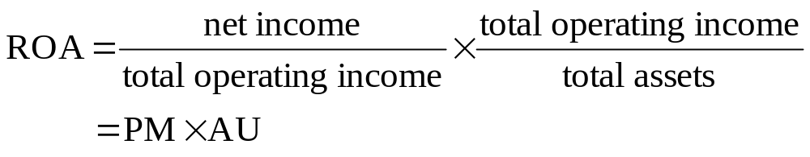
Return on Equity (ROE) Framework Continued
Return on Assets (ROA) determines the net income produced per dollar of assets
Equity Multiplier (EM) measures the dollar value of assets funded with each dollar of equity payments
  The higher this ratio, the more leverage or debt the bank is using to fund its assets
ROA can also be broken down into two components:

Slide 19
Return on Assets (ROA) Components
Profit Margin (PM) measures the ability to produce net income from operating expenses (or revenue)
  Interest expense ratio
  Provision for loan loss ratio
  Noninterest expense ratio
  Tax ratio
Asset Utilization (AU) measures the extent to which the bank’s assets generate revenue
  Interest income ratio
  Noninterest income ratio

Slide 20

Other Ratios
The net interest margin (NIM) measures the net return on a bank’s earning assets
The spread measures the difference between the average yield on earning assets and average cost of interest-bearing liabilities

Slide 21
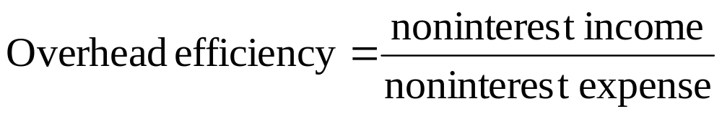
Other Ratios Continued
Overhead efficiency measures the bank’s ability to generate noninterest income to cover noninterest expenses
Many components of key ratios provide additional insight into the financial stability of banks
  See Table 12-6 for a decomposition of profit margin
  See Table 12-7 for a decomposition of asset utilization

Slide 22
Application: Heartland Bank and Trust vs Bank of America
Heartland Bank and Trust
  Profitable and efficient community bank
  Invests mainly in agriculture, real estate loans, and low-cost funding methods
Bank of America
  Operates with a larger and more balanced portfolio of assets and liabilities across both wholesale and retail banking

Slide 23
The Impact of Market Niche and Size
Retail and wholesale commercial banks operate in different market niches that should be noted when performing financial statement analysis
Large banks have greater access to purchased funds and capital markets compared to small banks
  Lends to large banks generally operating with lower amounts of equity capital than small banks
  Large banks generally use more repurchased funds and fewer core deposits
  Large banks tend to put more into salaries, premises, and other expenses than do small banks
  Large banks tend to diversity their operations and services more than small banks, and they also generate more noninterest income
Notes:
Note that, while large banks tend to hold less equity, they don’t necessarily return more on their assets.

Slide 24
Application: Heartland Bank and Trust vs Bank of America Continued
Return on Assets (ROA)
  HBT is more profitable overall
Profit Margin (PM)
  HBT is producing the higher income per dollar of total operating income
Asset Utilization (AU)
  BOA is producing less operating income per dollar of assets
BOA generates more noninterest income than HBT
  Likely due to BOA’s relatively large amount of OBS activities

