Slide 1
Chapter Thirteen
Regulation of Commercial Banks

Slide 2
Commercial Banks
Commercial banks provide many unique services
  Information services
  Liquidity services
  Price-risk reduction services
Failure to provide these services or a breakdown in their efficient provision can be costly to both the ultimate providers (households) and users (firms) of funds
Accordingly, commercial banks are regulated at the federal (and sometimes state) level

Slide 3
Types of Regulation
Six types of regulations seek to enhance the net social benefits of commercial banks’ services to the economy
  Safety and soundness regulation
  Monetary policy regulation
  Credit allocation regulation
  Consumer protection regulation
  Investor protection regulation
  Entry and chartering regulation

Slide 4
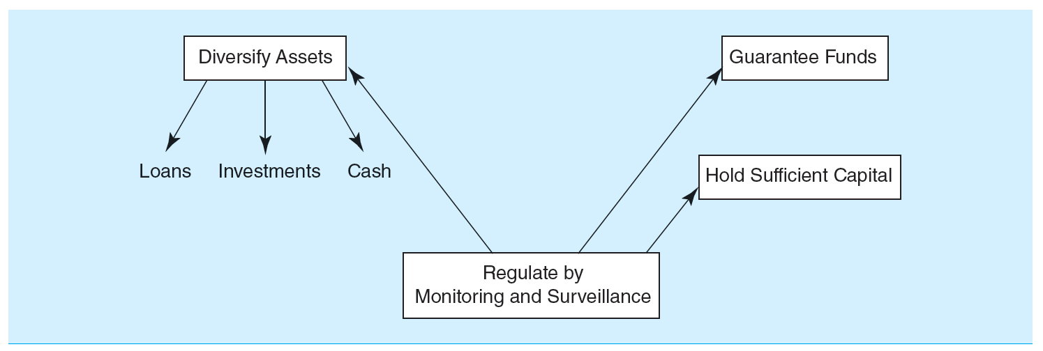
Safety and Soundness Regulation
Safety and soundness regulation
  Exists to protect depositors and borrowers against the risk of CB failure
    E.g., due to a lack of diversification in asset portfolios

Slide 5
5 Objectives of 2010 Wall Street Reform and Consumer Protection Act
#1 - Promote robust supervision and regulation of financial firms by establishing
  A new Financial Services Oversight Council of financial regulators
  A new authority for the Federal Reserve to supervise all firms that could pose a threat to financial stability, even those that do not own banks
  Stronger capital and other prudential standards for all financial firms
  A new National Bank Supervisor to supervise all federally chartered banks
  The elimination of the federal thrift charter for thrifts not dedicated to mortgage lending and other loopholes
  The registration of advisors of hedge funds and other private pools of capital with the Securities Exchange Commission (SEC)

Slide 6
5 Objectives of 2010 Wall Street Reform and Consumer Protection Act Continued
#2 - Establish comprehensive supervision of financial markets by establishing
  The regulation of securitization markets
  Comprehensive regulation of all OTC derivatives
  New authority for the Federal Reserve to oversee payment, clearing and settlement systems
#3 - Protect consumers and investors from financial abuse by establishing
  A new Consumer Financial Protection Agency
  Stronger regulations to improve the transparency, fairness, and appropriateness of consumer and investor products and services
  A level playing field and higher standards for providers of consumer financial products and services

Slide 7
5 Objectives of 2010 Wall Street Reform and Consumer Protection Act Concluded
#4 - Provide the government with the tools it needs to manage financial crises by establishing
  A new regime to resolve crises involving nonbank financial institutions whose failure could have serious systemic effects
  Revisions to the Federal Reserve’s emergency lending authority to improve accountability
#5 - Raise international regulatory standards and improve international cooperation by establishing international reforms to support efforts in the U.S., including strengthening the capital framework, improving oversight of global financial markets, coordinating the supervision of internationally active firms, and enhancing crisis management tools

Slide 8
Monetary Policy and Credit Allocation Regulation
Monetary policy regulation
  Regulators control and implement monetary policy by requiring minimum levels of cash reserves to be held against commercial bank deposits
  CBs often view required reserves as similar to a tax and as a positive cost of undertaking financial intermediation
Credit allocation regulation
  Regulations support the CB’s lending to socially important sectors, such as housing and farming
  May require a CB to hold a minimum amount of assets in one particular sector of the economy or to set maximum interest rates, prices, or fees to subsidize certain sectors
    E.g., qualified thrift lender (QTL) test
13-8
Notes:
8

Slide 9
Consumer Protection Regulation
Consumer protection regulation
  Regulations are imposed to prevent the CB from discriminating unfairly in lending
  Community Reinvestment Act (CRA) of 1977
    CRA ratings range from outstanding to substantial noncompliance, and examinations for compliance have become increasingly rigorous
  Home Mortgage Disclosure Act (HMDA) of 1975
    Especially concerned about discrimination on the basis of age, race, sec, or income
  Consumer Financial Protection Agency (CFPB)
    Created as part of the financial services overhaul bill passed in 2010 to protect consumers from unfair, deceptive and abusive practices
    Example of CFPB oversight occurred in September 2016 when Wells Fargo Bank was ordered o pay $185 million in fines and penalties to settle “the widespread illegal practice of secretly opening unauthorized deposit and credit card accounts”

Slide 10
Investor Protection Regulation
Investor protection regulation
  Considerable number of laws protect investors who use commercial banks directly to purchase securities and/or indirectly to access securities markets through investing in mutual or pension funds managed by CBs
    Protect investors against abuses such as insider trading, lack of disclosure, outright malfeasance, and breach of fiduciary responsibilities
  Securities Act of 1933 and 1934
  Investment Company Act of 1940
  Wall Street Reform and Consumer Protection Act of 2010
Notes:
10

Slide 11
Entry and Chartering Regulation
Entry and chartering regulation
  Entry into commercial banking is regulated
  Activities once a CB has been established are also regulated
Increasing/decreasing the cost of entry into a financial sector affects the profitability of firms already competing in that industry
Barriers to entry and regulations pertaining to the scope of permitted activities affect a CB’s charter value and the size of its net regulatory burden
Notes:
11

Slide 12
Commercial Bank Regulators
U.S. commercial banks may be subject to the supervision and regulations of as many as four separate regulators
  Federal Deposit Insurance Corporation (FDIC)
  Office of the Comptroller of the Currency (OCC)
  Federal Reserve (FR)
  State bank regulators
Facets of regulatory structure
  Regulation of the overall operations
  Regulation of product and geographic operations
  Provision and regulation of deposit insurance
  Balance sheet regulations
Notes:
12

Slide 13
Product Segmentation
Commercial banking and investment banking
  Commercial banking involves deposit taking and lending
  Investment banking involves underwriting, issuing, and distributing securities
The Glass-Steagall Act of 1933 imposed a rigid separation between commercial and investment banks
By 1987, commercial banks were allowed to engage in limited investment banking activity through Section 20 affiliates
The Financial Services Modernization Act (FSMA) of 1999 repealed Glass-Steagall
Notes:
13

Slide 14
Product Segmentation Continued
Banking and insurance
  Bank Holding Company Act (BHCA) of 1956 and the Garn-St. Germain Depository Institutions Act of 1982 restricted insurance companies from owning or being affiliated with full-service banks
  FSMA of 1999 now allows bank holding companies to open insurance underwriting affiliates and also allows insurance companies to open banks
Commercial banking and commerce
  BHCA of 1956 required BHCs to divest themselves of nonbank-related subsidiaries over a 10-year period and effectively restricted acquisitions of banks by commercial firms
  FSMA of 1999 changed restrictions on ownership limits imposed on financial services holding companies
Notes:
14

Slide 15
Product Segmentation Concluded
Nonbank financial service firms and banking
  Relative to the barriers separating banking and either securities, insurance, or commercial sector activities, the barriers among nonbank financial service firms and banking are generally much weaker
  Activities of nonfinancial service firms that perform banking service have been termed shadow banking
  As of 2016, shadow banks continue to be unregulated by the federal government
    However, the 2010 Wall Street Reform and Consumer Protection Act calls for regulators to be given broad authority to monitor and regulate nonbank financial firms that pose risks to the financial system
Notes:
15

Slide 16
Geographic Expansion
Geographic expansions can have a number of dimensions. In particular, they can be
  Domestic
  Within a state or region
  International (participating in a foreign market)
Regulatory factors impacting geographic expansion
  Restrictions on intrastate banking by commercial banks
    By 1994, only one state (Iowa) had not deregulated intrastate banking
  Restrictions on interstate banking by commercial banks
    McFadden Act, passed in 1927 and amended in 1933
    Douglas Amendment to the Bank Holding Company Act, 1956
    By 1994, all states but Hawaii had passed some form of interstate banking law or pact
Notes:
16

Slide 17
Geographic Expansion
Regulatory factors impacting geographic expansion
  Riegle-Neal Interstate Banking and Branching Efficiency Act of 1994
    Allowed U.S. and foreign banks to branch interstate by consolidating out-of-state bank subsidiaries into a branch network and/or by acquiring banks of individual branches of banks through acquisitions or merger
    Result of this is that full interstate banking is a reality in the U.S.
    Relaxation of the branching restrictions, along with recognition of the potential cost, revenue, and risk benefits from geographic expansions, are major reasons for the recent merger wave (and increased consolidation) in U.S. banking
Notes:
17

Slide 18
Deposit Guarantee Funds
The Federal Deposit Insurance Corporation (FDIC)
  The FDIC was created in 1933 during the Depression to restore public confidence in the banking system.
  The initial insurance limit was $2,500; this amount was periodically increased to $100,000, where it remained until the financial crisis of 2007-2008, when it was increased to $250,000
Other laws of the 1930s limited competition among banks
  Regulation Q specified maximum interest rates on deposits and prevented competition on deposit rates
Notes:
18

Slide 19
Deposit Guarantee Funds Continued
System worked extremely well until 1979; from October 1979 to October 1982, the Fed changed its monetary policy strategy by targeting bank reserves rather than interest rates in an attempt to lower the underlying rate of inflation
  Led to a sudden and dramatic rise in interest rates, with T-bill rates rising as high as 16%
Led to disintermediation—i.e., the withdrawal of deposits from depository institutions and their reinvestment elsewhere
Notes:
19

Slide 20
Deposit Guarantee Funds Concluded
Increasing competition and record high interest rates reduced industry profitability, particularly at thrifts
Problems were exacerbated by a policy of regulatory forbearance—i.e., a policy of not closing economically insolvent depository institutions, but allowing their continued operation
Notes:
20

Slide 21
Demise of FSLIC
Federal Savings and Loan Insurance Corporation (FSLIC)
  Insured savings institutions from 1934 to 1989
  Savings institutions failures in the 1980s led to an insolvent FSLIC by 1989
The Financial Institutions Reform, Recovery, and Enforcement Act (FIRREA) of 1989
  Dissolved the FSLIC and transferred management to the FDIC
  Restructured savings association fund was renamed the Savings Association Insurance Fund (SAIF)
  Restructured bank insurance fund was renamed the Bank Insurance Fund (BIF)
Notes:
21

Slide 22
Reform of Deposit Insurance
The FDIC introduced risk-based deposit insurance premiums in January of 1993
  In 1996, the safest institutions insured by the BIF paid no deposit insurance premiums
  In 1997, the safest institutions insured by the SAIF paid no deposit insurance premiums
  By the early 2000s, over 90% of depository institutions paid the statutory minimum premium, and the average assessment rate was less than 0.1 cent per $100 of deposits
In March 2006, the BIF and the SAIF were merged into the Deposit Insurance Fund (DIF)
In January 2007, the FDIC began a more aggressive risk-based system
Notes:
22

Slide 23
Balance Sheet Regulation
Liquidity regulation
  Banks must hold minimum levels of reserves against net transaction accounts
  Ensures that banks can meet required payments on liability claims, such as deposit withdrawals
  See Appendix 13B for more details
Notes:
23

Slide 24
Balance Sheet Regulation Continued
Under Basel III, Dis must calculate and monitor four capital ratios
  Common equity Tier I RBC ratio
    Common equity Tier I capital / Credit risk-adjusted assets
  Tier I RBC ratio
    Tier I capital (common equity Tier I capital + additional Tier I capital) / credit risk-adjusted assets
  Total RBC ratio
    Total capital (Tier I + Tier II) / credit risk-adjusted assets
  Tier I leverage ratio
    Tier I capital / total exposure
Notes:
24

Slide 25
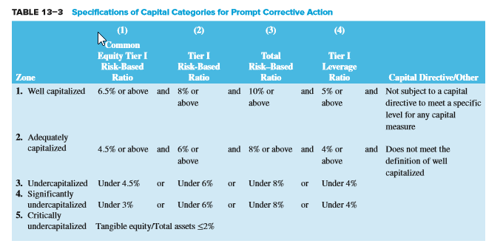
Specifications of Capital Categories for Prompt Corrective Action (PCA)
Notes:
25

Slide 26
Balance Sheet Regulation Concluded
Credit risk-adjusted assets
  Credit risk-adjusted on-balance-sheet assets
  Credit risk-adjusted off-balance-sheet assets
Capital conservation buffer
  Designed to ensure that Dis build up a capital surplus, or buffer, outside period of financial stress that can be drawn down as losses are incurred during period of financial stress
Countercyclical capital buffer
  May be declared by any country experiencing excess aggregate credit growth
  Aims to protect the banking system and reduce systemic exposures to economic downturns
Notes:
26

Slide 27
Foreign vs. Domestic Regulation
Regulation of U.S. banks in foreign countries
  The Overseas Direct Investment Control Act of 1964 restricted U.S. banks’ ability to lend to U.S. corporations to make foreign investment
  The North American Free Trade Agreement (NAFTA) of 1994 enabled U.S. banks to expand to Mexico and Canada
  A 1997 agreement between 100 countries (under the World Trade Organization (WTO)) began dismantling barriers inhibiting foreign direct investment into emerging countries
Notes:
27

Slide 28
Foreign vs. Domestic Regulation Continued
The International Banking Act (IBA) of 1978 declared foreign banks are to be regulated the same as national domestic banks
  Foreign banks are subject to Federal Reserve examinations
The Foreign Bank Supervision Enhancement Act (FBSEA) of 1991 gave additional powers to the Federal Reserve
  Fed must approve new subsidiary, branch, agency, or representative offices of foreign banks in the U.S.
  Fed has the authority to close foreign banks operating in the U.S.
Notes:
28

Slide 29
Calculating Deposit Insurance Premium Assessments
FDIC Reform Act of 2005
  Instituted a deposit insurance premium scheme, effective January 1, 2007 (and subsequently revised) that combined examination ratings and financial ratios
    Risk Category I contains all well-capitalized institutions in Supervisory Group A (generally those with CAMELS ratings of 1 or 2)
    Risk Category II contains all institutions in Supervisory Groups A and B (generally those with CAMELS ratings of 1, 2, or 3) except those in Risk Category I and undercapitalized institutions
    Risk Category III contains all undercapitalized institutions in Supervisory Groups A and B and institutions in Supervisory Group C
Notes:
29

Slide 30
Calculating Minimum Required Reserves at U.S. DIs
U.S. bank regulation concentrates on a bank’s management of its cash reserves, defined as vault cash and cash deposits held by the bank at the Federal Reserve
The reserve computation period always begins on a Tuesday and ends on a Monday 14 days later
Reserve maintenance period is the period over which deposits at the FRB must meet or exceed the required reserve target
  Lagged reserve accounting versus contemporaneous reserve accounting systems
Notes:
30

