Slide 1
Chapter Fourteen
Other Lending Institutions: Savings Institutions, Credit Unions, and Finance Companies

Slide 2
Savings Institutions (SIs)
Comprise two groups of DIs: savings associations and savings banks
  Savings associations were historically referred to as Savings and Loans (S&Ls) associations
Specialize in long-term residential mortgages, which are usually financed with short-term deposits of small savers
Faced a major crisis during the 1982-1992 period, resulting in the failure of half of SIs
Notes:
2

Slide 3
The S&L Crisis of 1982-1992
Alarming number (1,248) of savings institution failures occurred in the 1982-1992 period, peaking at 316 in 1989
Rapid decline in asset growth of the industry
The Federal Reserve radically changed its monetary policy during October 1979 to October 1982
  Targeted reserves rather than interest rates
  Led to sudden surge in interest rates
  Many SIs faced negative net interest margins
  SIs lost depositors because of Regulation Q
Notes:
3

Slide 4
The S&L Crisis of 1982-1992 Continued
Real estate and land prices collapsed in many areas of the U.S. in the mid-1980s
  Many mortgages defaulted as a result
The Federal Savings and Loan Insurance Corporation (FSLIC) had a policy of regulatory forbearance
  policy was to not close economically insolvent FIs, allowing them to continue to operate
Notes:
4

Slide 5
The S&L Crisis of 1982-1992 Concluded
The Financial Institutions Reform, Recovery, and Enforcement Act (FIRREA) of 1989
  Abolished the FSLIC
  Created a new Savings Association Insurance Fund (SAIF) that was put under the management of the Federal Deposit Insurance Corporation (FDIC)
  Replaced the Federal Home Loan Bank Board with the Office of Thrift Supervision (OTS)
  Created the Resolution Trust Corporation (RTC) to close and liquidate insolvent SIs
  The Qualified Thrift Lender Test (QTL) sets a floor on the mortgage-related assets that thrifts must hold (currently at 65%)
  Introduced Prompt Corrective Action (PCA), which mandates that regulators must close problem banks and thrifts faster
Notes:
5

Slide 6
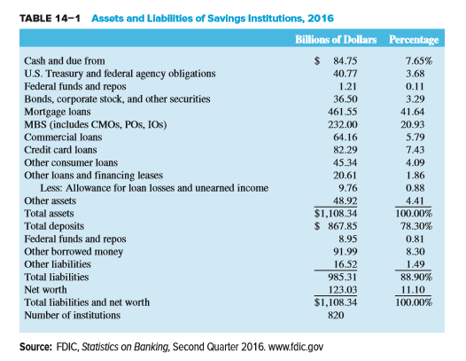
Assets and Liabilities of SIs, 2016
Notes:
6

Slide 7
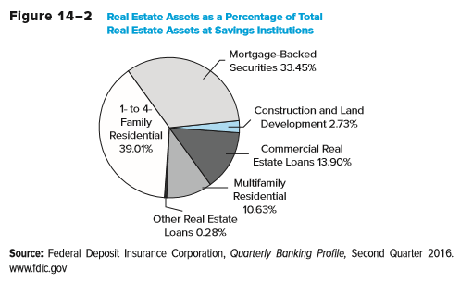
Real Estate Assets
Notes:
7

Slide 8
SI Balance Sheets
Assets
  Mortgages (41.64%) and mortgage-backed securities (20.93%) represent 62.57% of total assets
    This compares to less than 40% for commercial banks
  Commercial loans and consumer loans amounted to just 5.79% and 11.52% of SI assets, respectively
    This compares to 12.16% and 8.84% for commercial banks, respectively
Liabilities
  Transaction accounts and small time and savings deposits are the predominant source of funds, with total deposits accounting for 78.30% of total liabilities and net worth
Net worth is the book value of the equity holders’ capital contribution
Notes:
8

Slide 9
Regulators of SIs
Main regulators of savings institutions
  #1 - Office of the Comptroller of the Currency
    Established in 1989 under FIRREA
    Chartered and examined all federal savings institutions, and supervised the holding companies of savings institutions
    Wall Street Reform and Consumer Protection Act of 2010 mandated the consolidation of the Office of Thrift Supervision and the OCC, and now the OCC regulates both national banks and federal savings institutions
  #2 - The FDIC
    Also established in 1989 under FIRREA
    Oversaw and managed the Savings Association Insurance Fund (SAIF)
    FDIC merged the SAIF and the Bank Insurance Fund (BIF) in 2007
  #3 - Other regulators (i.e., state regulators)
Notes:
9

Slide 10
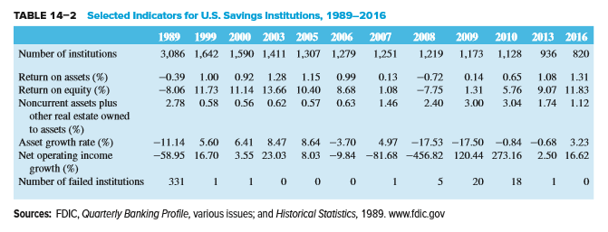
Selected Indicators for U.S. Savings Institutions, 1989 through 2016
Notes:
10

Slide 11
Credit Unions (CUs)
Credit unions (CUs) are nonprofit depository institutions mutually organized and owned by their members (depositors)
First established in the early 1900s as self-help organizations
  Members deposit savings and the funds are lent to other members
CUs are prohibited from serving the general public—i.e., members are required to have a common bond of occupation, association, etc.
  E.g., university-affiliated CUs, police CUs, etc.
Because CUs are nonprofit organizations, their earnings are not taxed
  May offer higher interest rates than commercial banks on deposits
  May charge lower interest rates than commercial banks on loans
Notes:
11

Slide 12
Credit Unions (CUs) Continued
Most numerous of all depository institutions
  6,105 CUs in 2016
  107.6 million members
Less affected by the crisis of the 1980s that hit SIs and CBs
  Traditionally make small (< $10,000) consumer loans
  Loans are funded with member deposits
  Small amounts of residential mortgages
  Tend to hold large amounts of safe, liquid government securities as assets
    E.g., 14.7% of assets in 2016
Notes:
12

Slide 13
Credit Unions (CUs) Concluded
National credit union system consists of three tiers
  U.S. Central Credit Union is the top tier
    Provides investment and liquidity services to Corporate CUs
  12 corporate credit unions comprise the middle tier at the state or regional level
    Cooperatively owned by their member CUs
    Serve members by investing and lending excess funds that member CUs place with them
    Provide automated settlement, securities safekeeping, data processing, accounting, and payment services
  Individual credit unions make up the bottom tier
Notes:
13

Slide 14
Credit Union (CU) Trends
Recently, CUs have expanded their services to compete with CBs and SIs
  Many have converted to a common charter
  Now offer mortgages, credit lines, and mobile banking
  Some offer business and commercial loans to their employer groups
Banking industry challenged CU expansion in 1997
  Feb 1998 - Supreme Court sided with the banking industry
  Later that year, Congress quickly passed a bill that sided with CUs
Notes:
14

Slide 15
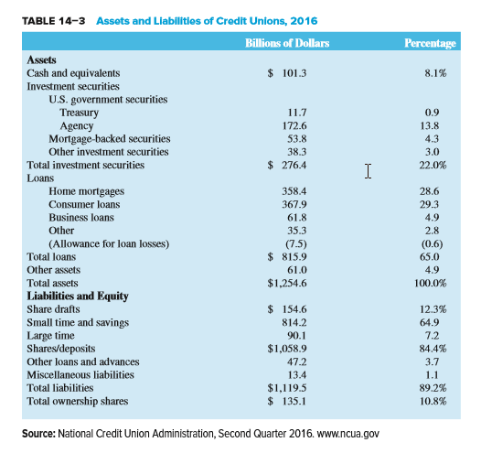
Assets and Liabilities of Credit Unions, 2016
Notes:
15
CU equity is the accumulation of past earnings that is “owned” collectively by member depositors

Slide 16
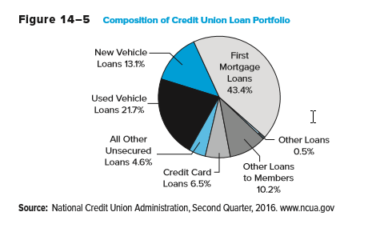
Composition of CU Loan Portfolio
Notes:
16

Slide 17
CU Regulators and Industry Performance
As of 2016, 62.5% of CUs were federally chartered
  Subject to regulation by the National Credit Union Administration (NCUA)
  Deposit insurance is provided by the National Credit Union Share Insurance Fund (NCUSIF)
    NCUSIF covers 98% of all credit union deposits
Remaining CUs are regulated at the state level
Membership increased from 77.5 million to 107.6 million from 1999 to 2016
Notes:
17

Slide 18
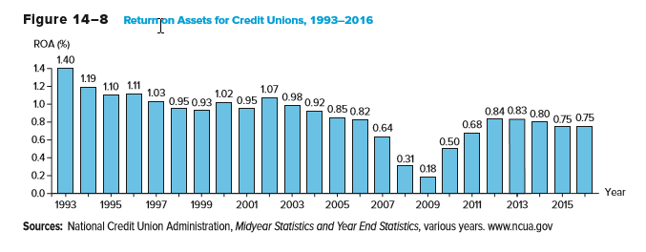
Return on Assets for Credit Unions, 1993 through 2016
Notes:
18

Slide 19
Finance Companies (FCs)
There are three major types of finance companies (FCs)
  Sales finance institutions specialize in loans to customers of a particular retailer or manufacturer
  Personal credit institutions specialize in installment and other loans to consumers
  Business credit institutions specialize in business loans, especially through equipment leasing and factoring
    Factoring is the process of purchasing accounts receivable from corporations, usually with no recourse to the seller should the receivables go bad
Notes:
19

Slide 20
Finance Companies (FCs) Continued
Industry assets were $1,820.6 billion in 2016
FC industry is highly concentrated
  The 20 largest FCs account for more than 65% of industry assets
  Many of the largest FCs tend to wholly owned or captive subsidiaries of major manufacturing companies
    E.g., Ford Motor Credit is a subsidiary of Ford Motor
Notes:
20

Slide 21
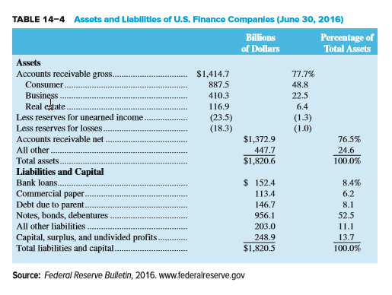
Assets and Liabilities of U.S. Finance Companies, June 2016
Notes:
21

Slide 22
Balance Sheets of FCs
Some finance companies make loans to riskier customers at higher interest rates than CBs
  Subprime lenders are FCs that lend to high-risk customers
  Loan sharks are subprime lenders that charge unfairly exorbitant rates to desperate, subprime borrowers
  Payday lenders provide short-term cash advances that are often due when borrowers receive their next paycheck
    An estimated 12 million Americans used payday loans in 2016
Notes:
22

Slide 23
Balance Sheets of FCs Continued
FCs often have advantages over CBs with respect to business loans because FCs:
  Are not subject to regulations that restrict the type of products and services they can offer
  Do not accept deposits—accordingly, bank-type regulators do not monitor their behavior
  Often have substantial industry and product expertise
  Are more willing to accept risky customers
  Generally have lower overhead than CBs
Notes:
23

Slide 24
Balance Sheets of FCs Concluded
Real estate loans
  Second mortgages are in the form of home equity loans, i.e., loans that let customers borrow on a line of credit secured with a second mortgage on their home
  Securitized mortgage assets are mortgages purchased and used as assets backing secondary market securities
  Mortgage servicing is a fee-related activity whereby the flow of mortgage repayments is collected and passed on to investors in whole mortgage loan packages or securitization vehicles
Notes:
24

Slide 25
FC Performance
Problems arose in the FC industry in the mid- and late-2000s with the crash of the market for subprime mortgage loans
  Many FCs saw sharply lower equity values
FCs are subject to state-imposed usury ceilings and additional restrictions have been imposed on payday loans in many states
Because FCs do not accept deposits, they are not subject to the extensive oversight common among CBs, SIs, and CUs
FC industry improved in the mid-200s and early 2010s
  In the mid-2010s, industry median ROE rose to 9.33%, up from 6.61% during the height of the crisis, for business credit institutions
  During the mid-2010s, industry median ROE rose to 13.73%, up from 5.31% during the height of the crisis, for personal credit institutions
Notes:
25

Slide 26
FC Performance Continued
Between 2005 and 2007, home prices began to fall and borrowers faced rising interest rates, resulting in more people defaulting on their mortgages
Mortgage loan delinquencies and small business loan failure rates peaked in 2008 and 2009, hurting overall profitability
Crash in the subprime mortgage market led to serious problems for the U.S. and worldwide economies as a whole
  Countrywide Financial failed, GMAC Financial Services was forced to convert to a bank holding company to prevent failure, and CIT Group also failed
Financial crisis issues remained even into 2016
  Industry receivables stood at $1.42 trillion in the mid-2010s, down from $1.93 trillion during the crisis, while industry employment was 562,400 in the mid-2010s, down from 715,900 as the crisis began
Notes:
26

Slide 27
Global Issues
Unlike the U.S., SIs in Europe traditionally catered to the commercial industry
The majority of SIs in Europe are mutuals
SIs worldwide are quite small compared to CBs
Nonbank FI lending has increased in both Latin America and in Europe in the last decade, although there were failures, restructurings and consolidations from the financial crisis
Many foreign SIs operate cooperatively to fund local development rather than focus on profitability
Notes:
27

