Slide 1
Chapter Fifteen
Insurance Companies

Slide 2
Insurance Companies (ICs)
The primary function of insurance companies is to compensate policyholders if a prespecified event occurs, in exchange for premiums paid
  Insurance underwriters assesses and prices risks
  Insurance brokers sells insurance contracts
Insurance is broadly classified into two groups
  Life insurance policies provide protection against untimely death or illness, and/or transfer wealth through time to retirement
  Property-casualty insurance protects against property damage, personal injury and liability associated with specific events
Insurance companies also sell a variety of investment products, similar to other FIs
Notes:
2

Slide 3
Life Insurance Companies
872 life insurance companies existed in the U.S. in 2015
  Compares to over 2,300 in 1988
  The industry has seen consolidation to take advantage of scale and scope economies
Aggregate industry assets were $6.47 trillion at the beginning of 2016
  Compares to $1.12 trillion in 1988
The four largest life insurers wrote 30.5% of the industry’s over $681 billion premiums in 2015
  Many of these policies are sold through commercial banks
  For example, in 2015 commercial banks sold over 17% of all annuity contracts
Notes:
3

Slide 4
Life Insurance Companies Continued
Life insurers pool the risks of individuals to diversify away some of the customer-specific risk
  Thus, they are able to offer insurance services at a cost lower than any individual could achieve on his/her own
  This allows the transfer of income related uncertainties from the individual to the group
Other activities of life insurance companies:
  Sell annuities, which are savings contracts that involve the liquidation of those funds saved over a period of time
  Manage pension plans (e.g., tax-deferred savings plans)
  Provide accident and health insurance
Notes:
4

Slide 5
Life Insurance Companies Concluded
Insurance companies accept or underwrite risk that a pre-specified event will occur in return for insurance premiums
  Underwriting decisions determine which risks are accepted and which are not
  Underwriting decisions determine how much to charge (in the form of premiums) for accepted risks
The adverse selection problem is the problem that customers who apply for insurance policies are more likely to be those in need of coverage
Notes:
5

Slide 6
The Role of Actuaries
Actuaries reduce the risks of underwriting and selling insurance
  With traditional life insurance, actuaries analyze mortality, produce life tables, and apply time-value-of-money tools to price life insurance, annuities, and endowment policies
  With health insurance, actuaries analyze the rates of disability, morbidity, mortality, fertility, etc.
Notes:
6

Slide 7
The Four Types of Life Insurance
#1 - Ordinary life insurance is marketed to individuals—policyholders make periodic premium payments in exchange for coverage
  Term life is the closest to pure life insurance; has no savings element attached
  Whole life protects the individual over an entire lifetime rather than for a specified coverage period
  Endowment life combines a pure (term) insurance element with a savings element
  Variable life invests fixed premium payments in mutual funds of stocks, bonds, and money market instruments
  Universal life and variable universal life
Notes:
7

Slide 8
The Four Types of Life Insurance Continued
#2 - Group life insurance covers a large number of persons under a single policy
  Contributory—both the employer and the employee cover a share of the premiums
  Noncontributory—the costs are borne entirely by the employer
#3 - Credit life insurance protects lenders against borrower death prior to the repayment of a debt contract, such as a mortgage or car loan
Notes:
8

Slide 9
The Four Types of Life Insurance Concluded
#4 – Other activities include the sale of annuities, private pension plans, and accident and health insurance
  Annuities represent the reverse of life insurance principals
    Popular among individuals as a mechanism used to save for retirement
    Annuity sales in 2015 topped $236.7 billion
  In 2016, life insurance companies were managing over $3.6 trillion in pension fund assets, equal to 41% of all private pension plans
  More than $171 billion in premiums were written annually by life and health companies in accident-health in 2015
Notes:
9

Slide 10
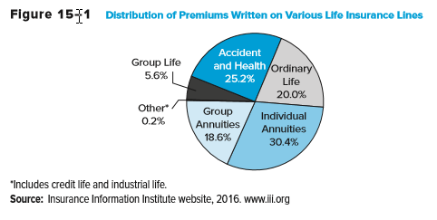
Distribution of Premiums Written on Various Life Insurance Lines
Notes:
10

Slide 11
Annuities Example
You have a policy with a cash value of $250,000 which you wish to annuitize. You are currently 62 years old and your spouse is 58. Interest rates are 5% per year, and you are considering receiving monthly payments under three options.
  In option 1, you will receive 10 years of monthly payments.
  With option 2, you will receive a monthly payment until you die, which is expected to be in 14 years.
  With option 3, you will receive a monthly payment until both you and your spouse die. Your spouse is expected to outlive you by 8 years.
How much will you receive per month with each option (ignoring administrative costs and fees)?
Notes:
11

Slide 12
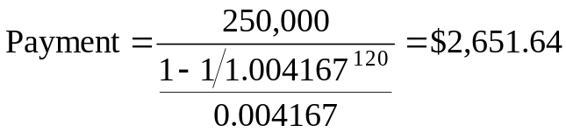


Annuities Example Continued
In option 1, you will receive 10 years of monthly payments.
With option 2, you will receive a monthly payment until you die, which is expected to be in 14 years.
With option 3, you will receive a monthly payment until both you and your spouse die. Your spouse is expected to outlive you by 8 years.
Notes:
12

Slide 13
Balance Sheets and Recent Trends
Assets
  Life insurers concentrate their asset investments at the longer end of the maturity spectrum
    E.g., corporate bonds, equities, and government securities
    In 2016, 10.8% of assets were invested in government securities, 67.6% in corporate bonds and stocks, and 6.8% in mortgages
Liabilities
  Net policy reserves made up $2.9 trillion, or 44.1% of total liabilities and equity
  To meet unexpected future losses, life insurers hold a capital and surplus reserve fund with which to meet such losses
    Reserves for life insurers in 2016 totaled $280.8 billion, or 5.9% of total liabilities and capital
Notes:
13

Slide 14
Balance Sheets and Recent Trends Continued
Insurers earn profits by taking in more premium income than they pay out in policy payments
  Firms can increase their spread between premium income and policy payouts in two ways:
  #1 – Decrease future required payouts for any given level of premium payments
    Accomplished by reducing the risk of the insured pool
  #2 – Increase the profitability of interest income on net policy reserves
Treasury Department extended bailout funds to a number of struggling life insurers in late 2008/early 2009
  E.g., AIG, Hartford Financial Services Group, Prudential Financial, Lincoln Financial, and Allstate
Notes:
14

Slide 15
Regulation
McCarren-Ferguson Act of 1945 confirmed primacy of states over federal regulation of ICs
  State insurance commissions charter and examine ICs
  The National Association of Insurance Commissioners (NAIC) has developed a coordinated examination system
States promote insurance guarantee funds
  Funds are run by the insurance companies themselves
  Contributions are paid only when an IC fails (except in NY)
The Financial Services Modernization Act (FSMA) of 1999 allowed CBs, IBs, and ICs to exist as subsidiaries under one Financial Holding Company (FHC)
Notes:
15

Slide 16
Regulation Continued
During the financial crisis, Congress considered adding a federal regulator of the insurance industry, but left regulation to the states
Wall Street Reform and Consumer Protection Act of 2010 created the Federal Insurance Office (FIO) that reports to Congress and the President on the insurance industry
  The FIO is supposed to identify systemic risks arising from insurers, monitor international insurance events, eliminate state regulatory gaps and encourage the offering of insurance products to underserved segments
  The Financial Stability Oversight Council (FSOC) is charged with identifying any financial institution (including insurance companies) that presents a systemic risk to the economy and subjecting such institutions to greater regulation
Notes:
16

Slide 17
Property-Casualty (P&C)
Insurance Companies
Currently, 2,544 companies sell property-casualty (P&C) insurance, and approximately half of those firms write P&C business in all or more of the U.S.
  Top 10 firms have a 50% market share
  Top 200 firms have more than a 95% market share
  In 2016, State Farm was the top firm, writing 11.3% of all P&C insurance premiums
Property insurance involves coverage related to the loss of real and personal property
Casualty insurance offers protection against legal liability exposure
Notes:
17

Slide 18
P&C Lines
Fire insurance and allied lines
  Protects against the perils of fire, lightning, and removal of property damaged in a fire
Homeowners multiple peril (MP) insurance
  Protects against multiple perils of damage to a personal dwelling and personal property, as well as liability coverage against the financial consequences of legal liability resulting from the injury to others
Commercial multiple peril (MP) insurance
  Protects commercial firms against perils similar to homeowners
Automobile liability and physical damage (PD) insurance
  Provides protection against losses resulting from legal liability due to the ownership/use of the vehicle and theft or damage to vehicles
Liability insurance (other than auto)
Notes:
18

Slide 19
Balance Sheets of P&C Companies
Assets
  P&C companies invest the majority of their assets in long-term securities, but hold a lower proportion in common stock than do life insurance companies
  Bonds, preferred stock, and common stock made up 71.7% of total assets in 2016
Liabilities
  Loss reserves and loss adjustment expenses are a major component (34.4% of total liabilities and capital)
    Loss reserves are funds set aside to meet expected losses from underwriting the P&C lines
    Loss adjustment expenses are the expected administrative and related costs of settling claims
Notes:
19
Unearned premiums, reserves set aside that contain the portion of a premium that has been paid before insurance coverage has been provided, are also a major liability and make up 13.2% of total liabilities and capital.

Slide 20
Underwriting Risk
Underwriting risk is the risk that premiums are insufficient to cover losses and administrative expenses after taking into account investment income
Underwriting risk may result from:
  Unexpected increases in loss rates
  Unexpected increases in expenses
  Unexpected decreases in investment yields
Notes:
20

Slide 21
Loss Risk and Expense Risk
Loss risk is a function of actuarial predictability
  Property vs. liability
  Severity vs. frequency
  Long tail vs. short tail
  Product inflation vs. social inflation
Loss risk is a measure of pure losses incurred to premiums earned
  Premiums earned are premiums received and earned on insurance contracts because time has passed with no claim filed
Expense risk occurs from two major sources:
  Loss adjustment expenses (LAE)
  Commissions and other expenses
Notes:
21

Slide 22
Property-Casualty (P&C) Key Ratios
The combined ratio is a measure of overall profitability
  Equals the loss ratio plus the ratios of loss-adjusted expenses to premium earned as well as commission and other acquisition costs to premiums written plus any dividends paid to policyholders as a proportion of premiums earned
Investment yield is measured as net interest income divided by premiums earned
The operating ratio is also a measure of overall profitability
  Equals the combined ratio minus the investment yield
Notes:
22

Slide 23
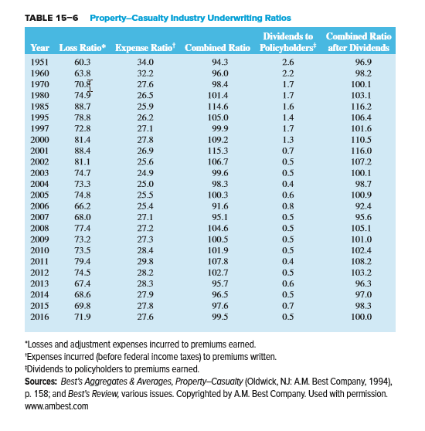
P&C Industry Underwriting Ratios
Notes:
23

Slide 24
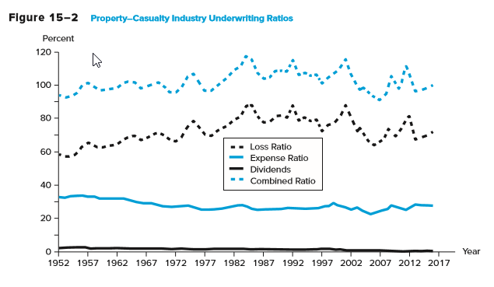
P&C Industry Underwriting Ratios Continued
Notes:
24

Slide 25
P&C Recent Trends
Many catastrophes of historically high severity have occurred recently
  See Figure 15-3 for a list of U.S. catastrophes between 1949 and 2016
An underwriting cycle is a pattern that the profits in the P&C industry tend to follow
The federal government has consistently increased their role of providing compensation and reconstruction assistance following natural disasters
Notes:
25

Slide 26
Property-Casualty (P&C)
Insurance Regulation
P&C insurers are chartered at the state level
P&C insurers are regulated by state commissioners
State guarantee funds provide (some) protection to policyholders, similar to the manner described for life insurance companies
The NAIC provides services to state regulatory commissions such as the Insurance Regulatory Information System (IRIS)
Given the social welfare importance of some lines (e.g., workers’ compensation and auto insurance), state commissioners often set ceilings on the premiums and premium increases in these lines
Notes:
26

Slide 27
Global Issues
The U.S., Japan, China, the U.K., and France are the world’s five largest countries in terms of insurance premiums written
Worldwide, 2012 was the third costliest year for the worldwide insurance industry (after 2011 and 2005)
  Natural disasters cost insurers $65 billion in 2012
  Losses in the U.S. accounted for 90% of the total
In 2012, total economic costs from natural disasters amounted to $160 billion, compared with $400 billion in 2011
Notes:
27

