Slide 1
Chapter Sixteen
Securities Firms and Investment Banks

Slide 2
Securities Firms and Investment Banks (IBs)
Investment banks (IBs) help corporations and governments raise capital through debt and equity security issues in the primary market
  Underwriting is assisting in issuing new securities
  IBs also advise on mergers and acquisitions (M&As) and corporate restructuring
Securities firms assist in the trading of securities in secondary markets
  Broker-dealers assist in the trading of existing securities
Notes:
2

Slide 3
Size, Structure and Composition of Industry
The size of the industry is usually measured by the equity capital of firms rather than total asset size
  Equity capital in the industry in 2015 was $235 billion
The number of firms in the industry changed due to economies of scale and scope, losses with the economy, scandals at some firms, and regulations that allowed both inter- and intra-industry mergers
  5,248 firms in 1980
  9,515 firms in 1987
  6,016 firms in 2006
  4,115 firms in 2016
As with commercial banks, consolidation has largely occurred through mergers and acquisitions
Notes:
3

Slide 4
Subgroups of National Full-Service Firms
#1 - Commercial bank or financial services holding companies
  Largest of the full-service investment banks
  Extensive domestic and international operations
  Offer advice, underwriting, brokerage, trading, and asset management services
#2 - National full-service firms specializing in corporate finance or primary market activities
  Highly active in trading securities, or secondary market activities
#3 - Large investment banks maintain more limited branch networks concentrated in major cities
  Operate with predominantly institutional client bases
Notes:
4

Slide 5
Investment Banking
Investment banking
  First time debt and equity issues occur through initial public offerings (IPOs)
  New issues from a firm whose debt or equity is already traded are called seasoned security offerings
  A private placement is a securities issue that is placed with one or a few large institutional investors
  Public offerings are offered to the public at large
  IBs act only as an agent in best efforts underwriting
  IBs act as principals in firm commitments
Notes:
5

Slide 6
Venture Capital
Venture capital (VC) is a professionally managed pool of money used to finance new (i.e., start-up) and often high-risk firms
  VC usually purchases an equity stake in the start-up
  VC firms are not generally passive investors, but instead provide valuable expertise to the firm’s managers
  Institutional venture capital firms find and fund the most promising new firms
    Venture capital limited partnerships
    Financial venture capital firms
    Corporate venture capital firms
Notes:
6

Slide 7
Venture Capital vs. Private Equity
Private equity investments
  Private equity (PE) differs from VC in funds sources and in types of investments
    PE firms raise funds by selling securities rather than commingling private funds
    PE firms often acquire established existing firms rather than purchase start-ups
Notes:
7

Slide 8
Market Making
Market making involves the creation of secondary markets for an issue of securities
  Agency transactions are two-way transactions made on behalf of customers
  With principal transactions, market makers seek to profit for their own accounts
In 2016, J.P. Morgan Chase managed over $53 trillion in derivative securities (28% of all derivative securities held by FIs)
Notes:
8

Slide 9
Trading
Trading involves taking an active net position in an underlying instrument or asset
  Position trading involves relatively long-term views of market trends
  Pure arbitrage involves attempts to profit from price discrepancies
  Risk arbitrage involves attempts to profit by forecasting information releases
  Program trading is the simultaneous buying and selling of at least 15 different stocks valued at $1 million or more
  Stock brokerage involves trading on behalf of customers
  Electronic brokerage offers customers direct access, via the internet, to the trading floor
Notes:
9

Slide 10
Investing and Cash Management
Investing involves managing pools of assets such as closed- and open-end mutual funds
  As agents
  As principals
Cash management involves offering deposit-like accounts, such as money market mutual funds (MMMFs), that offer check writing privileges
Notes:
10

Slide 11
Mergers and Acquisitions
Investment banks frequently provide advice on, and assistance in, mergers and acquisitions
  Assist in finding merger partners
  Underwrite any new securities to be issued by the merged firms
  Assess the value of target firms
  Recommend terms of the merger agreement
  Assist target firms in preventing a merger
M&A activity
  $1.15 trillion for the first nine months of 2016
Notes:
11

Slide 12
Other Service Functions
Other Service Functions
  Custody and escrow services
  Clearance and settlement services
  Research and advisory services
IBs are making increasing inroads into traditional bank service areas, such as small-business lending and the trading of loans
Notes:
12

Slide 13
Industry Performance
Industry trends depend heavily on the state of the stock market and the economy
  Commission income fell after the 1987 stock market crash
  Improvements in the U.S. economy in the mid-2000s led to increases in commission income, but income fell with the stock market in 2006-2008 because of rising oil prices and the subprime mortgage collapse
  Commission income again rose to between 15 and 20 percent of total revenues as the economy and the stock market recovered in the early- and mid-2010s
Notes:
13

Slide 14
Industry Performance Continued
By the mid-2010s, while the industry had put most problems from the financial crisis behind it, the industry was affected by post-crisis consequences, with increased regulation on risk taking and capital requirements
  This has led to balance sheet reductions, as well as downsizing or disposition of select businesses, trading products, and investments
  Corporate strategies increasingly focus on client services and away from making large bets through principal investments
Notes:
14

Slide 15
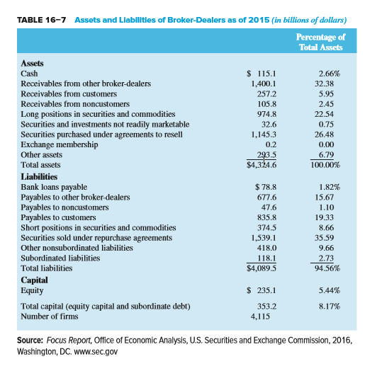
Assets and Liabilities of Broker-Dealers as of 2015
Notes:
15

Slide 16
Regulation
The Securities and Exchange Commission (SEC) is the primary regulator of the securities industry
The National Securities Markets Improvement Act (NSMIA) of 1996 reaffirmed federal (over state) authority
  Even so, state attorneys generally intervene through securities-related investigations that have led to many highly publicized criminal cases
Notes:
16

Slide 17
NSMIA of 1996
The National Securities Markets Improvement Act (NSMIA) of 1996
  Reaffirmed the significance of the SEC as the primary regulatory of securities firms
  States are not allowed to require federally registered securities firms to be registered in a state as well
  States are prohibited from requiring registrations of securities firms’ transactions and from imposing substantive requirements on private placements
  Effectively gives the SEC primary regulatory jurisdiction over securities firms
Notes:
17

Slide 18
Regulation Continued
While the SEC sets the overall regulatory standards for the industry, the Financial Industry Regulatory Authority (FINRA) is involved in the day-to-day regulation of trading practices
  FINRA is an independent, not-for-profit organization as opposed to the SEC, which is a government run regulator
  FINRA writes and enforces rules governing the activities of securities firms, examines firms for compliance with those rules, works to foster market transparency, and supports investor education
Wall Street Reform and Consumer Protection Act of 2010
Notes:
18

Slide 19
Regulation Concluded
U.S. Congress also oversees the industry
  U.S. Senate Permanent Subcommittee on Investigations was created with the broad mandate to determine whether any changes are required in U.S. law to better protect the public
  Spring of 2010
    Subcommittee hearing focused on the contributing role of investment banks in the financial crisis
    Subcommittee brought up evidence and internal Goldman documents that showed Goldman knew the housing market was on the brink of collapse but continued to sell mortgage-backed securities to investors
Notes:
19

Slide 20
SIPC
Securities Investor Protection Corporation (SIPC)
  Not an agency or establishment of the U.S. government and has no authority to regulate its member broker-dealers
  SIPC was created under the Securities Investor Protection Act of 1970 as a non-profit membership corporation
  SIPC oversees the liquidation of member broker-dealers that close when the broker-dealer is bankrupt or in financial trouble and customer assets are missing
  SIPC’s focus is on restoring customer cash and securities left in the hands of bankrupt of otherwise financially troubled brokerage firms
Notes:
20

Slide 21
Global Issues
Securities firms and investment banks are by far the most global of any group of financial institutions
As a result of the financial crisis of the late 2000s, large investment banks around the world became concerned with capital, liquidity, and leverage, but did not want to lose ground in the global competition for clients
  Result was that global investment banks looked for strategic alliances that would allow them to compete in foreign markets or they exited foreign markets altogether
Increase in cross-border strategic alliances
Notes:
21

Slide 22
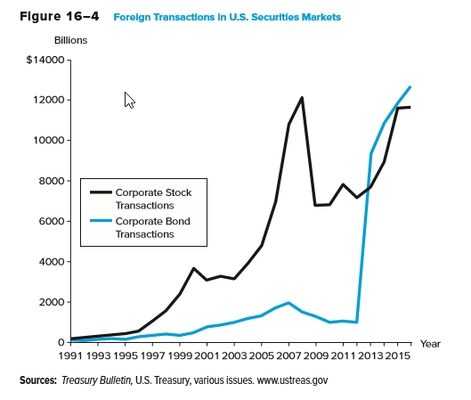
Foreign Transactions in U.S. Securities Markets
Notes:
22

Slide 23
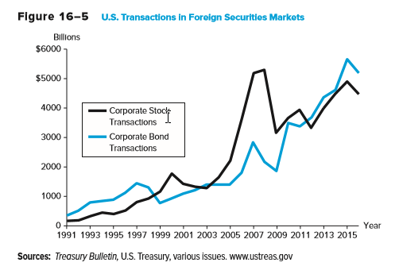
U.S. Transactions in Foreign Securities Markets
Notes:
23

Slide 24
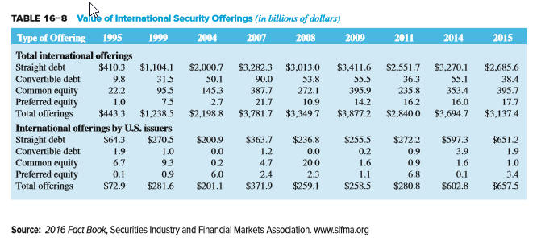
Value of International Security Offerings
Notes:
24

