Slide 1
Chapter Seventeen
Investment Companies

Slide 2
Investment Companies
Open-end mutual funds sell new shares to investors and redeem outstanding shares on demand at their fair market values
  The first MF was established in Boston in 1924
  By 1970, 361 MFs held about $50 billion in assets
Hedge funds (HFs) are a type of investment pool that solicits funds from (wealthy) individuals and other investors (e.g., commercial banks) and invests these funds on their behalf
Money market mutual funds (MMMFs) were introduced in 1972
Tax-exempt MMMFs were introduced in 1979
By 2016, 8,105 MFs held over $16 trillion in assets

Slide 3
Mutual Fund Industry
Cash flows into MFs are highly correlated with the return on stock markets
Growth has also resulted from the rise in retirement funds under management by MFs
  MFs manage ~ 25% of retirement fund assets
MFs are the second most important group of FIs as measured by asset size; second only to depository institutions
  Banks’ share of all MF assets was 5% in 2016
  Insurance companies managed 5% of MF industry assets in 2016
Notes:
3

Slide 4
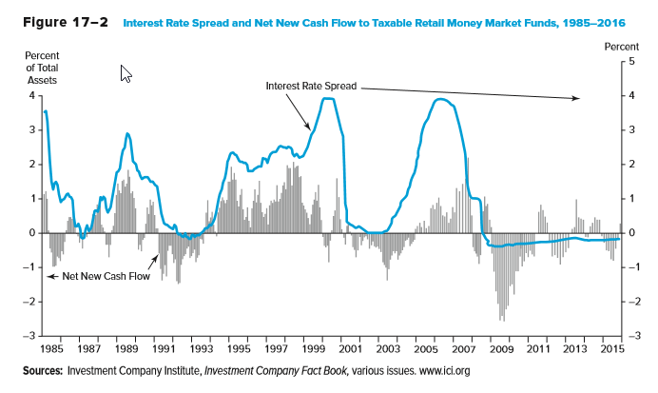
Interest Rate Spread and Net New Cash Flow to Taxable Retail MMFs
Notes:
4

Slide 5
Mutual Fund Industry Continued
In September 2008, the Primary Reserve Fund - a money market mutual fund - ‘broke the buck’ and had its share value fall below the standard $1 due to losses on $785 million of commercial paper issued by Lehman brothers
This led to contagion and a run on money funds with over $200 billion outflows over the next few days
The Treasury guaranteed payments on money funds for one year to stop the runs. The insurance ran out September 19, 2009.
New rules proposed by the SEC mandate money fund shares fluctuate with value of fund holdings to prevent runs
Notes:
5

Slide 6
Mutual Fund Industry Concluded
The barriers to entry in the MF industry are low
  The largest MF sponsors have not increased their market share recently
    The largest 25 companies that sponsor mutual funds managed 75% of industry assets in 2016, just slightly larger than 1995
  However, the composition of the top 25 fund sponsors in the industry has changed
    15 of the largest fund companies in 2016 were not among the largest in 1990
Notes:
6

Slide 7
Types of Mutual Funds
The MF industry has two sectors
  Short-term funds invest in securities with original maturities of less than one year
    Money market mutual funds (MMMFs) are funds consisting of various mixtures of money market securities
    Tax-exempt money market mutual funds contain various mixed of those money market securities with an original maturity of less than one year
  Long-term funds invest in portfolios of securities with original maturities of more than one year
    Equity funds consist of common and preferred stock
    Bond funds consist of fixed-income capital market debt securities
    Hybrid funds consist of both stock and bond securities
Notes:
7

Slide 8
Types of Mutual Funds Concluded
Money market mutual funds (MMMFs) provide an alternative investment to interest-bearing deposits at commercial banks
  Bank deposits are relatively less risky, because they are FDIC insured, and generally offer lower returns than MMMFs
Households own the majority of MFs
  Owned 57.4% of long-term funds in 2013
  Owned 38.4% of short-term funds in 2013
  44.4% of all U.S. households owned MFs in 2016—which represents ~55.9 million households
  Typical owner has $94,300 invested in four funds
Notes:
8

Slide 9
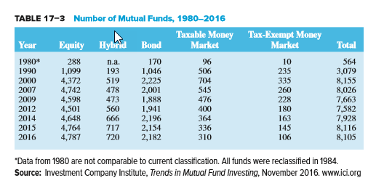
Number of Mutual Funds, 1980 through 2016
Notes:
9

Slide 10
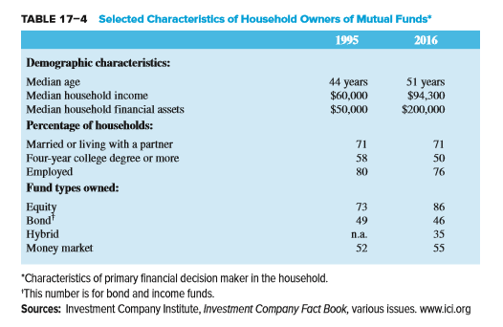
Selected Characteristics of Household Owners of Mutual Funds
Notes:
10

Slide 11
Other Types of Investment Company Funds
An open-end MF is a fund for which the supply of shares is not fixed, but can increase or decrease daily with purchases and redemptions of shares
  In 2016, there were $16,350 billion invested in 8,105 open-end mutual funds
A closed-end investment company is a specialized investment company that has a fixed supply of outstanding shares, but invests in the securities and assets of other firms
  In 2016, there were $265 billion invested in 545 closed-end funds
A unit investment trust, such as a real estate investment trust, is a fund that sells a fixed number of redeemable shares that are redeemed on a set termination date
  In 2016, there was about $74.25 billion invested in over 5,188 UITs
Notes:
11

Slide 12
Mutual Fund Prospectus and Objectives
MF managers must specify their fund’s investment objectives in a prospectus (a formal summary of a proposed investment), which is made available to potential investors
  Holds lists of the securities invested in by the funds
  In 1998, the Securities and Exchange Commission (SEC) mandated that prospectuses must be written in “plain English” instead of overly legal language
  No investor should invest in a fund without carefully reading the prospectus
  The prospectus will contain historical return information, usually for 1-year, 3-year and 5-year periods and perhaps longer
  The prospectus must also show historical fees and the effect of those fees on a given investment over time
  Little information on risk is usually provided
Notes:
12

Slide 13
Index Funds and Exchange Traded Funds (ETFs)
In 2016, there were 406 index funds managing $2.2 trillion
  Index funds are funds in which managers buy securities in proportions similar to those included in a specified major index
  Index funds involve little research or management, which results in lower management fees and higher returns than actively managed funds
Exchange traded funds (ETFs) are long-term mutual funds that are also designed to replicate a particular stock market index
  Traded on exchanges at prices determined by the market
  Management fees are lower than actively traded funds
  Unlike index funds, ETFs can be traded during the day, sold short, and purchased on margin
Notes:
13
Actively traded funds generally underperformed index funds across nearly all asset classes examined over the period 2004-2014.

Slide 14
Investor Returns from Mutual Fund Ownership
Investor returns from MF ownership reflect three components
  Income and dividends on portfolio assets
  Capital gains on assets bought and sold at higher prices
  Capital appreciation on assets held in the fund
MF assets are marked to market daily
  Managers of the fund calculate the current value of each mutual fund share by computing the daily market value of the fund’s total asset portfolio less any liabilities and then dividing this amount by the number of mutual fund shares outstanding
The net asset value (NAV) of a MF share is equal to the market value of the assets in the MF portfolio divided by the number of shares outstanding
Notes:
14

Slide 15
Mutual Fund Costs
MFs charge investors fees for the services they provide
  Sales loads (front end or back end)
  12b-1 fees are fees related to the distribution costs of MF shares
    Marking and distribution expenses cannot exceed 0.75% of a fund’s average net assets per year
    FINRAvalso imposes an annual cap of 0.25% on shareholder service fees
  MFs may offer different share classes with different combinations of loads
A load fund is an MF with an up-front sales or commission charge that the investor must pay
A no-load fund is an MF that does not charge up-front sales or commission charges on the sale of mutual fund shares to investors
Notes:
15

Slide 16
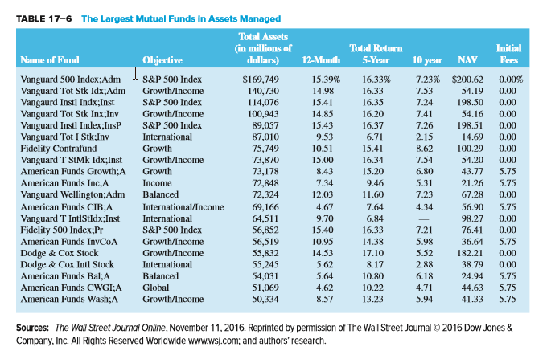
Largest Mutual Funds in Assets Managed
Notes:
16

Slide 17
Example
This year an investor placed $10,000 in a mutual fund with a 6% load (one time fee) and estimated annual expenses of 1.35%. Fees are charged against average assets for the year. The fund’s gross return is 11.5%. What was the investor’s first year return net of loads and expenses?
Amount initially invested
Amount after gross return
Average asset value for year
Fees
Ending amount after fees
Net rate of return (first year)
= $10,000 – (0.06 × $10,000) = $9,400
= $9,400 × 1.115 = $10,481
= ($10,481 + $9,400) / 2 = $9,940.50
= $9,940.50 * 0.0135 = $134.20
= $10,481 - $134.20 = $10,346.80
= ($10,346.80 / $10,000) – 1 = 3.47%
Notes:
17

Slide 18
Mutual Fund Regulation
MFs are heavily regulated because they manage and invest small investor savings
  The SEC is the primary regulator
    The Securities Act of 1933
    The Securities Exchange Act of 1934
  The Investment Advisers Act and Investment Company Act of 1940
  The Insider Trading and Securities Fraud Enforcement Act of 1988
  The Market Reform Act of 1990
  The National Securities Market Improvement Act (NSMIA) of 1996
Notes:
18

Slide 19
Investor Abuses
Even with heavy regulation, investor abuses still occur
  Market timing is short-term trading of mutual funds that seeks to take advantage of short-term discrepancies between the price of a mutual fund’s shares and out-of-date values on the securities in the fund’s portfolio
  Late trading involves buys and sells long after prices have been set at 4:00 pm E.T.
  Directed brokerage occurs when brokers improperly influence investors on their fund recommendations
  Improperly assessed fees occur when brokers trick customers into thinking they are buying no-load funds or fail to provide discounts properly
Notes:
19

Slide 20
Global Issues
During the 1990s, mutual funds were the fasting growing financial institution in the United States
Worldwide investments (other than in the U.S.) in mutual funds have increased over 187%, from $4.916 trillion in 1999 to $14.130 trillion in 2007
  This compares to growth of 75% in U.S. funds
Non-U.S. mutual funds experienced bigger losses in total assets during the financial crisis
  Worldwide funds fell to 49.316 trillion (34.1%) in 2008, while U.S. funds fell to $9.603 trillion (20%)
By 2016, worldwide investments in mutual funds increased to $21.16 trillion (an increase of 127% from 2008), while U.S. investments increased to $18.13 trillion (an increase of 88.8%)
Notes:
20

Slide 21
Hedge Funds
Hedge funds (HFs) are investment pools that solicit funds from wealthy individuals and other investors (e.g., commercial banks) and invest these funds on their behalf
  Similar to MFs, but smaller funds under $100 million in assets are not required to register with the SEC
  Subject to less regulatory oversight than mutual funds and generally can (and do) take significantly more risk than MFs
  Do not have to publicly disclose their activities to third parties and thus offer a high degree of privacy
HFs avoid regulation by limiting the number of investors to less than 100 and by requiring investors to be “accredited”
  Accredited investors have net worth over $1 million or annual income over $200,000 if single (or $300,000 if married)
Notes:
21

Slide 22
Hedge Funds Continued
HFs use more aggressive trading strategies than MFs, such as short selling, leveraging, program trading, arbitrage, and the use of derivatives
Because not all HFs are registered, industry and firm data cannot be accurately tracked (i.e., the data is self-reported)
  ~ 10,000 HFs in the U.S. in 2013
  ~ $2.98 trillion in assets in 2016
Notes:
22

Slide 23
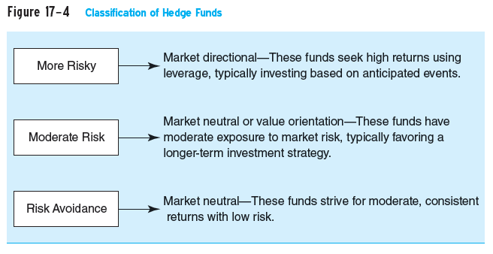
Types of Hedge Funds
Notes:
23

Slide 24
Fees on Hedge Funds
Management fees on HFs are computed as a percent of total assets under management and run between 1.5% and 2%
Performance fees give fund managers a share of any positive returns on a hedge fund
  The average is 20%, but performance fees vary substantially depending on the HF
  A hurdle rate is a benchmark that must be realized before a performance fee can be assessed
  A high-water mark is when a manager does not receive a performance fee unless the value of the fund exceeds the highest NAV it has previously achieved
Offshore HFs are attractive to investors because they provide anonymity and are not subject to U.S. taxes
Notes:
24

Slide 25
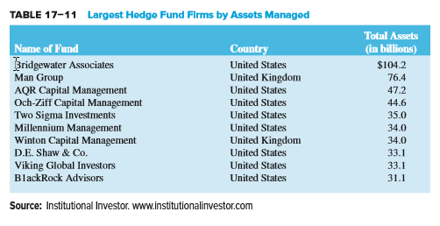
Largest Hedge Fund Firms by Assets Managed
Notes:
25

Slide 26
Regulation of Hedge Funds
While mutual funds are very highly regulated, hedge funds have generally been unregulated
  Mutual funds in the U.S. are required to be registered with the SEC
Hedge funds operate under two exemptions from registration requirements as set forth in the Investment Company Act of 1940
  Funds are exempt if they have less than 100 investors
  Funds are exempt if the investors are “accredited”
Hedge funds are only sold via private placements, and may not be offered or advertised to the general investing public
Notes:
26

Slide 27
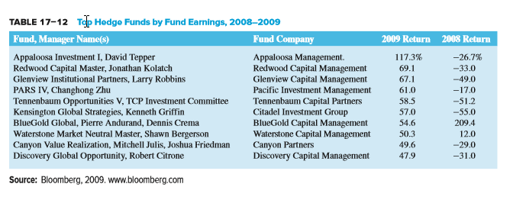
Top Hedge Funds by Fund Earnings, 2008-2009
Notes:
27

Slide 28
High Profile Hedge Funds Problems
The collapse of the two Bear Stearns hedge funds led to investor losses of $1.6 billion and led to the bankruptcy of the company
Bernard Madoff Investment Securities run by former NASDAQ chairman Bernie Madoff ran a $65 billion Ponzi scheme
In October 2009, a large hedge fund, Galleon Group LLC, was closed due to an insider trading scandal
In July 2013, SAC Capital was charged with pervasive violations of inside trading laws
Notes:
28

