Slide 1
Chapter Eighteen
Pension Funds

Slide 2
Pension Funds
Pension funds (PFs) offer savings plans through which fund participants accumulate tax-deferred savings during their working years before withdrawing them in their retirement years
  Earnings on funds invested are exempt from current taxation (i.e., during working years)
  Tax payments are not made until funds are withdrawn by the participant (i.e., during retirement)
PFs were first established in the U.S. in 1759 to benefit the widows and children of church ministers
The first corporate PF was established by American Express Co. in 1875

Slide 3
Pension Funds Continued
By 1940, approximately 400 PFs existed
  Most were for employees in the railroad, banking, and public utilities industries
Currently, over 680,000 PFs exist
  34% of U.S. households’ financial assets were in PFs in 2016
  Compares to just over 5% in 1950
The financial crisis reduced global pension assets from $25 trillion to $20 trillion
U.S. retirement accounts fell by $2 trillion, causing many to postpone retirement and reduce spending to save more

Slide 4
Private versus Public Pension Funds
There are two distinct PF sectors
  Private PFs are funds administered by private corporations (e.g., insurance companies or mutual funds)
    Total financial assets in 2016 were $11,803.6 billion
  Public PFs are funds administered by federal, state, or local governments (e.g., Social Security)
    Total financial assets in 2016 were $9,929.4 billion

Slide 5
Pension Funds Concluded
A pension plan governs the operation of a pension fund
Pension funds are broadly classified into two categories: defined benefit plans and defined contribution plans
A defined benefit PF is a fund in which the employer agrees to provide the employee with a specific cash benefit upon retirement
  A flat benefit formula PF pays a flat amount for every year of employment
  A career average formula PF pays benefits based on the employee’s average salary over the entire period of employment
  A final pay formula PF pays benefits based on a percentage of the average salary during a specified number of years at the end of the employee’s career times the number of years of service

Slide 6
Example 1: Defined Benefit Plans
An employee works 20 years for a firm. Her average salary over her entire career with the firm was $65,000, and $75,000 over the last five years. Find the annual retirement benefit for various defined benefit plans.
Assume the employer pays a flat benefit of $2,000 per year worked:
$2,000 × 20 years = $40,000
Assume the employer pays a career average of 4% of the career average salary * number of service years
$65,000 × 0.04 x 20 years = $52,000
Assume the employer uses final pay, specifically 4% of the last five years of salary times the number of years of service:
$75,000 × 0.04 × 20 years = $60,000
Notes:
Note that the $2,000 for the “flat benefit” plan is decided upon by the employer. In other words, the $2,000 is a “given” to students when working this type of problem.

Slide 7
Plan Funding
Defined benefit PFs
  A fully funded PF has sufficient funds available to meet all future payment obligations
  An underfunded PF does not have sufficient funds available to meet all future promised payments
  An overfunded PF has more than enough funds available to meet the required future payouts

Slide 8
Defined Contribution PFs
A defined contribution PF is a fund in which the employer agrees to make a specified contribution to the pension fund during the employee’s working years
  Fixed-income funds typically offer a guaranteed minimum rate of return
  With variable-income funds, all profits and losses on the underlying securities are passed through to the fund participants

Slide 9
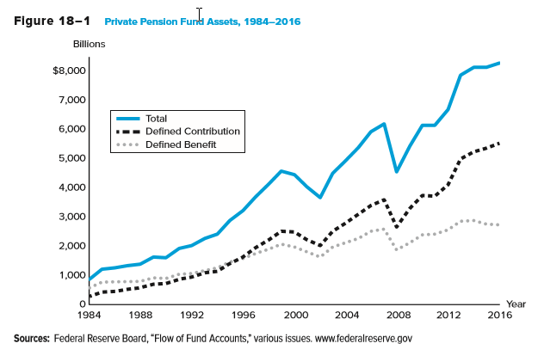
Private Pension Fund Assets, 1984 - 2016

Slide 10
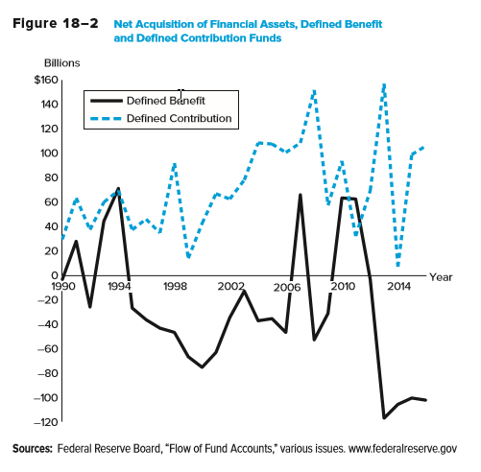
Net Acquisition of Financial Assets, DB and DC Funds

Slide 11
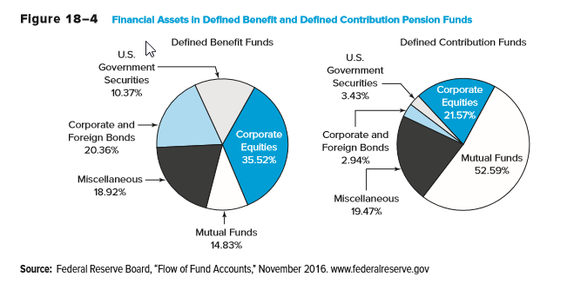
Financial Assets in DB and DC Pension Funds

Slide 12
Pension Fund Administration
Pension funds may be either insured or noninsured
  An insured pension fund is administered by a life insurance company
  A noninsured pension fund is administered by some other type of financial institution
Private pension funds are created by private entities and administered by private corporations
  $11,803.6 billion in total financial assets in 2016
    Life insurance companies administered $2,928.3 billion
    Mutual funds administered $3,317.6 billion
    Other financial institutions (e.g., banks) administered $5,557.7 billion

Slide 13
Private Pension Funds
401(k) and 403(b) plans are employer-sponsored plans that supplement a firm’s basic retirement plan
  Allow for both employer and employee contributions
  401(k) plans are offered to employees of taxable firms
  403(b) plans are offered to employees of tax exempt employers
  Contributions are made on a pretax basis and thus reduce the employee’s taxable salary
  Most plans are transferable if the employee changes jobs
  Participants generally make their own choice of the allocation of assets from both employee and employer contributions
    Younger participants generally invest more in equities while older participants generally invest more in fixed-income securities

Slide 14
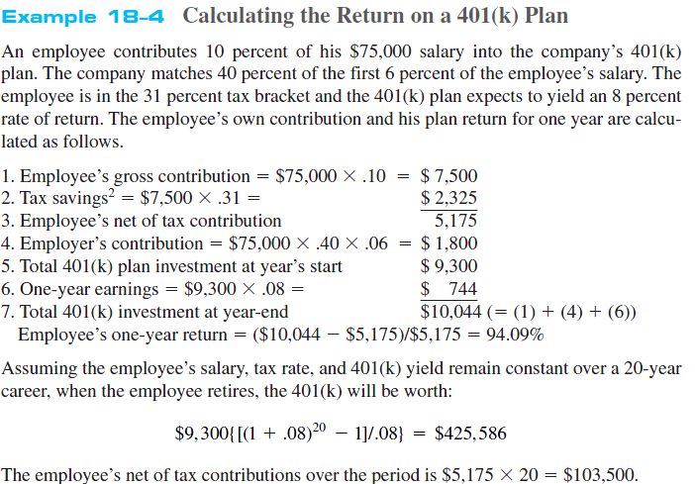
Return on a 401(k)
Notes:
The employee will have to pay taxes on the funds as he withdraws funds during retirement. However, the tax rate is likely to be lower and tax payments are delayed by several years.

Slide 15
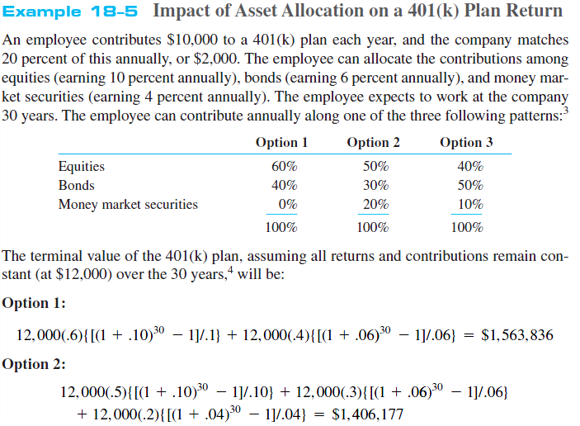
Asset Allocation
Notes:
In reality, the employee has a larger number of possible choices in terms of fund asset allocation. For simplicity, we assume that the employee’s contribution remains constant over the 30 years. Realistically, as an employee’s salary increases over his or her working years, contributions to the retirement funds increase as well.

Slide 16
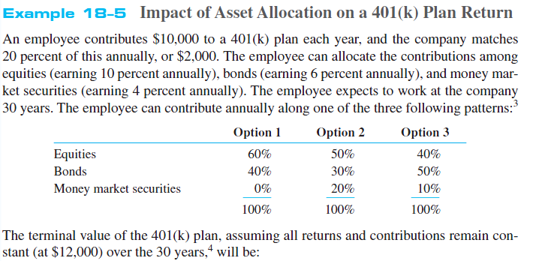

Asset Allocation Continued
Which option is riskier?

Slide 17
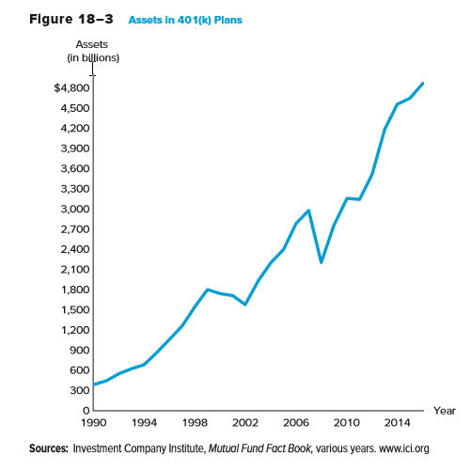
Assets in 401(k) Plans

Slide 18
IRAs
Individual retirement accounts (IRAs) are self-directed retirement accounts set up by employees who may also be covered by employer-sponsored pension plans as well as self-employed individuals
  Contributions are made strictly by the employee
  First introduced in 1981 to supplement employer-sponsored programs
  As of 2017, maximum contributions were $5,500 per year
Roth IRAs were introduced in 1998
  In 2016, they allowed a maximum of $5,500 after-tax contribution per individual ($11,000 per household)
  Contributions are taxed in the year of contributions, while withdrawals are tax-free as long as they have been invested at least five years and the account holder is at least 59 ½ years old
  Income test for availability

Slide 19
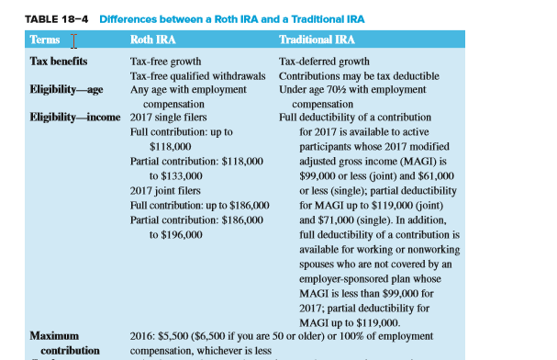
Roth IRAs vs Traditional IRAs

Slide 20
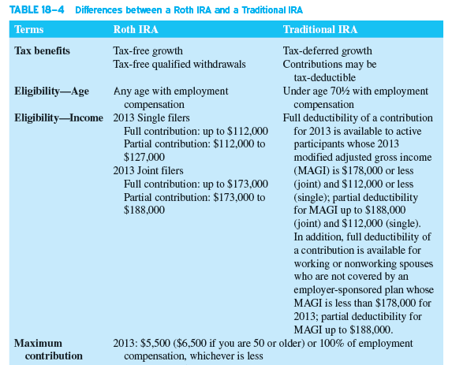
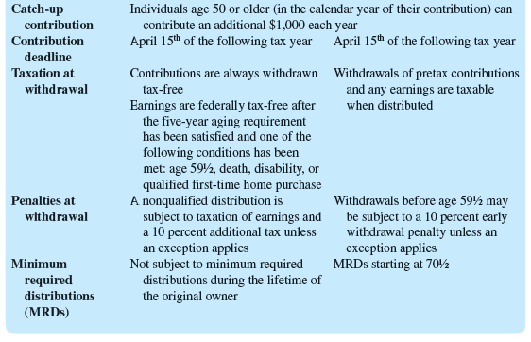
Roth IRAs vs Traditional IRAs Continued

Slide 21
Public Pension Funds
State or local government pension funds
  “Pay as you go” in that current employee contributions fund current retiree benefits
  Because of an increasing number of retirees relative to workers, some funds’ current payments exceed current contributions
Federal government pension funds
  Civil service funds cover all federal employees not in the armed forces
    Such employees are not covered by Social Security
  A military pension fund covers career military personnel
    Military personnel are also covered by Social Security
    Military personnel are eligible after 20 years of military service
Notes:
Pension funds sponsored by the federal or state and local governments are referred to as public pension funds, and these funds managed assets of more than $9.93 trillion in 2016.
The federal government sponsors two types of pension funds. The first type are funds for federal government employees: civil service employees, military personnel, and railroad employees. The second type of fund, and the largest federal government pension fund, is Social Security.

Slide 22
Public Pension Funds Continued
Social Security, aka Old Age and Survivors Insurance Fund
  Provides retirement benefits to almost all employees and self-employed individuals in the U.S.
  Established in 1935 to provide a minimum level of retirement income to all retirees
  Funded on a “pay as you go” basis
  Historically, contributions have exceeded disbursements
    FICA contributions are 7.65% of the first $115,500 earned in 2016 (which is also matched by an employer contribution of 7.65%)
    Self-employed individuals pay the full 15.30%
  Disbursements exceeded revenues (excluding interest) for the first time in 2010
  System is expected to be bankrupt by 2034

Slide 23
Private Pension Fund Investments
Private Pension Funds
  Financial assets held by private pension funds in 1975 totaled $244.3 billion and $8.838.6 billion in 2016.
    In 2016, 62.11% of pension fund assets were in corporate equities or equity mutual fund shares. This compares to 44.61% in 1975.
  In 2016, defined benefit funds had 30.73% of their funds invested in U.S. government securities and corporate and foreign bonds compares to 6.37% for defined contribution funds.
    Defined benefit funds had 35.52% percent of their assets invested in corporate equities compared to 21.57% by defined contribution funds.

Slide 24
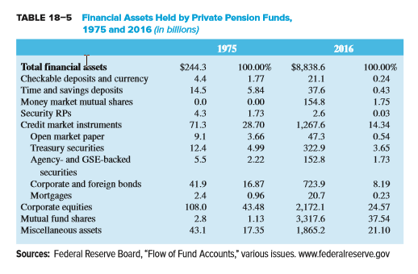
Assets Held by Private Pension Funds, 1975 - 2016

Slide 25
Public Pension Fund Investments
Social Security
  Contributions are invested in relatively low risk and low-return U.S. Treasury securities
  Slow population growth and an increasing retirement population challenge the long-term viability of Social Security
Social Security was restructured in the mid-1990s
  Contributions were increased and benefits were decreased
    Full retirement age is 67 for people born after 1959
    Dollar amount of income subject to FICA increases nearly every year
Future changes to Social Security are slow to occur
  Increasing contributions and decreasing benefits are unpopular with the public, and are thus unpopular with politicians seeking election or re-election
  The economic downturn in the U.S. has shifted the spotlight away from Social Security

Slide 26
Pension Fund Regulation
The Employee Retirement Income Security Act (ERISA) of 1974 focused on five areas of reform:
  Pension plan funding
  Vesting of benefits
  Fiduciary responsibility
  Pension fund transferability
  Pension fund insurance
Notes:
ERISA does not mandate that employers establish pension funds for their employees, but it does require them to meet certain standards if a fund is eligible for tax-deferred status.

Slide 27
Regulation - Funding
Funding
  Prior to ERISA, regulation did not require defined benefit fund administrators to adequately fund their pension funds
  ERISA established guidelines for funding and set penalties for fund deficiencies
    Contributions must be sufficient to meet all annual costs and expenses
    Contributions must be sufficient to fund any unfunded historical liabilities over a 30-year period
    Any new underfunding must be funded over a 15-year period
    Has led many defined benefit plans to switch over to a defined contribution structure
Notes:
Underfunded pension liabilities for single-employer plans surged to $823 billion in 2012 and $759 billion in 2013 – the largest values in history. (see Figure 18-5)

Slide 28
Regulation – Vesting and Fiduciary Responsibilities
Vesting of benefits
  A vested employee is an employee who is eligible to receive pension benefits because he or she has worked for a stated period of time
  Prior to ERISA, vesting could take up to 25 years
  ERISA set the maximum vesting period at 10 years
Fiduciary responsibilities
  A PF fiduciary is a trustee/investment advisor that manages a PF
  ERISA requires that PF contributions be invested with the same diligence, skill, and care as a “prudent person” in like circumstances
  The sole objective of PF management is to provide the promised benefits to the plan participants

Slide 29
Regulation – Transferability and Insurance
Transferability
  ERISA allows employees to transfer pension credits from one employer to another when switching jobs
Insurance
  ERISA established the Pension Benefit Guarantee Corporation (PBGC), an insurance fund for pension fund participants similar to the FDIC
  PBGC insures participants of defined benefit pension funds if the proceeds from the fund are unable to meet its promised pension obligations
  Employers paid $1 in premiums per employee when PBGC was created in 1974
    In 2017, the maximum annual coverage for workers who will begin receiving payments from PBGC at age 65 was $64,432

Slide 30
Regulation - Insurance
Insurance
  Due to chronic deficits, the Retirement Protection Act of 1994 attempted to strengthen the PBGC
    The act forced the PBGC to change to a move overtly risk-based premium plan, and underfunded programs were subjected to even higher premiums
    By 2000, the PBGC operated at a record surplus of $9.7 billion
  Large bankruptcies in the early 2000s resulted in the agency posting a $23.3 billion deficit and a call for additional reform in 2005

Slide 31
Regulation – Insurance Continued
The Pension Protection Act of 2006
  Increased annual premiums paid by companies to $30 per worker from $19
  Imposed automatic increases in premiums each year (which are tied to average wage increases of U.S. workers)
    As of 2018, rates are $74 per participant for single-employer plans and $28 per participant for multi-employer plans
    Underfunded pension plans pay an addition variable rate change of $38 per $1,000 of unfunded vested benefits
  The act gives companies 5 years (rather than the previous 20 years) to make up shortfalls in their defined benefit plans

Slide 32
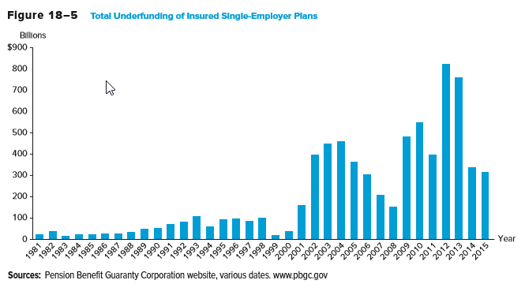
Underfunding of Single-Employer Plans

Slide 33
Global Issues
Pension systems vary widely in Europe
  The U.K., the Netherlands, Ireland, Denmark, and Switzerland all have a tradition of state- (or public-) funded pension schemes
  Spain, Portugal, and Italy have less developed pension systems
  France uses a pay-as-you-go system
One method of distinguishing systems across countries is by the extent to which a person’s contributions are linked to the benefits he/she receives in retirement
  The link between contributions and benefits is weak in France and Germany, but strong in Sweden, Italy, the U.K., and Chile
Reform around the globe has included benefit reduction, measures to encourage later retirement, and expansions of private funding for government pensions

