Slide 1
Chapter Nineteen
Types of Risks Incurred by Financial Institutions

Slide 2
Risks at Financial Institutions
One of the major objectives of a financial institution’s (FI’s) managers is to increase the FI’s returns for its owners
Increased returns typically come at the cost of increased risk, which comes in many forms:
  credit risk
  liquidity risk
  interest rate risk
  market risk
  off-balance-sheet risk
foreign exchange risk
country or sovereign risk
technology risk
operational risk
insolvency risk

Slide 3
Credit Risk at FIs
Credit risk is the risk that the promised cash flows from loans and securities held by FIs may not be paid in full
  FIs make loans or buy bonds backed by a small percentage of capital
    Thus, banks, thrifts, and insurance companies can be significantly hurt by even minor amounts of loan losses
  Many financial claims issued by individuals or corporations have:
    Limited upside return (with a high probability)
    Large downside risk (with a low probability)
  A key role of FIs involves screening and monitoring loan applicants to ensure only the creditworthy receive loans
    FIs also charge interest rates commensurate with the riskiness of the borrower
Notes:
3

Slide 4
Credit Risk at FIs Continued
Credit risk (continued)
  The effects of credit risk are evidenced by net charge-offs
    The Bankruptcy Reform Act of 2005 makes it more difficult for consumers to declare bankruptcy
  FIs can diversify away some individual firm-specific credit risk, but not systematic credit risk
    Firm-specific credit risk is the risk of default for the borrowing firm associated with the specific types of project risk taken by that firm
    Systematic credit risk is the risk of default associated with general economywide or macroeconomic conditions affecting all borrowers
Notes:
4

Slide 5
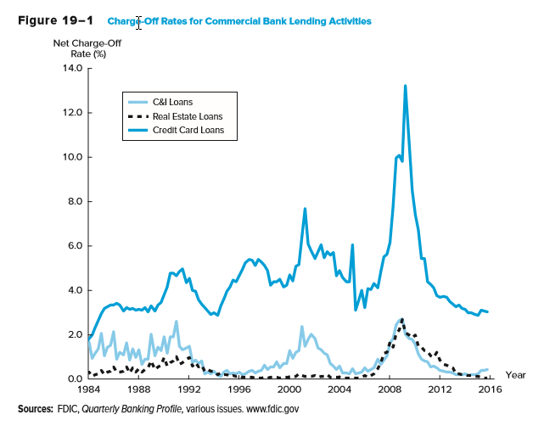
Commercial Bank Charge-off Rates for Lending Activities
Notes:
5

Slide 6
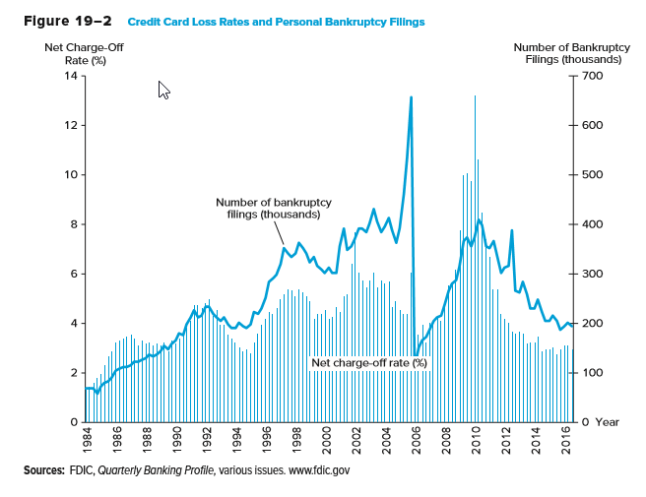
Credit Card Loss Rates and Personal Bankruptcy Filings
Notes:
6

Slide 7
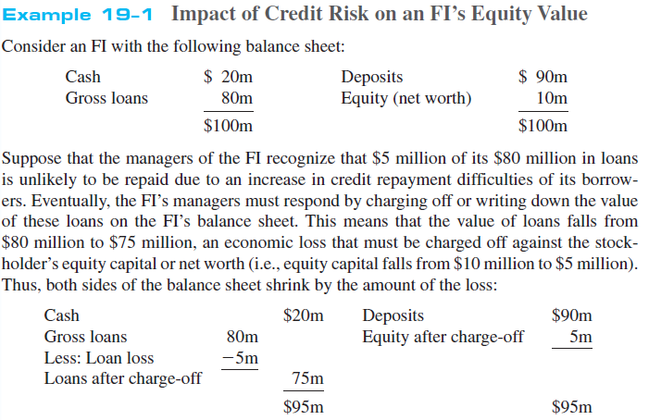
Impact of Credit Risk on an FI’s Equity Value
Notes:
7
Only the unexpected portion of loan losses generates solvency risk per se because banks set aside an allowance for loan loss account against to cover expected loan losses.

Slide 8
Liquidity Risk
Liquidity risk is the risk that a sudden and unexpected increase in liability withdrawals may require an FI to liquidate assets in a very short period of time and at low prices
  Day-to-day withdrawals and loan demand are generally predictable
  To meet the demand for cash by liability holders, FIs must either liquidate assets or borrow additional funds
    Purchased funds include short-term borrowings, such as federal funds loans and brokered deposits
Notes:
8

Slide 9
Liquidity Risk Continued
Liquidity risk (continued)
  Unusually large withdrawals by liability holders can create liquidity problems. In these cases:
    The cost of purchased and/or borrowed funds rises for FIs
    The supply of purchased or borrowed funds declines
    FIs may be forced to sell less liquid assets at “fire-sale” prices
Notes:
9

Slide 10
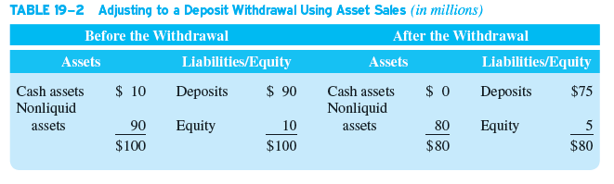
Effect of Unexpected Deposit Withdrawal
$15 million deposit withdrawal, met with liquidating $10 million cash assets and liquidation of $10 million of nonliquid assets at ‘fire sale’ price of $5 million
What is the effect on equity? Why?
Notes:
10

Slide 11
Interest Rate Risk
Interest rate risk is the risk incurred by an FI when the maturities of its assets and liabilities are mismatched and interest rates are volatile
  Asset transformation involves an FI buying primary securities or assets and issuing secondary securities or liabilities to fund the assets
  If an FI’s assets are longer-term relative to its liabilities, it faces refinancing risk
    The risk that the cost of rolling over or reborrowing funds will rise above the returns being earned on asset investments
  If an FI’s assets are shorter-term relative to its liabilities, it faces reinvestment risk
    The risk that the returns on funds to be reinvested will fall below the cost of funds
Notes:
11

Slide 12
Interest Rate Risk Continued
An FI has $100 million of fixed earning assets that mature in 2 years. The assets earn an average of 7%. These are funded by 6 month CD liabilities paying 4%. What is the bank’s net interest margin (NIM)?
  NIM = [(7% – 4%)*$100 million] / $100 million = 3%
How does the NIM change if in 6 months interest rates increase 100 basis points?
  The 2-year assets will still be earning 7%, but the new 6-month CDs will have to pay 5%:
  New NIM = [(7% – 5%)*$100 million] / $100 million = 2%
Notes:
12
This illustrates refinancing risk

Slide 13
Interest Rate Risk Concluded
Interest rate risk (continued)
  All FIs face price risk (or market value uncertainty)
    The risk that the price of the security changes when interest rates change
  FIs can hedge or protect themselves against interest rate risk by matching the maturity of their assets and liabilities
    This approach is inconsistent with their asset transformation function
    They may match the rate sensitivity of their assets and liabilities
    They may match the duration of their assets and liabilities
Notes:
13

Slide 14
Market Risk
Market risk is the risk incurred in trading assets and liabilities due to changes in interest rates, exchange rates, and other asset prices
  Closely related to interest rate and foreign exchange risk
  Adds risk of trading activity—i.e., market risk is the incremental risk incurred by an FI (in addition to interest rate or foreign exchange risk) caused by an active trading strategy
  FIs’ trading portfolios are differentiated from their investment portfolios on the basis of time horizon and liquidity
    Trading assets, liabilities, and derivatives are highly liquid
    Investment portfolios are relatively illiquid and are usually held for longer periods of time
Notes:
14

Slide 15
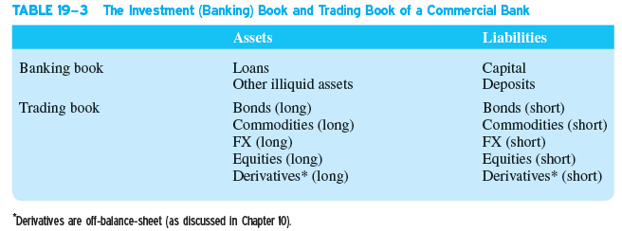
Banking Book and Trading
Book of a Commercial Bank
Notes:
15

Slide 16
Market Risk Continued
Market risk (continued)
  Declines in underwriting and brokerage income at large investment banks have been offset by increases in trading activity and income
  Mutual fund managers, who actively manage their asset portfolios, are also exposed to market risk
  FIs are concerned with fluctuations in trading account assets and liabilities
    Value at risk (VAR) and daily earnings at risk (DEAR) are measures used to assess market risk exposure
Notes:
16
Value at risk (VAR): fluctuation in value
Daily earnings at risk (DEAR): fluctuation in value of trading account assets and liabilities for periods as short as one day

Slide 17
Off-Balance-Sheet Risks
Off-balance-sheet (OBS) risk is the risk incurred by an FI as the result of activities related to contingent assets and liabilities
  In 2016, commercial banks had $15.029 trillion in on-balance-sheet items, while the face or notional value of their off-balance-sheet derivative items was $189.832 trillion
    OBS activities do not appear on an FI’s current balance sheet since it does not involve holding a currency primary claim (asset) or the issuance of a current secondary claim (liability)
  OBS activities involve the creation of contingent assets and liabilities that give rise to their potential placement in the future on the balance sheet
Notes:
17
Contingent asset and liabilities: assets and liabilities off the balance sheet that potentially can produce position or negative future cash flows for an FI

Slide 18
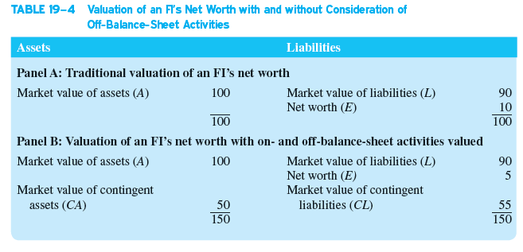
Valuation with vs. without OBS Activities
Notes:
18

Slide 19
Off-Balance-Sheet Risks Continued
Off-balance-sheet (OBS) risk (continued)
  Large commercial banks engage in OBS activity
  The losses on OBS commitments in the financial crisis indicate that banks had excessive risks in their derivatives activities and did not have sufficient capital to back these commitments
  Very complex derivatives sold by banks
    In some cases, the securities were so complicated that ratings agencies and regulators had to rely on the bankers’ assessment of the riskiness of the securities
Notes:
19

Slide 20
Off-Balance-Sheet Risks Concluded
OBS activities can affect the future shape of FIs’ balance sheets
  OBS items become on-balance-sheet items only if some future event occurs
  A letter of credit (LOC) is a credit guarantee issued by an FI for a fee on which payment is contingent on some future event occurring, most notably default of the agent that purchases the LOC
  Other examples include:
    Loan commitments by banks
    Mortgage servicing contracts by savings institutions
    Positions in forwards, futures, swaps, and other derivatives held by almost all large FIs
Notes:
20

Slide 21
Foreign Exchange Risk
Foreign exchange (FX) risk is the risk that exchange rate changes can affect the value of an FI’s assets and liabilities denominated in foreign currencies
  FIs can reduce risk through domestic-foreign activity/investment diversification
  FIs expand globally through:
    Acquiring foreign firms or opening new branches in foreign countries
    Investing in foreign financial assets
  Returns on domestic and foreign direct investments and portfolio investments are not perfectly correlated
    Underlying technologies of various economies differ, as do the firms in those economies
    Exchange rate changes are not perfectly correlated across countries
Notes:
21

Slide 22
Foreign Exchange Risk Continued
FX risk (continued)
  A net long position in a foreign currency involves holding more foreign assets than foreign liabilities
    FI loses when foreign currency falls relative to the U.S. dollar
    FI gains when foreign currency appreciates relative to the U.S. dollar
  A net short position in a foreign currency involves holding fewer foreign assets than foreign liabilities
    FI gains when foreign currency falls relative to the U.S. dollar
    FI loses when foreign currency appreciates relative to the U.S. dollar
  An FI is fully hedged if it holds an equal amount of foreign currency denominated assets and liabilities (that have the same maturities)
Notes:
22

Slide 23
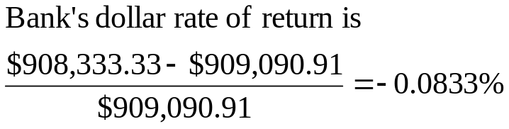
Foreign Exchange Risk Concluded
A U.S. FI lends ¥100 million when the ¥/$ exchange rate is ¥110. The interest rate is fixed at 9% and the loan is for one year. If, in a year, the exchange rate is ¥120 to the dollar, what is the bank’s dollar rate of return on the loan?
The original dollar amount lent by the bank is:
  ¥100,000,000 / ¥110 = $909,090.91
In one year the borrower repays:
  (¥100,000,000 × 1.09) = ¥109,000,000
In dollar terms this is now worth:
  ¥109,000,000 / ¥120 = $908,333.33
Notes:
23
Analysis: The dollar depreciated by (¥120/¥110) – 1 = 9.09% and the bank only earned 9% in interest.

Slide 24
Sovereign Risk
Country, or sovereign, risk is the risk that repayments from foreign borrowers may be interrupted because of interference from foreign governments
  Differs from credit risk of FIs’ purchasing domestic assets
    With domestic assets, FIs usually have some recourse through bankruptcy courts—i.e., FIs can recoup some of their losses when defaulted firms are liquidated or restructured
  Foreign corporations may be unable to pay principal and interest even if they desire to do so
    Foreign governments may limit or prohibit debt repayment due to foreign currency shortages or adverse political events
Notes:
24

Slide 25
Sovereign Risk Continued
Country or sovereign risk (continued)
  An FI claimholder may have little or no recourse to local bankruptcy courts or to an international claims court
  Measuring sovereign risk includes analyzing:
    The trade policy of the foreign government
    The fiscal stance (deficit or surplus) of the foreign government
    Government intervention in the economy
    The foreign government’s monetary policy
    Capital flows and foreign investment
    Inflation
    The structure of the foreign country’s financial system
Notes:
25
E.g., In 2001, the government of Argentina, which had pegged its peso to the dollar on a one-to-one basis since the early 1990s, had to default on its government debt largest because of an overvalued peso and the adverse effect this had on its exports and foreign currency earnings.

Slide 26
Technology and Operational Risk
Technology risk and operational risk are closely related
  Technology risk is the risk incurred by an FI when its technological investments do not produce anticipated cost savings
    The major objectives of technological expansion are to allow the FI to exploit potential economies of scale and scope by:
      Lowering operating costs
      Increasing profits
      Capturing new markets
  Operational risk is the risk that existing technology or support systems may malfunction or break down
    Operational risk could be the result of technological failure, but other sources of operational risk can result in direct costs, indirect costs, and opportunity costs that reduce an FI’s profitability and market value.
Notes:
26

Slide 27
Insolvency Risk
Insolvency risk is the risk that an FI may not have enough capital to offset a sudden decline in the value of its assets relative to its liabilities
  Insolvency risk is a consequence or an outcome of one or more of the risks previously described:
    Interest rate, market, credit, OBS, technological, foreign exchange, sovereign, and/or liquidity risk
  Generally, the more equity capital to borrowed funds an FI has (i.e., the lower its leverage), the less insolvency risk it is exposed to
  Both regulators and managers focus on capital adequacy as a measure of an FI’s ability to remain solvent
Notes:
27

Slide 28
Other Risks and Interactions
Other risks and interactions among risks
  In reality, all of the previously defined risks are interdependent
    E.g., liquidity risk is correlated with interest rate and credit risks
  When managers take actions to mitigate one type of risk, they must consider effects on other risks
  Changes in regulatory policy constitute another type of discrete or event-type risk
  Other event risks
    Sudden and unexpected changes in financial market conditions due to war, revolutions, and sudden market collapses
    Theft, malfeasance, and breach of fiduciary trust
  Macroeconomic risks include increased inflation, inflation volatility, and unemployment
Notes:
28

