Slide 1
Chapter Twenty
Managing Credit Risk on the Balance Sheet

Slide 2
Credit Risk Management
Financial institutions (FIs) are special because of their ability to transform financial claims of household savers into claims issued to corporations, individuals, and governments
FIs’ ability to process and evaluate information and control and monitor borrowers allows them to transform these claims at the lowest possible cost to all parties
Credit allocation is an important type of financial claim transformation
  FIs transform claims of household savers (in the form of deposits) into loans issued to corporations, individuals, and governments
  The FI accepts the credit risk on these loans in exchange for a fair return sufficient to cover the cost of funding paid (to household savers, the credit risk involved in lending, and a profit margin reflecting competitive conditions
Notes:
2

Slide 3
Credit Risk Management Continued
The default of one major borrower can have a significant impact on the value and reputation of many FIs
  E.g., WorldCom bankruptcy in 2002
Likewise, a single major economic event can cause losses to many FIs’ loan portfolios
  E.g., Hurricanes Katrina and Rita in 2005 resulted in over $1.3 billion in bad loans for major banks operating in areas hit by the storm
  E.g., financial crisis of 2008-2009 resulted in the largest ever credit risk-related losses for U.S. financial institutions
Many FIs were unable to survive the mortgage crisis
  E.g., Countrywide Financial acquired by BofA
Bank loan portfolios were exposed to losses from the recent European debt crisis
Notes:
3
Note: The acquisition of Countrywide proved costly for Bank of America. Even in 2014, BofA paid a record $17 billion settlement to the U.S. Justice Department over questionable mortgages issued by Countrywide before the acquisition. The settlement was the largest ever reached between the U.S. and a single company, and was approximately equal to BofA’s total profit for the previous 3 years.

Slide 4
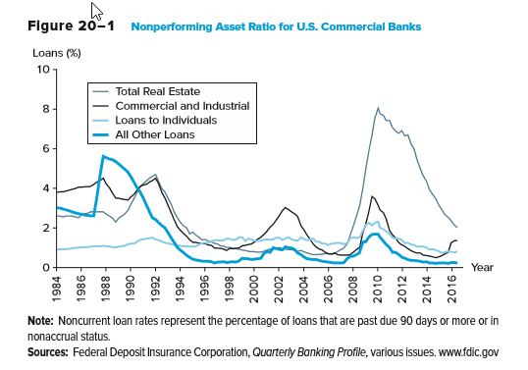
Nonperforming Asset Ratio for U.S. Commercial Banks
Notes:
4

Slide 5
Real Estate Lending
Real estate lending
  Residential mortgage loan applications are among the most standardized of all credit applications
  Decisions to approve a mortgage application depend on:
    The applicant’s ability and willingness to make timely interest and principal repayments
    The value of the borrower’s collateral
  The ability to maintain mortgage payments is measured by the gross debt service (GDS) and total debt service (TDS) ratios
Notes:
5

Slide 6
Real Estate Lending Continued
GDS refers to the gross debt service ratio
  Equal to the total accommodation expenses (mortgage, lease, condominium, management fees, real estate taxes, etc.) divided by gross income
  Acceptable threshold generally set around maximum of 25% to 30%
TDS refers to the total debt service ratio
  Equal to the total accommodation expenses plus all other debt service payments divided by gross income
  Acceptable threshold generally set around maximum of 35% to 40%
Notes:
6

Slide 7
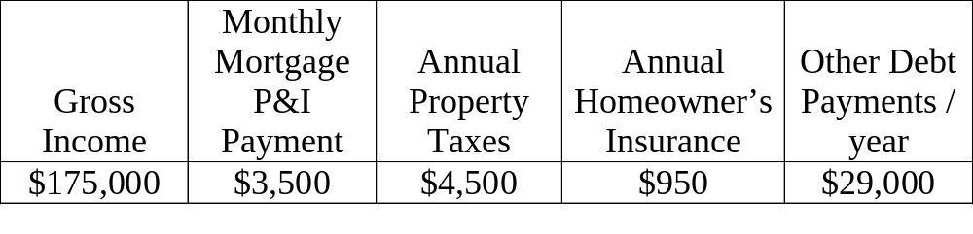
Real Estate Lending Example
A mortgage loan applicant has the following data:
GDS Ratio = (Annual mortgage payments + Property taxes) / gross income
= (($3,500*12) + $4,500) / $175,000 = 26.57%
Conclusion: Pass
TDS Ratio = Annual total debt payments / Annual gross income
= (($3,500*12) + $4,500 + $950 + $29,000) / $175,000 = 43.69%
Conclusion: Fail
Notes:
7

Slide 8
Credit Scoring Systems
FIs also use credit scoring systems to evaluate potential borrowers
  Credit scoring systems are mathematical models that use observed loan applicant’s characteristics to calculate a score that represents the applicant’s probability of default
  Loan officers can often give immediate “yes” or “no” answers —along with justifications for the decision
Lender may use standard FICO credit scores
  FICO scores run from 300 to 850, with the majority of scores between 600 and 800
  Scores of 720 or higher are usually sufficient to receive a good mortgage rate
FIs also verify borrower’s financial statements
Notes:
8
Perfecting collateral is the process of ensuring that collateral used to secure a loan is free and clear to the lender should the borrower default on the loan

Slide 9
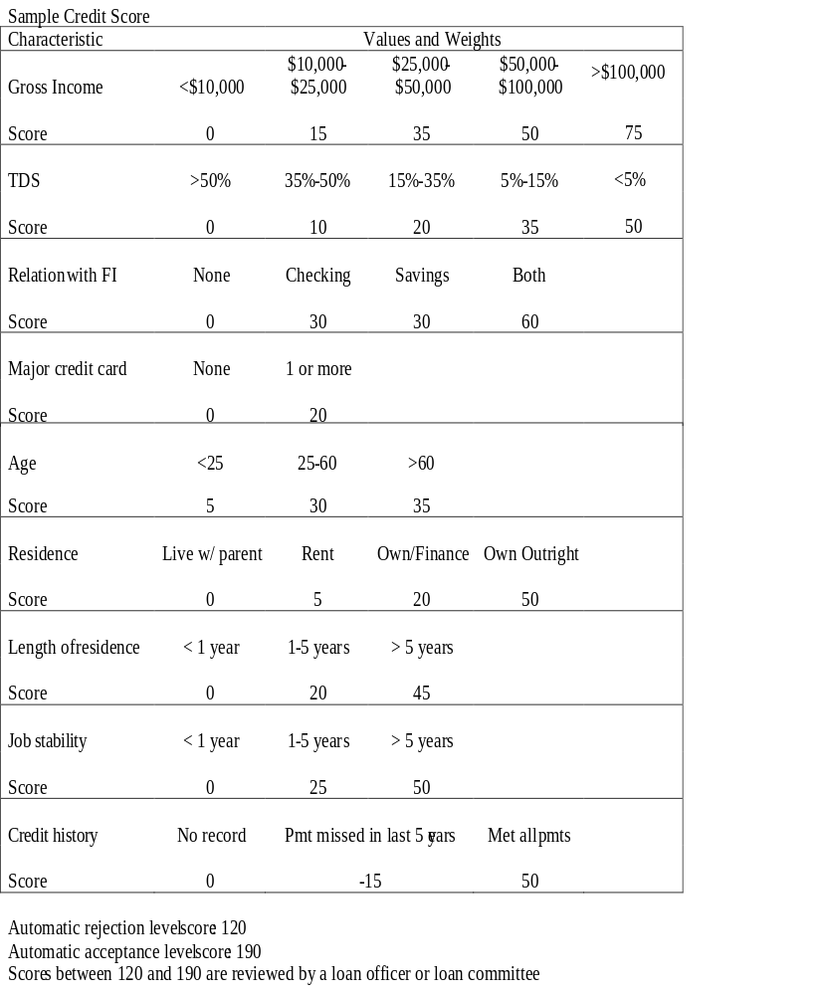
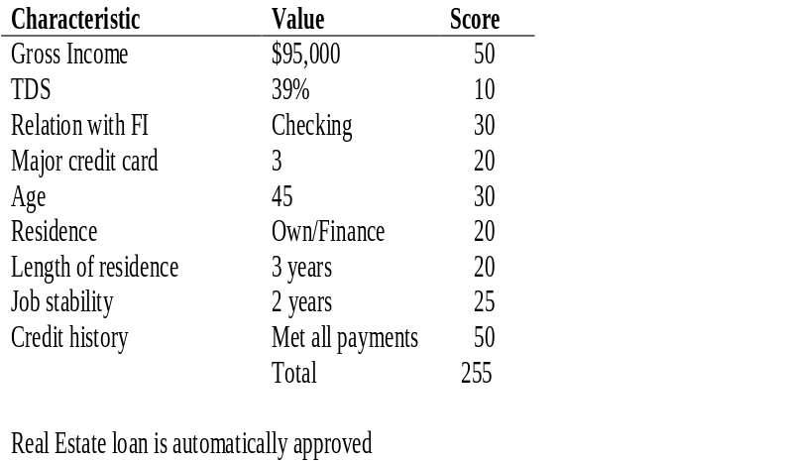
Sample Credit
Score Criteria
Notes:
9

Slide 10
Real Estate Lending Concluded
FIs do not desire to become involved in loans that are likely to go into default
In the event of default, lenders usually have recourse
  Foreclosure is the process of taking possession of the mortgaged property in satisfaction of a defaulting borrower’s indebtedness and forgoing claim to any deficiency
  Power of sale is the process of taking the proceedings of the forced sale of a mortgaged property in satisfaction of the indebtedness and returning to the mortgagor the excess over the indebtedness or claiming any shortfall as an unsecured creditor
Notes:
10

Slide 11
Steps Taken by FI Prior to Accepting a Mortgage
Before an FI accepts a mortgage, it:
  Confirms the title and legal description of the property
  Obtains a surveyor’s certificate confirming that the house is within the property’s boundaries
  Checks with the tax office to confirm that no property taxes are unpaid
  Requests a land title search to determine that there are no other claims against the property
  Obtains an independent appraisal to confirm that the purchase price is in line with the market value
Notes:
11

Slide 12
Consumer (Individual) and Small-Business Lending
Techniques are very similar to that of mortgage lending
However, nonmortgage consumer loans focus on the ability to repay rather than on the property
  Credit models put more emphasis on personal characteristics, such as annual gross income, the TDS score, etc.
Small-business loan decisions often combine computer-based financial analysis of borrower financial statements with behavioral analysis of the business owner
  Usually, these loans are made to small businesses to help start up the company
Notes:
12

Slide 13
Mid-Market Commercial and Industrial Lending
Generally a profitable market for credit-granting FIs
Typically, mid-market corporates:
  Have sales revenues from $5 million to $100 million per year
  Have a recognizable corporate structure
  Do not have ready access to deep and liquid capital markets
Commercial loans can be for as short as a few weeks to as long as 8 years or more
  Short-term loans are used to finance working capital needs
  Long-term loans are used to finance fixed asset purchases
Notes:
13

Slide 14
Mid-Market Commercial and Industrial Lending Continued
Generally, at least two loan officers must approve a new loan customer and large credit requests are presented formally to a credit approval officer and/or committee
Five C’s of credit
  Character, capacity, collateral, conditions, and capital
FIs perform cash flow analyses, which provide information regarding an applicant’s expected cash receipts and disbursements
  The statement of cash flows separates cash flows into:
    CF from operating activities, CF from investing activities, and CF from financing activities
  FIs may also perform ratio analyses
    Time-series and cross-sectional analyses
Notes:
14

Slide 15
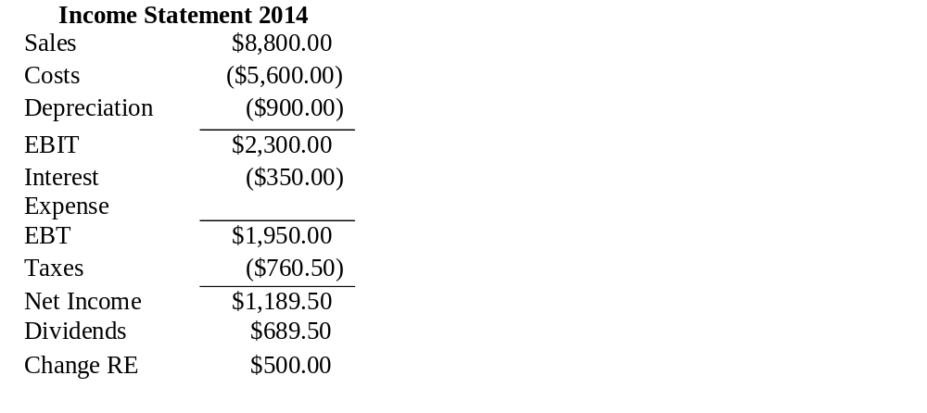
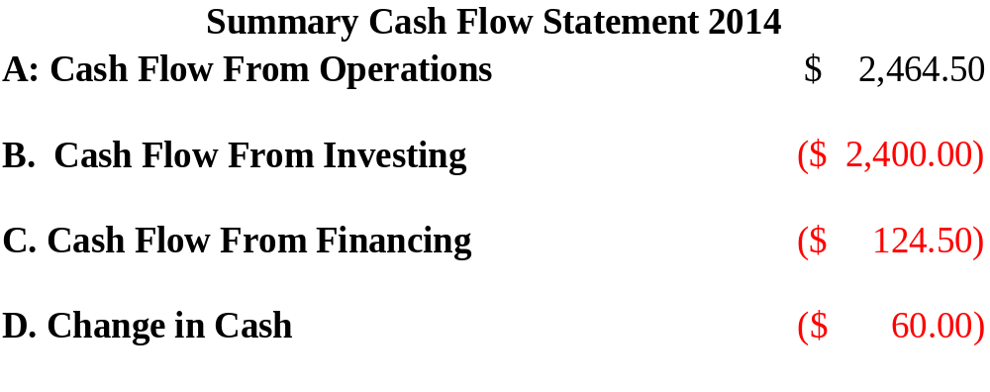
Sample Cash Flow Analysis
Change | Assets | 2013 | 2014 | Liabilities & Equity | 2013 | 2014 | Change
($60) | Cash | $170 | $110 | Accounts payable | $135 | $120 | ($15)
$200 | Accounts rec. | 500 | 700 | Notes payable | 1,200 | 1,400 | $200
($240) | Inventory | 1,240 | 1,000 | Total current liabilities | 1,335 | 1520
 | Total current | 1,910 | 1810 | Long-term debt | 2,005 | 2,620 | 615
$1,500 | Fixed assets | 2,000 | 3,500 | Common stock | 100 | 200 | 100
 |  |  |  | Retained earnings | 470 | 970 | 500
 | Total assets | $3,910 | $5,310 | Total liab. & equity | $3,910 | $5,310
Notes:
15
Notice that although the firm has positive earnings, cash decreased. Ordinarily the loan applicant should have positive operating cash flows. Cash from investing may be positive or negative, depending on the rate of return the firm is earning these investments may generate good growth. In the case above the lender would wish to verify that the borrower will have sufficient return on investment the fixed asset increases to ensure that the firm will have adequate cash balances to repay the loan. A trend of declining operating cash flows financed by cash flow from financing would be a red flag as this is probably not sustainable in the long run. This would imply the firm is borrowing more (possibly from you) to sustain dropping profitability.

Slide 16
Common Ratios
Liquidity ratios
  Current and quick (i.e., acid test) ratios
Asset management ratios
  # of days in receivables, # of days in inventory, sales to working capital, sales to fixed assets, and sales to total assets (i.e., the asset turnover ratio)
Debt and solvency ratios
  Debt-to-asset, times interest earned, and cash-flow-to-debt ratios
Profitability ratios
  Gross margin, operating profit margin, return on assets (ROA), return on equity (ROE), and dividend payout ratios
Notes:
16

Slide 17
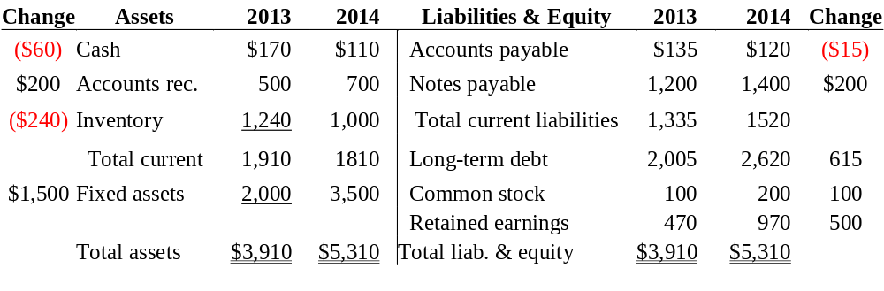
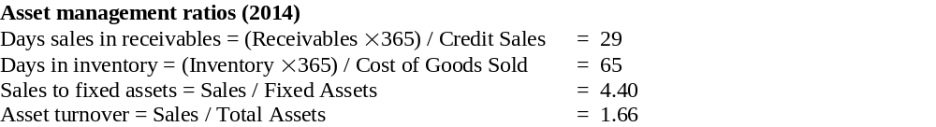
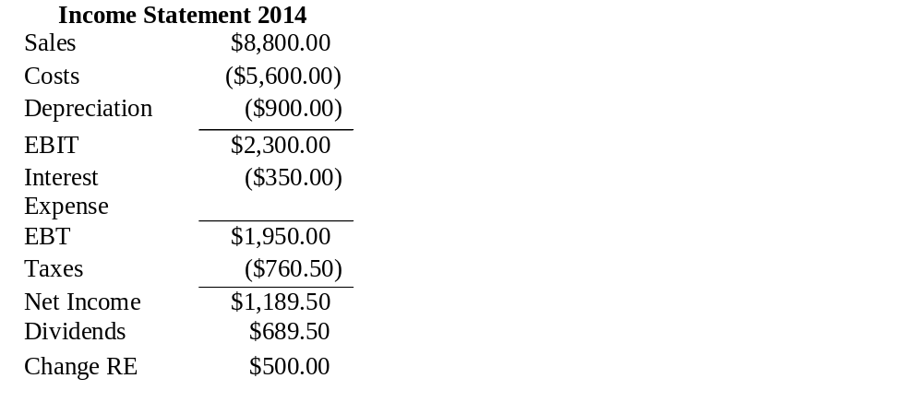
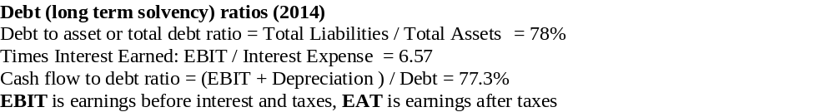
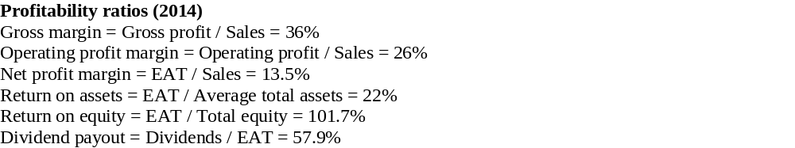
Sample Ratio Analysis
Notes:
17
Optional slide with ratio example, hide if you do not wish to cover this material

Slide 18
Limitations of Ratio Analysis
Ratio analysis has limitations:
  Diverse firms are difficult to compare versus benchmarks
  Different accounting methods can distort industry comparisons
  Applicants can distort financial statements
Common-size analysis and growth rates
  Common-size financial statements present values as percentages to facilitate comparison versus competitors
  Year-to-year growth rates can identify trends
Loan covenants can be used as part of the loan agreement to mitigate credit risk
Ratio analysis has limitations:
  diverse firms are difficult to compare versus benchmarks
  different accounting methods can distort industry comparisons
  applicants can distort financial statements
common-size analysis and growth rates
  common-size financial statements present values as percentages to facilitate comparison versus competitors
  year-to-year growth rates can identify trends
Notes:
18
In addition to using the ratios discussed previously, an analyst can compute sets of ratios by dividing all income statement amounts by total sales revenue and all balance sheet amounts by total assets. These calculations yield common-size financial statements that can be used to identify changes in corporate performance. Year-to-year growth rates also give useful ratios for identifying trends.

Slide 19
Mid-Market Commercial and Industrial Lending Concluded
Following approval of the loan, the account officer ensures that conditions precedent have been cleared
  Those conditions specified in the credit agreement that must be fulfilled before drawdowns are permitted
    Includes title searches, perfecting of collateral, etc.
FIs typically wish to develop permanent, long-term, mutually beneficial relationships with their mid-market commercial and industrial customers
Notes:
19

Slide 20
Large Commercial and Industrial Lending
Fees and spreads are smaller relative to small and mid-size corporate loans, but the transactions are often large enough to make them worthwhile
FIs’ relationships with large clients often center around broker, dealer, and advisor activities with lending playing a lesser role
  Large corporations often use loan commitments, performance guarantees, and term loans
Account officers preparing credit reviews often rely on rating agencies and market analysts to aid in their credit analysis, in addition to utilizing sophisticated credit-scoring models based on accounting and/or financial market data
Notes:
20
Bargaining strength of FI is severely diminished when it deals with large creditworthy corporate customers because they’re able to issue debt/equity directly in the capital markets, as well as make private placements of securities, among other reasons.

Slide 21
Altman’s Z-Score
Z is an overall measure of the borrower’s default risk classification, where
  X₁ = working capital / total assets
  X₂ = retained earnings / total assets
  X₃ = earnings before interest and taxes / total assets
  X₄ = market value of equity / book value of total liabilities
  X₅ = sales / total assets
Notes:
21
Developed to analyze publicly traded manufacturing firms in the U.S.

Slide 22
Altman’s Z-Score Interpretation
Default classifications (according to Altman)
  Z < 1.81 – high default risk firm
  1.81 < Z < 2.99 – indeterminate default risk firm
  Z > 2.99 – low default risk firm
Problems associated with Z-score model
  Usually discriminates only among three cases of borrower behavior – high, indeterminate, and low
  No obvious economic reason to expect the weights in the Z-score model (or, the weights in any credit-scoring model) will be constant over any but very short periods
  Ignores hard-to-quantify factors that may play a crucial role in the default or no-default decision
  Accounting variables are updated infrequently
Notes:
22

Slide 23
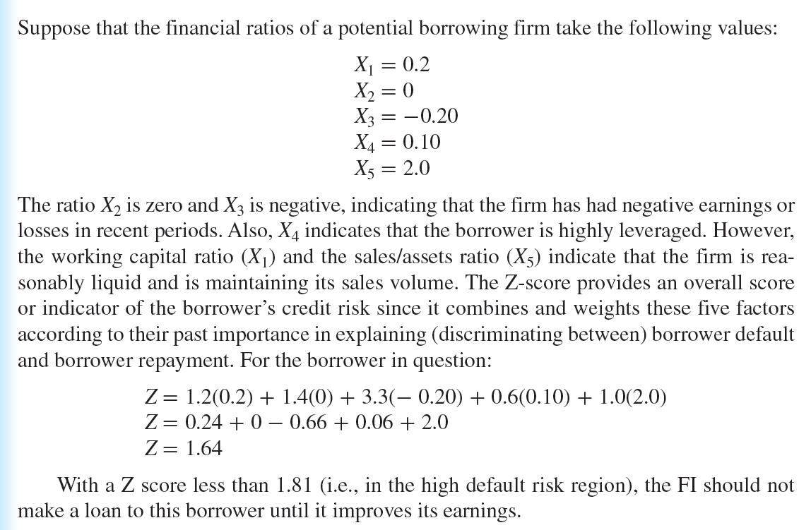
Altman’s Z-Score Example
Notes:
23

Slide 24
Large Commercial and Industrial Lending Continued
Moody’s Analytics (KMV) Credit Monitor Model
  Uses the option pricing model of Merton, Black, and Scholes to calculate expected default frequencies (EDF) for over 60,000 public companies and many private ones worldwide
  The EDF predicts the probability of whether the market value of the firm’s assets will fall below required debt repayments in one year
Notes:
24

Slide 25
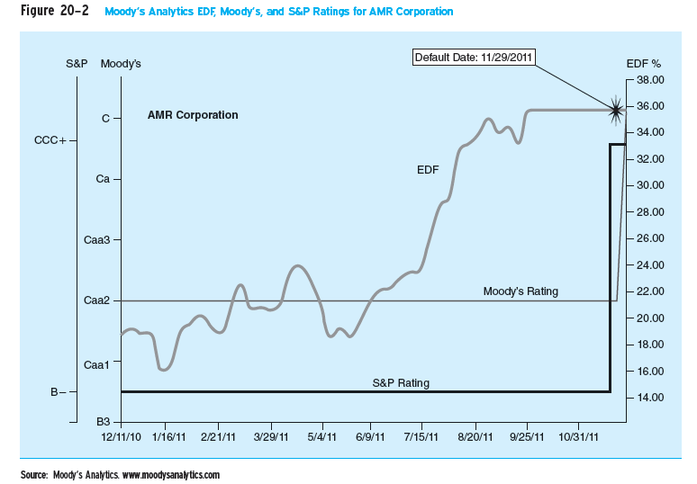
Moody’s Analytics EDF, Moody’s, and S&P Ratings for AMR Corporation
Notes:
25

Slide 26
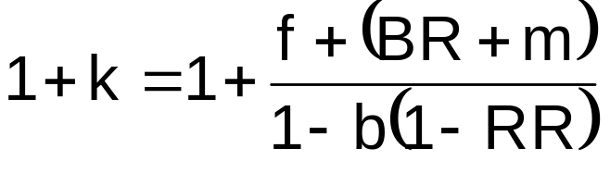
Calculating the Return on a Loan
The return on assets (ROA) approach shows the contractually promised gross return on a loan, k, per dollar lent (or 1 + k) – or ROA per dollar lent – will equal:
    where f = loan origination fee
    b = compensating balance requirement
    RR = the reserve requirement charge
    BR = the base lending rate
    m = the credit risk premium on the loan
Notes:
26
The numerator of this formula is the promised gross cash inflow to the FI per dollar lent, reflecting direct fees (f) plus the loan interest rat (BR +m). In the denominator, for every $1 that the FI lends, it retains b as non-interest-bearing compensating balances. Thus, 1 – b represents the net proceeds of each $1 of loan received by the borrower from the FI, ignoring reserve requirements.

Slide 27
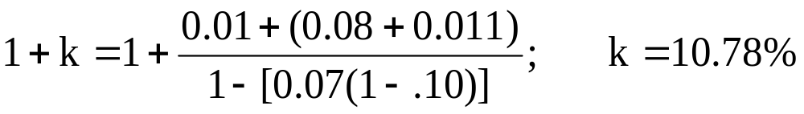
Calculating the Return on a Loan Example
A bank has a base lending rate of 8% (BR), and charges a certain customer a 110 basis point risk premium (m). The bank also charges a 1% origination fee (f). The bank requires the borrower to maintain compensating balances (b) of 7% of the loan amount. The reserve requirement (RR) is 10% and the loan amount is $1 million. Calculate the required gross return on a loan = k.
Notes:
27

Slide 28
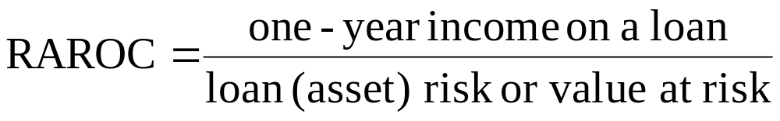
RAROC Model
The risk-adjusted return on assets (RAROC) model balances a loan’s expected income against its expected risk
The RAROC is compared vis-à-vis the lender’s tax-adjusted return on equity (ROE)
  If RAROC > ROE, make the loan
  If RAROC < ROE, either adjust the loan such that RAROC > ROE or decline to make the loan
Notes:
28

Slide 29
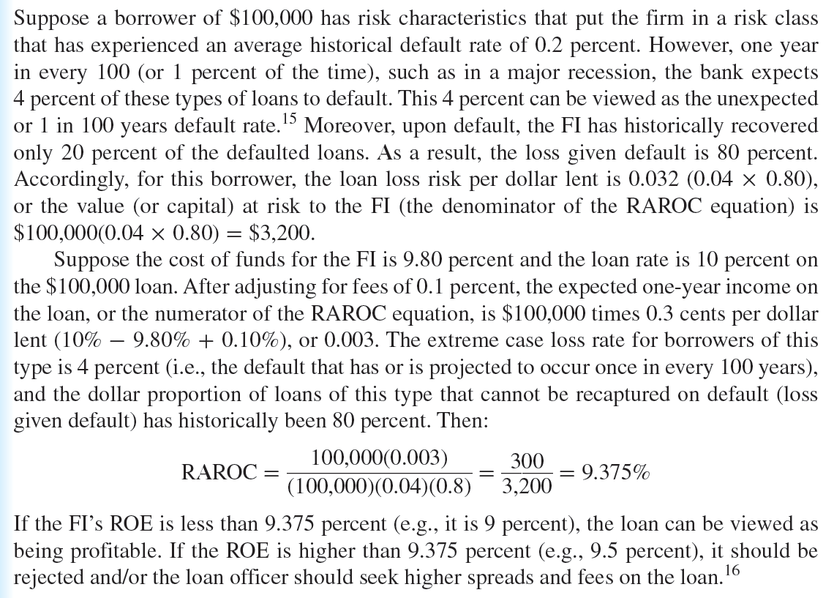
RAROC Example
Notes:
29

