Slide 1
Chapter Twenty-One
Managing Liquidity Risk on the Balance Sheet

Slide 2
Liquidity Risk Management
Unlike other risks, liquidity risk is a normal aspect of the everyday management of financial institutions (FIs)
At the extreme, liquidity risk can lead to insolvency
Some FIs are more exposed to liquidity risk than others
  Depository institutions (DIs) are highly exposed
  Mutual funds, hedge funds, pension funds, and property-casualty insurers have relatively low liquidity risk

Slide 3
Causes of Liquidity Risk
Liquidity risk arises for two reasons:
  The liability-side reason occurs when an FI’s liability holders, such as depositors or insurance policyholders, seek to cash in their financial claims immediately
    FIs must meet the withdrawals with stored or borrowed funds
    Can be costly if assets can only be sold at fire-sale prices
  The asset-side reason arises when the FI needs to fund loans immediately
    Again, FIs may meet this need by running down cash assets, selling off other liquid assets, or borrowing funds
    Unexpected loan demand can occur when off-balance-sheet loan commitments are drawn down suddenly and in large volumes
    FIs are contractually obliged to supply funds through loan commitments immediately should they be drawn down
Notes:
3

Slide 4
Liquidity Risk and
Depository Institutions (DIs)
DIs’ balance sheets typically have:
  Large amounts of short-term liabilities, such as demand deposits and other transaction accounts, that must be paid out immediately if demanded by depositors
  Large amounts of relatively illiquid long-term assets, such as commercial loans and mortgages
DIs know that normally only a small portion of demand deposits will be withdrawn on any given day
  Most demand deposits act as core deposits—i.e., they are a stable and long-term funding source
Deposit withdrawals are normally offset by the inflow of new deposits
Notes:
4

Slide 5
Liquidity Risk and
Depository Institutions (DIs) Continued
DI managers monitor net deposit drains—i.e., the amount by which cash withdrawals exceed additions; a net cash outflow
DIs manage a drain on deposits in two major ways:
  Stored liquidity management is an adjustment to a deposit drain that occurs on the asset side of the balance sheet
    FI liquidates some of its assets, utilizing stored liquidity
  Purchased liquidity management is an adjustment to a deposit drain that occurs on the liability side of the balance sheet
    Rely on the ability to acquire funds from brokered deposits and borrowings
    Used primarily by the largest banks with access to the money market and other nondeposit sources of fund
Notes:
5
Most DIs utilize a combination of stored and purchased liquidity management.

Slide 6
Stored Liquidity Management
Stored liquidity
  Liquidating cash stores and selling existing assets
  Banks hold cash reserves in their vaults and at the Federal Reserve in excess of minimum requirements to meet liquidity drains
  When managers utilize stored liquidity to fund deposit drains, the composition of the balance shset changes
Notes:
6

Slide 7
Purchased Liquidity Management
Purchased liquidity includes
  Market for purchased funds
    Fed funds market
    Repurchase (repo) agreement markets
  Issue additional fixed-maturity certificates of deposits
  Issue additional notes and bonds
Allows FIs to maintain the overall size of their balance when faced with liquidity demands without disturbing the size/composition of the asset size of the balance sheet
Purchased liquidity may be expensive relative to stored liquidity and adds to volatility of interest expense
Notes:
7

Slide 8
Liquidity Risk and
Depository Institutions (DIs) Concluded
Loan commitments and other credit lines can cause liquidity needs
  As with liability side liquidity risk, asset side liquidity risk can be managed with stored or purchased liquidity
If stored liquidity is used to fund commitments, the composition of the asset side of the balance sheet changes, but not the size of the balance sheet
If purchased liquidity is used to fund commitments, the composition of both the asset and liability sides of the balance sheet changes, and the size of the balance sheet increases
Notes:
8

Slide 9
Financing Gap and the Financing Requirement
The first way to measure liquidity risk exposure is to determine the DI’s financing gap (i.e., the difference between a bank’s average loans and average (core) deposits)
  If the financing gap is positive, the bank must find liquidity to fund the gap
    The funding may come from purchase liquidity management (i.e., borrowing funds) or stored liquidity management (i.e., liquidating assets)
  Financing gap = Average loans – Average deposits
  Financing gap = - Liquid Assets + Borrowed funds
Notes:
9

Slide 10
Financing Gap and the Financing Requirement Continued
The financing requirement is the financing gap plus a DI’s liquid assets
  Financing Requirement (or Borrowed Funds) =
  Financing Gap + Liquid Assets
A widening financing gap can be an indicator of future liquidity problems since it may indicate increased deposit withdrawals and increasing loans due to more exercise of loan commitments
Notes:
10

Slide 11
Sources and Uses of Liquidity
The liquidity position of banks is measured by managers on a daily basis, if possible
A net liquidity statement lists sources and uses of liquidity, and, thus, provides a measure of a DI’s net liquidity position
  This is a tool used by DI managers, serving as the second method by which to measure liquidity risk exposure
DI can obtain liquid funds in the following ways:
  Sell its liquid assets, such as T-bills, immediately with very little price risk and low transaction costs
  Borrow funds in the money/purchased funds market up to a maximum amount
  Use any excess cash reserves over and above the amount held to meet regulatory imposed reserve requirements
Notes:
11

Slide 12
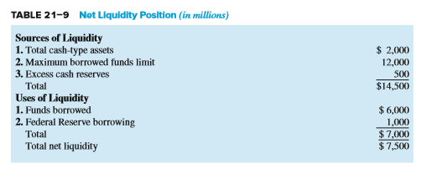
Net Liquidity Position
Notes:
12

Slide 13
Peer Group Ratio Comparisons
The third way to measure a DI’s liquidity exposure is to use peer group ratio comparisons
Peer group ratio comparisons are when certain key ratios and balance sheet features of a DI are compared against those same key ratios and balance sheet features of another DI
Ratios are often compared to those of banks of a similar size and in the same geographic location
Notes:
13

Slide 14

Liquidity Index
A final way to measure liquidity risk is to use a liquidity index, which measures the potential losses a bank could suffer from a sudden (or fire-sale) disposal of assets
    where w_{i} = the percent of each asset in the DI’s portfolio
    Pi = price if a DI liquidates asset i today
    P_{i}* = price if a DI liquidates asset i at some future point in time (e.g., in one month)
Notes:
14

Slide 15
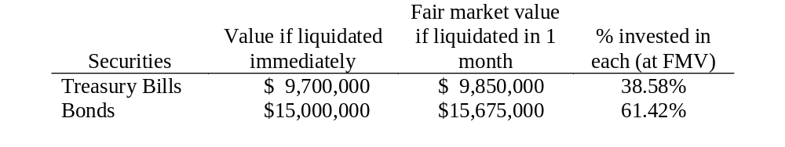
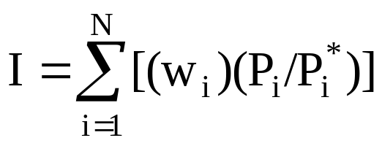
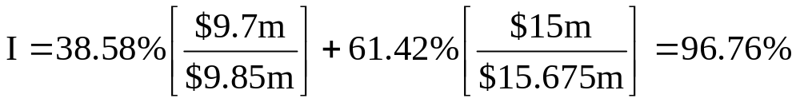
Liquidity Risk Example
For simplicity, assume a bank has only two assets.
Notes:
15
The lower the index the greater the liquidity risk.
Teaching Tip: Discount instruments increase in price as they approach maturity but non-discount instruments receive interest income. The liquidity index should measure not only any loss in fair market value, but also any loss in income due to a required change in FI behavior. For example, a T-bill may be priced at fair market value at 99% of par prior to maturity. Nevertheless, if the FI planned to hold the bill until maturity but had to sell it to meet liquidity needs, the required sale at the fair market value of $99 per $100 of par still represents a loss due to liquidity risk. Thus, the index should account for lost interest as well as losses in current fair market value.
Teaching Tip: The index is a better measure of the cost of liquidity risk than the likelihood of occurrence of liquidity problems.

Slide 16
New Liquidity Risk Measures Implemented by BIS
Two regulatory standards were developed by BIS for liquidity risk supervision
  Standards are intended to “enhance tools, metrics, and benchmarks that supervisors can use to assess the resilience of banks’ liquidity cushion and constrain any weakening in liquidity maturity profiles, diversity of funding sources, and stress testing practices”
Notes:
16
Note that this rule applies to large, internationally active banking organizations with $250 billion or more in total consolidated assets or $10 billion or more in total on-balance-sheet foreign exposure, and to consolidated subsidiary depository institutions of these banking organizations with $10 billion or more in total assets.

Slide 17
Liquidity Planning
Liquidity planning allows managers to make important borrowing priority decisions before liquidity problems arise
  Lowers the costs of funds by determining an optimal funding mix
  Minimizes the amount of excess reserves that a DI needs to hold
  Liquidity plan components
    Delineation of managerial responsibilities
    List of fund providers most likely to withdraw funds and a pattern of fund withdrawals
    Identification of the size of potential deposit and fund withdrawals over various time horizons in the future
    Internal limits on separate subsidiaries’ and branches’ borrowings as well as acceptable risk premiums to pay in each market
Notes:
17

Slide 18
Liquidity Risk, Unexpected Deposit Drains, and Bank Runs
Major liquidity problems arise if deposit drains are abnormally large and unexpected
Abnormal deposit drains can occur for a number of reasons:
  Concerns about a DI’s solvency
  Failure of a related DI (i.e., a contagion effect)
  Sudden changes in investor preferences regarding holding nonbank financial assets relative to DI deposits
A bank run is a sudden and unexpected increase in deposit withdrawals from a DI
Notes:
18

Slide 19
Deposit Drains and Bank Run Liquidity Risk
Demand deposits are first-come, first-served contracts
The incentives for depositors to withdraw their funds at the first sign of trouble creates a fundamental instability in the banking system
  A bank panic is a systemic or contagious run on the deposits of the banking industry as a whole
Regulatory mechanisms are in place to ease banks’ liquidity problems and to deter bank runs and panics
  Deposit insurance
  The discount window
Notes:
19

Slide 20
Deposit Insurance
Deposit insurance was first introduced in the U.S. in 1934 with coverage up to $2,500
  Coverage was increased to $100,000 in 1980 and to $250,000 in 2008
Individuals can achieve many times the $250,000 coverage cap on deposits by creatively structuring their deposits and by using multiple banks
The FDIC now uses a risk-based deposit insurance program to evaluate and assign deposit insurance premiums
Some states operate state guarantee funds to insure investments made with insurance firms, but they are not federally backed
Notes:
20

Slide 21
The Discount Window
The Federal Reserve also provides a “discount window” lending facility, serving as a lender of last resort
The interest rate at which securities are discounted is called the discount rate and is set by the central bank
In response to the liquidity problems caused by the credit crunch in 2007 and 2008, the Fed announced in March 2008 that it would lend up to $200 billion to both commercial and investment banks through its new Primary Dealer Credit Facility (PDCF)
New federal borrowing programs emerged over the succeeding months providing funding to money market mutual funds, commercial paper, insurance companies, and others
Notes:
21

Slide 22
Liquidity Risk and Insurance Companies
Life insurance companies hold cash reserves and other liquid assets for the following reasons:
  Meet policy payments
  Meet cancellation (surrender) payments
    The surrender value of a life insurance policy is the amount that an insurance policyholder receives when cashing in a policy early
  Fund working capital needs, which can be unpredictable
Property-casualty (P&C) insurance companies
  Claims against P&C insurers are hard to predict
  Thus, P&C insurance companies have a greater need for liquidity than life insurance companies
Notes:
22

Slide 23
Liquidity Risk and Investment Funds
Investment funds, such as mutual funds and hedge funds, sell shares as liabilities to investors and invest the proceeds in assets such as bonds and equities
Face similar liquidity problems as DIs when the number of withdrawals rises to abnormally high or unexpected levels
  Fundamental difference in the way investment fund contracts are valued compared to the valuation of DI deposit contracts, thereby reducing the incentives for investment fund shareholders to engage in deposit-like runs
Notes:
23

