Slide 1
Chapter Twenty-Two
Managing Interest Rate Risk and Insolvency Risk on the Balance Sheet

Slide 2
Interest Rate Risk
The asset-transformation function performed by financial institutions (FIs) often exposes them to interest rate risk via the mismatching of asset and liability maturities
FIs use two main methods to measure interest rate exposure:
  The repricing model (a.k.a. the funding gap model) examines the impact of interest rate changes on net interest income (NII)
  The duration model examines the impact of interest rate changes on the overall market value of an FI, and thus on net worth

Slide 3
Interest Rate Risk Measurement and Management
The Federal Reserve’s monetary policy strategy is the most direct influence on the level and movement of interest rates
  If the Fed wants to slow down the economy, it will tighten monetary policy by taking actions that raise interest rates
  If the Fed wants to stimulate the economy (i.e., expansionary monetary policy), it allows interest rates to fall
Notes:
3

Slide 4
Repricing Model
The repricing or funding gap is the difference between those assets whose interest rates will be repriced or changed over some future period (RSAs) and liabilities whose interest rates will be repriced or changed over some future period (RSLs)
  Simple model used by small FIs in the U.S.
  Using this approach, DIs report quarterly on their Call Reports, interest-rate sensitivity reports which show the repricing gaps for assets and liabilities with various maturities
Notes:
4

Slide 5
Repricing Model Continued
Example of maturity bucks (or bins):
  One day
  More than 1 day to 3 months
  More than 3 months to 6 months
  More than 6 months to 12 months
  More than 1 year to 5 years
  More than 5 years
Notes:
5

Slide 6
Repricing Model Concluded
The gap in each bucket (or bin) is measured as the difference between the rate-sensitive assets (RSAs) and the rate-sensitive liabilities (RSLs)
  Rate sensitivity is the time to repricing of an asset or liability
A negative gap (where RSA < RSL) exposes the FI to refinancing risk, which is the risk that the cost of rolling over or reborrowing funds will rise about the returns being earned on asset investments
A positive gap (where RSA > RSL) exposes the FI to reinvestment risk, which is the risk that the returns on funds to be reinvested will fall below the cost of the funds
Notes:
6
Note that repricing could be the result of a rollover of an asset or liability, or it can occur if the asset of liability is a variable-rate instrument.

Slide 7
Change in Net Interest Income
The change in net interest income for any given bucket i (ΔNII_{i}) is measured as:
  ΔNII_{i} = (GAP_{i})ΔR_{i} = (RSA_{i} – RSL_{i})ΔR_{i}
  where GAP_{i} = the dollar size of the gap between the book
  value of rate-sensitive assets and rate-sensitive
  liabilities in maturity bucket i
  ΔR_{i} = the change in the level of interest rates
  impacting assets and liabilities in the ith
  maturity bucket
Notes:
7

Slide 8
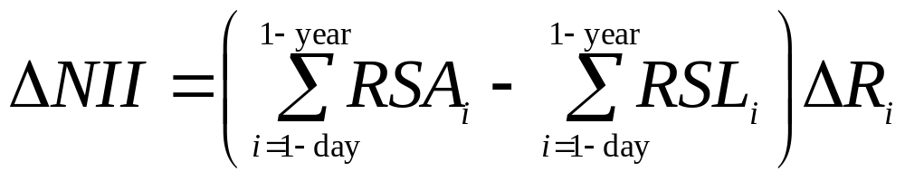
CGAP
Cumulative gaps (CGAP) over various repricing categories may also be estimated, with a common interest being the one-year repricing gap
The cumulative effect on the bank’s net interest income may be estimated using:
where ΔNII is the cumulative change in net interest income from all rate-sensitive assets and liabilities that are repriced within a year given a change in interest rates, ΔR_{i}
Notes:
8
Note that the cumulative change in net interest income is equivalent to CGAP times the change in interest rates.

Slide 9
Spread Effect
The spread effect is the effect that a change in the spread between rates on RSAs and RSLs has on net interest income (NII) as interest rates change
ΔNII = (RSA x ΔR_{RSA}) – (RSL x ΔR_{RSL})
In general, the spread effect is such that, regardless of the direction of the change in interest rates, a positive relation exists between changes in the spread (between rates on RSAs and RSLs) and changes in NII
When the spread increases (decreases), NII increases (decreases)
Notes:
9

Slide 10
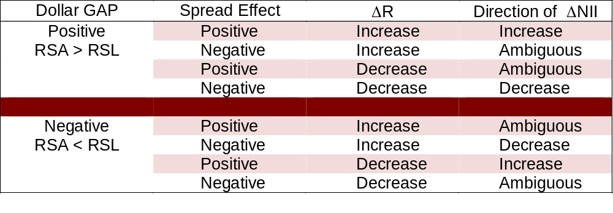
Repricing Gap
Ignoring the spread effect for simplicity (highlighted rows):
For a positive repricing gap, interest rates and profitability move in the same direction
For a negative repricing gap, interest rates and profitability move in the opposite direction
Notes:
10
The four highlighted rows ignore the spread effect. In each of these cases, the effect of the spread effect is the same as the effect of the interest rate change.

Slide 11
Limitations of the Repricing Model
The repricing model has some major weaknesses
  It ignores market value effects of interest rate changes
  It ignores cash flow patterns within a maturity bucket
  It fails to deal with the problem of rate-insensitive asset and liability cash flow runoffs and prepayments
  It ignores cash flows from off-balance-sheet (OBS) activities
Notes:
11

Slide 12
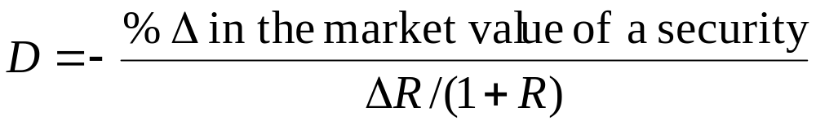
The Duration Model
Duration measures the interest rate sensitivity of an asset or liability’s value to small changes in interest rates
The duration gap is a measure of overall interest rate risk exposure for an FI
To find the duration of the total portfolio of assets (D_{A}) (or liabilities, (D_{L})) for an FI:
  First, determine the duration of each asset (or liability) in the portfolio
  Then, calculate the market value weighted average of the duration of the assets (or liabilities) in the portfolio
Notes:
12

Slide 13
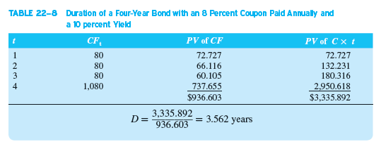
Duration Example
Notes:
13

Slide 14
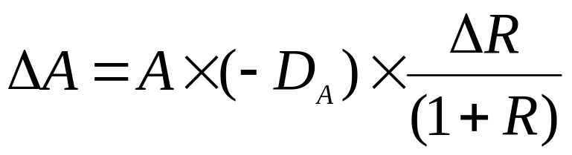
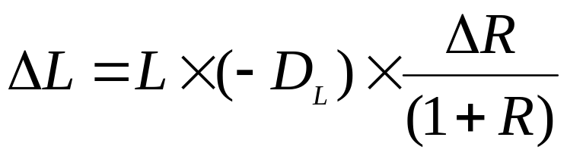
The Duration Model Continued
The dollar change in the market value of the asset portfolio for a change in interest rates is:
Similarly, the dollar change in the market value of the liability portfolio for a change in interest rates is:
Notes:
14

Slide 15
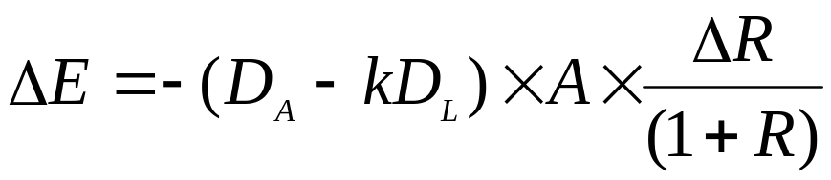
The Duration Model Concluded
Finally, the change in the market value of equity of an FI given a change in interest rates is determined from the basic balance sheet equation:
By substituting and rearranging, the change in net worth is given as:
  where k = L/A = a measure of the FI’s leverage
Notes:
15
In other words, k is the amount of borrowed funds or liabilities rather than owners’ equity used to fund its asset portfolio.

Slide 16
Effects of Interest Rate Changes on Net Worth
The effect of interest rate changes on the market value of equity or net worth of an FI breaks down to three effects:
  The leverage adjusted duration gap = (D_{A} – kD_{L})
    Measured in years
    Reflects the degree of duration mismatch on an FI’s balance sheet
    The larger the gap (in absolute terms), the more exposed the FI to interest rate risk
  The size of the FI = A = the size of the FI’s assets
  The size of the interest rate shock = ∆R / (1 + R)
Notes:
16

Slide 17
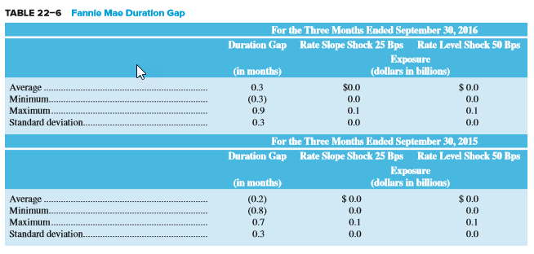
Fannie Mae Duration Gap
Notes:
17

Slide 18
Limitations of the Duration Model
Duration matching can be costly
  Critics claim that restructuring the balance sheet can be time-consuming and costly
  Note that this argument isn’t as true today as is has been in the past, given the growth of purchased funds, asset securitization and loan sales markets have eased the speed and lowered the transaction costs of major balance sheet restructurings
Immunization is a dynamic problem
  The duration of assets and liabilities changes as they approach maturity, and the rate at which their durations change through time may not be the same on the asset and liability sides of the balance sheet
Large interest rate changes and convexity
  Convexity is the degree of curvature of the price-yield curve around some interest rate level
Notes:
18

Slide 19
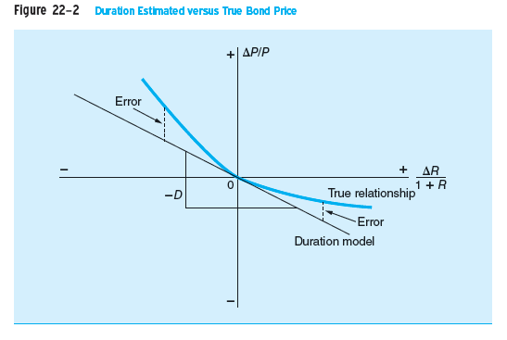
Duration Estimated versus True Bond Price
Notes:
19

Slide 20
Insolvency Risk Management
To ensure survival, an FI manager must protect against the risk of insolvency
The primary protection against the risk of insolvency is equity capital
  Capital is also a source of funds
  Capital is a necessary requirement for growth under existing minimum capital-to-asset ratios set by regulators
FI managers often prefer low levels of capital in order to generate a higher return on equity (ROE)
  The moral hazard problem of deposit insurance exacerbates this tendency
  Strategy results in an increased likelihood of insolvency
Notes:
20

Slide 21
Insolvency Risk Management Continued
The Capital Purchase Program (CPP) was part of the TARP funding in 2008-2009
  The Treasury purchased over $205 billion in senior preferred stock under the program
The CPP was designed to help U.S. FIs increase their capital with the aim of increasing lending to the general public
  Through December 2016, $245 billion of TARP capital injections had been allocated to DIs, of which $239.6 billion had been paid back, along with a return of $35.7 billion in dividends and assessments
Notes:
21

Slide 22
Capital
The economic meaning of capital is net worth
  Net worth is equal to the difference between the market value (MV) of an FI’s assets and the market value of its’ liabilities
  The market value or mark-to-market value basis uses balance sheet values that reflect current rather than historical prices
Regulatory and accounting-defined capital is based in whole or in part on historical or book values (BV), which means the value of assets and liabilities are based on their historical costs
Notes:
22

Slide 23
Market Value of Capital
The market value of capital and credit risk
  Decreases in current and expected future cash flows on loans lowers the MV of an FI’s assets
  Decreases in the MVs of assets are directly charged against the equity owners’ capital or net worth
  Liability holders are only hurt when asset losses exceed equity capital levels
  Thus, equity capital acts as “insurance” protecting liability holders (and guarantors, such as the FDIC) against insolvency risk
The market value of capital and interest rate risk
  Rising interest rates decrease the value of an FI’s assets more than the value of the FI’s liabilities when the duration gap of the FI’s balance sheet is positive
  Losses are first charged against equity capital
Notes:
23
Note that the market value of equity is more relevant than book value because, in the event of bankruptcy, the liquidation (market) value determines the FI’s ability to pay various claims.

Slide 24
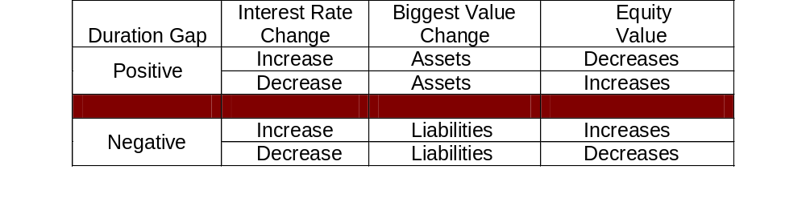
Interest Rate Changes and
Equity Value
If interest rates are projected to increase, how should the FI position its’ duration gap?
If interest rates are projected to decrease, how should the FI position its’ duration gap?
Notes:
24

Slide 25
The Book Value of Capital
The book value of capital is the difference between the BV of assets and the BV of liabilities
  BV of capital is usually composed of the par value of shares, the surplus value of shares, and retained earnings
  BV of equity does not equal the market value of equity
  Managers can manipulate the BV of equity by:
    Using discretion when timing the recognition of loan losses
    Selectively selling assets to inflate reported earnings (and, thus, capital)
Notes:
25
Selectively selling assets to inflate reported earnings (and thus capital) is called ‘gains trading.’

Slide 26
Discrepancy between MV and BV
Interest rate changes have no impact on book values of assets and liabilities
  FIs can be solvent from a BV perspective, but massively insolvent from an economic perspective
The degree to which the BV of capital deviates from the MV of capital depends on:
  Interest rate volatility
  Examination and enforcement
  Asset trading
The discrepancy between the MV and BV of equity capital is measured by the market-to-book ratio
Notes:
26

Slide 27
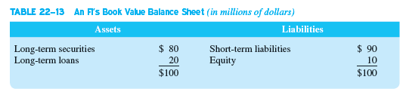
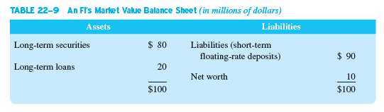
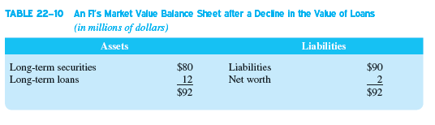
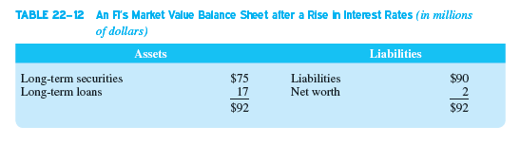
Market Value versus Book Value
Scenario 1, credit problems
Scenario 2, interest rate increase
Notes:
27

Slide 28
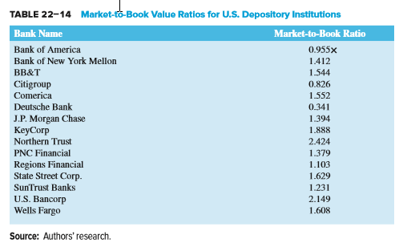
Market-to-Book Value Ratios for U.S. DIs
Notes:
28
1. Interest Rate Volatility —the higher the interest rate volatility, the greater the discrepancy between market and book value.
2. Examination and Enforcement —the more frequent are on-site and off-site examinations and the stiffer the examiner/regulator standards regarding charging off problem loans, the smaller the discrepancy.
3. Asset Trading —the more assets that are traded, the easier it is to assess the true market value of the asset portfolio.

Slide 29
Arguments Against MV Accounting
Arguments include:
  It is difficult to implement
    Especially for small FIs that are not publicly traded, because when market prices cannot be determined accurately, marking to market may be done only with error
  It introduces an unnecessary degree of variability into reported earnings
  FIs are less willing to accept longer-term asset exposures if these assets must be continually marked-to-market to reflect changing credit quality and interest rates
Notes:
29

Slide 30
Arguments Against MV Accounting Continued
The industry argues the lack of liquidity in the recent crisis led to unrealistically low market values of assets and marking to market imposed excessive losses on institutions
  Consequently, the Financial Accounting Standards Board (FASB) allows management to rely on internal estimates of cash flows to estimate fair value
As of April 2009, FASB allows DIs to not recognize losses in earnings and regulatory capital on accounts that are a) designated as held for investment rather than sale and b) temporarily impaired in value due to market conditions rather than underlying credit deterioration
Notes:
30

