Slide 1
Chapter Twenty-Three
Managing Risk off the Balance Sheet with Derivative Securities

Slide 2
Derivative Securities Used to Manage Risk
Managers are increasingly turning to off-balance-sheet (OBS) instruments such as forwards, futures, options, and swaps to hedge the risks their financial institutions (FIs) face
  Interest rate risk
  Foreign exchange risk
  Credit risk
FIs also generate fee income from derivative securities transactions
Notes:
2

Slide 3
Forward and Futures Contracts
A spot contract is an agreement to transact involving the immediate exchange of assets and funds
A forward contract is a contractual agreement between a buyer and a seller, at time 0, to exchange a prespecified asset for cash at some later date at a price set at time 0
  Often involve underlying assets that are nonstandardized (e.g., six-month pure discount bonds)
  Buyer and seller must locate and deal directly with each other to set terms of contract
  Once a party has agreed to a forward position, canceling the deal prior to expiration is generally difficult

Slide 4
Forward and Futures Contracts Continued
A futures contract is an exchange-traded agreement to transact involving the future exchange of a set amount of assets for a price that is settled daily
  Futures are liquid, most traders close their position before the delivery date so the underlying transaction may never take place
  Futures contracts are marked to market daily—i.e., the traders’ gains and losses on outstanding futures contracts are realized each day as futures prices change
  Exchange clearinghouse stands behind all contracts so there is no counterparty default risk and trading is anonymous

Slide 5

Hedging with Forward Contracts
A naïve hedge is a hedge of a cash asset on a direct dollar-for-dollar basis with a forward (or futures) contract
Managers can predict capital loss (ΔP) using the duration formula:
where ΔP = capital loss on portfolio = ?
P = the initial value of portfolio
    D = the duration of the portfolio
    R = the interest rate (and thus ΔR is the change in interest)
FIs can immunize assets against risk by using hedging to fully protect against adverse movements in interest rates
Notes:
5

Slide 6
Hedging with Futures Contracts
Microhedging is using a derivative securities contract to hedge a specific asset or liability
  Basis risk is a residual risk that occurs in a hedged position because the movement in an asset’s spot price is not perfectly correlated with the movement in the price of the asset delivered under a futures (or forwards) contract
  Firms use short positions in futures contracts to hedge an asset that declines in value as interest rates rise
Macrohedging is hedging the entire (leverage-adjusted) duration gap of an FI
Notes:
6

Slide 7
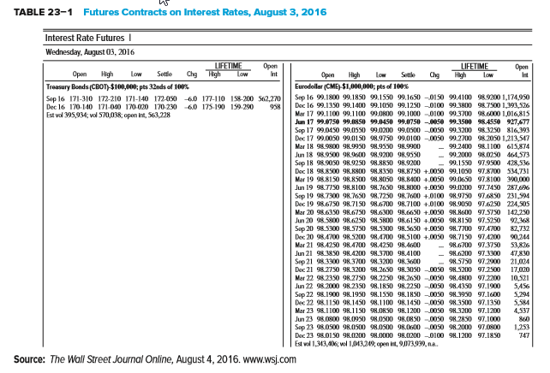
Futures Contracts on Interest Rates, August 3, 2016
Notes:
7

Slide 8
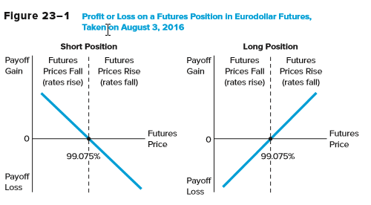
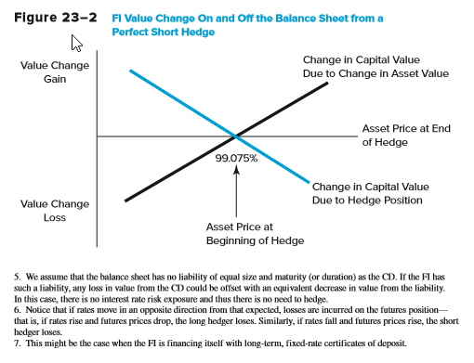
Futures Gain and Loss and Hedging with Futures
Notes:
8

Slide 9
Options
Many types of options are used by FIs to hedge
  Exchange-traded options
  Over-the-counter (OTC) options
  Options embedded in securities
  Caps, collars, and floors
Four basic option strategies that FIs might employ to hedge interest rate risk
  Consider options in which the underlying the futures contracts are bonds whose payoff values are inversely linked to interest rate movements in a manner similar to bond prices and interest rates in general
Notes:
9

Slide 10
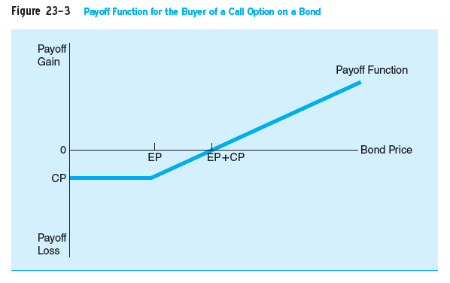
#1 - Buying a Call Option
Buying a call option on a bond
  As interest rates fall, bond prices rise, and the call option buyer has a large profit potential
  As interest rates rise, bond prices fall, and the potential for a negative payoff (loss) for the buyer of the call increases
Notes:
10
Note: buying a call is a good strategy if interest rates are expected to fall.

Slide 11
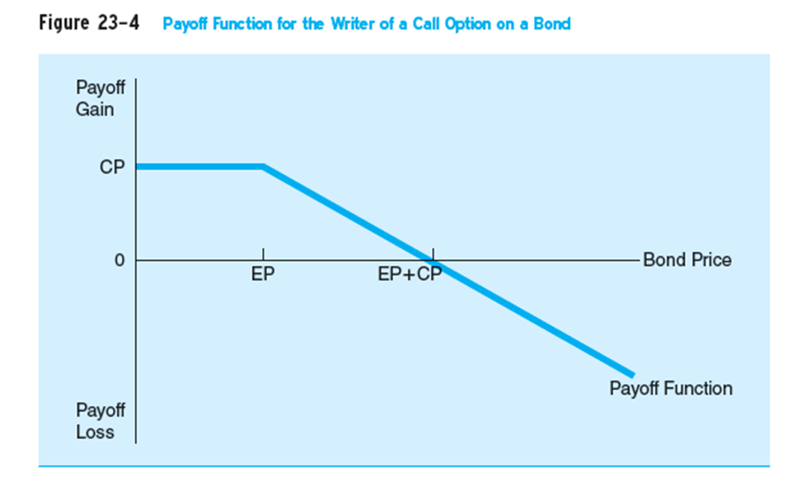
#2 - Writing a Call Option
Writing a call option on a bond
  When interest rates fall, bond prices rise, and the call option writer will take a loss increase
  When interest rates rise, bond prices fall, and the potential for the writer of the call to receive a positive payoff or profit increases
Notes:
11
Note: writing a call option if a good strategy if interest rates are expected to rise.

Slide 12
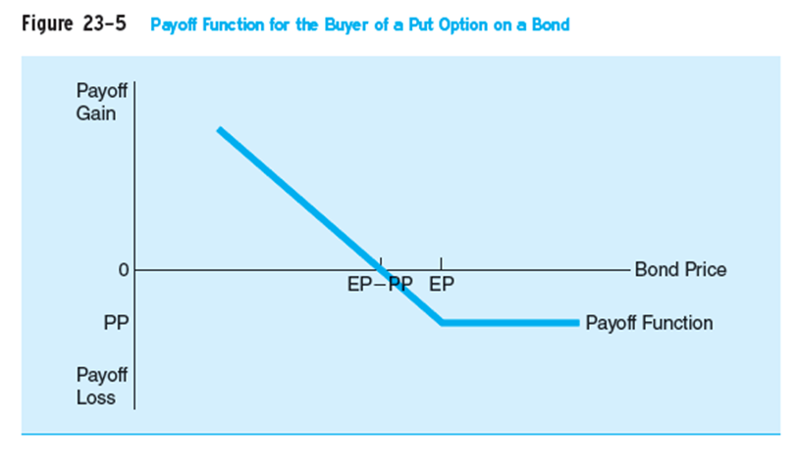
#3 - Buying a Put Option
Buying a put option on a bond
  When interest rates rise, bond prices fall, and the buyer of the put will make a profit
  When interest rates fall, bond prices rise, and the probability the buyer of a put has a loss increases
Notes:
12
Note: buying a put option is a strategy to take when interest rates are expected to rise.

Slide 13
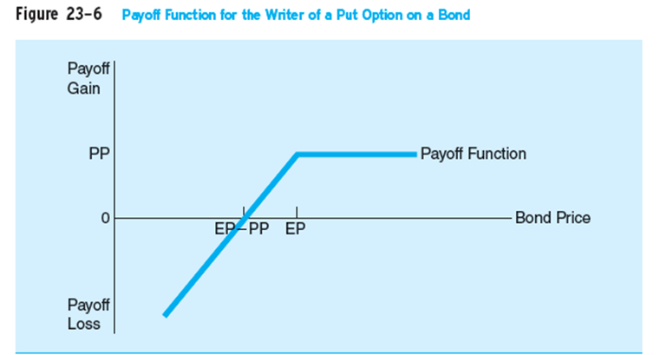
#4 - Writing a Put Option
Writing a put option on a bond
  When interest rates rise, bond prices fall, and the put option writer has large potential losses
  As interest rates fall, bond prices rise, the writer has an enhanced probability of making a profit
Notes:
13
Note: writing a put option is a strategy to take when interest rates are expected to fall.

Slide 14
Hedging with Put Options
Payoff
Gain
0 Bond price
X
-P Payoff from
buying a put
Payoff on a bond
Loss
Payoff for a bond
held as an asset
Net payoff function

Slide 15
Caps, Floors, and Collars
Buying a cap means buying a call option, or a succession of call options, on interest rates rather than on bond prices
  Like buying insurance against an (excessive) increase in interest rates
Buying a floor is akin to buying a put option on interest rates
  Seller compensates the buyer should interest rates fall below the floor rate
  Like caps, floors can have one or a succession of exercise dates
A collar amounts to a simultaneous position in a cap and a floor
  Usually involves buying a cap and selling a floor to offset cost of cap
Notes:
15

Slide 16
Risks Associated with Futures, Forwards, and Options
Contingent credit risk is likely to be present when FIs expand their positions in forward, futures, and option contracts
Contingent credit risk is the risk that the counterparty defaults on payment obligations, leaving the FI unhedged and having to replace the contract at today’s interest rates, prices, or exchange rates
  Forward contracts and all OTC derivatives are exposed to counterparty default risk, as they are nonstandard contracts entered into bilaterally
Notes:
16

Slide 17
Interest Rate and Currency Swaps
Swap agreements are contracts where two parties agree to exchange a series of payments over time
There are several types of swaps:
  Interest rate swaps
    Parties agree to swap interest payments on a stated notional principal amount for a set period of time (some more than 5 years), and no principal is usually exchanged
  Currency swaps
    Used to hedge against foreign exchange rate risk from mismatched currencies on assets and liabilities
Notes:
17

Slide 18
Currency Swap Example
Consider a U.S. FI with fixed-rate $ denominated assets and fixed-rate £ denominated liabilities
Also, consider a U.K. FI with fixed-rate £ denominated assets and fixed-rate $ denominated liabilities
The FIs can engage in a currency swap to hedge their foreign exchange exposure
  That is, the FIs agree on a fixed exchange rate at the inception of the swap agreement for the exchange of cash flows at some point in the future
  Both FIs have effectively hedged their foreign exchange exposure by matching the denominations of their cash flows
Notes:
18

Slide 19
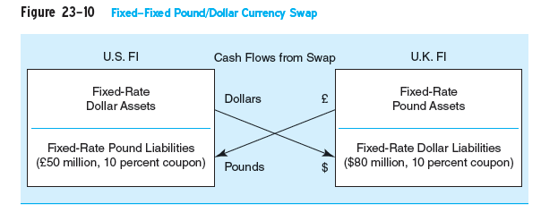
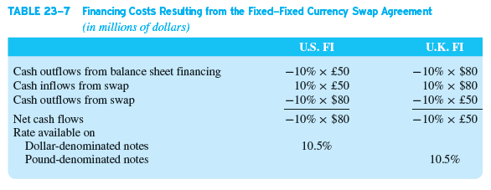
Currency Swap Hedging Example Illustrated
Notes:
19

Slide 20
Credit Default Swaps (CDSs)
Total Return Swap (TRS):
  Swap involving an obligation to pay interest at a specified fixed or floating rate for payments representing the total return on a specified amount
  Can be designed to cover any change in value of the principal as well as just the interest
    Often used when there is exposure to a change in the credit risk of the counterparty
Pure Credit Swap (PCS):
  Swap in which an FI receives the par value of the loan on default in return for paying a periodic swap fee
Notes:
20

Slide 21
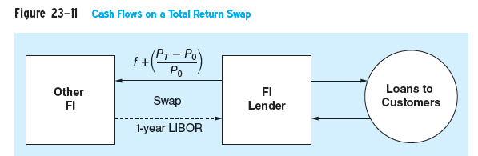
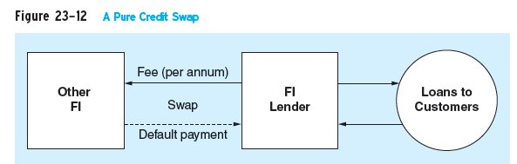
Credit Default Swaps (CDSs) Continued
Total Return Swap
Pure Credit Swap
Notes:
21

Slide 22
Swaps and the Financial Crisis
Lehman Brothers and AIG sold credit default swaps worth billions of dollars in payments insuring mortgage-backed securities (MBS)
When mortgage security values collapsed, required outflows at these firms far exceeded capital
Other institutions invested more heavily in MBS because they were insured; exposure to mortgage markets was more widespread than it would have been otherwise
Credit swaps may cause lenders to make loans they would not otherwise make and earn fee income on other services offered to borrowers.
Notes:
22

Slide 23
Plain Vanilla Swap
A plain vanilla swap is:
  A standard agreement where one participant pays a fixed rate of interest and the other party pays a variable rate of interest on a stated notional principal; no principal is exchanged
The SB sends fixed-rate interest payments to the MCB
  Thus, the MCB’s fixed-rate inflows are now matched to its fixed-rate payments
The MCB sends variable-rate interest payments to the SB
  Thus, the SB’s variable-rate inflows are now matched to its variable-rate payments
Notes:
23

Slide 24
Credit Risk Concerns with Swaps
The growth of the over-the-counter swap market was a major factor underlying the imposition of the BIS risk-based capital requirements
  The fear was that out-of-the-money counterparties would have incentives to default
  BIS now requires capital to be held against interest rate, currency, and other swaps
Credit risk concerns with swaps
  Netting: only the difference between the fixed and the floating payment is exchanged between swap parties
  Payment flows are often interest, not principal
  Standby letters of credit are required of poor-quality swap participants
Notes:
24

Slide 25
Comparison of Hedging Methods
Writing vs. buying options
  Writing options limits upside profits, but not downside losses
  Buying options limits downside losses, but not upside profits
  CBs are prohibited from writing options in some areas
Futures vs. options hedging
  Futures produce symmetric gains and losses
  Options protect against losses, but do not fully reduce gains
Swaps vs. forwards, futures, and options
  Swaps and forwards are OTC contracts, unlike options and futures
  Futures are marked to market daily
  Swaps can be written for longer-time horizons
Notes:
25

Slide 26
Regulation
Regulators specify “permissible activities” that FIs may engage in
  Institutions engaging in permissible activities are subject to regulatory oversight
  Regulators judge the overall integrity of FIs engaging in derivatives activity based on capital adequacy regulation
The Securities and Exchange Commission (SEC) and the Commodity Futures Trading Commission (CFTC) are the functional regulators of derivatives securities markets
The Dodd-Frank Act of 2010 requires most OTC derivatives to be exchange-traded to ensure performance by all parties
Notes:
26
The Dodd-Frank Act also requires OTC derivatives be regulated by the SEC and/or the CFTC

