Slide 1
Chapter Twenty-Four
Managing Risk off the Balance Sheet with Loan Sales and Securitization

Slide 2
Loan Sales and Securitization
FIs use loan sales and securitization to hedge credit, interest rate, and liquidity risk exposure
A loan sale occurs when an FI originates a loan and then subsequently sells it
Loan securitization is the packaging and selling of loans and other assets backed by securities issued by an FI
Mortgage securitization generally takes one of three forms:
  Pass-through securities
  Collateralized mortgage obligations (CMOs)
  Mortgage-backed bonds (MBBs)

Slide 3
Loan Sales
A large part of correspondent banking involves small FIs making large loans and selling (or syndicating) parts of the loans to large banks
  Correspondent banking is a relationship between a small bank and a large bank in which the large bank provides a number of deposit, lending, and other services
Large banks also sell parts of their loans, called participations, to smaller FIs
The syndicated loan market is the buying and selling of loans once they have been originated
Notes:
3

Slide 4
Loan Sales Continued
Syndicated loan market participants
  Market makers
    Generally large commercial banks (CBs)
  Active traders
    Mainly IBs, CBs, and vulture funds
  Occasional sellers and investors
The syndicated loan market grew rapidly in the early 1980s due to the expansion of HLT loans
  Highly leveraged transaction (HLT) loans are loans that finance a merger and acquisition; a leveraged buyout results in a high leverage ratio for the borrower
Notes:
4

Slide 5
Loan Sales Concluded
A loan sale is the sale of a loan originated by a bank with or without recourse
  Recourse is the ability of a loan buyer to sell the loan back to the originator should it go bad
Two basic types of loan sale contracts
  A participation in a loan is the act of buying a share in a loan syndication with limited contractual control and rights over the borrower
  An assignment is the purchase of a share in a loan syndication with some contractual control and rights over the borrower
Notes:
5

Slide 6
The Loan Sales Market
Traditional short-term segment
  Loans are secured by assets of the borrower
  Borrowers are investment-grade
  Original maturities of 90 days or less
  Sold in units of $1 million and up
  Loan rates are closely tied to commercial paper rates
Highly leveraged transactions (HLTs) loan sales
  Secured by assets of borrower
  Long maturity - often 3 to 6 years
  Interest rates are floating
  Have strong covenant protection
  May be distressed or nondistressed
Less developed country (LDC) loan sales
  LDC loans are loans made to less developed countries
Notes:
6
The U.S. loan sales market has three segments – two involve sales and trading of domestic loans, and the third involves sales of LDC (less developed country) loans.

Slide 7
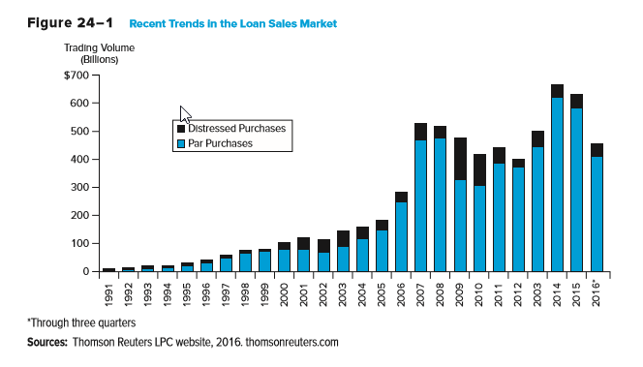
Recent Trends in the Loan Sales Market
Notes:
7

Slide 8
The Buyers
Investment banks are the predominant buyers of HLT loans
  Adept at the analysis required to value these types of loans
  Often are closely associated with the HLT borrower
Vulture funds are specialized funds that invest in distressed loans
Other domestic banks
  Traditional correspondent relationships are breaking down as markets get more competitive
  Counterparty risk and moral hazard have increased
  Barriers to nationwide banking have eroded and fewer smaller banks exist now than in the past
Notes:
8

Slide 9
The Buyers and Sellers
Loan buyers (continued)
  Foreign banks are the dominant buyer of U.S. bank loans
  Insurance companies and pension funds buy long-term loans
  Closed-end bank loan mutual funds buy U.S. bank loans
  Nonfinancial corporations: predominantly financial service arms of the very largest companies
Loan Sellers
  Major money center banks dominate loan sales
  Small regional or community banks sell loans to diversify credit risk
  Foreign banks
  Investment banks act as loan sellers
  U.S. government and agencies
Notes:
9

Slide 10
Less Developed Country (LDC) Debt
In recent years, three market segments of sovereign debt have emerged
Sovereign bonds (i.e., government-issued debt)
Performing loans are original or restructured outstanding sovereign loans on which the sovereign country is currently maintaining promised payments
Nonperforming loans reflect the secondary market prices for the sovereign loans of countries where there are no interest or principal payments currently being made
Notes:
10

Slide 11
Future Loan Sales Growth
Factors encouraging future loan sales growth
  Fee income – originating and quickly selling loans can boost an FI’s reported income
  Liquidity risk - secondary market for loans reduces their illiquidity
  Capital costs: regulatory capital ratios can be increased by reducing the overall size of the balance sheet
  Reserve requirements: represents a form of tax that adds to the cost of funding the loan portfolio
Factors discouraging future loan sales growth
  Access to the commercial paper (CP) market: many firms now rely on CP rather than bank loans
  Customer relationship effects: loan sales can harm revenues generated by the FI as current and potential future customers take their business elsewhere
  Legal concerns such as fraudulent conveyance
Notes:
11
Fraudulent conveyance means that a loan sale was conducted improperly or illegally according to the terms of the original loan agreement. In particular, fraudulent conveyance is the transfer of assets at less than fair value made while a firm is insolvent. This activity is prohibited to protect the interests of creditors.

Slide 12
Loan Securitization
Securitization is the process of transforming loans (or other debt instruments) into marketable securities
Pass-through mortgage securities “pass-through” promised payments by households of principal and interest on pools of mortgages created by FIs to secondary market investors holding an interest in these pools
Each pass-through security represents a fractional ownership share in a mortgage pool
Pass-through securitization was originally developed by government-sponsored programs to enhance the liquidity of residential mortgages
  Ginnie Mae (GNMA), Fannie Mae (FNMA), and Freddie Mac (FHLMC)
Notes:
12

Slide 13
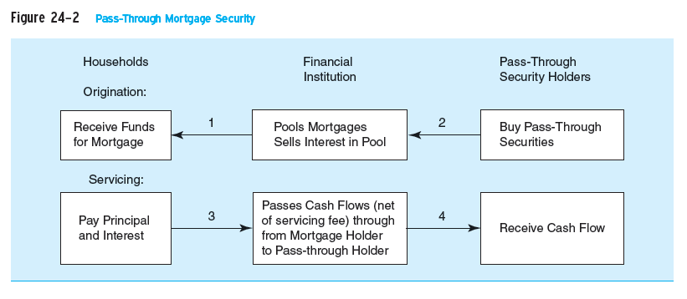
Pass-Through Mortgage Security
Notes:
13

Slide 14
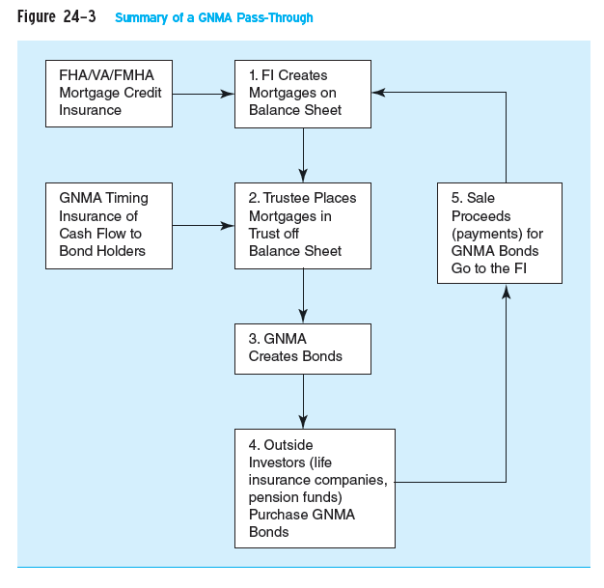
Summary of a GNMA Pass-Through
Notes:
14

Slide 15
Prepayment Risk on GNMA Pass-Throughs
Most fixed-rate mortgages are fully amortized
  Full amortization is the equal, periodic repayment on a loan that reflects part interest and part principal over the life of the loan
Most mortgages are paid off prior to maturity because borrowers move or refinance their mortgages
  To prepay is to pay back a loan before its maturity
Thus, realized cash flows can deviate from expected cash flows
Notes:
15

Slide 16
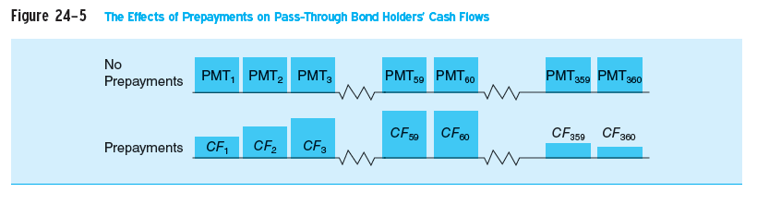
Effects of Prepayments on Pass-Through Bond Holders’ Cash Flows
Notes:
16

Slide 17
Collateralized Mortgage Obligations (CMOs)
Collateralized mortgage obligations (CMOs) are mortgage-backed securities issued in multiple classes, or tranches, to provide prepayment protection
  In a sequential pay CMO, tranches are differentiated by the order in which each class is paid off
  Each class has a guaranteed coupon payment, but prepayment of principal occurs sequentially to only one class of bondholder at a time
    Thus, some classes of bondholders are more protected against prepayment risk than others
Notes:
17

Slide 18
Creation of CMOs
CMOs are usually created by placing existing pass-through securities in a trust off-the-balance-sheet
The trust issues three different classes, each with a different level of prepayment risk
  Class A CMO holders have the least prepayment protection, and are of great interest to investors seeking short-duration mortgage-backed assets to reduce the duration of their mortgage-related asset portfolios
  After all Class A CMOs have been retired, Class B CMO holders receive principal prepayment cash flows
  Finally, Class C has the most prepayment protection, and are attractive to insurance companies and pension funds
Notes:
18
CMOs may also be creating by packaging and securitizing whole mortgage loans.
Note: each class also receives regular coupon (interest) payments

Slide 19
Initial Payments on a Three-Class Agency CMO
Month 1 | Amount paid into pool in Month 1: |  | $2 million
Class | Beginning Balance | Interest Due & Paid | Actual Principal reduction | End Balance
A | $50,000,000 | $375,000 | $2 mill - $1,125,000 =$875,000 | $49,125,000
B | $50,000,000 | $375,000 |  | $50,000,000
C | $50,000,000 | $375,000 |  | $50,000,000
 | Total | $1,125,000
Month 2 | Amount paid into pool in Month 2: |  | $3 million
Class | Beginning Balance | Interest Due & Paid | Actual Principal reduction | End Balance
A | $49,125,000 | $368,437 | $3 mill - $1,118,437 =$1,881,563 | $47,243,437
B | $50,000,000 | $375,000 |  | $50,000,000
C | $50,000,000 | $375,000 |  | $50,000,000
 | Total | $1,118,437
Notes:
19

Slide 20
Collateralized Mortgage Obligations (CMOs) Continued
The sum of the prices at which CMO classes can be sold normally exceeds that of the original pass-through
  The CMO’s restructured prepayment risk makes each class more attractive to specific classes of investors
  CMOs with up to 17 different classes have been created
CMOs often contain a Z class that accrues, but does not pay, interest (or principal) until all other classes have been fully retired
Another special CMO class is a planned amortization class (PAC)
  Produces a constant cash flow within a band of prepayment rates
  Offers greater predictability of cash flows
  Has priority in receiving principal payments
Notes:
20

Slide 21
Mortgage-Backed Bond
Mortgage- (asset-) backed bonds (MBBs) are bonds collateralized by a pool of assets
MBBs differ from pass-throughs and CMOs
  Mortgages remain on the balance sheet
  Mortgages collateralize MBBs, but are not directly related to the associated cash flows
FIs usually back MBBs with excess collateral, which results in a higher investment rating for the MBB than for the issuing FI
MBB costs
  MBBs tie up mortgages on the balance sheet for long periods of time
  The FI is subject to prepayment risk on the underlying mortgages
  The FI continues to face capital adequacy and reserve requirement taxes as the mortgages remain on the balance sheet
Notes:
21

Slide 22
Securitization of Other Assets
The same securitization techniques applied to mortgages have been used to securitize other assets:
  Automobile loans
  Credit card receivables (CARDs)
  Small-business loans guaranteed by the Small Business Administration
  Commercial and industrial loans
  Student loans
  Equipment loans
  Junk bonds
  Adjustable-rate mortgages
Notes:
22

Slide 23
Can All Assets be Securitized?
Can all assets and loans eventually be securitized?
  In theory – yes, so long as doing so is profitable or the benefits to the FI from securitization outweigh its costs
With heterogeneous loans, the salient features should be standardized, default risks should be reduced via diversification, and expected maturities should be reasonably similar
Notes:
23

Slide 24
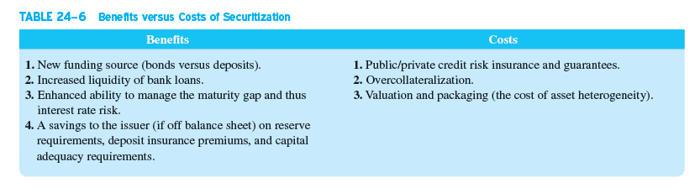
Benefits versus Costs of Securitization
Notes:
24

