Slide 1
Chapter One
Introduction
©2019 McGraw-Hill Education. All rights reserved. Authorized only for instructor use in the classroom. No reproduction or further distribution permitted without the prior written consent of McGraw-Hill Education.

Slide 2
Why Study Financial Markets and Institutions? 1
Markets and institutions are primary channels to allocate capital in our society.
  Proper capital allocation leads to growth in:
    Societal wealth.
    Income.
    Economic opportunity.

Slide 3
Why Study Financial Markets and Institutions? 2
In this text we will examine:
  the structure of domestic and international markets.
  the flow of funds through domestic and international markets.
  an overview of the strategies used to manage risks faced by investors and savers.

Slide 4
Financial Markets
Financial markets are one type of structure through which funds flow.
Financial markets can be distinguished along two dimensions:
  primary versus secondary markets.
  money versus capital markets.

Slide 5
Primary versus Secondary Markets 1
Primary markets.
  Markets in which users of funds (e.g., corporations) raise funds by issuing new financial instruments (e.g., stocks and bonds).
Secondary markets.
  Markets where existing financial instruments are traded among investors (e.g., exchange traded: N Y S E and over-the-counter: N A S D A Q).
Notes:
You might also wish to mention electronic communication networks or ECNs. ECNs allow direct electronic trading among buyers and sellers without a third party. Two former ECNs, BATS (formed in 2005) and DirectEdge (formed in 1998), merged in fall 2013, and applied to become an exchange. The combined entity makes them the number two stock market ahead of NASDAQ and behind NYSE. Together the two have about 270 employees. The NYSE and NASDAQ have far more! Sign of the times.
BATS Global Markets is a stock exchange based in Lenexa, Kansas, a suburb of Kansas City. BATS was founded in June 2005 as an Electronic Communication Network (ECN) and its name stands for Better Alternative Trading System.[2] (Trades stocks on BZX and options on BYX exchange.) (source BATS website)

Slide 6
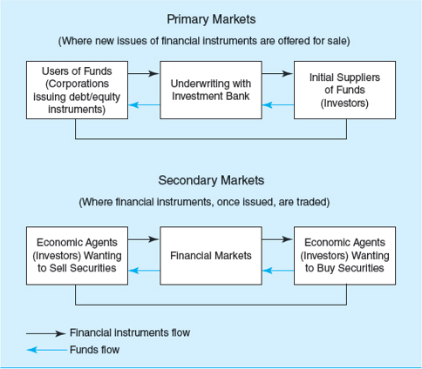
Primary versus Secondary Markets 2
Figure 1-2 Primary and secondary Market Transfer of Funds Time Line
Access the long description slide.

Slide 7
Primary versus Secondary Markets Concluded
How were primary markets affected by the financial crisis?
Do secondary markets add value to society or are they simply a legalized form of gambling?
  How does the existence of secondary markets affect primary markets?
Notes:
Primary market issuance declined sharply during the crisis, although with low interest rates bond issuance boomed after market uncertainty declined in 2010. Stock issuance remained weaker longer, recovering in 2012.
Secondary markets add liquidity for risky investments and encourage investment in primary markets. Secondary markets also aid in price discovery, providing up to date signals of the ongoing value of firms. These signals also provide benchmarks for corporate performance. It is not true that secondary markets are simply a legalized form of gambling.

Slide 8
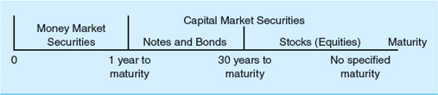
Money versus Capital Markets
Money markets.
  Markets that trade debt securities with maturities of one year or less (e.g., C D s and U.S. Treasury bills).
    little or no risk of capital loss, but low return.
Capital markets.
  Markets that trade debt (bonds) and equity (stock) instruments with maturities of more than one year.
    substantial risk of capital loss, but higher promised return.
Figure 1.3
Access the long description slide.

Slide 9
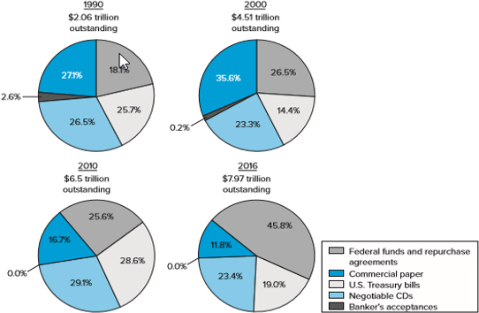
Money Market Instruments Outstanding, ($Tn)
Figure 1-4 Money Market Instruments Outstanding.
Source: Federal Board, “Financial Accounts of the United States,” Statistical Releases, Washington, D C, various issues, www.federalreserve.gov.
Access the long description slide.
Notes:
Notice with the 2016 data that T-bills are now about 1/5 of total money market instruments. Banker’s Acceptances continue to be used less due to their cost and the growth of other trading arrangements. The commercial paper (cp) market collapsed during the financial crisis and has grown more slowly since. Stress that cp is an alternative to a bank loan and may provide a cheaper source of financing for large well known companies.
Many students will not be familiar with commercial paper, repurchase agreements (repos or RPs) and banker’s acceptances so it is worthwhile to discuss these briefly. In a repo one sells a security and agrees to repurchase it at maturity at a higher price that is set in the contract. A repo is best thought of as a short term collateralized loan as compared to a fed funds loan which is uncollateralized.
Banker’s Acceptances have traditionally been used to finance international trade where a bank is asked to guarantee payment on a commercial contract in case the buyer of the goods does not or cannot pay.

Slide 10
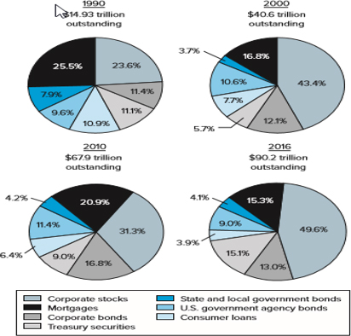
Capital Market Instruments Outstanding, ($Tn)
Figure 1-5 Capital Market Instruments Outstanding.
Source: Federal Reserve Board, “Financial Accounts of the United States,” Statistical Releases, Washington, DC, various issues. www.federalreserve.gov.
Access the long description slide.
Notes:
Text: As of mid-March 2009, the Dow Jones Industrial Average (DJIA) had fallen 53.8 percent in value in less than 1 ½ years, larger than the decline during the market crash of 1929 when it fell 49 percent. However, stock prices recovered, along with the economy, in the last half of 2009, rising 71.1 percent between March 2009 and April 2010.

Slide 11
Foreign Exchange (F X) Markets
FX markets.
  trading one currency for another (e.g., dollar for yen).
Spot FX.
  the immediate exchange of currencies at current exchange rates.
Forward FX.
  the exchange of currencies in the future on a specific date and at a pre-specified exchange rate.
Notes:
Spot FX: Note that ‘immediate’ usually means delivery within one or two business days.

Slide 12
Derivative Security Markets 1
Derivative security.
  A financial security whose payoff is linked to (i.e., “derived” from) another, previously issued security such as a security traded in capital or foreign exchange markets.
    Generally an agreement to exchange a standard quantity of assets at a set price on a specific date in the future.
    The main purpose of the derivatives markets is to transfer risk between market participants.

Slide 13
Derivative Security Markets 2
Selected examples of derivative securities.
  Exchange listed derivatives.
    Many options, futures contracts.
  Over the counter derivatives.
    Forward contracts.
    Forward rate agreements.
    Swaps.
    Securitized loans.
Notes:
Exchange listed are more regulated, more transparent, and generally involve no default risk for the counterparty.
OTC derivatives are nonstandard, largely unregulated and may involve substantial counterparty credit risk.
Forward rate agreements are prearranged loan contracts with the loan terms set now, drawdowns in the future.

Slide 14
Derivatives and the Crisis 1
Mortgage derivatives allowed a larger amount of mortgage credit to be created in the mid-2000s.
Growing importance of ‘shadow banking system’.
Mortgage derivatives spread the risk of mortgages to a broader base of investors.
Change in banking from ‘originate and hold’ loans to ‘originate and sell’ loans.
  Decline in underwriting standards on loans.
Notes:
(Optional slide: Hide if you do not wish to cover this topic)
This helped fuel a ‘credit boom’ that led to unsustainable increases in home prices. The shadow banking system refers to non-bank FIs who indirectly provide financing for loans buy originating loans or more likely by purchasing securities backed by loans. Shadow banking allows more rapid growth in credit by increasing the supply of funds available.
When home prices began falling in late 2006, more institutions were affected.
Resulted in a change in culture at some banks as well from a lending culture to a trading culture that was less risk averse.
The instructor may wish to ask students whether it makes sense to blame the instrument or the users. Warren Buffett has called derivatives, ‘weapons of mass destruction.’ However, used properly they allow market participants to transfer risk to other parties that they themselves do not wish to bear, and allow others lower cost methods to gain exposure to markets. It does seem reasonable to require greater transparency in OTC derivatives to ensure that players can cover the promises they make. Derivatives that involve payments of principal, such as credit default swaps, should be required to be traded on an exchange so that there are guarantees of performance and reasonable limits to speculation.

Slide 15
Derivatives and the Crisis 2
  Subprime mortgage losses were large, reaching over $700 billion.
  The “Great Recession” was the worst since the “Great Depression” of the 1930s.
    Trillions $ global wealth lost, peak to trough stock prices fell over 50% in the U.S.
    Lingering high unemployment and below trend growth in the U.S.
    Sovereign debt levels in developed economies reached post-war all-time highs.
Notes:
(Optional slide: Hide if you do not wish to cover this topic)
Led to overall large declines in home prices nationwide. Houses are illiquid assets and falling home values are a drag on economic growth. Millions of homeowners are ‘underwater,’ owing more on their homes than their current market value.
Much of the wealth loss may be temporary over the long term, but growth declined at a rapid rate during the crisis. As of 2014 only now beginnin to see a return to more normal growth rates of the U.S. economy.
The instructor may wish to ask students whether it makes sense to blame the instrument or the users. Warren Buffett has called derivatives, ‘weapons of mass destruction.’ However, used properly they allow market participants to transfer risk to other parties that they themselves do not wish to bear, and allow others lower cost methods to gain exposure to markets. It does seem reasonable to require greater transparency in OTC derivatives to ensure that players can cover the promises they make. Derivatives that involve payments of principal, such as credit default swaps, should be required to be traded on an exchange so that there are guarantees of performance and reasonable limits to speculation.

Slide 16
Financial Market Regulation
The Securities Act of 1933.
  Full and fair disclosure and securities registration.
The Securities Exchange Act of 1934.
  Securities and Exchange Commission (S E C) is the main regulator of securities markets.

Slide 17
Financial Institutions (F I s)
Financial Institutions.
  Institutions through which suppliers channel money to users of funds.
Financial Institutions are distinguished by:
  Whether they accept insured deposits.
    Depository versus non-depository financial institutions.
  Whether they receive contractual payments from customers.
Notes:
Institutions that accept insured deposits must be regulated by the government to offset the government’s liability. Insured deposits are a low cost source of financing, but the regulatory burden increases these institution’s costs significantly.
FIs that receive contractual payments, such as life insurers, pension funds and property and casualty insurers have steady premium income to invest. This allows them to take on more risk in their investment portfolio.

Slide 18
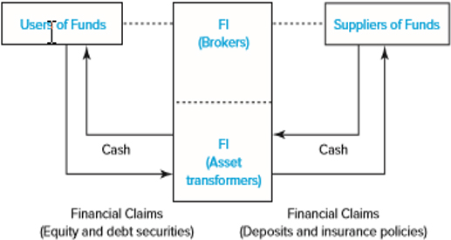
Percentage Shares of Assets of Financial Institutions in the United States, 1948–2016
Figure 1-7 Flow of Funds in a World with F l s.
We describe and illustrate this flow of funds in Chapter 2.
Access the long description slide.
Notes:
Point out the large decline in the share of commercial banks from 2010 (32.8%) to 2016 (26.1%).

Slide 19
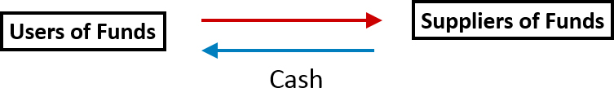
Non-Intermediated (Direct) Flows of Funds
Flow of Funds in a World without F I s
Direct Financing
Financial Claims (equity and debt instruments)
Access the long description slide.

Slide 20
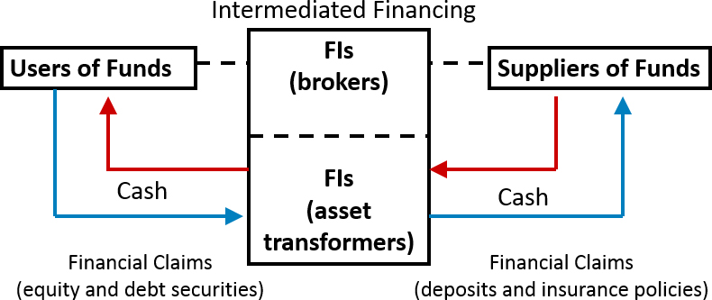
Intermediated Flows of Funds
Flow of Funds in a World with FIs.
Access the long description slide.

Slide 21
Depository versus Non-Depository F I s
Depository institutions:
  commercial banks, savings associations, savings banks, credit unions.
Non-depository institutions.
  Contractual:
    insurance companies, pension funds,
  Non-contractual:
    securities firms and investment banks, mutual funds.
Notes:
Note: savings associations, savings banks and credit unions are often called ‘thrifts.’

Slide 22
F I s Benefit Suppliers of Funds
Reduce monitoring costs.
Increase liquidity and lower price risk.
Reduce transaction costs.
Provide maturity intermediation.
Provide denomination intermediation.

Slide 23
F I s Benefit the Overall Economy
Conduit through which Federal Reserve conducts monetary policy.
Provides efficient credit allocation.
Provide for intergenerational wealth transfers.
Provide payment services.

Slide 24
Risks Faced by Financial Institutions
Credit.
Foreign exchange.
Country or sovereign.
Interest rate.
Market.
Off-balance-sheet.
Liquidity.
Technology.
Operational.
Insolvency.
Volcker Rule: Insured institutions may not engage in proprietary trading

Slide 25
Regulation of Financial Institutions
FIs are heavily regulated to protect society at large from market failures.
Regulations impose a burden on F I s; before the financial crisis, U.S. regulatory changes were deregulatory in nature.
Regulators attempt to maximize social welfare while minimizing the burden imposed by regulation.

Slide 26
Enterprise Risk Management
Enterprise risk management.
  Recognizes the importance of managing the combined impact of the full spectrum of risks as an interrelated risk portfolio.
Popularity rose as a result of the failure of advanced risk measurement and management systems to detect exposures that led to the financial crisis.
Stresses importance of building a strong risk culture.

Slide 27
Globalization of Financial Markets and Institutions
The pool of savings from foreign investors is increasing and investors look to diversify globally now more than ever before.
Information on foreign markets and investments is becoming readily accessible and deregulation across the globe is allowing even greater access to foreign markets.
International mutual funds allow diversified foreign investment with low transactions costs.
Global capital flows are larger than ever.

Slide 28
Appendix: F I s and the Crisis 1
Timeline of events
Home prices decline in late 2006 and early 2007.
  Delinquencies on subprime mortgages increase.
  Huge losses on mortgage-backed securities (M B S) announced by institutions.
Bear Stearns fails and is bought by J.P. Morgan Chase for $2 a share (deal had government backing).
Notes:
In 2007 Citigroup, Merrill Lynch and Morgan Stanley wrote off $40 billion in bad mortgages.
The MBS insurer, MBIA, reported a $2.3 billion loss in the fourth quarter of 2007, Countrywide had to draw down its entire $11.5 billion credit line, leading to a buyout by Bank of America.
Indy Mac Bank, the largest mortgage lender in the U.S. at the time tried to find additional capital throughout 2007, but could not, and was seized by the FDIC in July 2008 after facing deposit withdrawals of $1.3 billion. The cost to the FDIC was betweent $8.5 and $9.4 billion.

Slide 29
Appendix: F I s and the Crisis 2
Timeline of events
September 2008, the government seizes government-sponsored mortgage agencies Fannie Mae and Freddie Mac.
  The two had $9 billion in losses in the second half 2007.
  Now run by Federal Housing Finance Agency (F H F A).
September 2008, Lehman Brothers files for bankruptcy; Dow drops 500 points.
Notes:
Lehman had been around for over 150 years, Barclays eventually acquires many of Lehman’s assets.

Slide 30
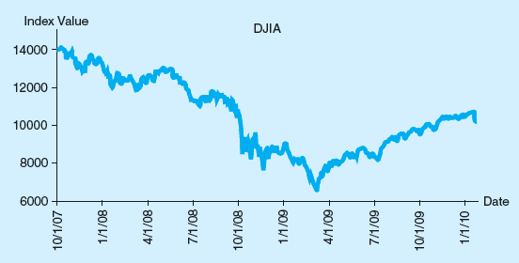
Appendix: F I s and the Crisis Concluded
  Figure 1-9 The Dow Jones Industrial Average, October 2007–January 2010
Access the long description slide.
Notes:
Dow drops during the crisis.

Slide 31
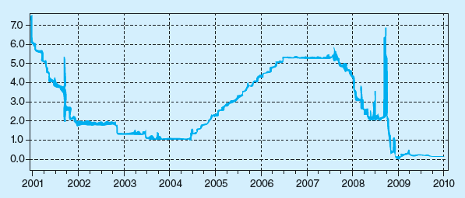
Overnight L I B O R, 2001 - 2010
  Figure 1-10 Overnight London Interbank Offered Rate (L I B O R), 2001–2010
Access the long description slide.
Notes:
International lending market seizes up. LIBOR (London Interbank Offer Rate) climbs rapidly.
(Institutions intentionally misreport LIBOR to hide default risk from the markets.)

Slide 32
Appendix: Government Rescue Plan 1
  Table 1-12 Federal Government Rescue Efforts through December 2009
Program | Committed | Invested | Description
T A R P | $700.0 billion | $356.2 billion | Financial rescue plan aimed at restoring liquidity to financial markets.
A I G | 70.0 b | 69.8 b
Auto industry financing | 80.1 b | 77.6 b
Capital Purchase Program | 218.0 b | 204.7 b
Public-private Investment program | 100.0 b | 26.7 b
Targeted Investments to Citigroup and Bank of America | 52.5 b | 45.0 b
Amount required |  | $118.5 billion

Slide 33
Appendix: Government Rescue Plan 2
Program | Committed | Invested | Description
Federal Reserve Rescue Efforts | $6.4 thrillion | $1.5 thrillion | Financial rescue plan aimed at restoring liquidity to financial markets.
Asset-backed commercial paper money market mutual fund liquidity facility | unlimited | $0.0
Bear Stearns bailout | 29.0 b | 26.3 b
Commercial paper funding facility | 1.8 t | 14.3 b
Foreign exchange dollars swaps | unlimited | 29.1 b
G S E (Fannie Mae and fredie Mac) debt purchase | 200.0 b | 149.7 b
G S E mortgage – backed securities purchase | 1.2 t | 775.6 b

Slide 34
Appendix: Government Rescue Plan 3
Program | Committed | Invested | Description
Term asset-backed securities loan facility | 1.0 t | 43.8 t
U.S government bond purchase | 300.0 b | 295.3 b
Federal Stimulus Act | $1.2 thrillion | $577.8 billion | Programs designed to save or create jobs
Economic Stimulus Act | 168.0 b | 168.0 b
Student loan guarantees | 195.0 b | 32.6 b
American Recovery and reinvestment Act | 787.2 b | 358.2 b

Slide 35
Appendix: Government Rescue Plan 4
Program | Committed | Invested | Description
American International Group | $182.0 billion | $ 127.4 billion | Bailout to help A I G through restructuring and to get rid of toxic assets
Asset purchases | 52.0 billion | 38.6 billion
Bridge loan | 25.0 billion | 44.0 billion
T A R P investment | 70.0 billion | 44.8 billion
F D I C Bank Takeovers | $ 45.4 billion | $ 45.4 billion | Cost to F D I C to fund deposit losses on bank failures
2008 failures | 17.6 billion | 17.6 billion
2009 failures | 27.8 billion | 27.8 billion

Slide 36
Appendix: Government Rescue Plan 5
Program | Committed | Invested | Description
Other Financial Initiatives | $ 1.7 trillion | $ 366.4 billion | Other programs designed to rescue the financial sector
N C U A bailout of U.S. Central Credit Union | 57.0 billion | 57.0 billion
Temporary Liquidity Guarantee Program | 1.5 trillion | 308.4 billion

Slide 37
Appendix: Government Rescue Plan 6
Program | Committed | Invested | Description
Other Housing Initiatives | $745.0 billion | $ 130.6 billion | Other programs intended to rescue the housing market and prevent home foreclosures
Fannie Mae and Freddie Mac bailout | 400.0 billion | 110.6 billion
F H A housing rescue | 320.0 billion | 20.0 billion
Overall Total | $ 11.0 trillion | $ 3.0 trillion

Slide 38
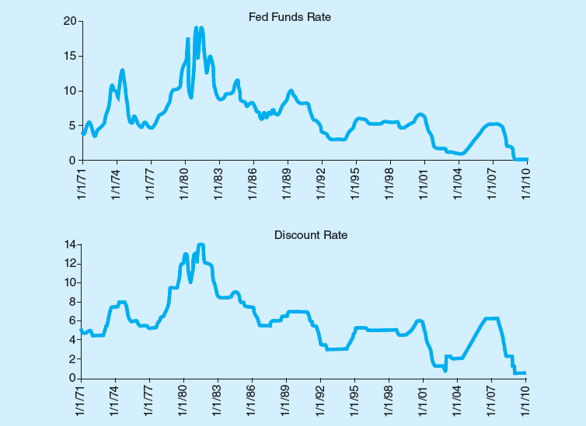
Federal Funds Rate and Discount Window Rate
  Figure 1-11 Federal Funds Rate and Discount Window Rate—January 1971 through January 2010

Slide 39
Major Items in the Stimulus Program
  Table 1-13 Major Items in the $787 Billion Stimulus Program as Passed by the U.S. Congress, February 13, 2009
$116.1 b. | for tax cuts and credits to low- and middle-income workers
69.8 b. | for middle-income taxpayers to get an exemption from the alternative minimum tax
87.0 b. | in Medicaid provisions
27.0 b. | for jobless benefits extension to a total of 20 weeks in addition to regular unemployment compensation
17.2 b. | for increases in student aid
40.6 b. | for aid to states
30.0 b. | for modernization of electric grid and energy efficiency
19.0 b. | for payments to hospitals and physicians who computerize medical record systems
29.0 b. | for road and bridge infrastructure construction and modernization
18.0 b. | for grants and loans for water infrastructure, flood prevention, and environmental cleanup

Slide 40
Primary versus Secondary Markets Long Description
Primary markets are where new issues of financial instruments are offered for sale. The time line begins with users of the funds (Corporations issuing debt/equity instruments). Financial instruments flow to underwriting with an investment bank, then financial instruments flow to the initial suppliers of the funds, who are the investors. Then the funds flow back to the investment bank and back to the corporations issuing the debt/equity instruments. The secondary markets is where financial instruments, once issued, are traded. Economic Agents (investors) want to sell securities. Financial instruments flow to the financial markets, which flow to the economic agents (investors) wanting to buy securities. The funds then flow back to the financial markets and back to the economic agents wanting to sell the securities.
Return to slide containing original image.

Slide 41
Money versus Capital Markets Long Description
This diagram shows a time line. Money market securities take 1 year to reach maturity. Capital market securities, such as notes and bonds, take 30 years to reach maturity, and stocks (equities) have no specified maturity.
Return to slide containing original image.

Slide 42
Money Market Instruments Outstanding, ($Tn) Long Description
In 1990 there was 2.06 trillion outstanding, of which 18.1% was federal funds and repurchase agreements, 27.1% was commercial paper, 25.7% was U.S. Treasury bills, 26.5% was negotiable C Ds, and 2.6% was banker's acceptances. In 2000 there was 4.51 trillion outstanding, of which 26.5% was federal funds and repurchase agreements, 35.6% was commercial paper, 14.4% was U.S. Treasury bills, 23.3% was negotiable C Ds, and 0.2% was banker's acceptances. In 2010 there was 6.5 trillion outstanding, of which 25.6% was federal funds and repurchase agreements, 16.7% was commercial paper, 28.6% was U.S. Treasury bills, 29.1% was negotiable C Ds, and 0.0% was banker's acceptances. In 2016 there was 7.97 trillion outstanding, of which 45.8% was federal funds and repurchase agreements, 11.8% was commercial paper, 19.0% was U.S. Treasury bills, 23.4% was negotiable C Ds, and 0.0% was banker's acceptances.
Return to slide containing original image.

Slide 43
Capital Market Instruments Outstanding, ($Tn) Long Description
In 1990 there was 14.93 trillion outstanding, of which 23.6% was corporate stocks, 25.5% was mortgages, 11.4% was corporate bonds, 11.1% was treasury securities, 7.9% was state and local government bonds, 9.6% was U.S. government agency bonds, and 10.9% was consumer loans. In 2000 there was 40.6 trillion outstanding, of which 43.4% was corporate stocks, 16.8% was mortgages, 12.1% was corporate bonds, 5.7% was treasury securities, 3.7% was state and local government bonds, 10.6% was U.S. government agency bonds, and 7.7% was consumer loans. In 2010 there was 67.9 trillion outstanding, of which 31.3% was corporate stocks, 20.9% was mortgages, 16.8% was corporate bonds, 9.0% was treasury securities, 4.2% was state and local government bonds, 11.4% was U.S. government agency bonds, and 6.4% was consumer loans. In 2016 there was 90.2 trillion outstanding, of which 49.6% was corporate stocks, 15.3% was mortgages, 13% was corporate bonds, 15.1% was treasury securities, 4.1% was state and local government bonds, 9.0% was U.S. government agency bonds, and 3.9% was consumer loans.
Return to slide containing original image.

Slide 44
Percentage Shares of Assets of Financial Institutions in the United States, 1948–2016 Long Description
Financial claims (equity and debt securities) from the users of funds and financial claims (deposits and insurance policies) from the suppliers of funds flow through the financial institution (brokers and asset transformers) in the form of cash.
Return to slide containing original image.

Slide 45
Intermediated Flows of Funds Long Description
Using intermediated financing, the users and suppliers of funds use brokers and asset transformers to exchange cash. The users of funds exchange equity and debt securities through the asset transformers who exchange deposits and insurance policies with the suppliers of funds for cash which is passed back to the users of the funds.
Return to slide containing original image.

Slide 46
Appendix: F I s and the Crisis Concluded Long Description
The values decrease from about 14,000 until early 2009 where it hit about 6500 and then increased to a value of about 10,000 in January 2010.
Return to slide containing original image.

Slide 47
Overnight L I B O R, 2001 – 2010 Long description
The rate was about 7.0 in 2001 and decreased to 2.0 by 2002, it decreased to 1.0 by 2004 then increased steadily to 5.0 during mid 2006. It remained there until mid 2007, then decreased sharply to just above 0 by 2009 (with the exception of one large spike prior to 2009). Since 2009, the rate has remained flat at just above 0.
Return to slide containing original image.

Slide 48
Non-Intermediated (Direct)
Flows of Funds Long Description
Financial claims (equity and debt instruments) would flow back and forth between the users of funds and the suppliers of funds in the form of cash.
Return to slide containing original image.

