Slide 1
Chapter Two
Determinants of Interest Rates
©2019 McGraw-Hill Education. All rights reserved. Authorized only for instructor use in the classroom. No reproduction or further distribution permitted without the prior written consent of McGraw-Hill Education.

Slide 2
Interest Rate Fundamentals
Nominal interest rates: the interest rates actually observed in financial markets.
  Used to determine fair present value and prices of securities.
  Two components:
    Opportunity cost.
    Adjustments for individual security characteristics.
Notes:
Opportunity cost: All securities’ rates are dependent on rates available on competing investments. These rates will be a function of the underlying supply and demand of funds available.
As indicated later, adjustments for individual security characteristics would include default risk, maturity, liquidity risk and payment terms. Because these characteristics are different for different securities, we have different interest rates on each.

Slide 3
Real Riskless Interest Rates
Additional purchasing power required to forego current consumption.
  What causes differences in nominal and real interest rates?
  If you wish to earn a 3% real return and prices are expected to increase by 2%, what rate must you charge?
  Irving Fisher first postulated that interest rates contain a premium for expected inflation.
Notes:
The answers are inflation and about 5% respectively.

Slide 4
Loanable Funds Theory
Loanable funds theory explains interest rates and interest rate movements
Views level of interest rates as resulting from factors that affect the supply of and demand for loanable funds
Categorizes financial market participants – e.g., consumers, businesses, governments, and foreign participants – as net suppliers or demanders of funds

Slide 5
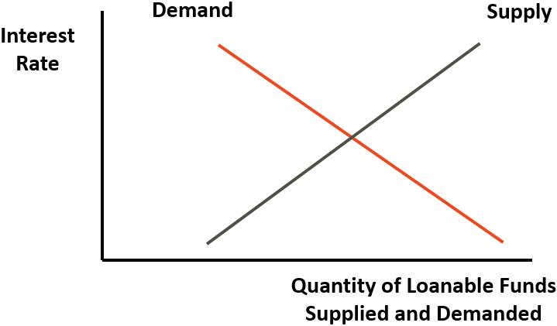
Supply and Demand for Loanable Funds
Access the long description slide.

Slide 6
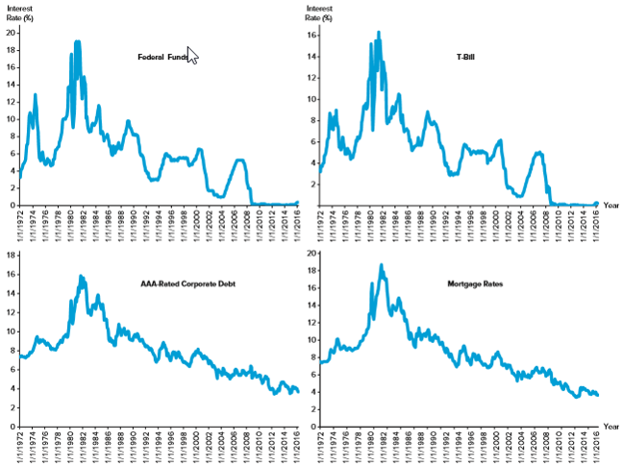
Key Interest Rates Over Time
Figure 2–1 Key U.S. Interest Rates, 1972–2016
Source: Federal Reserve Board website, May 2016. www.federalreserve.gov
Access the long description slide.

Slide 7
Net Supply & Demand of Funds in U.S. in 2016
TABLE 2–1 Funds Supplied and Demanded by Various Groups (in trillions of dollars)
 | Funds Supplied | Funds Demanded | Net Funds Supplied (Funds Supplied— Funds Demanded)
Households | $70.33 | $14.51 | $55.82
Business—nonfinancial | 23.20 | 55.85 | −32.65
Business—financial | 85.91 | 96.90 | −10.99
Government units | 5.22 | 23.19 | −17.97
Foreign participants | 23.03 | 17.24 | 5.79
Source: Federal Reserve Board website, “Financial Accounts of the United States,” May 2016. www.federalreserve.gov
Notes:
A negative number in the last column represents a net demand for funds.
The household (consumer) sector is one of the largest suppliers or loanable funds, while (financial) businesses demanded the most funds.

Slide 8
Determinants of Household Savings
Interest rates and tax policy.
Income and wealth: the greater the wealth or income, the greater the amount saved.
Attitudes about saving versus borrowing.
Credit availability: the greater the amount of easily obtainable consumer credit the lower the need to save.
Job security and belief in soundness of entitlements.

Slide 9
Determinants of Foreign Funds Invested in the U.S.
Relative interest rates and returns on global investments.
Expected exchange rate changes.
Safe haven status of U.S. investments.
Foreign central bank investments in the U.S.
Notes:
Foreign funds suppliers examine the same factors as U.S. suppliers except that they must also factor in expected changes in currency values, global interest rates, different tax rates and sovereign risk. There is typically some built in demand for U.S. investments however because the U.S. is considered a safe haven, i.e., a country with relatively low political and economic risk and a stable currency.
High levels of reserves are indicative of foreign central bank activity to limit the growth in the value of their currencies against the dollar. This may be done to stimulate their export sectors. The dollars are often reinvested in the U.S., typically in Treasuries. This provides an additional source of financing to the U.S. and helps remove a market discipline from U.S. borrowers.

Slide 10
Federal Government Demand for Funds Concluded
Governments borrow heavily in the markets for loanable funds.
  $23.19 trillion in 2016.
United States.
  National debt was $19.21 trillion in 2016.
    National debt (and interest payments on the national debt) have to be financed in large part by additional borrowing.

Slide 11
Business Demand for Funds
Level of interest rates:
  When the cost of loanable funds is high (i.e., interest rates are high), businesses finance internally.
Expected future profitability vs. risk:
  The greater the number of profitable projects available to businesses, the greater the demand for loanable funds.
Expected economic growth.

Slide 12
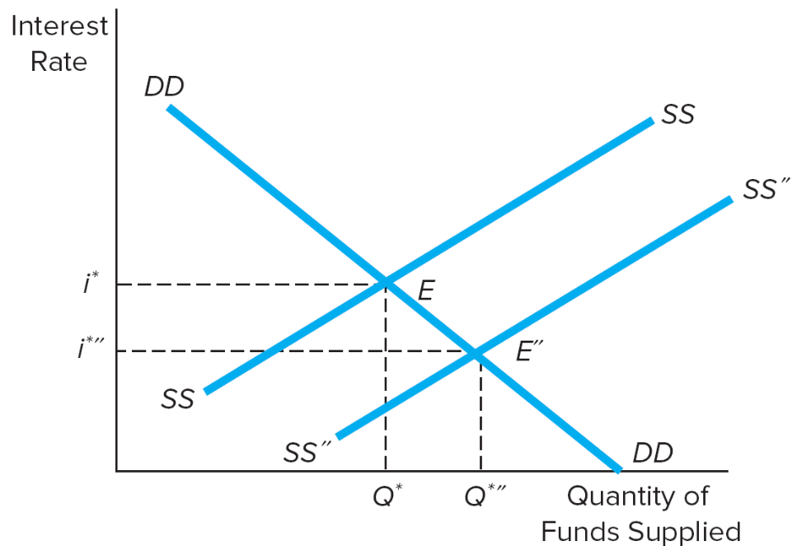
Effect on Interest Rates from a Shift in the Supply Curve for Loanable Funds
Figure 2–4 The Effect on Interest Rates from a Shift in the Supply Curve of or Demand Curve for Loanable Funds
(a) Increase in the supply of loanable funds
Access the long description slide.

Slide 13
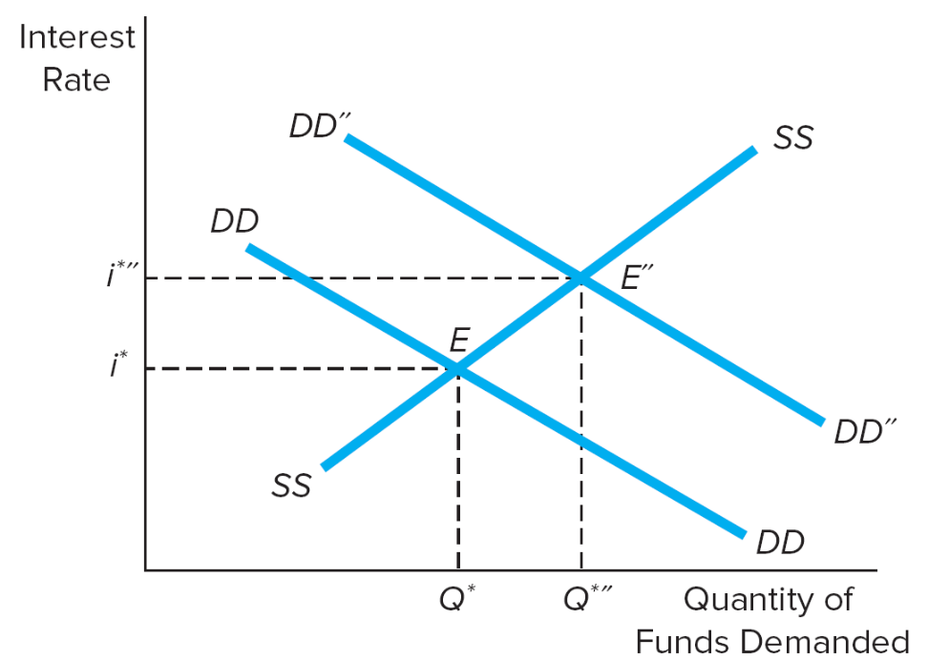
Effect on Interest Rates from a Shift in the Demand Curve for Loanable Funds
(b) Increase in the demand for loanable funds
Access the long description slide.

Slide 14
Factors that Affect the Supply of and Demand for Loanable Funds for a Financial Security 1
TABLE 2–2 Factors That Affect the Supply of and Demand for Loanable Funds for a Financial Security
Panel A: The supply of funds
Factor | Impact on Supply of Funds | Impact on Equilibrium Interest Rate*
Interest rate | Movement along the supply curve | Direct
Total wealth | Shift supply curve | Inverse
Risk of financial security | Shift supply curve | Direct
Near-term spending needs | Shift supply curve | Direct
Monetary expansion | Shift supply curve | Inverse
Economic conditions | Shift supply curve | Inverse

Slide 15
Factors that Affect the Supply of and Demand for Loanable Funds for a Financial Security 2
Panel B: The demand for funds
Factor | Impact on Demand for Funds | Impact on Equilibrium Interest Rate
Interest rate | Movement along the demand curve | Direct
Utility derived from asset purchased with borrowed funds | Shift demand curve | Direct
Restrictiveness of nonprice conditions | Shift demand curve | Inverse
Economic conditions | Shift demand curve | Direct
*A “direct” impact on equilibrium interest rates means that as the “factor” increases (decreases) the equilibrium interest rate increases (decreases). An “inverse” impact means that as the factor increases (decreases) the equilibrium interest rate decreases (increases).

Slide 16
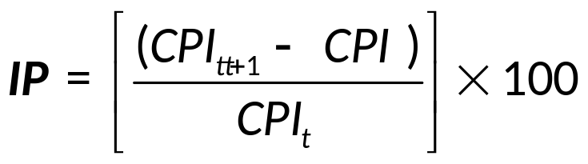
Determinants of Interest Rates for Individual Securities 1
i_{j}* = f(I P, R F R, D R P_{j}, L R P_{j}, S C P_{j}, M P_{j})
Inflation (I P).
Real risk-free interest rate (R F R) and the Fisher effect.
R F R = i − Expected (I P)
Notes:
Define CPI as the consumer price index.
i_{j}* = equilibrium nominal interest rate for a given security
Note: the first two factors (IP and RFR) are common to all financial securities, while the others can be unique to each individual security.

Slide 17
Determinants of Interest Rates for Individual Securities 2
Default risk premium (D R P).
D R P_{j} = i_{jt} − i_{Tt}
    i_{jt} = interest rate on security issued by a non-Treasury issuer (issuer j) of maturity m at time t
    i_{Tt} = interest rate on security issued by the U.S. Treasury of maturity m at time t
Liquidity risk (L R P).
Special provisions (S C P).
Term to maturity (M P).

Slide 18
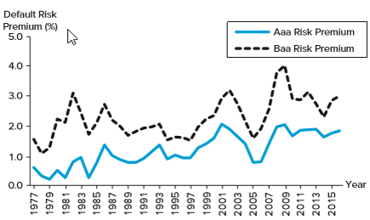
D R P s Over Time
Figure 2–6 Default Risk Premium on Corporate Bonds
Source: Federal Reserve Board website, May 2016. www.federalreserve.gov
Access the long description slide.

Slide 19
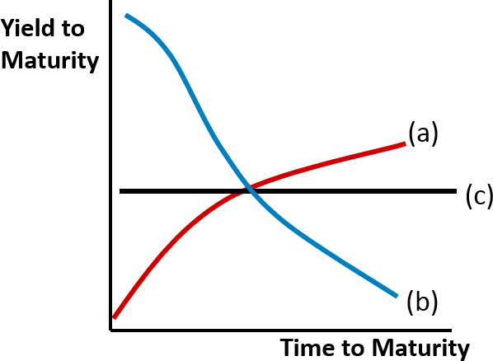
Term Structure of Interest Rates: the Yield Curve
(a) Upward sloping
(b) Inverted or downward sloping
(c) Flat
Access the long description slide.

Slide 20
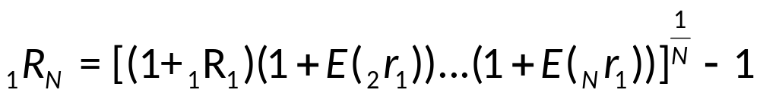
Unbiased Expectations Theory
Current long-term interest rates (₁R_{N}) are geometric averages of current and expected future, E(_{N}r₁), short-term interest rates.
  ₁R_{N} = actual N-period rate today
  N = term to maturity, N = 1, 2, …, 4, …
  ₁R₁ = actual current one-year rate today
  E(_{i}r₁) = expected one-year rates for years, i = 1 to N
Notes:
Assumes no interest rate volatility, note these rates should be zero coupon rates called ‘spot’ rates.

Slide 21
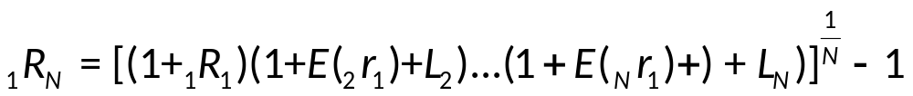
Liquidity Premium Theory
Long-term interest rates are geometric averages of current and expected future short-term interest rates plus liquidity risk premiums that increase with maturity.
  L_{t} = liquidity premium for period t
  L₂ < L₃ < …L_{N}

Slide 22
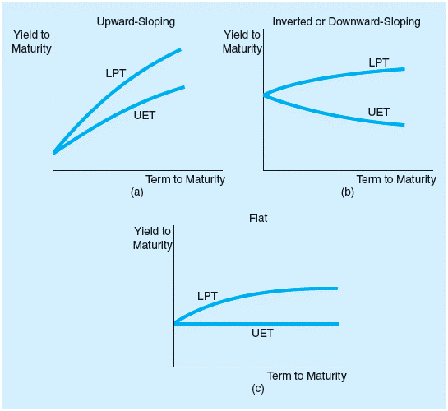
U E T vs. L P T
Figure 2–9 Yield Curve under the Unbiased Expectations Theory (U E T) versus the Liquidity Premium Theory (L P T)
Access the long description slide.

Slide 23
Market Segmentation Theory
Individual investors and FIs have specific maturity preferences.
Interest rates are determined by distinct supply and demand conditions within many maturity segments.
Investors and borrowers deviate from their preferred maturity segment only when adequately compensated to do so.

Slide 24
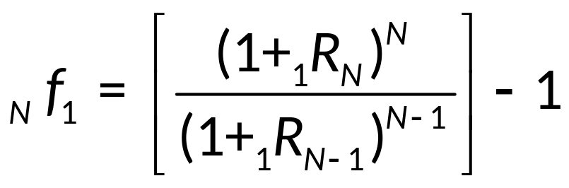
Implied Forward Rates
A forward rate (f) is an expected rate on a short-term security that is to be originated at some point in the future.
The one-year forward rate for any year, N years into the future is:

Slide 25
Time Value of Money and Interest Rates
The time value of money is based on the notion that a dollar received today is worth more than a dollar received at some future date.
  Simple interest: interest earned on an investment is not reinvested.
  Compound interest: interest earned on an investment is reinvested, most common.
Notes:
The formulas that follow are for compound interest.

Slide 26
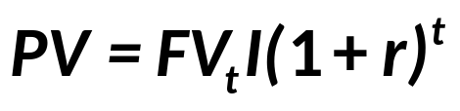
Present Value of a Lump Sum
Discount future payments using current interest rates to find the present value (P V)
  P V = present value of cash flow
  F V_{t} = future value of cash flow (lump sum) received in t periods
  r = interest rate earned per period on investment
  t = number of compounding periods in investment horizon

Slide 27
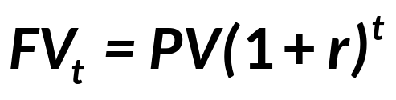
Future Value of a Lump Sum
The future value (F V) of a lump sum received at the beginning of the investment horizon

Slide 28
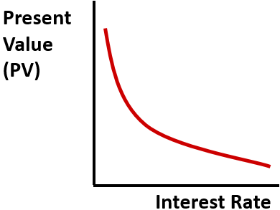
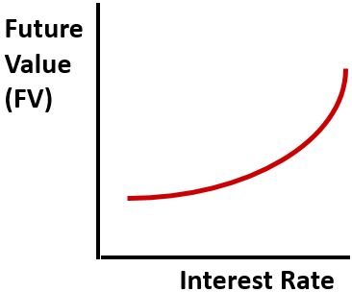
Relation between Interest Rates and Present and Future Values
Access the long description slide.

Slide 29
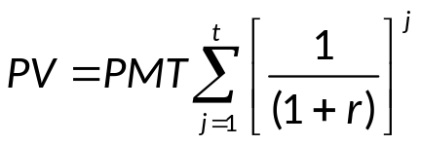
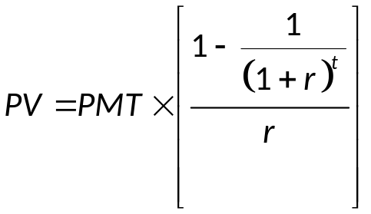
Present Value of an Annuity
The present value of a finite series of equal cash flows received on the last day of equal intervals throughout the investment horizon.
  P M T = periodic annuity payment

Slide 30
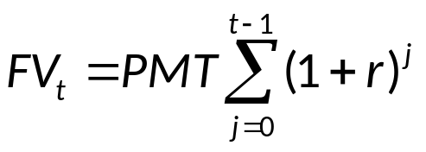
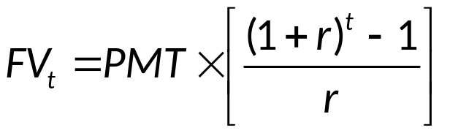
Future Value of an Annuity
The future value of a series of equal cash flows received at equal intervals throughout the investment horizon.

Slide 31
Financial Calculators
Setting up a financial calculator.
  Number of digits shown after decimal point.
  Number of compounding periods per year.
Key inputs/outputs (solve for one of five).
  N = number of compounding periods
  I/Y = annual interest rate
  P V = present value (i.e., current price)
  P M T = a constant payment every period
  F V = future value (i.e., future price)

Slide 32
Supply and Demand for Loanable Funds Long Description
As supply increases, demand decreases. As supply decreases, demand increases. The horizontal axis is labeled "quantity of loanable funds supplied and demanded" and the vertical axis is the interest rate. Scales are not provided.
Return to slide containing original image.

Slide 33
Effect on Interest Rates from a Shift in the Supply Curve for Loanable Funds Long description
The horizontal axis is unitless and displays the quantity of funds supplied. The vertical axis is unitless and displays the interest rate. The demand curve is a decreasing line. The supply curve is an increasing line that intersects the demand curve at point E, which comes from coordinates Q prime, I prime. The supply curve is then shifted to the right. The point E prime is now farther to the right and lower than before and has coordinates Q double prime and i double prime.
Return to slide containing original image.

Slide 34
Effect on Interest Rates from a Shift in the Demand Curve for Loanable Funds Long Description
The horizontal axis is unitless and displays the quantity of funds supplied. The vertical axis is unitless and displays the interest rate. The demand curve is a decreasing line. The supply curve is an increasing line that intersects the demand curve at point E, which comes from coordinates Q prime, I prime. The demand curve is then shifted up vertically. The point E prime is now farther to the right and greater than before and has coordinates Q double prime and i double prime.
Return to slide containing original image.

Slide 35
Key Interest Rates Over Time Long Description
All four graphs followed the same general trend. The interest rate for all 4 graphs peaked in the early 1980s and then have been on a relatively steady decline ever since.
Return to slide containing original image.

Slide 36
D R P s Over Time Long Description
Both premiums have fluctuated together, with the Baa risk premium always about 1% greater than the Aaa risk premium. The Aaa risk premium (%) fluctuated from just over 0% in the late 1970s until about 1.5% in 2015.
Return to slide containing original image.

Slide 37
U E T vs. L P T Long Description
When upward sloping, the L P T curve and U E T curves are both rising in a concave down manner, but the L P T curve is increasing more rapidly (is vertically higher). When downward sloping, the L P T curve is slowly increasing in a concave up manner and the U E T curve is slowly decreasing in a concave up manner. When flat, the L P T curve is slowly increasing in a concave down manner and the U E T curve is a horizontal line (is flat).
Return to slide containing original image.

