Slide 1
Chapter Three
Interest Rates and Security Valuation
©2019 McGraw-Hill Education. All rights reserved. Authorized only for instructor use in the classroom. No reproduction or further distribution permitted without the prior written consent of McGraw-Hill Education.

Slide 2
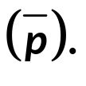
Various Interest Rate Measures
Coupon rate.
  periodic cash flow a bond issuer contractually promises to pay a bond holder.
Required rate of return (r).
  rates used by individual market participants to calculate fair present values (PV).
Expected rate of return or E(r).
  rates participants expect to earn by buying securities at current market prices
Realized rate of return (r).
  interest rate actually earned on investments.

Slide 3
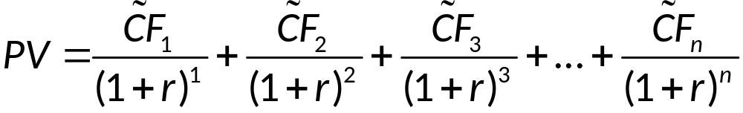
Required Rate of Return
The fair present value (PV) of a security is determined using the required rate of return (r) as the discount rate.
CF₁ = cash flow in period t (t = 1, …, n)
~ = indicates the projected cash flow is uncertain
n = number of periods in the investment horizon

Slide 4
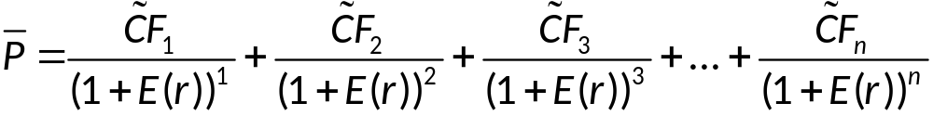
Expected Rate of Return
The current market price (P) of a security is determined using the expected rate of return, or E(r), as the discount rate.
CF₁ = cash flow in period t (t = 1, …, n)
~ = indicates the projected cash flow is uncertain
n = number of periods in the investment horizon

Slide 5


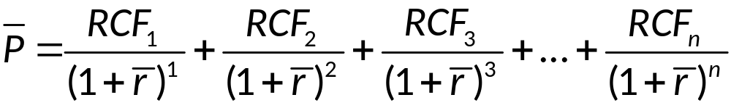
Realized Rate of Return
The realized rate of return,
is the discount rate
that just equates the actual purchase price,
to the present value of the realized cash flows, (RCF_{t}), where t (t = 1, ..., n).
RCF₁ = realized cash flow in period t (t = 1, ..., n)

Slide 6
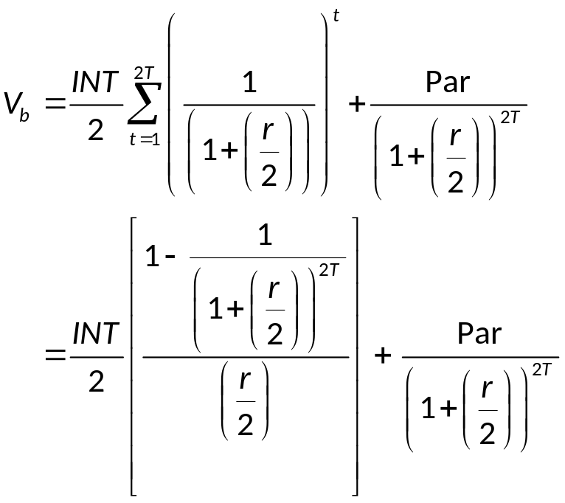
Bond Valuation 1
The present value of a bond (V_{b}) can be written as:
Par = the par or face value of the bond, usually $1,000
INT = the annual interest (or coupon) payment
T = the number of years until the bond matures
r = the annual interest rate (often called yield to maturity (YTM))

Slide 7
Bond Valuation 2
A premium bond has a coupon rate (INT) greater than the required rate of return (r) and the fair present value of the bond (V_{b}) is greater than the face or par value (Par).
Premium bond: If INT > r; then V_{b} > Par.
Discount bond: If INT < r, then V_{b} < Par.
Par bond: If INT = r, then V_{b} = Par.

Slide 8
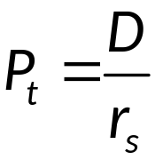
Equity Valuation 1
The present value of a stock (P_{t}) assuming zero growth in dividends can be written as:
D = constant dividend paid at end of every year
P_{t} = the stock’s price at the end of year t
r_{s} = the interest rate used to discount future cash flows

Slide 9
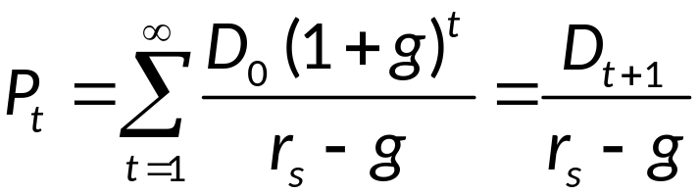
Equity Valuation 2
The present value of a stock (P_{t}), assuming constant growth in dividends, can be written as:
D₀ = current dividend per share
D_{t} = dividend per share at time t = 1, 2, …, ∞
g = the constant dividend growth rate
r_{s} = required return on the stock

Slide 10
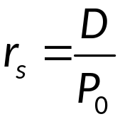
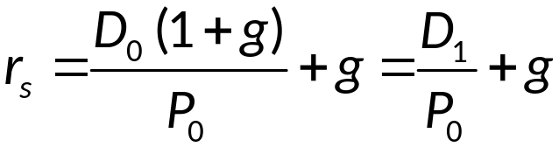
Equity Valuation Concluded
The return on a stock with zero dividend growth, if purchased at current price P₀, can be written as:
The return on a stock with constant dividend growth, if purchased at price P₀, can be written as:

Slide 11
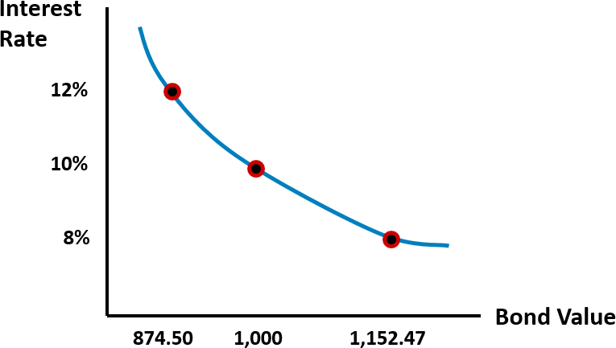
Relation between Interest Rates and Bond Values

Slide 12
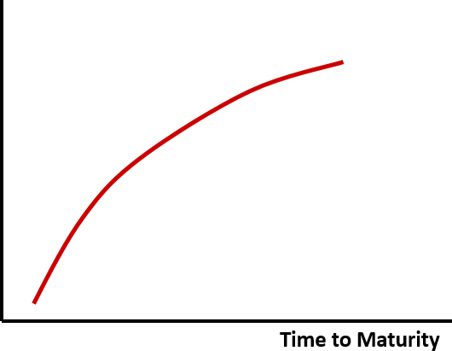
Impact of a Bond’s Maturity on its Price Sensitivity
Absolute Value of Percent Change in a
Bond’s Price for a Given Change in Interest Rates
Access the long description slide.

Slide 13
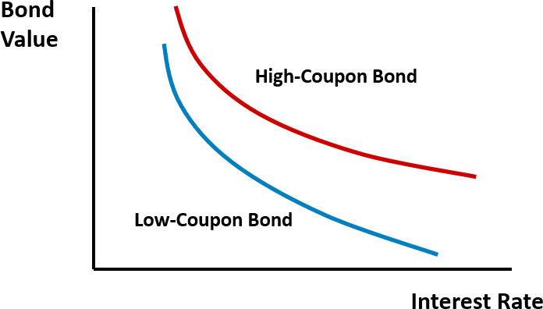
Impact of a Bond’s Coupon Rate on its Price Sensitivity

Slide 14
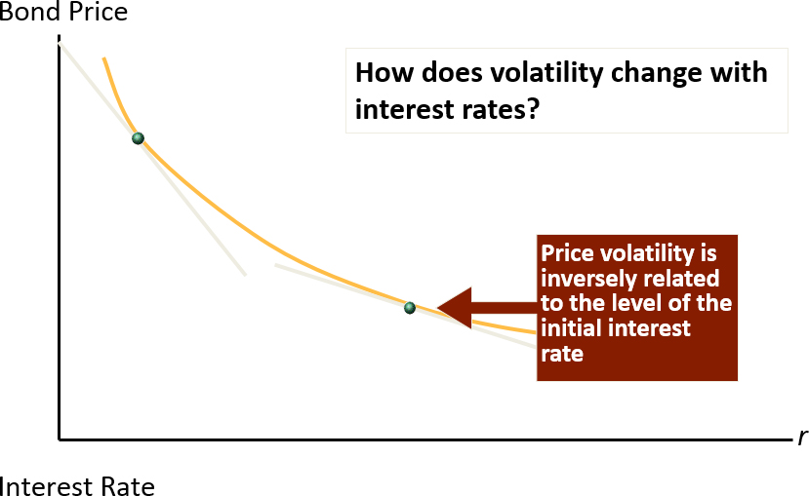
Impact of r on Price Volatility
Notes:
You may wish to point out that actual price changes are curvilinear, duration based predicted price changes are linear with r.
Volatility varies along line: prices are a nonlinear function of interest rates, Blue line is actual price change, green line is predicted price change.
Concept: At higher interest rates, volatility is lower: Reason is that discounting far out cash flows more heavily to begin with at higher interest rates, this increases the near term percentage PV weights in relation to the long term weights.
The four variables that affect volatility are coupon and maturity (which are captured by duration), change in ytm or change in r and the starting ytm or the starting r. (r = ytm)

Slide 15
Duration 1
Duration is the weighted-average time to maturity (measured in years) on a financial security.
Duration measures the sensitivity (or elasticity) of a fixed-income security’s price to small interest rate changes.
Duration captures the coupon and maturity effects on volatility.
Notes:
So the only other two variables needed to predict volatility are r and the change in r.

Slide 16
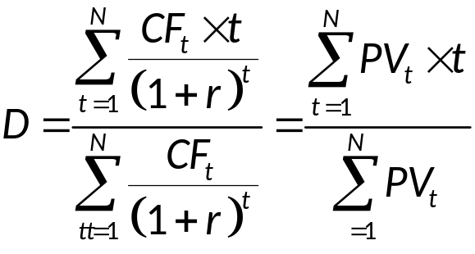
Duration 2
Duration (D) for a fixed-income security that pays interest annually can be written as:
D = Duration measured in years
t = 1 to T, the period in which a cash flow is received
N = the number of years to maturity
CF_{t} = cash flow received at end of period t
r = yield to maturity or current required rate of return
PV_{t} = present value of cash flow received at end of period t
Notes:
Note that if the security makes semiannual or monthly payments then the cash flow, the interest rate and the number of periods must be adjusted to reflect the payment frequency.

Slide 17
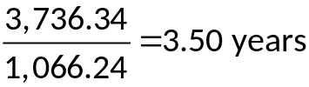
Duration Example – Annual Interest
Bond with 10% coupon, face value of $1,000, 4 year maturity, current yield to maturity (ytm) of 8%, and current price of $1,066.24.
Table 3-7 Duration of a Four-Year Bond with 10 Coupon Paid Annually and 8 Percent Yield
t | CF_{t}
1 | 100 | 0.9259 | 92.59 | 92.59
2 | 100 | 0.8573 | 85.73 | 171.47
3 | 100 | 0.7938 | 79.38 | 238.15
4 | 1,100 | 0.7350 | 808.53 | 3,234.13
blank | blank | Blank | 1,066.24 | 3,736.34

Slide 18
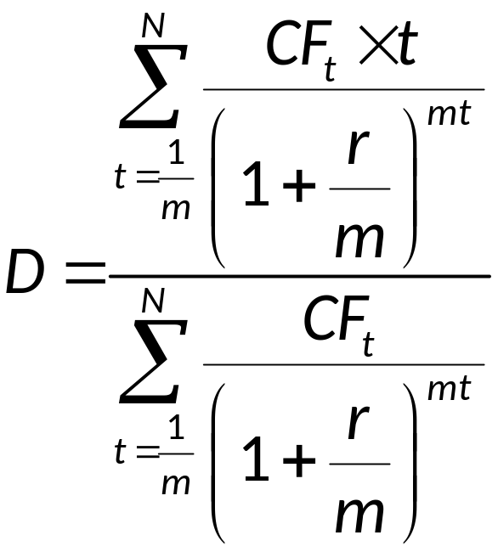
Duration – Various Number of Interest Payments per Year
Duration (D) for a fixed-income security, in general, can be written as:
m = the number of times per year interest is paid

Slide 19
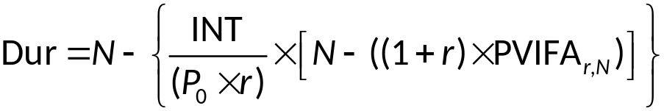
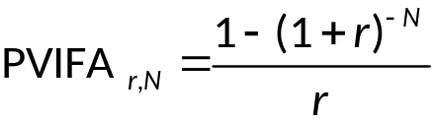
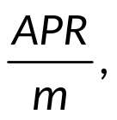
Closed Form Duration Equation
P₀ = Price.
INT= Periodic cash flow in dollars, normally the semiannual coupon on a bond or the periodic monthly payment on a loan.
r = periodic interest rate =
where m = # compounding
periods per year.
N = Number of compounding or payment periods (or the number of years × m).
Dur = Duration = # Compounding or payment periods; Duration_{period} is what you actually get from the formula.
Notes:
This version is in closed form, no summation needed. It is convenient for longer term securities.
If you divide by Price*m you get the duration in years. m= # of compounding or payment periods per year.
I believe the citation is:
Caks, J., Lane, W. R., Greenleaf, R. W., & Joules, R. G. (1985). A SIMPLE FORMULA FOR DURATION. Journal Of Financial Research, 8(3), 245.

Slide 20
Features of Duration
Duration and coupon interest.
  The higher the coupon or promised interest payment on the bond, the shorter its duration.
    Due to the fact that the larger the coupon or promised interest payment, the more quickly investors receive cash flows on a bond and the higher are the present value weights of those cash flows in the duration calculation.
Duration and rate of return.
  Duration decreases as the rate of return on the bond increases.
Duration and maturity.
  Duration increases with maturity, but at a decreasing rate

Slide 21
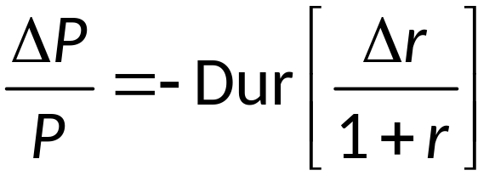
Duration and Modified Duration 1
Given an interest rate change, the estimated percentage change in a(n) (annual coupon paying) bond’s price is given by.
Notes:
This really doesn’t demonstrate the usage of modified duration (MD). MD is used for non-annual payment securities.

Slide 22
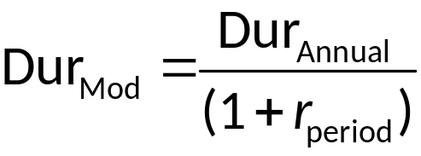
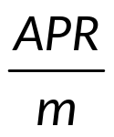
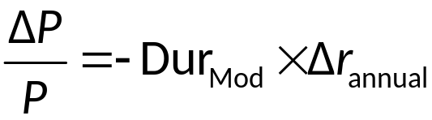
Duration and Modified Duration 2
Modified duration (Dur_{Mod}) is a more direct measure of bond price elasticity.
It is found as:
where r_{period} =
Using modified duration to predict price changes:
Notes:
Note that the annual change in interest rates is plugged into the prediction model. An example calculation is provided at the end of this file.

Slide 23
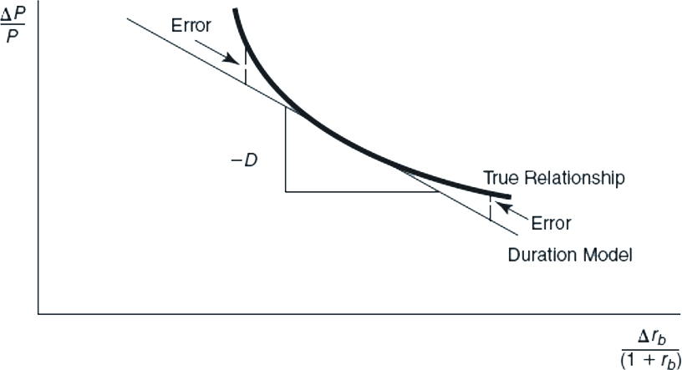
Duration Based Prediction Errors
Figure 3-7 Duration Estimated Versus True Bond Price
Access the long description slide.
Notes:
Duration is an accurate predictor of price changes only for very small interest rate changes. For day to day fluctuations duration works quite well but when interest rates move significantly, such as when the Fed makes an announcement of a rate change, the predicted pricing errors can become significant. The prediction errors arise because bond prices are not linear with respect to interest rates.

Slide 24
Convexity
Convexity (CX) is the degree of curvature of the price-interest rate curve around some interest rate level.
  Convexity is desirable.
    The greater the convexity of a security or portfolio, the more insurance or interest rate protection an investor or FI manager has against rate increases and the greater the potential gains after interest rate falls.
  Convexity diminishes the error in duration as an investment criterion.
  All fixed-income securities are convex.
    As interest rates change, bond prices change at a nonconstant rate.

Slide 25
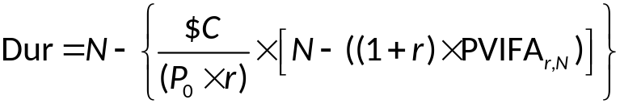
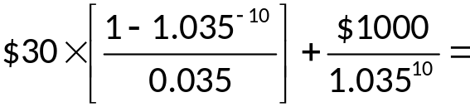


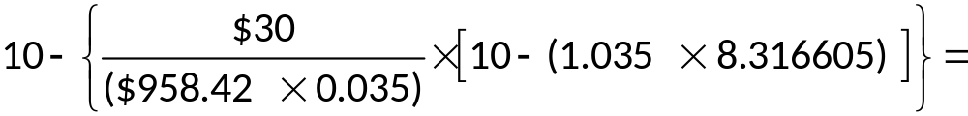


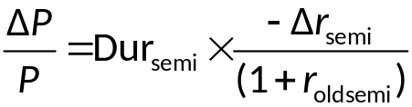
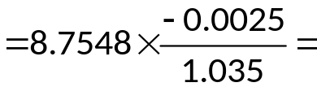


Practice Problem 1
A 5 year bond that pays interest semiannually has a 6% coupon and a 7% quoted yield to maturity. Annual interest rates increase 50 basis points. What is the predicted new price after the interest rate change?
Notes:
Dur Annual = 4.3774 years.

Slide 26
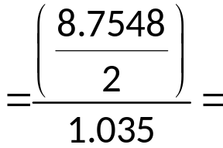
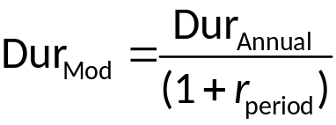
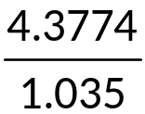




Practice Problem 2
Using Modified Duration
Predicted Price Change Using Modified Duration
Notes:
Dur Annual = 4.3774 years.

Slide 27
Impact of a Bond’s Maturity on its Price Sensitivity Long Description
Line graph showing that as time to maturity increases the absolute value of the percentage change in a bond's price for a given change in interest rate increases in a nonlinear, concave down manner.
Return to slide containing original image.

Slide 28
Duration Based Prediction Errors Long Description
The true relationship is vertically greater than the duration model, but the duration model lies tangent to this curve. The vertical distance between the duration model and the true relationship is labeled error.
Return to slide containing original image.

