Slide 1
Chapter Four
The Federal Reserve System, Monetary Policy, and Interest Rates
©2019 McGraw-Hill Education. All rights reserved. Authorized only for instructor use in the classroom. No reproduction or further distribution permitted without the prior written consent of McGraw-Hill Education.

Slide 2
The Federal Reserve
Founded by Congress under the Federal Reserve Act in 1913.
Subject to oversight by Congress under its authority to create money.
An independent central bank–its decisions do not have to be ratified by the President or Congress.
  Congressional oversight.

Slide 3
Functions of the Federal Reserve 1
Conduct monetary policy.
Supervise and regulate depository institutions.
Provide payment and other financial services to the U.S. government, the public, FIs, and foreign official institutions.

Slide 4
Functions of the Federal Reserve 2
Maintain financial system stability.
  The Wall Street Reform and Consumer Protection Act of July 2010 requires the Fed to supervise complex financial institutions that could generate systemic risk to the economy.
  The Fed (and others) has now been given broader powers to seize or break up institutions whose actions could harm the economy.

Slide 5
Functions of the Federal Reserve Concluded
Maintain financial system stability.
  Implementing federal laws designed to protect consumers in credit and other financial transactions.
  Implementing regulations to ensure compliance, investigating complaints, and ensuring availability of services to low and moderate income groups and certain geographic regions.

Slide 6
Structure of the Federal Reserve
Divided into 12 Federal Reserve districts, each with a main Federal Reserve Bank.
Federal Reserve Banks operate under the general supervision of the Board of Governors of the Federal Reserve.
The Office of the Comptroller of the Currency (O C C) charters national banks, which are members of the Federal Reserve System (F R S).
F R S member banks “own” the 12 Federal Reserve Banks.

Slide 7
Board of Governors of the F R S
Seven member board headquartered in Washington, DC.
President appoints and Senate confirms members to nonrenewable 14-year terms.
President appoints and Senate confirms Chairman and vice-chairman to renewable 4-year terms.
Formulates and conducts monetary policy and supervises and regulates banks.

Slide 8
Federal Open Market Committee (F O M C) 1
F O M C consists of 12 members.
  seven members of the Board of Governors.
  the president of the Federal Reserve Bank of N Y.
  the presidents of four other Federal Reserve Banks (on a rotating basis).
The major monetary policy-making body of the F R S.

Slide 9
Federal Open Market Committee (F O M C) 2
Policies seek to promote full employment, economic growth, price stability, and a sustainable pattern of international trade.
  Are there tradeoffs between these goals?
  Why is international monetary cooperation necessary?
Notes:
There can be tradeoffs between these goals. The Fed must balance expansive monetary policy that tends to generate growth and higher employment against inflationary pressures in the economy. When unemployment is high the Fed’s attempt to stimulate the economy to generate additional jobs may result in inflation.
There are also tradeoffs in U.S. monetary policy and the value of the dollar. A simulative U.S. policy may cause the dollar to drop, particularly if U.S. growth remains slow.
If the Fed keeps U.S. inflation below the rest of the world then the U.S. dollar will tend to strengthen, all else equal, and with a strong dollar U.S. imports are likely to exceed U.S. exports, leading to a trade deficit. This is why international monetary policy cooperation is needed and the Group of 20 meets periodically to coordinate policies.

Slide 10
Federal Open Market Committee (F O M C) Concluded
The F O M C sets ranges for growth of monetary aggregates and the fed funds rate, and also directs operations in FX markets.
Open market operations are the main policy tool used to achieve monetary targets:
  involve the purchase and sale of U.S. government and federal agency securities.
  are implemented by the Federal Reserve Board Trading Desk of the New York Federal Reserve Bank.

Slide 11
The Fed and the Crisis 1
2007.
  Term Auction Facility (T A F) created.
2008.
  March: Fed facilitates J.P. Morgan Chase purchase of Bear-Stearns.
  Term Securities Lending Facility (T S L F) created.
  Primary Dealer Credit Facility (PDCF): Expands discount window borrowing to investment banks.
  September: Lehman Brothers collapses, Goldman-Sachs and Morgan Stanley become commercial banks, Merrill-Lynch is bought by Bank of America.
Notes:
The Fed took the unprecedented step of guaranteeing $30 billion of Bear Stearn’s illiquid mortgage assets, presumably via TSLF

Slide 12
The Fed and the Crisis 2
2008.
  Asset-Backed Commercial Paper Money Market Mutual Fund Liquidity Facility, the Commercial Paper Funding Facility, the Money Market Investor Funding Facility and the Term Asset-Backed Securities Loan Facility (T A L F) are created.
  Average weekly lending from the Fed grew from about $59 million in 2006 to almost $850 billion per week in late 2008.
Notes:
The AMLF and the CPFF were created because liquidity collapsed in the commercial paper market. The MMIFF was created to help stem liquidity problems in money market mutual funds that resulted when one fund failed. The TALF was designed to encourage securitization to continue. Slowdowns in securitization have reduced the amount of credit available to borrowers in certain markets.

Slide 13
The Fed and the Crisis Concluded
August 2006 fed funds rate = 5.25%.
April 2008 fed funds rate = 2.00%.
By year end 2008 target fed funds rate between 0 and 0.25% and the discount rate was lowered to 0.5%.
November 2008 -- The Fed announces it would engage in purchasing up to $600 billion in Treasuries and mortgage-backed securities (quantitative easing).
  This amount was increased to $1.7 trillion in March 2009.
November 2010 the Fed announced a new series of bond buying of up to $600 billion in what has been termed Q E2.
September 2012 began Q E3, monthly purchases of Treasuries and mortgage backed securities, tapering began in 2013.

Slide 14
Federal Reserve Banks 1
Assist in the conduct of monetary policy.
  Set and change the discount rate (must be approved by the Board of Governors).
  Make discount window loans to depository institutions.
Supervise and regulate F R S member banks.
  Conduct examinations and inspections of member banks.
  Issue warnings when banking activity is unsafe or unsound.
  Approve bank mergers and acquisitions.
Provide government services.
  Act as the commercial banks of the U.S. Treasury.

Slide 15
Federal Reserve Banks 2
Issue new currency
  Collect and replace currency in circulation as necessary.
Clear checks
  Act as a central clearing system for U.S. banks.
Provide wire transfer services
  Fedwire.
  Automated Clearinghouse (A C H).
Perform banking sector and economic research
  Used in the formulation of monetary policy.
Notes:
The Fed Wire facilitates trading of bank reserves.
The Fed/ACH processes debit and credit transactions and direct deposits and direct bill paying functions. The ACH now processes cross border payments and has recently begun offering same day clearing of certain checks converted to electronic images.
The Clearing House Interbank Payments System (CHIPS) provides yet another payment mechanism. CHIPS is a private sector electronic network operated by about 100 U.S. and foreign banks to facilitate correspondent services and international transactions. It is usually used in conjunction with Society for Worldwide Interbank Financial Telecommunication (SWIFT), an international messaging system, that sends instructions for payment terms. Authorization through SWIFT before money is moved via CHIPS provides a safeguard.

Slide 16
Discussion of the Federal Reserve
What are the implications of the bailouts of the financial crisis? Is the system safer now or can we expect another crisis in the future?
What does it mean to be too big to fail or systemically risky? Does designating an institution as systemically risky make the system safer?
What are the pros and cons of deposit insurance? Should the U.S. employ unlimited deposit insurance as some other countries do?

Slide 17
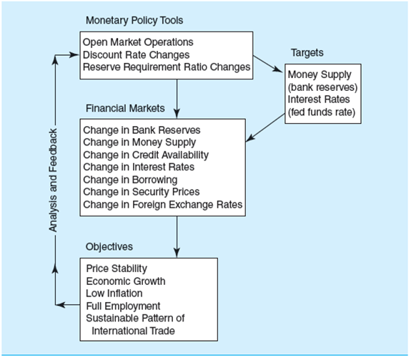
Figure 4-5: The Process of Monetary Policy Implementation
Figure 4-5 The Process of Monetary Policy Implementation
Access the long description slide.

Slide 18
Balance Sheet of the Federal Reserve
Major liabilities.
  Reserve deposits.
  Currency in circulation.
    Note that currency in circulation + reserves = monetary base.
Major assets.
  Treasury securities.
  U.S. government agency securities.

Slide 19
Monetary Policy Tools 1
Monetary policy affects the macroeconomy by influencing the supply and demand for excess bank reserves.
  Influences the money supply and the level of short-term and long-term interest rates.
  Affects foreign exchange rates, the amount of money and credit in the economy, and the levels of employment, output, and prices.

Slide 20
Monetary Policy Tools 2
Financial Services Regulatory Relief Act of 2006.
  Authorized Federal Reserve to pay interest on reserve balances held by depository institutions.
Federal Reserve can take one of two basic approaches to affect the market for banks’ excess reserves.
  Target quantity of reserves.
  Target interest rate on those reserves.

Slide 21
Open Market Operations 1
Open market operations
  Policy directive of the F O M C is forwarded to the Federal Reserve Board Trading Desk at the Federal Reserve Bank of New York.
  Trading Desk manager buys or sells U.S. Treasury securities in the over-the-counter (O T C) market, which keeps the fed funds rate near its desired target.

Slide 22
Open Market Operations 2
Open market operations.
  F R B N Y acts through the Trading Desk to implement policy directives each business day.
  Operations may be permanent or temporary.
  May use repurchase agreements for temporary increases or decreases in excess reserves.

Slide 23
Discount Rate
The discount rate is the rate Federal Reserve Banks charge on loans to financial institutions in their district.
The Federal Reserve rarely uses the discount rate as a policy tool.
  Discount rate changes are strong signals of the Federal Reserves intentions.
  There is no guarantee that banks will borrow, nor that they will lend.
Notes:
The Fed did reduce the discount rate during the financial crisis and broadened access to more institutions.

Slide 24
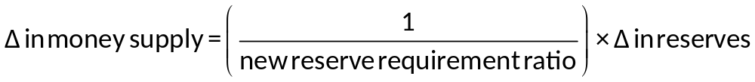
Reserve Requirements
Reserve requirements are the reserve assets depository institutions must keep to “back” transaction deposits.
  Reserve assets include vault cash and deposits at Federal Reserve Banks.
The multiplier effect.

Slide 25
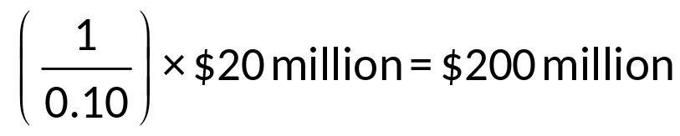
Reserve Requirements: Example 1
Suppose reserves are $2 billion and the Fed increases reserves by 1%, or $20 million, when bank reserve requirements are 10%.
What is the predicted increase in bank deposits?

Slide 26
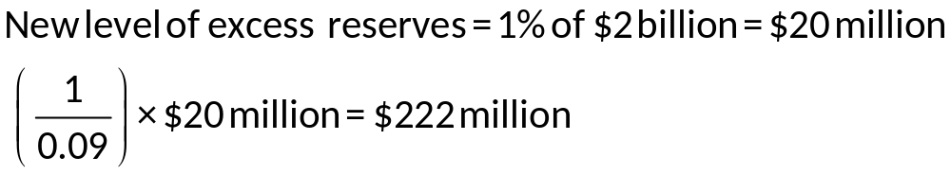
Reserve Requirements: Example 2
Suppose that instead of changing the $2 billion in reserves, the Fed reduces the reserve requirement from 10% to 9%. What is the predicted increase in bank deposits?
Notes:
This assumes no drains.
The amount of drains is not very predictable. For instance, decreases in reserve requirements cannot be guaranteed to lead to increases in the money available for lending if banks choose to hold higher amounts of excess reserves at the Fed (as they did in the early 1990s and again in 2008.) Changes in the reserve requirement are rarely used as a monetary policy tool. This is perhaps because it is difficult to predict the effect of changes in the reserve ratio on the money supply. Changing the ratio frequently would likely impose additional costs on the banking system which attempts to manage and minimize its excess reserves.

Slide 27
Monetary Policy
Expansionary monetary policy.
  open market purchases of securities by the Fed.
  discount rate decreases.
  reserve requirement ratio decreases.
Contractionary monetary policy.
  open market sales of securities by the Fed.
  discount rate increases.
  reserve requirement ratio increases.

Slide 28
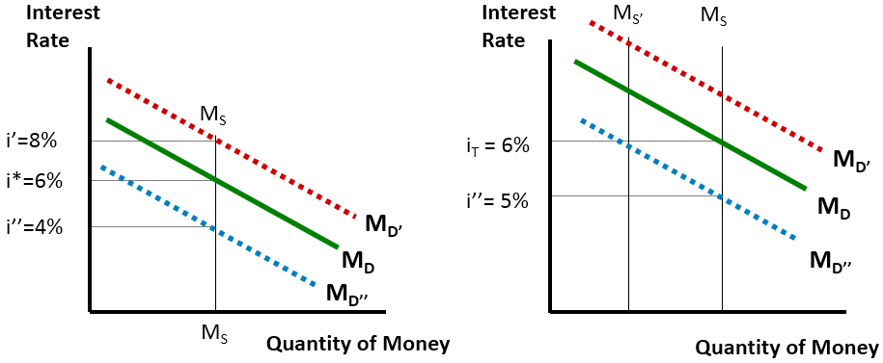
Money Supply versus Interest Rate Targeting
Access the long description slide.
Notes:
Some economists believe that the Federal Reserve should announce a target inflation rate and limit monetary policy changes to hitting this target. Others believe the Fed should employ a different type of monetary policy rule where the rate of money supply growth is tied inflexibly to the economic growth rate. Most economists however believe that there are enough shocks to the system that require more intervention by the Federal Reserve than a rule or inflexible target would allow.

Slide 29
Problems in Conducting Monetary Policy 1
Significant time lags involved between policy implementation and effect.
Supplying money to lenders does not guarantee they will lend.

Slide 30
Problems in Conducting Monetary Policy 2
Lowering interest rates or supplying money are attempts to stimulate demand, but they may not work.
  Problems in consumer confidence.
  High unemployment.
  High debt levels.

Slide 31
Problems in Conducting Monetary Policy Concluded
Excessive money creation may reduce the value of the dollar and generate inflation.
  Inflation can cause interest rates to increase, hurting growth.
  Loss in confidence of foreign investors could cause higher interest rates, hurting growth.

Slide 32
International Monetary Policy
The Federal Reserve generally allows foreign exchange rates to fluctuate freely.
Foreign exchange intervention.
  Commitments between countries about the institutional aspects of their intervention in the foreign exchange markets.
  similar to open market purchases and sales of Treasury securities.

Slide 33
Global Rescue Programs
Responses by major central banks to the financial crisis:
  Expansion of retail deposit insurance.
  Direct injections of capital to improve lender’s balance sheets.
  Debt guarantees.
  Asset purchases or asset guarantees.
  Stress tests of banks.

Slide 34
Figure 4-5: The Process of Monetary Policy Implementation Long Description
The monetary policy tools are open market operations, discount rate changes, reserve requirement ratio changes. These tools are used to manage the following targets: Money supply (bank reserves) and interest rates (fed funds rate). These tools and targets are used to make changes in the financial markets such as change in bank reserves, change in money supply, change in credit availability, change in interest rates, change in borrowing, change in security prices, and change in foreign exchange rates. The objectives are price stability, economic growth, low inflation, full employment, sustainable pattern of international trade. They receive analysis and feedback on these objectives and then reevaluate.
Return to slide containing original image.

Slide 35
Money Supply versus Interest Rate Targeting Long Description
Both graphs consist of 3 parallel lines with negative slopes representing the demand lines. When setting a targeted money supply, the interest rate could be 4%, 6%, or 8%. When targeting specific interest rates (5% or 6%), the money supply could be one of two options depending on the demand line referenced.
Return to slide containing original image.

