Slide 1
Chapter Five
Money Markets
©2019 McGraw-Hill Education. All rights reserved. Authorized only for instructor use in the classroom. No reproduction or further distribution permitted without the prior written consent of McGraw-Hill Education.

Slide 2
Money Markets
Money markets involve debt instruments with original maturities of one year or less.
Money market debt.
  Issued by high-quality (i.e., low default risk) economic units that require short-term funds.
  Purchased by economic units that have excess short-term funds.
  Little or no chance of principal loss.
  Low rates of return.
Most money market instruments have active secondary markets to provide liquidity.

Slide 3
Money Market Yields
Money market securities use special rate quoting conventions:
  Discount yields (i_{d}): Interest rate is quoted on an annual basis assuming a 360 day year as a percent of redemption price or face value.
  Single payment yields (i_{sp}): Interest rate is quoted on an annual basis assuming a 360 day year as a percent of purchase price.
Both may be converted to a bond equivalent yield (i_{be}) for comparison with bonds.
Notes:
Note that i_{bey} is an APR.

Slide 4
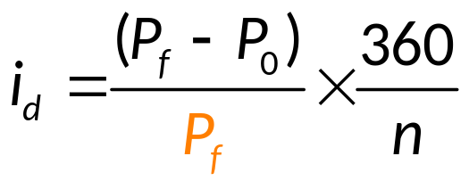
Discount Yields
Treasury bills and commercial paper rates are quoted as discount yields.
Discount yields (i_{d}) use a 360-day year.
  P_{f} = the face value of the security
  P₀ = the purchase price of the security
  n = the number of days until maturity

Slide 5
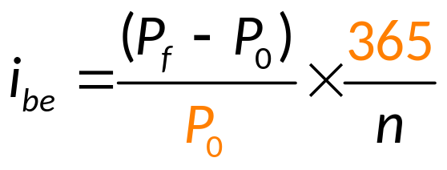
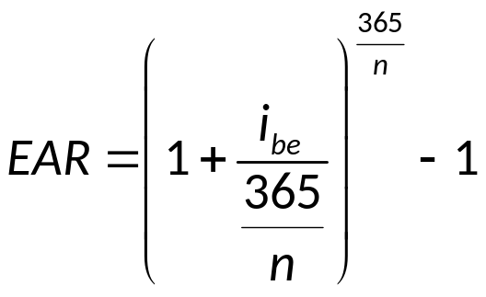
Bond Equivalent Yields
Compare discount securities to bonds with bond equivalent yields (i_{be}).
Convert bond equivalent yields into effective annual returns (E A R).
Notes:
Notice the two differences with the BEY – 1) the denominator is P0 rather than the face value and 2) the calculation uses 365 rather than 360 days.

Slide 6
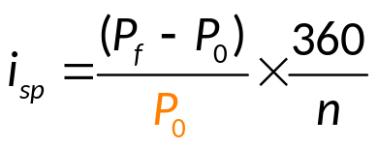
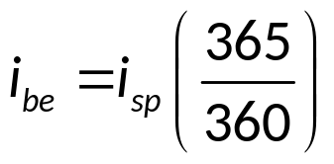
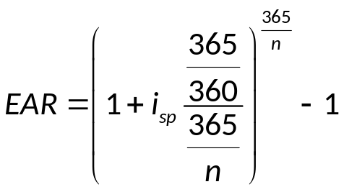
Single-Payment Yields
Negotiable CDs and fed funds are money market securities that pay interest only at maturity. These use single-payment yields (i_{sp}).
to convert a single-payment yield to a bond equivalent yield:
to directly convert a single payment yield to an E A R:

Slide 7
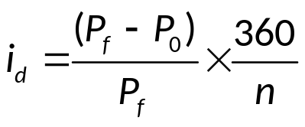
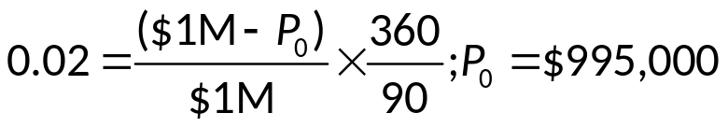
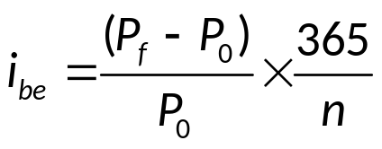
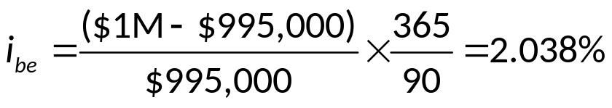
Sample Calculations of Money
Market Yields 1
A $1M investment in 90 day commercial paper has a 2% discount yield. An equivalent size and risk 90 day CD has a 2% single payment yield. Which security offers the better return? For the commercial paper:
The bond equivalent yield for the commercial paper is 2.038%.

Slide 8
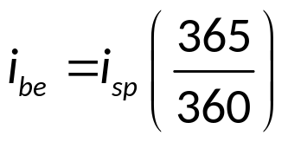
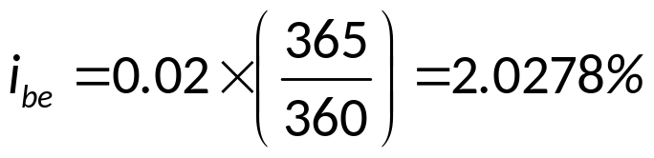
Sample Calculations of Money
Market Yields 2
A $1M investment in 90 day commercial paper has a 2% discount yield. An equivalent size and risk 90 day CD has a 2% single payment yield. Which security offers the better return? For the CD:
The bond equivalent yield for the CD is 2.0278%.
The commercial paper has the better return since its bond equivalent yield is 2.038%.

Slide 9

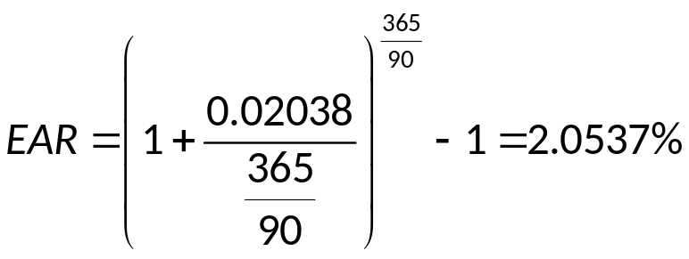
Sample Calculations of Money
Market Yields Concluded
What is the commercial paper’s E A R?

Slide 10
Money Market Instruments
Treasury bills (T-bills).
Federal funds (fed funds).
Repurchase agreements (repos or R P).
Commercial paper (C P).
Negotiable certificates of deposit (C D).
Banker’s acceptances (B A).

Slide 11
Treasury Bills (T-Bills)
T-Bills are short-term debt obligations issued by the U.S. government.
T-bills are virtually default risk free, are highly liquid, and have little interest rate risk.
The Federal Reserve buys and sells T-bills to implement monetary policy.
Strong international demand for T-bills as safe haven investment.
Notes:
During the financial crisis, not only did the supply of T-bills increase, but demand for Treasuries as a safe haven investment soared. Demand increased so much that for the first time ever, yields on 3 month bills fell below zero. In essence, investors paid the U.S. government to take their money.

Slide 12
T-Bill Auctions 1
13- and 26-week T-bills are auctioned weekly, other maturities available.
Bids are submitted by government securities dealers, financial and nonfinancial corporations, and individuals.
Bids can be competitive or noncompetitive.
  Competitive bids specify the amount of par value of bills desired and the discount yield, rather than the price.
  Noncompetitive bidders get preferential allocation and agree to pay the lowest price of the winning competitive bids.

Slide 13
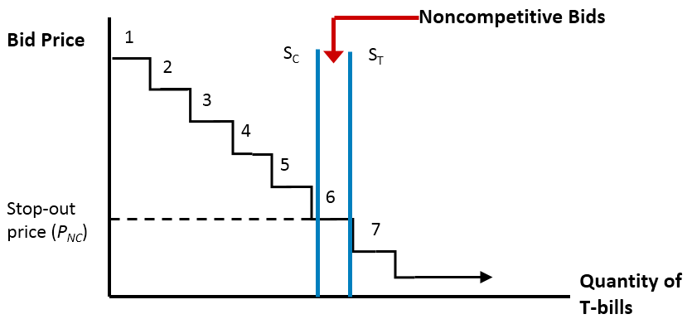
T-Bill Auctions 2
Access the long description slide.

Slide 14
The Secondary Market for T-Bills
The secondary market for T-bills is the largest of any U.S. money market instrument.
23 primary dealers “make” a market in T-bills by buying the majority sold at auction and by creating an active secondary market.
  Primary dealers trade for themselves and for customers.
  T-bill purchases and sales are book-entry transactions conducted over Fedwire.
T-Bills are sold on a discount basis.

Slide 15
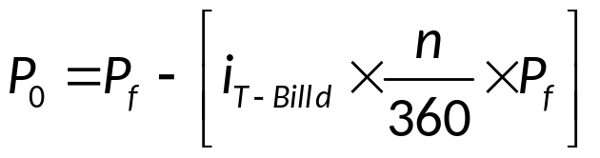
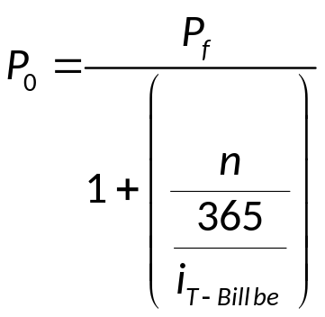
T-Bill Prices
T-Bill prices can be calculated from quotes (e.g., from The Wall Street Journal) by rearranging the discount yield equation.
Or, by rearranging the bond equivalent yield equation.

Slide 16
Federal Funds
The federal funds (fed funds) rate is the target rate in the conduct of monetary policy.
Fed fund transactions are short-term (mostly overnight) unsecured loans.
Banks with excess reserves lend fed funds, while banks with deficient reserves borrow fed funds.
Multimillion dollar loans may be arranged in a matter of minutes.
Fed funds are single-payment loans and thus use single-payment yields.

Slide 17
Repurchase Agreement 1
A repurchase agreement (repo or RP) is the sale of a security with an agreement to buy the security back at a set price in the future.
Repos are short-term collateralized loans (typical collateral is U.S. Treasury securities).
  Similar to a fed fund loan, but collateralized.
  Funds may be transferred over FedWire system.
  If collateralized by risky assets, the repo may involve a ‘haircut’.
Notes:
The repo rate is typically lower than the Fed funds rate because repos are collateralized loans.
If risky securities are pledged as collateral, the fund’s lender may require a larger ‘haircut,’ i.e. repos normally have to be slightly overcollateralized. For instance, to borrow $100 the repo seller would have to sell securities currently worth $102, for a $2 haircut.
Bank of America (BofA) used repos to hide about $10.7 billion of debt from the public from 2007 to 2009. Under accounting rules if the value of the securities pledged on the repo are worth 105% of the cash received the borrowing firm (BofA) can book the transaction as an asset sale rather than as a loan. So for the term of the repo the borrower can report lower leverage ratios (i.e., it will have a higher equity to asset ratio). If these transactions occur a few days before a financial report date such as the end of a quarter, the firm can appear to be safer than it actually is. The strategy is called a ‘Repo 105’ strategy because of the 105% collateral requirement. It is actually not allowed under U.S. law but may be allowed for European subsidiaries under British laws. Lehman Brothers used a similar strategy to hide debt amounts of between $8 billion and $15 billion in 2007 and 2008.
Merced, M and J. Werdigier. The Origins of Lehmans Repo 105. Investment Banking, NY Times Dealbook, March 12, 2010.
Inability to roll over their repo financing of their extensive mortgage holdings was one factor that led to the collapse of Bear Stearns

Slide 18
Repurchase Agreement 2
Typical denominations on repos of one week or less are $25 million and longer term repos usually have $10 million denominations.
A reverse repurchase agreement is the purchase of a security with an agreement to sell it back in the future.
Notes:
The repo rate is typically lower than the Fed funds rate because repos are collateralized loans.

Slide 19
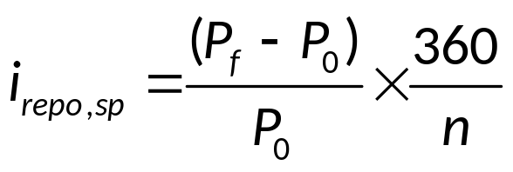
Repurchase Agreement Yield
The yield on repurchase agreements (i_{RA}) uses a 360-day year, like the discount rate, but uses the current price in the denominator, like the bond equivalent yield.
  P_{f} = the repurchase price of the security
  P₀ = the selling price of the security
  n = the number of days until the repo matures

Slide 20
Commercial Paper
Commercial Paper (C P) is unsecured short-term corporate debt issued to raise short-term funds (e.g., for working capital).
Generally sold in large denominations (e.g., $100,000 to $1 million) with maturities between 1 and 270 days.
C P is usually sold to investors indirectly through brokers and dealers.
C P is usually held by investors until maturity and has no active secondary market.
Yields are quoted on a discount basis (like T-bills).

Slide 21
Asset-Backed Commercial Paper
A type of commercial paper that is backed by assets of the issuing firm.
Grew very rapidly prior to the financial crisis peaking at $2.16 trillion, much of it was backed by mortgage investments.
The market collapsed during the financial crisis.

Slide 22
Negotiable Certificates of Deposit
A negotiable certificate of deposit (C D) is a bank-issued, fixed maturity, interest-bearing time deposit that specifies the interest rate and the maturity date.
C Ds are bearer instruments and thus are salable in the secondary market.
Denominations range from $100,000 to $10 million; $1 million being the most common.
Often purchased by money market mutual funds with pools of funds from individual investors.

Slide 23
Banker’s Acceptances
A banker’s acceptance (B A) is a time draft payable to a seller of goods, with payment guaranteed by a bank.
Used in international trade transactions to finance trade in goods that have yet to be shipped from a foreign exporter (seller) to a domestic importer (buyer).
Foreign exporters prefer that banks act as payment guarantors before sending goods to importers.
Banker’s acceptances are bearer instruments and thus are salable in secondary markets.

Slide 24
Money Market Participants
The U.S. Treasury.
The Federal Reserve.
Commercial banks.
Money market mutual funds.
Brokers and dealers.
Corporations.
Other financial institutions.
Individuals.

Slide 25
International Money Markets 1
U.S. dollars held outside the U.S. are tracked among multinational banks in the Eurodollar market.
The rate offered for sale on Eurodollar funds is the London Interbank Offered Rate (L I B O R).
Eurodollar Certificates of Deposit are U.S. dollar-denominated CDs held in foreign banks.
Eurocommercial paper (Euro-C P) is issued in Europe and can be in local currencies or U.S. dollars.

Slide 26
Central Bank Interest Rates 1
Table 5–8 Selected Central Bank Interest Rates
 | 2007 Rate | 2007 Rate | 2010 Rate | 2010 Rate | 2016 Rate | 2016 Rate
Country/Interest Rate | Percentage per Year | Applicable From | Percentage per Year | Applicable From | Percentage per Year | Applicable From
1. EU countries Euro area | 5 | June ’07 | 1.00 | May ’09 | 0.00 | Mar ’16
Denmark Discount rate | 4 | June ’07 | 0.75 | Jan. ’10 | 0.00 | July ’12
Sweden Deposit rate | 3 | Sept. ’07 | −0.25 | Aug. ’09 | −1.25 | Feb ’16
Repurchase rate | 3.75 | Sept. ’07 | 0.50 | July ’10 | −0.50 | Feb ’16
United Kingdom Repurchase rate* | 5.75 | July ’07 | 0.50 | Mar. ’09 | 0.50 | Mar. ’09

Slide 27
Central Bank Interest Rates 2
 | 2007 Rate | 2007 Rate | 2010 Rate | 2010 Rate | 2016 Rate | 2016 Rate
Country/Interest Rate | Percentage per Year | Applicable From | Percentage per Year | Applicable From | Percentage per Year | Applicable From
2. Switzerland Three-month LIBOR target | 2.25–3.25 | Sept. ’07 | 0.25 | May ’09 | −1.25 to −0.25 | Jan ’15
3. Non-European countries Canada† Discount rate | 4.5 | July ’07 | 0.50 | June. ’10 | 0.50 | July ’15
Japan Discount rate | 0.75 | Feb. ’07 | 0.10 | Nov. ’08 | −0.10 | Jan ’16
United States Federal funds rate‡ | 5.75 | Sept. ’07 | 0.25 | Dec. ’08 | 0.50 | Dec ’15
*Bank of England key rate.
†Bank of Canada’s ceiling rate for call money.
‡Rate targeted for interbank trade in central bank money.
Source: Authors’ research.

Slide 28
Eurocommercial Paper Outstanding, 1995 – 2016 1
Table 5–9 Eurocommercial Paper Outstanding, 1995–2016 (in billions of U.S. dollars)
 | Amount Outstanding | Amount Outstanding | Amount Outstanding | Amount Outstanding | Amount Outstanding | Amount Outstanding | Amount Outstanding | Amount Outstanding
 | 1995 | 1998 | 2001 | 2004 | June 2008 | March 2010 | June 2010 | March 2016
Eurocommercial paper | $87 | $133 | $243 | $415 | $807 | $595 | $521 | $509
Currency type U.S. dollar | 56 | 78 | 103 | 113 | 208 | 183 | 159 | 217
Euro-area currencies* | 9 | 24 | 80 | 209 | 405 | 295 | 259 | 165
Japanese yen | 2 | 4 | 14 | 4 | 19 | 5 | 5 | 0
Pound sterling | n.a. | n.a. | 29 | 62 | 122 | 79 | 68 | 102
Other currencies | 20 | 27 | 17 | 27 | 53 | 33 | 30 | 25
Amount Outstanding

Slide 29
Eurocommercial Paper Outstanding, 1995 – 2016 2
Amount Outstanding
 | Amount Outstanding | Amount Outstanding | Amount Outstanding | Amount Outstanding | Amount Outstanding | Amount Outstanding | Amount Outstanding | Amount Outstanding
 | 1995 | 1998 | 2001 | 2004 | June 2008 | March 2010 | June 2010 | March 2016
Issuer nationality Germany | 9 | 14 | 61 | 109 | 94 | 60 | 53 | 73
United Kingdom | 5 | 9 | 26 | 49 | 225 | 149 | 120 | 122
United States | 14 | 20 | 30 | 51 | 63 | 40 | 53 | 15
Japan | 12 | 18 | 7 | 17 | 1 | 2 | 1 | 2
Other developed countries | 36 | 56 | 92 | 176 | 377 | 317 | 277 | 219
Other | 11 | 16 | 27 | 13 | 47 | 27 | 17 | 78
*The BIS used the deutsche mark in 1995.
Sources: Bank for International Settlements, “International Banking and Financial Market
Developments,” Quarterly Review, various issues. www.bis.org

Slide 30
Foreign Investments in U.S. Money Market Instruments
Table 5–7 Foreign Investments in U.S. Money Market Instruments (in billions of dollars)
 | 1994 | 1997 | 2000 | 2004 | 2007 | 2010 | 2013 | 2016
Treasury securities* | $633 | $1,252 | $1,222 | $1,814 | $2,376 | $4,467 | $5,794 | $6,118
Repurchase agreements | 47 | 91 | 91 | 665 | 1,109 | −46 | 707 | 717
Negotiable CDs | 56 | 74 | 107 | 149 | 208 | 247 | 445 | 453
Open market paper† | 25 | 78 | 111 | 230 | 278 | 191 | 101 | 103
*Includes Treasury bills, notes, and bonds.
†Commercial paper and banker’s acceptances.
Source: Federal Reserve Board website, “Financial Accounts of the United States.” www.federalreserve.gov

Slide 31
International Money Markets 2
The London Interbank Offer Rate (L I B O R) is the rate on interbank loans between British banks.
LIBOR is the base rate on trillions of dollars of derivatives and is the base rate for many loans.
Large banks manipulated L I B O R to profit on derivatives positions and/or to appear less risky during the crisis.
  Bank profits from misquoting L I B O R may have exceeded $75 billion.
  Many banks fined, changed L I B O R reporting process.

Slide 32
Single versus Discriminating Price Treasury Auctions
Single price auction.
  Adopted by the U.S. Treasury in 1998.
  All Treasury security bidders pay the same price for the Treasury security.
Discriminating auctions.
  Different successful bidders paid different prices (their bid prices).

Slide 33
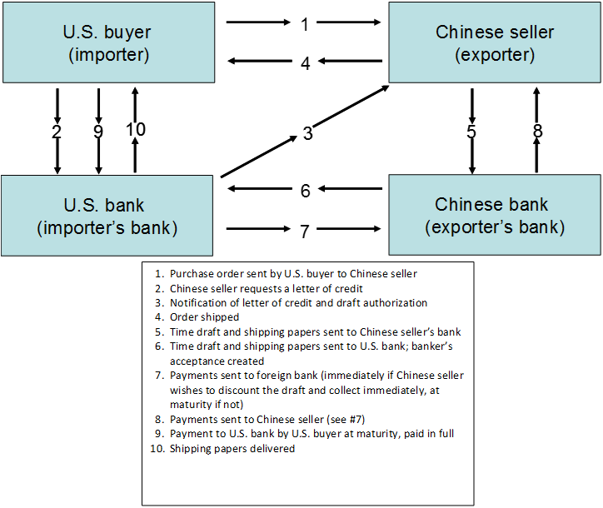
Creation of a Banker’s Acceptance
Access the long description slide.

Slide 34
T-Bill Auctions 2 Long Description
The horizontal axis displays the quantity of T-Bills, and the vertical axis displays the bid price. The function graphed is a step function, showing a series of 7 steps (like a descending staircase). The steps are labeled (from the top down) with the numbers 1 through 7. The first horizontal line segment corresponds to a bid price of 99.823%. The 6th step corresponds to a stop out price (low bid accepted = price paid by all bidders) of 99.8129%. This corresponds to a quantity of $25.4b. The total supply (illustrated as a vertical line) has a quantity of $26.0b.
Return to slide containing original image.

Slide 35
Creation of a Banker’s Acceptance 2 Long Description
1. Purchase order sent by U.S. buyer to Chinese seller.
2. Chinese seller requests a letter of credit.
3. Notification of letter of credit and draft authorization.
4. Order shipped.
5. Time draft and shipping papers sent to Chinese seller's bank.
6. Time draft and shipping papers sent to U.S. bank; banker's acceptance created.
7. Payments sent to foreign bank (immediately if Chinese seller wishes to discount the draft and collect immediately, at maturity if not).
8. Payments sent to Chinese seller (see number 7).
9. Payment to U.S. bank by U.S. buyer at maturity, paid in full.
10. Shipping papers delivered.
Return to slide containing original image.

